Slide 1
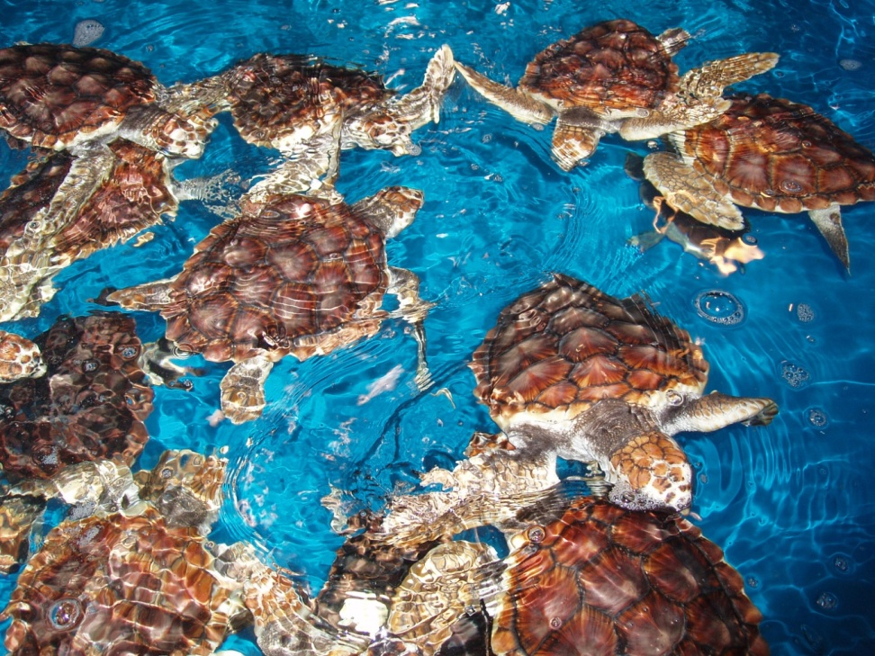
Partnership Research of Marine Turtles at the Pacific Islands Fisheries Science Center:
Identifying Loggerhead Pelagic Foraging Ecology
Ecosystems and Oceanography Division (EOD)
and
Marine Turtle Research Program (MTRP)

Slide 2
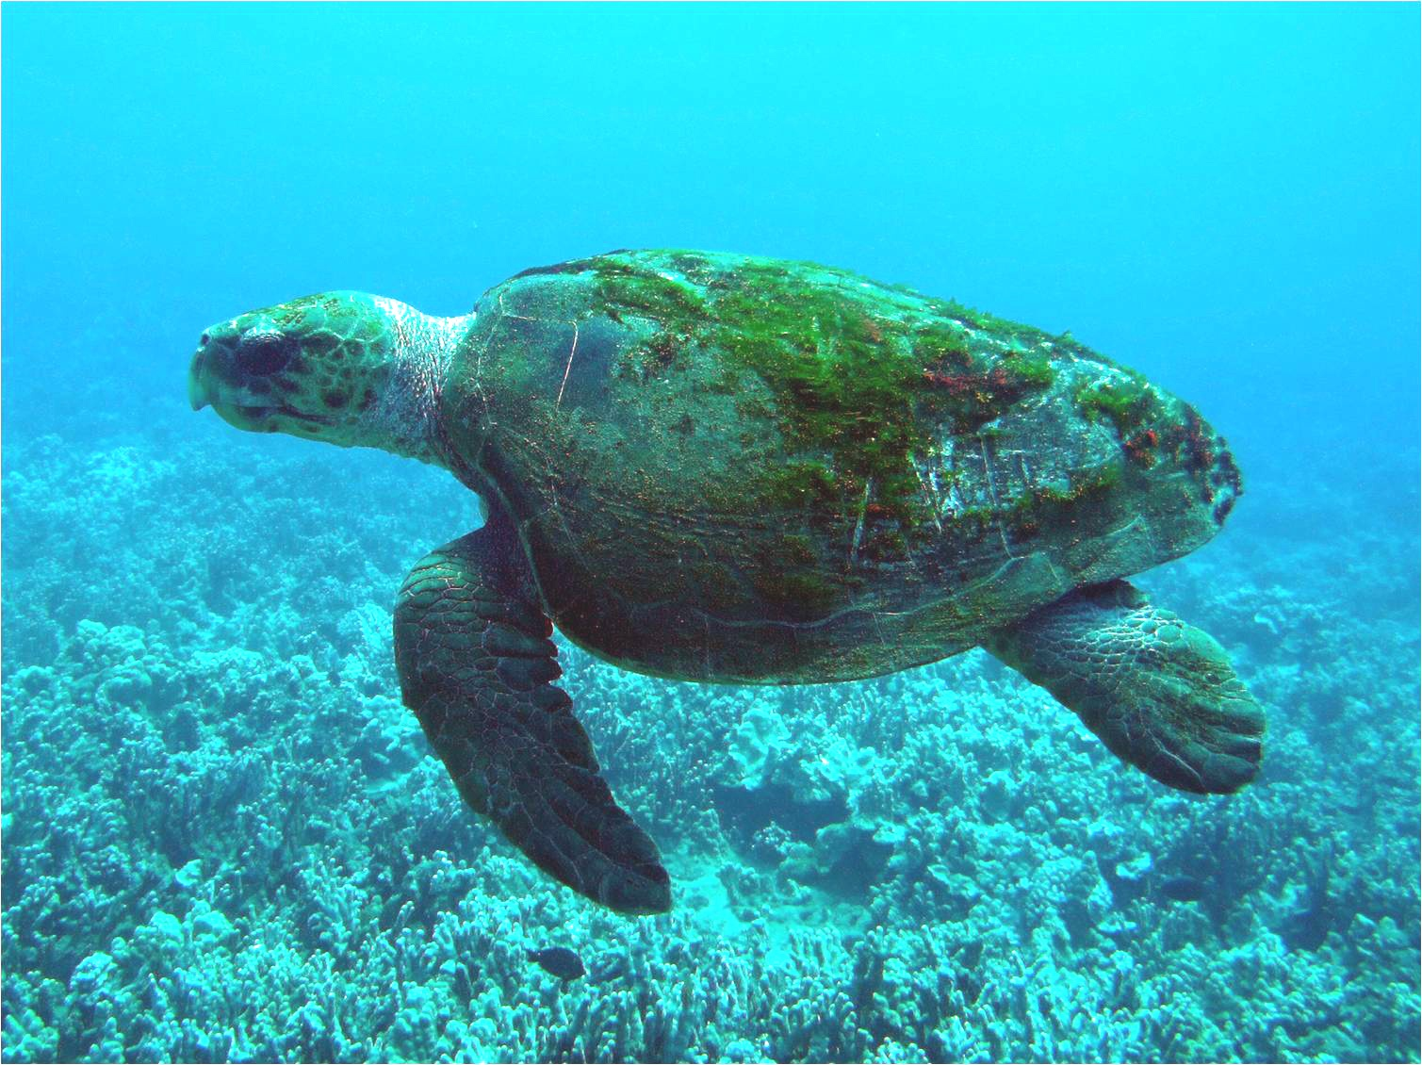
赤蠵龟
North Pacific Loggerhead

Slide 3
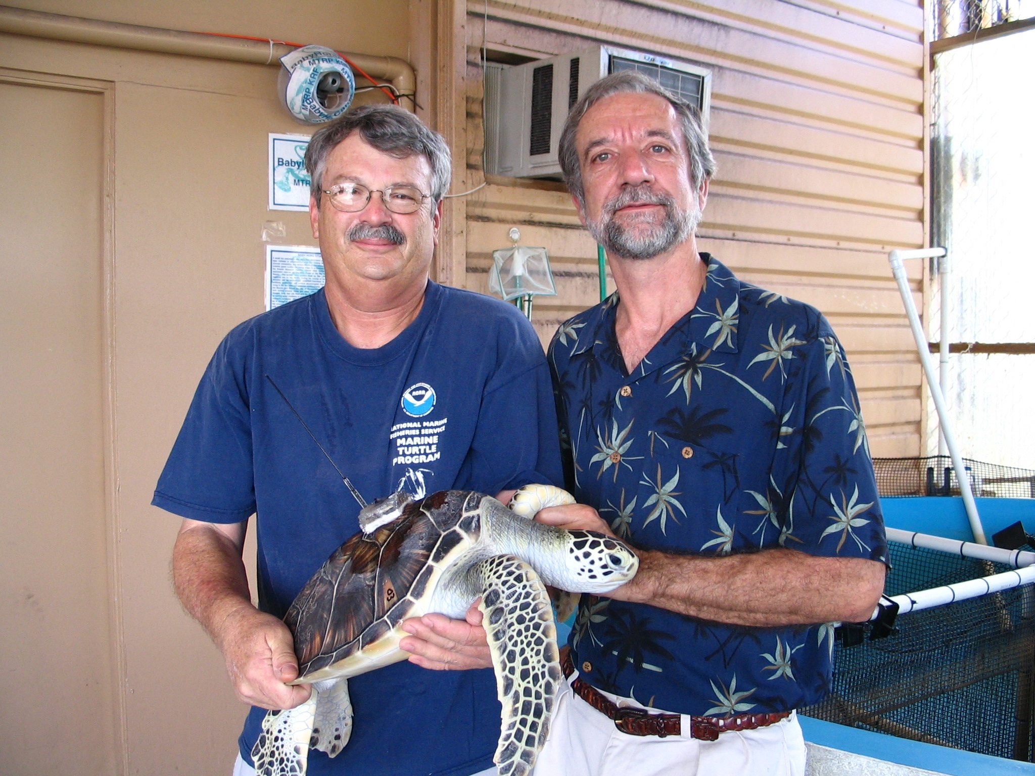
Releasing Turtles for Research
海龟放流的研究机会

Slide 4
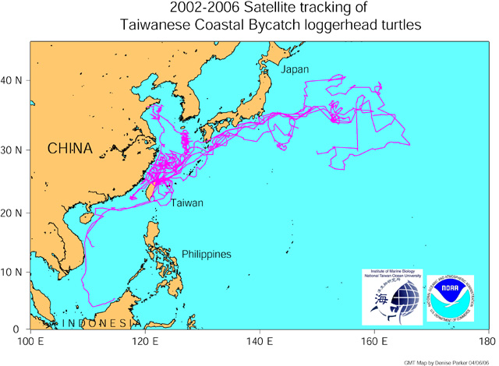
PIFSC MARINE TURTLE RESEARCH 太平洋島嶼漁業科學中心的海龜研究
Pelagic ecology of Chinese and Japanese loggerheads for bycatch reduction 台灣與日本赤蠵龜的遠洋生態，以減少混獲

Slide 5
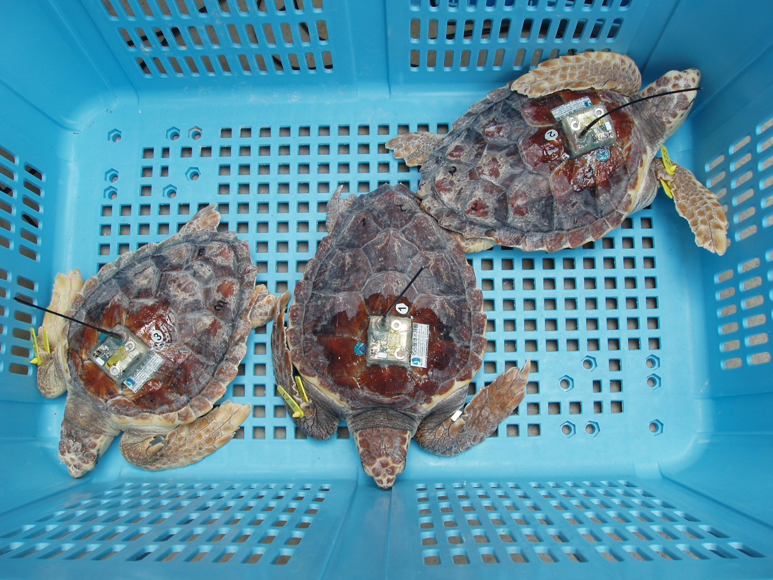
Miniature satellite tags

Slide 6
Satellite Ocean Imaging

Slide 8
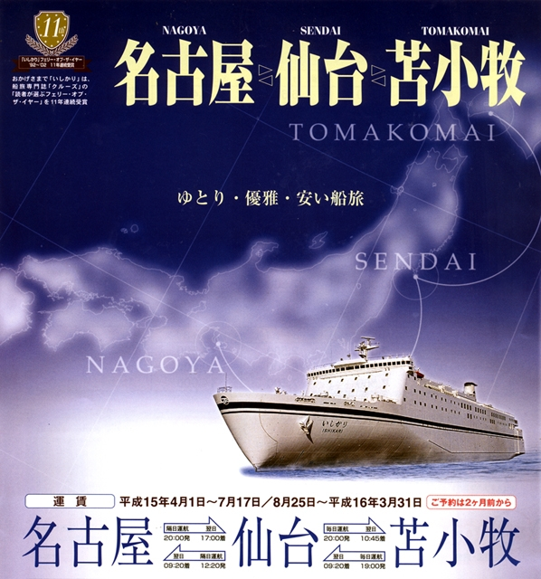

Slide 11
Choshi City Boso Peninsula

Slide 13
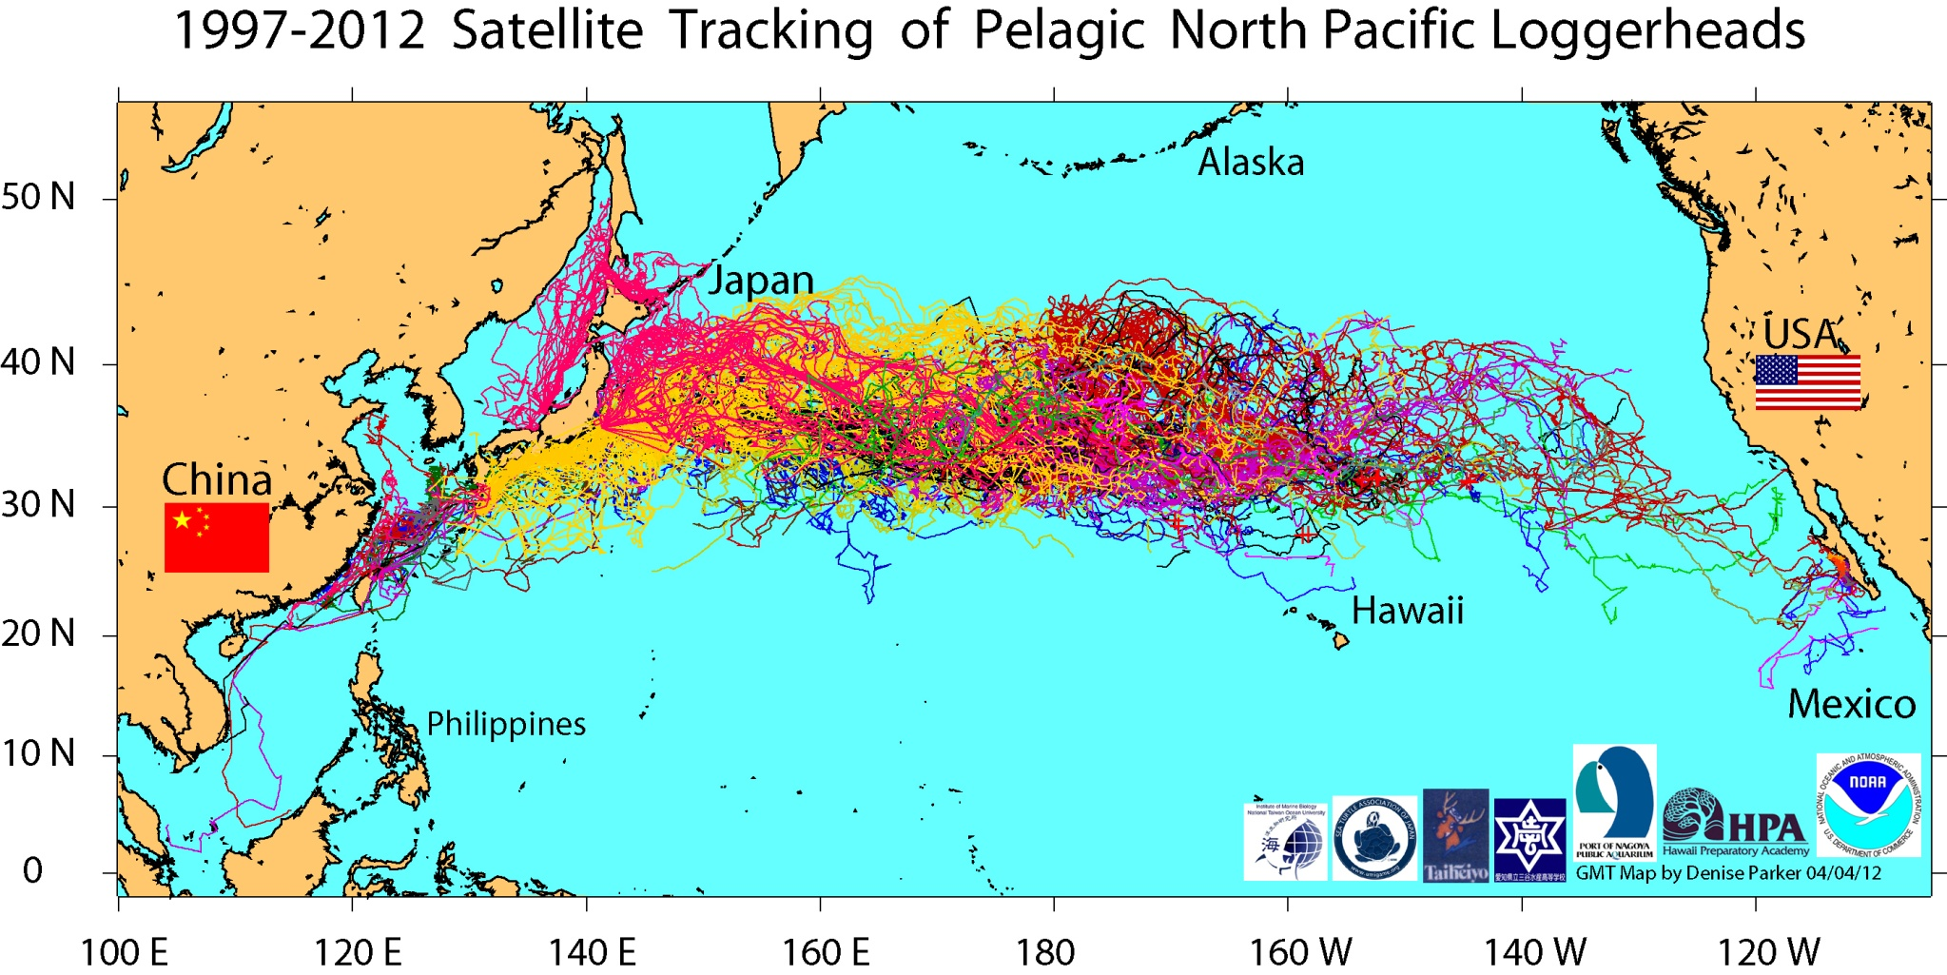

Slide 14
KEBR

Slide 15
Schematic of the Kuroshio Extension Bifurcation region (A)
AVISO altimetry for March 2003
AVISO altimetry for September 2003

Slide 16
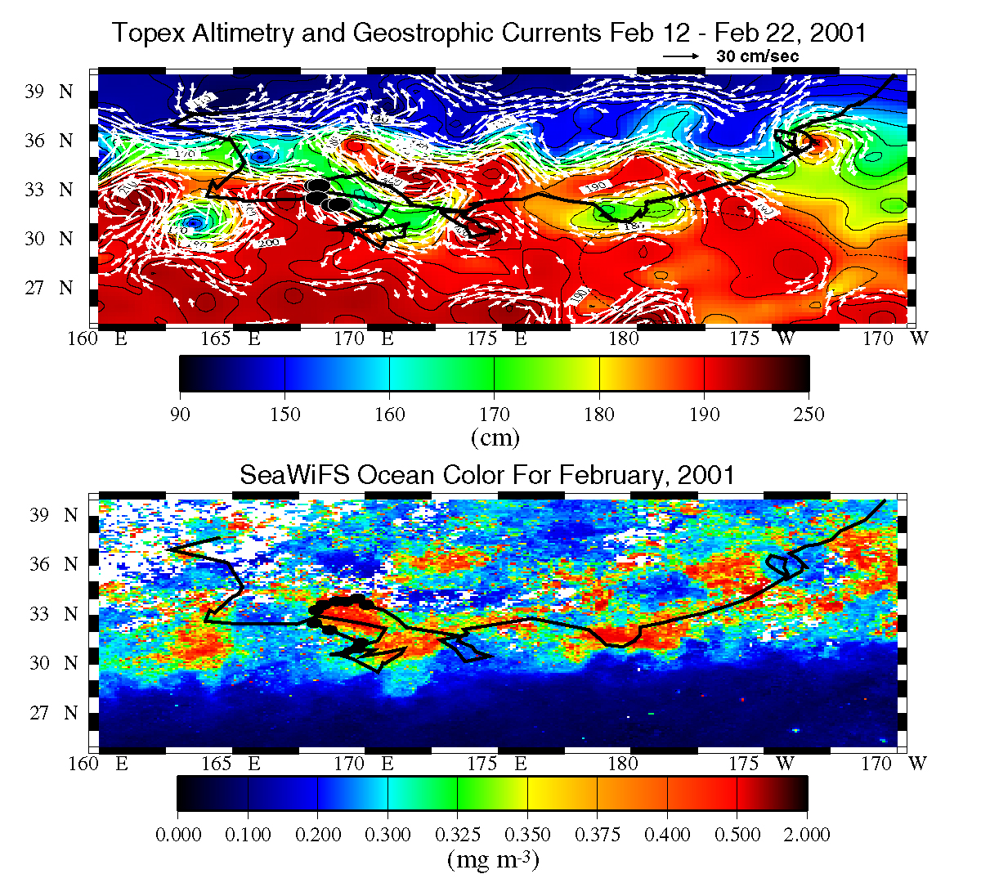
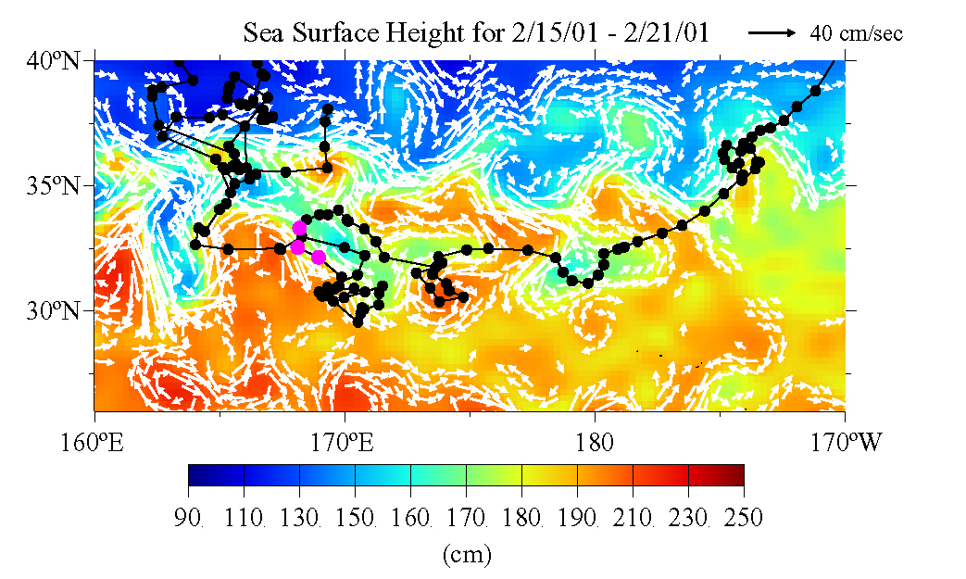

Slide 17
Loggerhead track over SSH and geostrophic currents for October 2003 (A), November 2003 (B), December 2003 (C), and January 2004 (D)

Slide 18
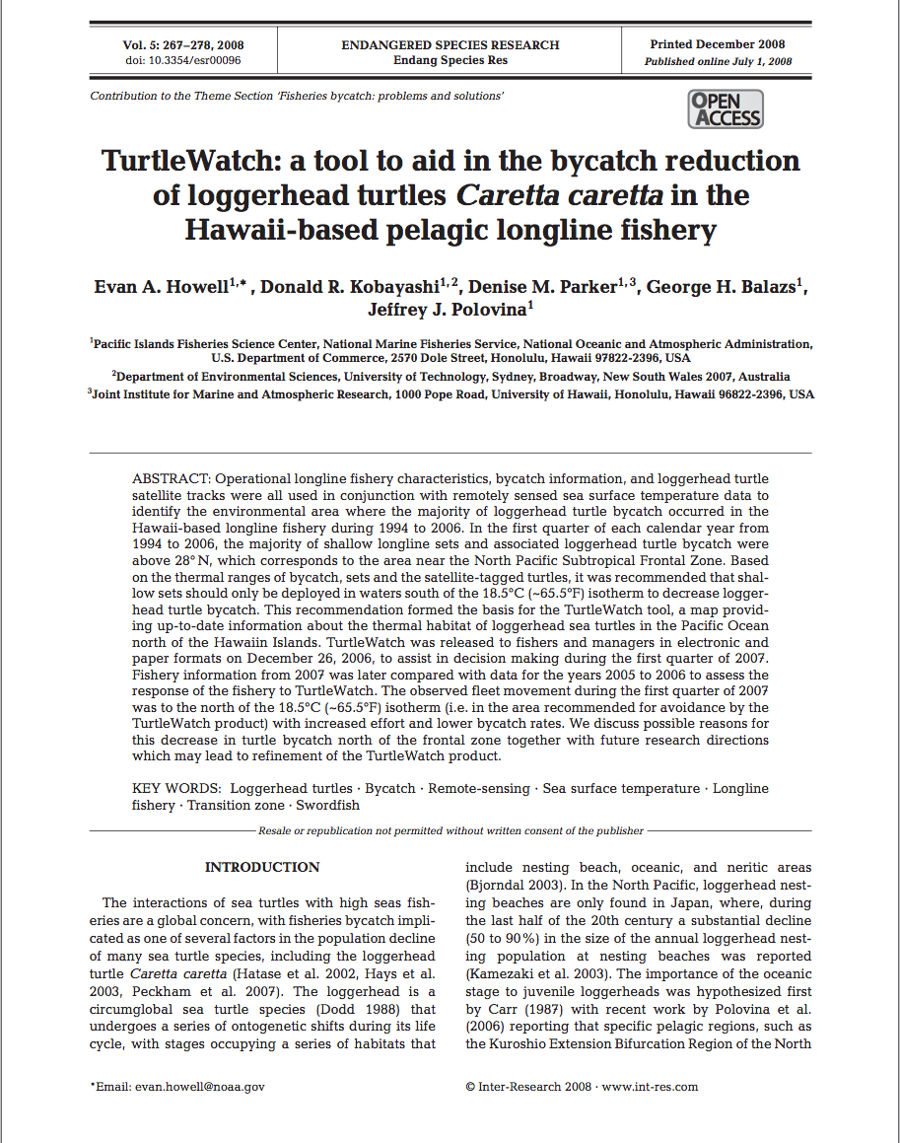
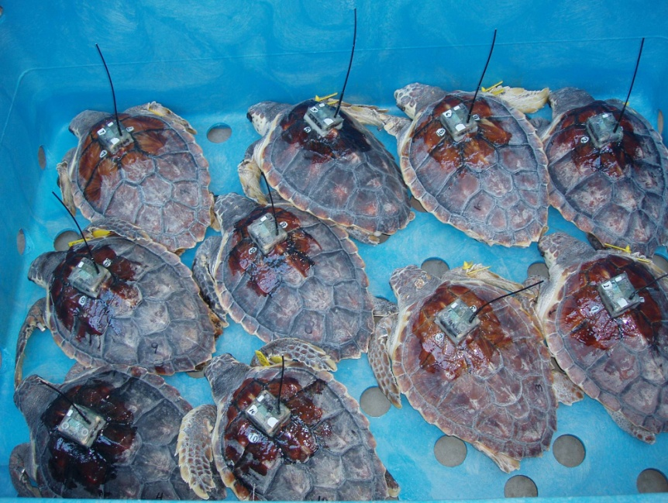
EOD TurtleWatch Evan.Howell@noaa.gov

Slide 19
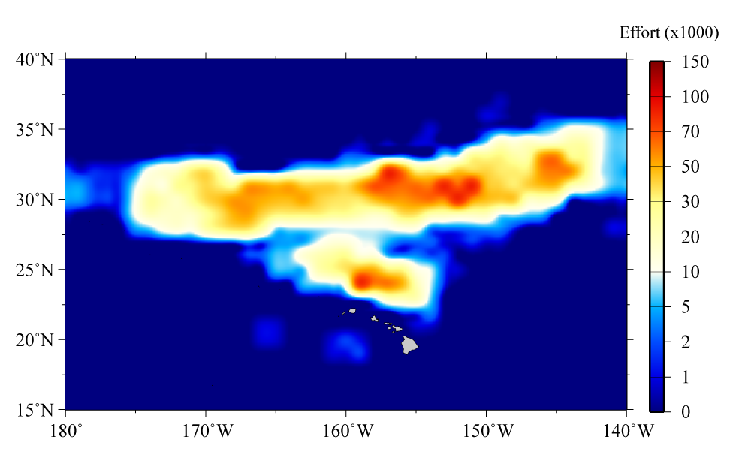
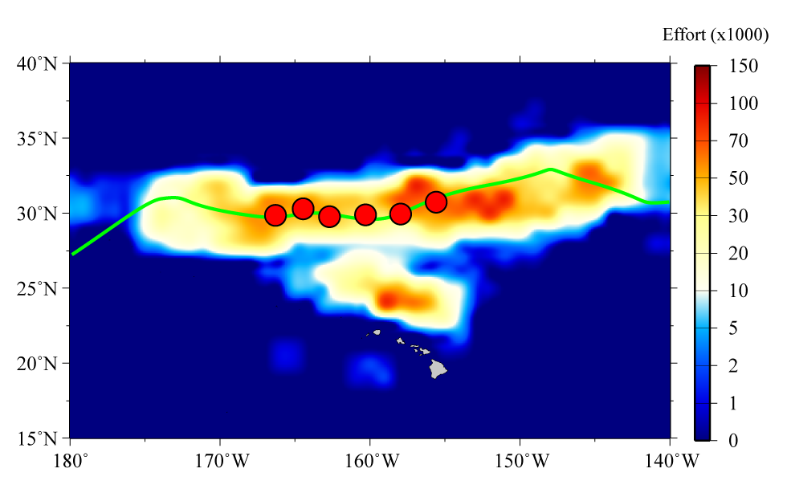
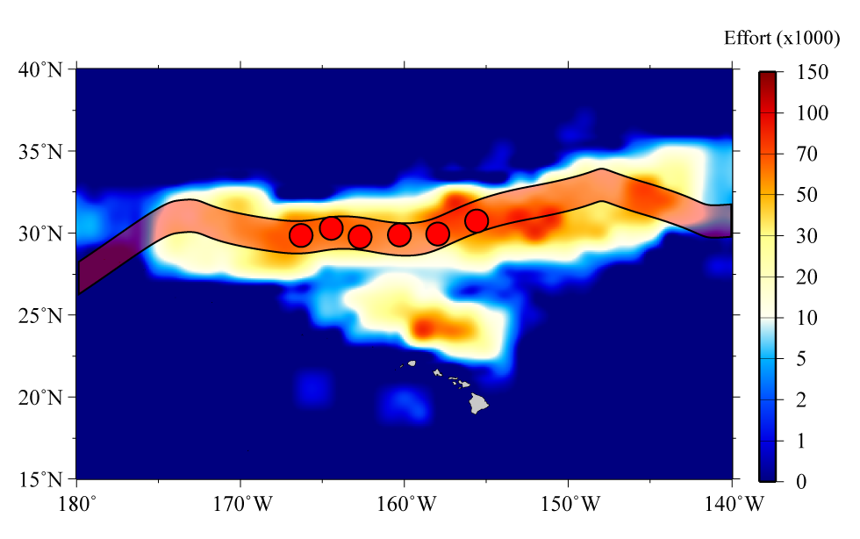
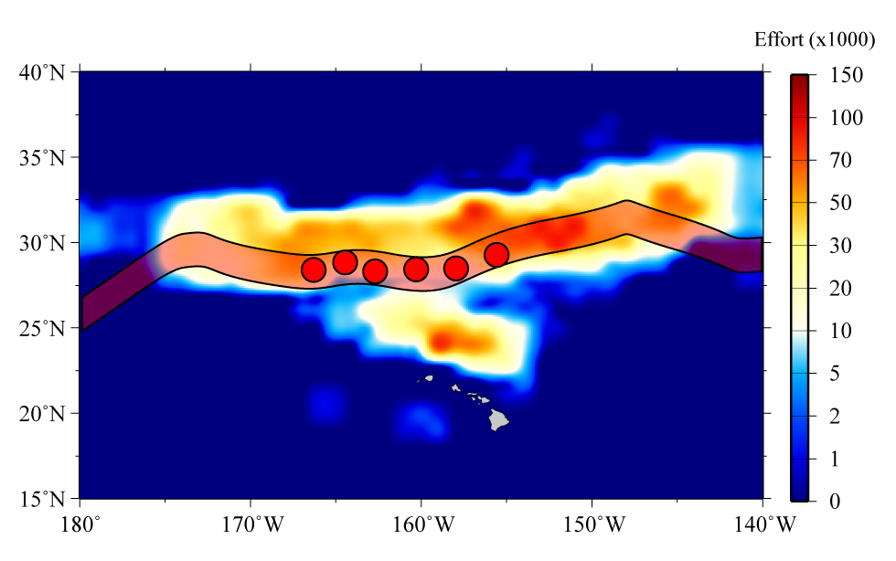
TurtleWatch: Background
Bycatch: Fishery data
Fishery/Bycatch in specific area
Turtles/Sword assoc. fronts¹
¹Polovina (Seki) et al, 2001, (2002),2004, 2006
Response = MPA (closures)
Static closures, dynamic fronts
Frontal/effort shifts (turtles)
Desire: Method to create turtle avoidance areas from environment (SST/Chl a?)
“DYNAMIC HABITAT ZONE”
Distribute daily to fishery
Post-2004: 17 loggerheads = closure
This limit reached March 2006
Prompted TurtleWatch research
First need to understand bycatch pattern (time/space)
Notes:
Based on previous research we have an established relationship between turtles and the environment.
Loggerhead bycatch occurs in specific areas with a relationship to the environment.
Post-2004 fishery regulations set a hard cap on loggerhead interactions (17), this limit was reached in March 2006, closing shallow set fishery for remainder of year
This prompted looking for tool to advise fishers of areas to avoid to try and decrease bycatch
Used previous work (Polovina et al. 2000,2001,2004,2006 and Kobayashi et al. 2008) to look for how bycatch relates to the environment

Slide 20
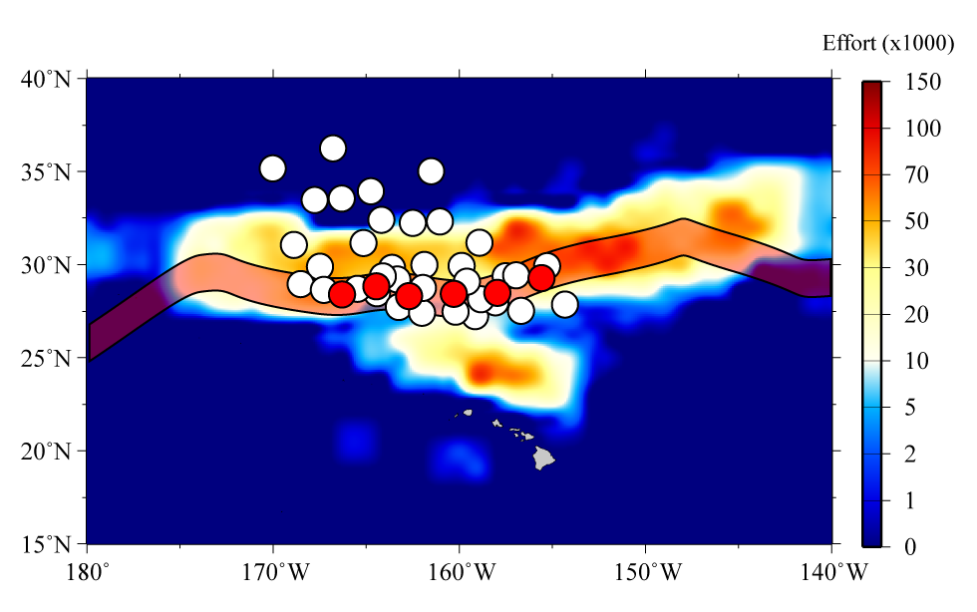
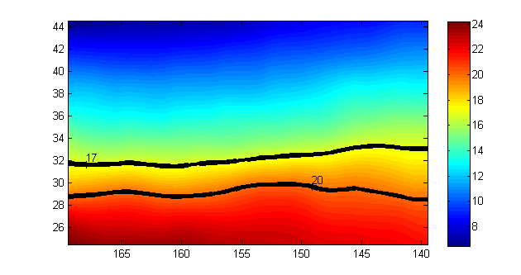
TurtleWatch: Methods
Fishery data
Non-fishery data
Extract SST values
Why SST? Complete coverage, HL fishery measures SST
Interquartile range SST (effort/bycatch)
Release Dynamic MPA Product
Assess fishery response
Incorporate dive behavior
Create Dynamic MPA
Notes:
Can combine both fishery dependent and fishery independent data with environmental data to look for relationship between bycatch and easily measurable signals (satellite data)
Reported relationship between turtles and fronts identified Chlorophyll-a, yet Chlorophyll-a data is sparse in short time scales.
Used SST based on increased coverage on shorter time scales and because a strong relationship between SST and Chlorophyll-a exists in the region north of Hawaii where longline fishery operated (180°-160°W) Bograd et al. 2004

Slide 21
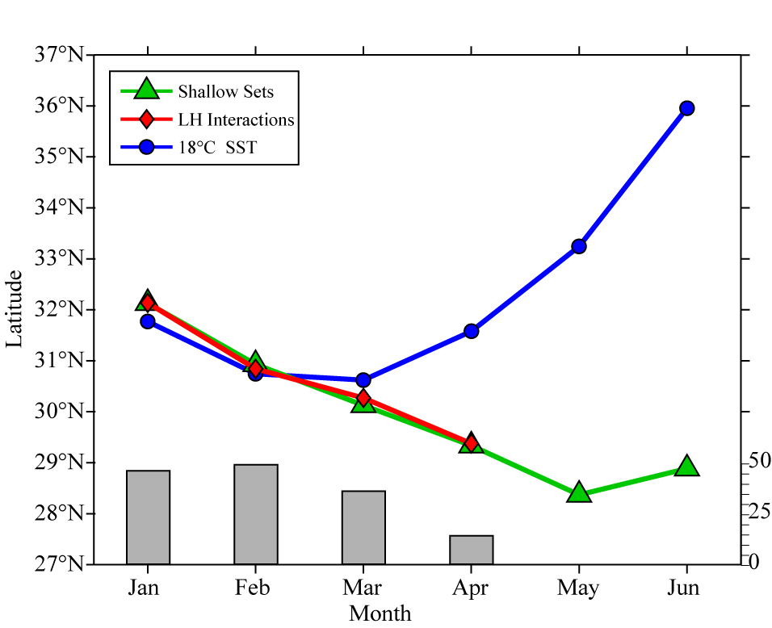
TurtleWatch: Loggerhead bycatch results
First quarter has > 60% of all bycatch
Monthly mean Fishery and RS SST data
(180°-160°W 1994-2006)
Bycatch/18C SST (TZCF) correlated
SST front/effort (bycatch) split Q2
Turtles track front, intra/interannual movements
Interactions (n)
Q1: Use SST habitat proxy (MATCH)
Notes:
Most interactions occur in the first quarter of the year. If we can minimize interactions in the first quarter higher probability of allowing shallow set fishery to continue through the entire calendar year.
Bycatch is highly correlated with the 18°C sea surface temperature isotherm, which is highly correlated to the 0.2 Chlorophyll-a isopleth (otherwise known as the demarcation of the Transition Zone Chlorophyll Front [TZCF])
Plotting the average movements of the fronts and the fishery shows that there is a high spatial correlation in these parameters during the first quarter of the year. After the first quarter the surface fronts move to the north while the fishery moves to the south
We continued to look at fishery and turtle parameters using sea surface temperature as a proxy for the TZCF

Slide 22
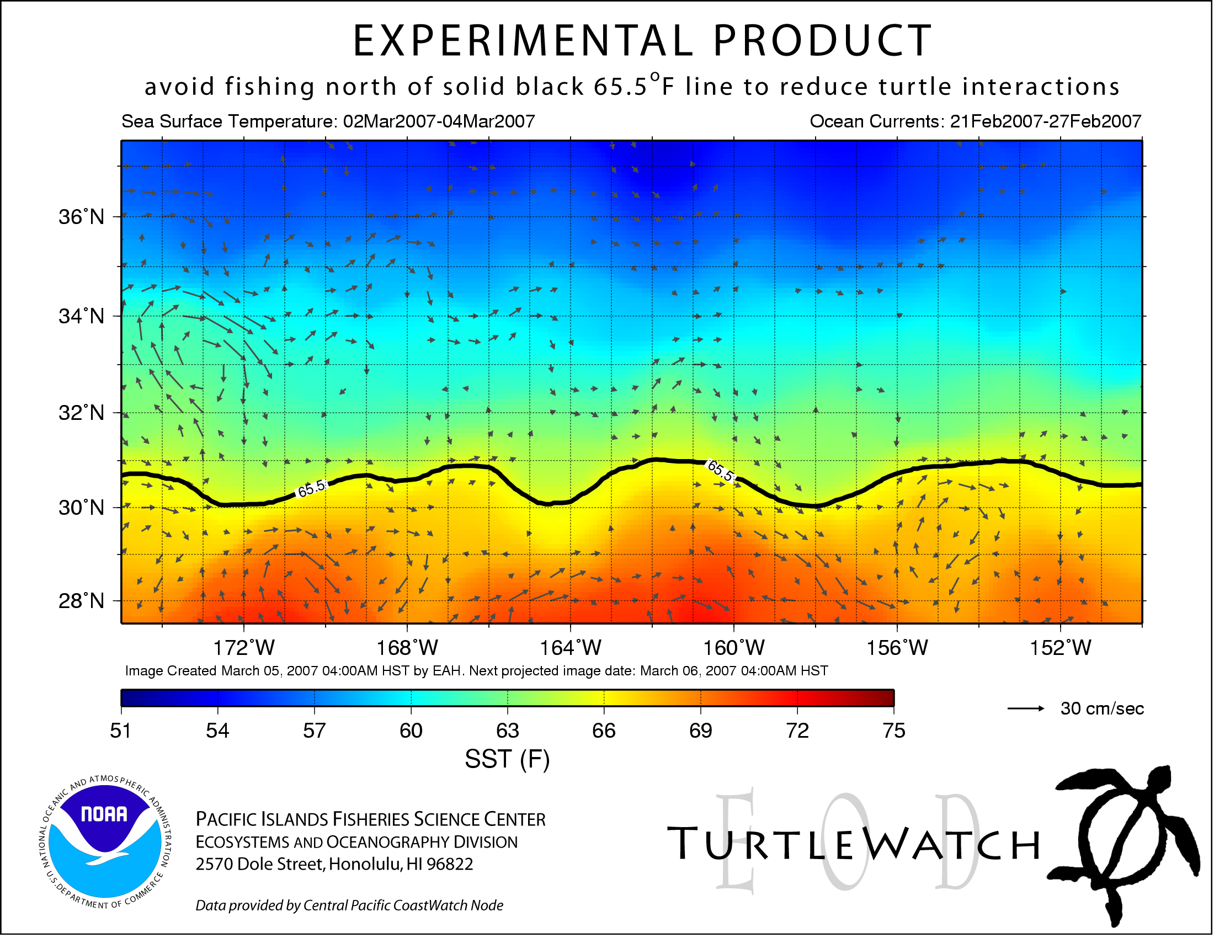
TurtleWatch: Final product / ongoing work
12/2006: TurtleWatch released
12/2007: TurtleWatch refined
2006 recommended large area NO GEAR
Additional refinement ongoing 2012
2007 results no bycatch in NE +
SST < 17.5°C
Based on lack of interactions changed to band (17.5-18.5°C)
Notes:
View of present day TurtleWatch with adjusted area for fishers to avoid setting shallow gear. This is based on feedback from fishers (area above 18.5°C too large) and no bycatch in 2007 in surface waters colder than 17.5°C.
Isotherms given in Fahrenheit for ease of interpretation to fishers.
Large decrease in bycatch after 2007 until 2011. TurtleWatch has also been successful in predicting areas of bycatch when bycatch did occur
In 2011 shallow set fishery was closed due to interaction limit reached for LEATHERBACKS
Now in 2012 we are looking at refining TurtleWatch to assess if we can adjust range with new information or create similar product for leatherback turtles.

Slide 23
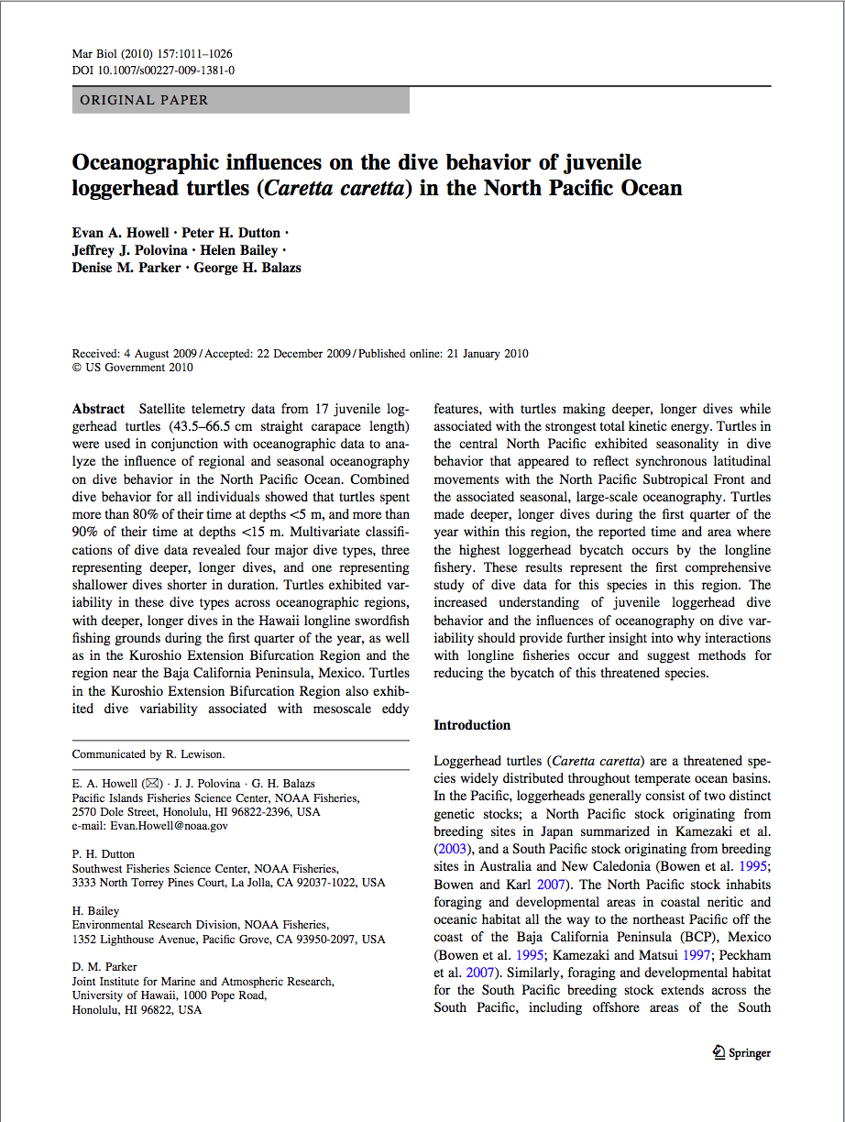
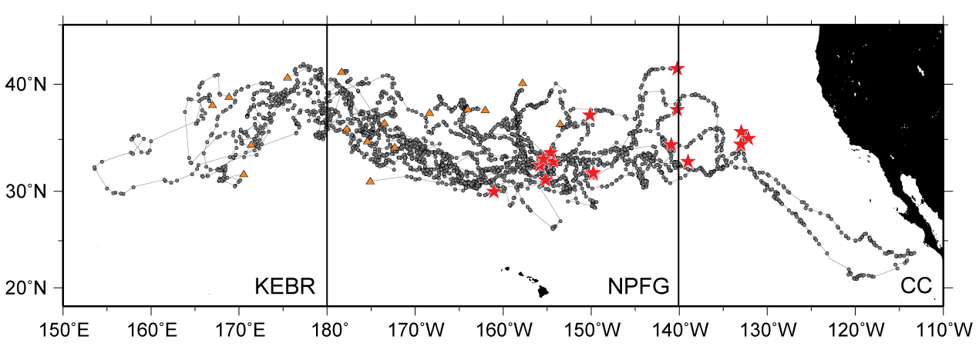
Loggerhead dive behavior: Background Evan.Howell@noaa.gov
Work to date studied 2-D (surface) behavior of loggerheads
Here we look at 3-D (+vertical) behavior of loggerheads
Goal: Identify dive behavior “types” and relationship to oceanography
Notes:
Previous research focused on 2-D behavior as we only had surface coordinates.
In this study we have 17 tags on loggerheads that provide depth information
From this depth information we can infer dive behavior and compare this with regional oceanography

Slide 24
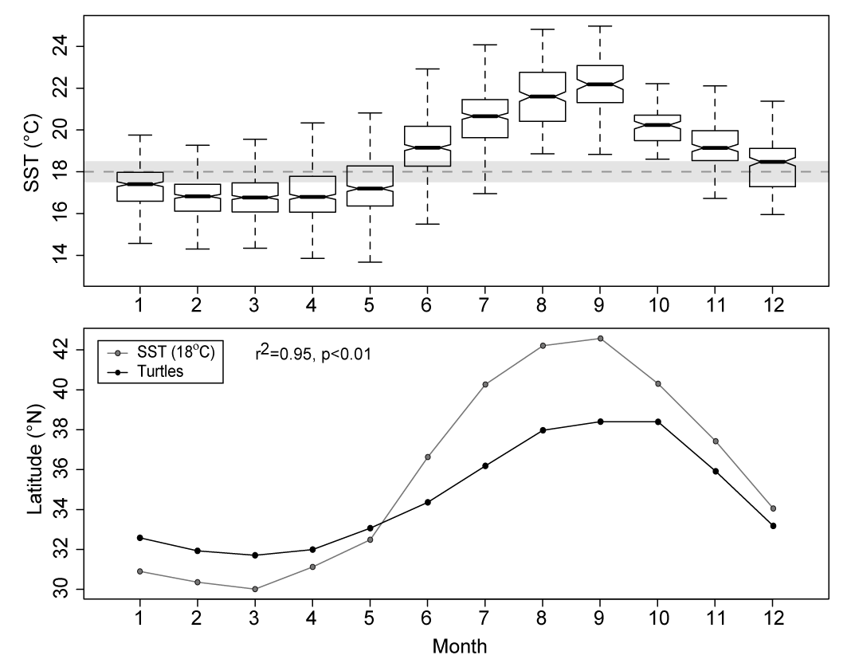
Seasonal movement
Satellite telemetry data (n=17) from 180-150°W north of Hawaii
Turtles follow fronts ~18-20°C
Follow front throughout year
Coldest SST Q1
Surface pattern similar to tagged (TurtleWatch)
Notes:
Spatial data shows that in the region where the Hawaii longline fishery operates turtles follow the surface frontal movements throughout the year.
The coldest sea surface temperature values are experienced in the first quarter of the year
This is similar to the results from the tagged turtles in the TurtleWatch study, not similar to the values for bycatch

Slide 25
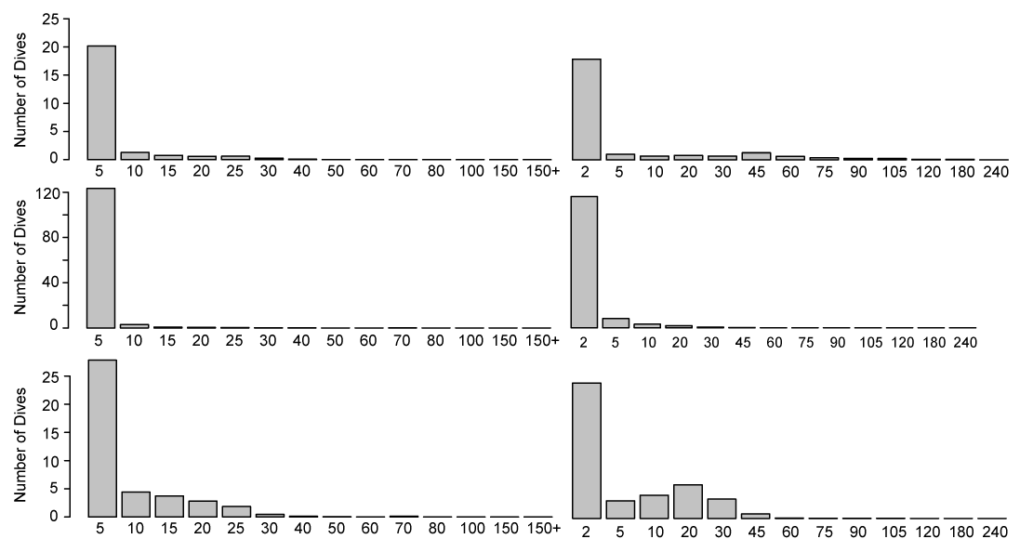
Dive type results
K-means cluster analysis: 3 distinct dive types north of Hawaii
Types 1,3 deeper, longer | Type 2 shallower, shorter
Dive type 1
Dive type 2
Dive type 3
Dive depth
Dive duration
Depth (m)
Time (min)
Notes:
The k-means cluster analysis identified four dive types, with three of these dive types observed in the area north of Hawaii where the Hawaii-based pelagic longline fishery operates.
Dive types 1 and 3 are deeper dives of longer duration
Dive type 2 contains shallower dives of shorter duration.

Slide 26
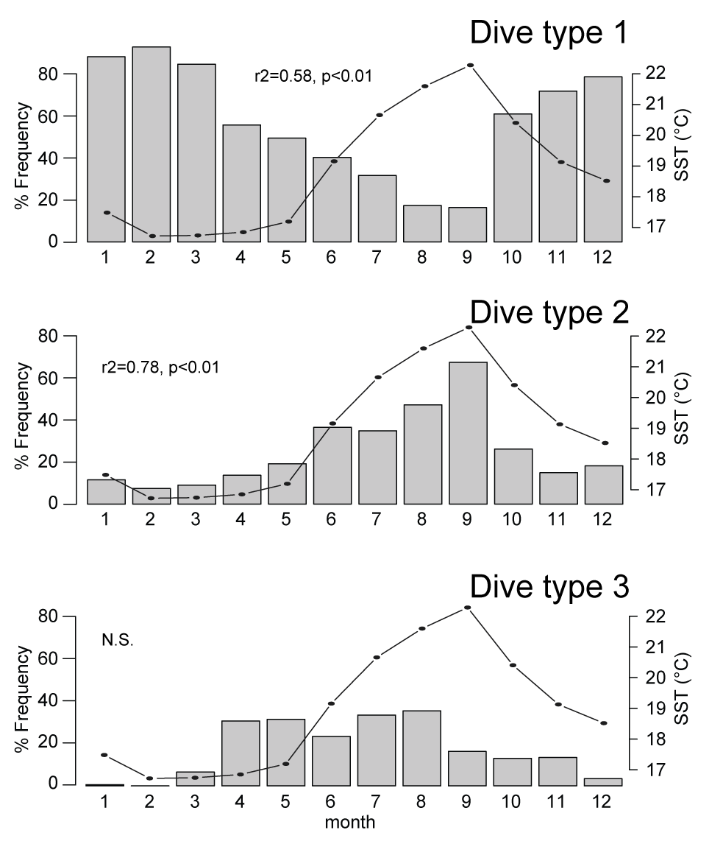
Dive variability (North of Hawaii)
Seasonal variability synced to movement of front (fishing ground)
Observed monthly changes in dive behavior
Coldest SST Q1 = deepest/longest dives
SST
Contrast to later months where shorter/shallower dives
Notes:
The seasonal variability of the turtle movements is synced to the movements of the surface fronts, which is the area used by the Hawaii longline fishery during the first quarter of the year.
We also observed monthly changes in dive behavior, with deeper longer dives observed in the first quarter of the year
This is contrast to later in the year where a higher frequency of shorter, shallower dives was observed

Slide 27
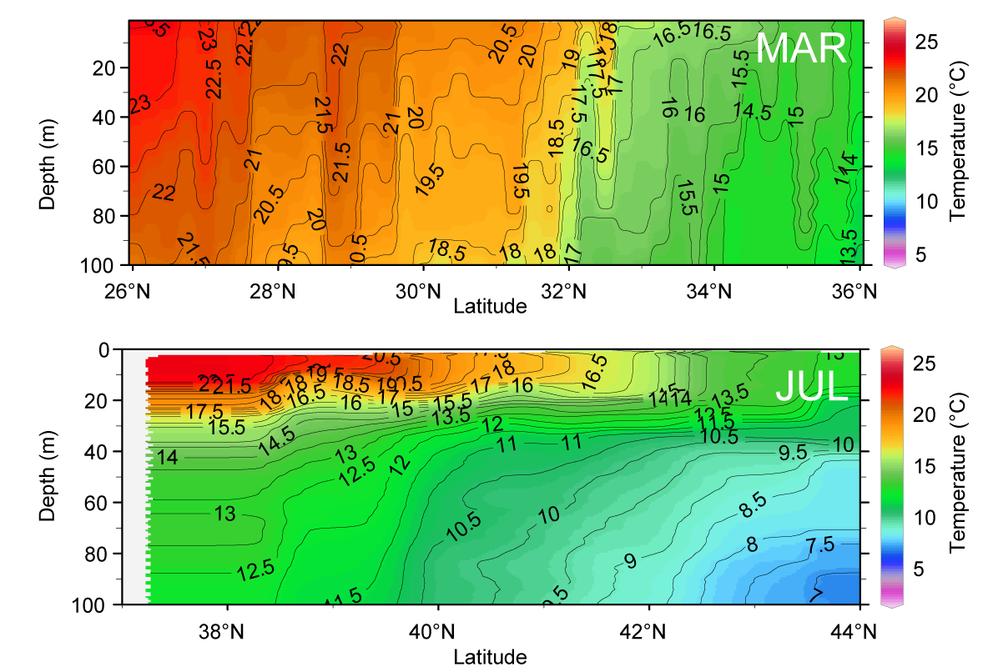
Loggerhead Oceanographic Habitat
March 2008 – In-situ Temperature from NOAA Sette
July 2005 – In-situ temperature from Oshoro Maru
Q1: deep mixed layer
Temp. front
Q3: shallow mixed layer
Sal. front
Rule: Fishery MUST target below 20m
Notes:
These changes in dive types are most likely tied to changed in subsurface oceanography.
During the first quarter the frontal zone is well mixed, with a deep mixed layer and no temperature change through the water column where turtles dive
Deeper dives in this first quarter cross over with where shallow set gear lies (red box)
In contrast, during the third quarter there is heavy stratification, with a shallow mixed layer and a large temperature change with depth.
Turtles dive shallower during this time and spend less time deeper than 20m where shallow set gear is located.
This helps explain why more interactions occur during the first quarter of the year.

Slide 28
North Pacific loggerhead track data Donald.Kobayashi@noaa.gov
2008. Kobayashi*, Polovina, Parker, Kamezaki, Cheng, Uchida, Dutton, Balazs. Pelagic habitat characterization of loggerhead sea turtles, Caretta caretta, in the North Pacific Ocean (1997-2006): Insights from satellite tag tracking and remotely-sensed data. Journal of Experimental Marine Biology and Ecology 356: 96-114.
* Dr. Donald R. Kobayashi, Research Fishery Biologist in the Ecosystems and Oceanography Division at the Pacific Islands Fisheries Science Center, NMFS/NOAA US Department of Commerce.
Notes:
Much of our work has involved loggerhead tracks in the Central part of the North Pacific Ocean. Over several decades of work have yielded a very nice tagging dataset.

Slide 29
Movement appears to relate to oceanography
Notes:
Some of the movement patterns appear to be related to the oceanography of the region. In this slide we see the tagged loggerhead movement and the climatological sea surface temperature or SST. The line shows a particular SST that is thought to be a preferred temperature, 17 degrees C.

Slide 30
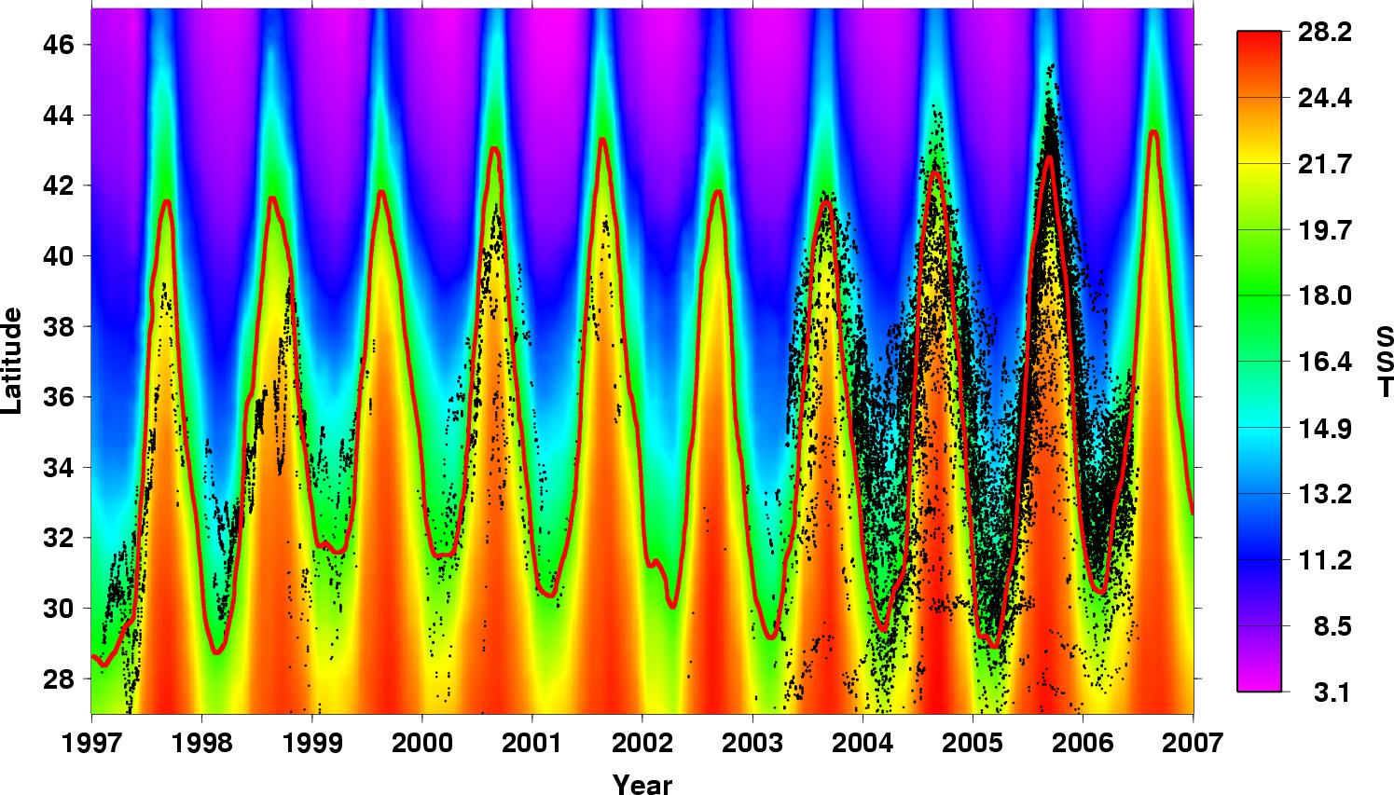
North Pacific loggerhead movement and sea surface temperature (SST)
Notes:
Here we see the same data but over the many years of the dataset. We see that there is a repeating seasonal pattern every year that the loggerheads in the North Pacific will follow this particular temperature, 17 degrees C.

Slide 31
Taiwan by-catch tagged loggerheads
China
2011. Kobayashi*, Cheng, Parker, Polovina, Kamezaki, Balazs. Loggerhead turtle (Caretta caretta) movement off the coast of Taiwan: characterization of a hotspot in the East China Sea and investigation of mesoscale eddies. ICES Journal of Marine Science. 68(4): 707-718.
Notes:
In our work with the Taiwan by-catch tagged loggerheads we observed a range of movement patterns.

Slide 32
Several movement strategies identified:
Pelagic entry to the “Kuroshio Extension Bifurcation Region”.
Coastal movement to southwest.
Persistent occupancy over continental shelf in the East China Sea.
Notes:
This shows each of the 34 tracks separately. You can see great variety in movement. There appears to be 3 primary patterns. Movement to the NE into the KEBR, movement to the SW, and a peculiar residency over the continental shelf. [point out T02, T16, T17, T22, among others which are a LOT of days in a small area…]

Slide 33
Animation of first 70 days
China
Notes:
Here is a simple animation of the first 70 days after tagging and release. [might be good to tell the joke about the turtle in the south following the borders in the hotly disputed regions of Spratly and Paracel islands…]

Slide 34
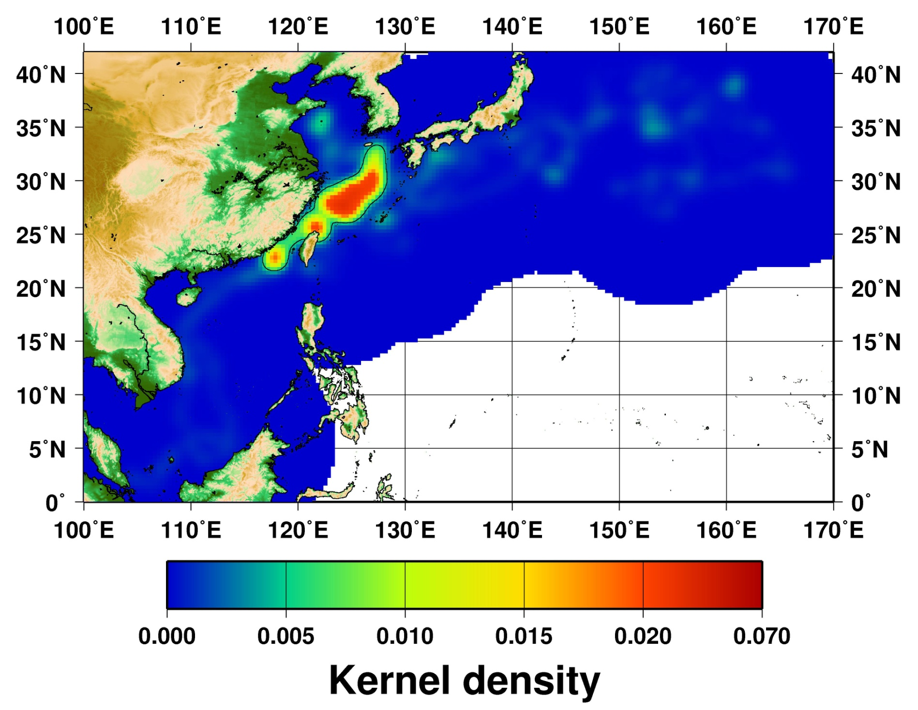
← East China Sea “Hotspot”
East China Sea “Hotspot” covers ~400,000 square kilometers of ocean.
Shallow, productive, effects of rivers/currents, multinational, location of many fisheries.
Notes:
By analyzing the data in something called a kernel density function, it is possible to identify this area as a potential loggerhead “hot spot”. This is a large area of ocean over 400,000 kilometers squared. We suspect this to be a very good foraging area for loggerheads but more research is needed.

Slide 35
The End
報告完畢

Slide 36
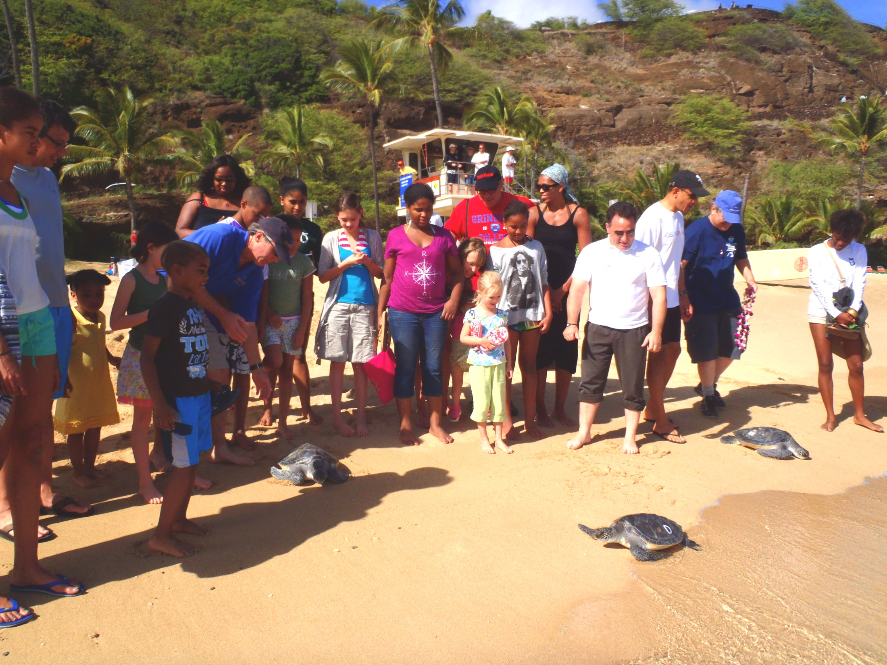
Releasing Turtles for Research
海龟放流的研究机会

Slide 37
Sea Life Park Hawaii
Partnership Research

Slide 38
