Slide 1
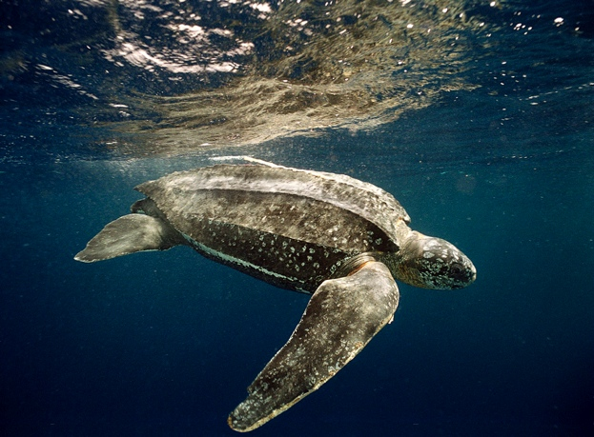


Leatherback turtle movements in the Pacific
Jeffrey A. Seminoff
Marine Turtle Ecology & Assessment Program
Stable Isotope and Chemical Ecology Laboratory
NOAA – Southwest Fisheries Science Center

Slide 2
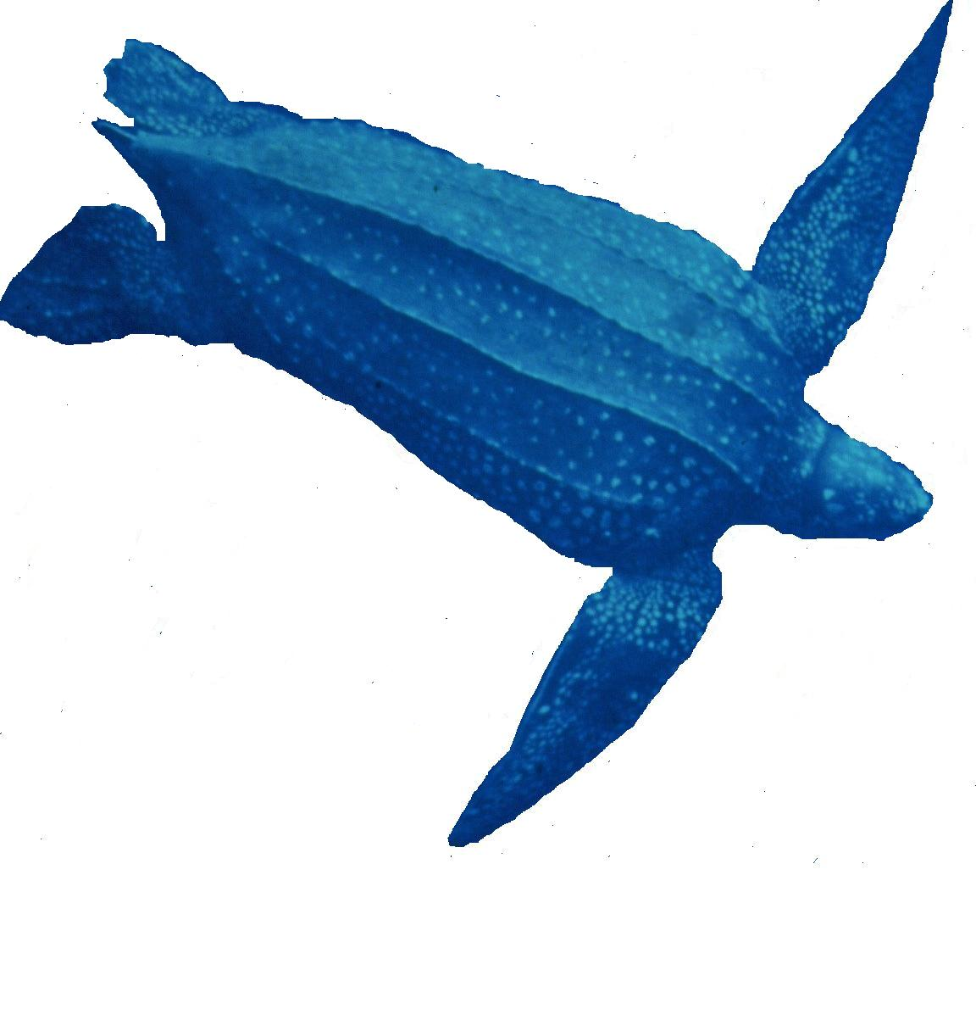
Pacific leatherback movements
Use of satellite telemetry to determine foraging
hotspots throughout the Pacific
Eastern Pacific and Western Pacific nesting groups
Habitat use and location of foraging behavior
Opportunities for China / U.S. collaboration

Slide 3
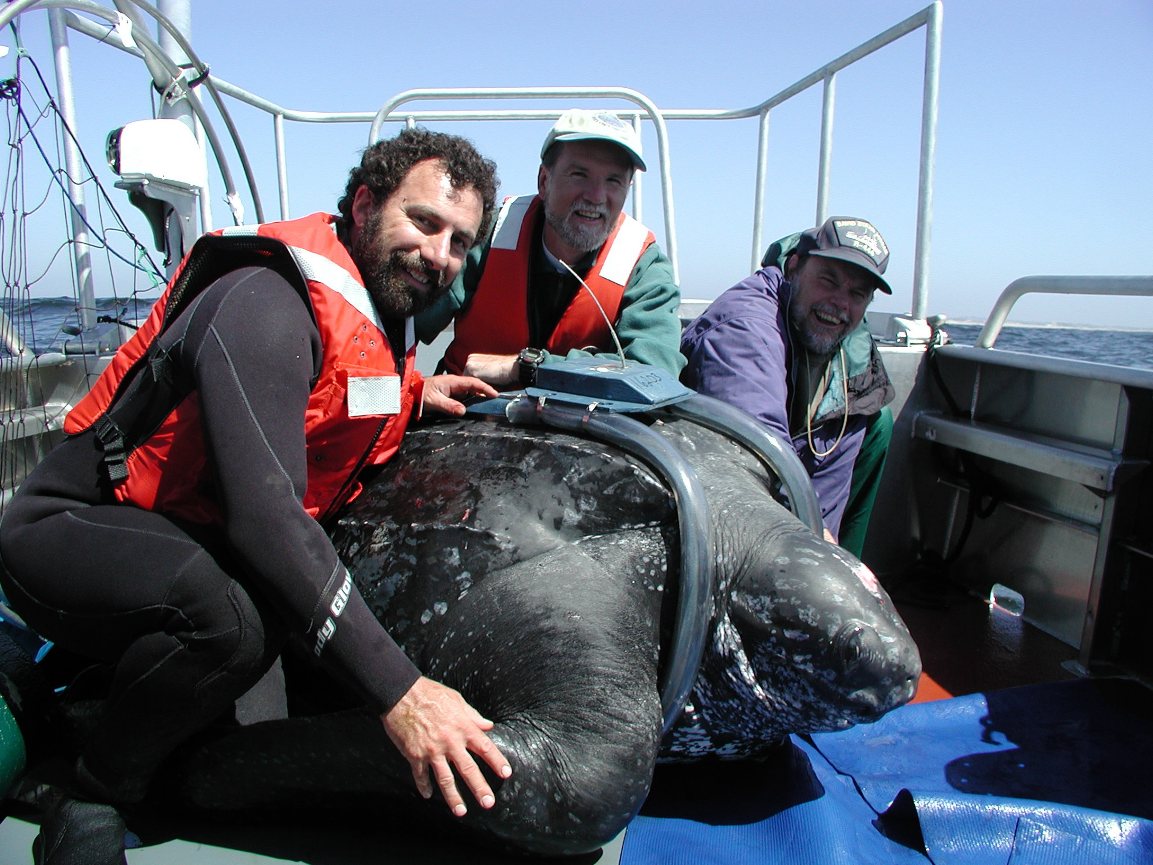










Slide 4
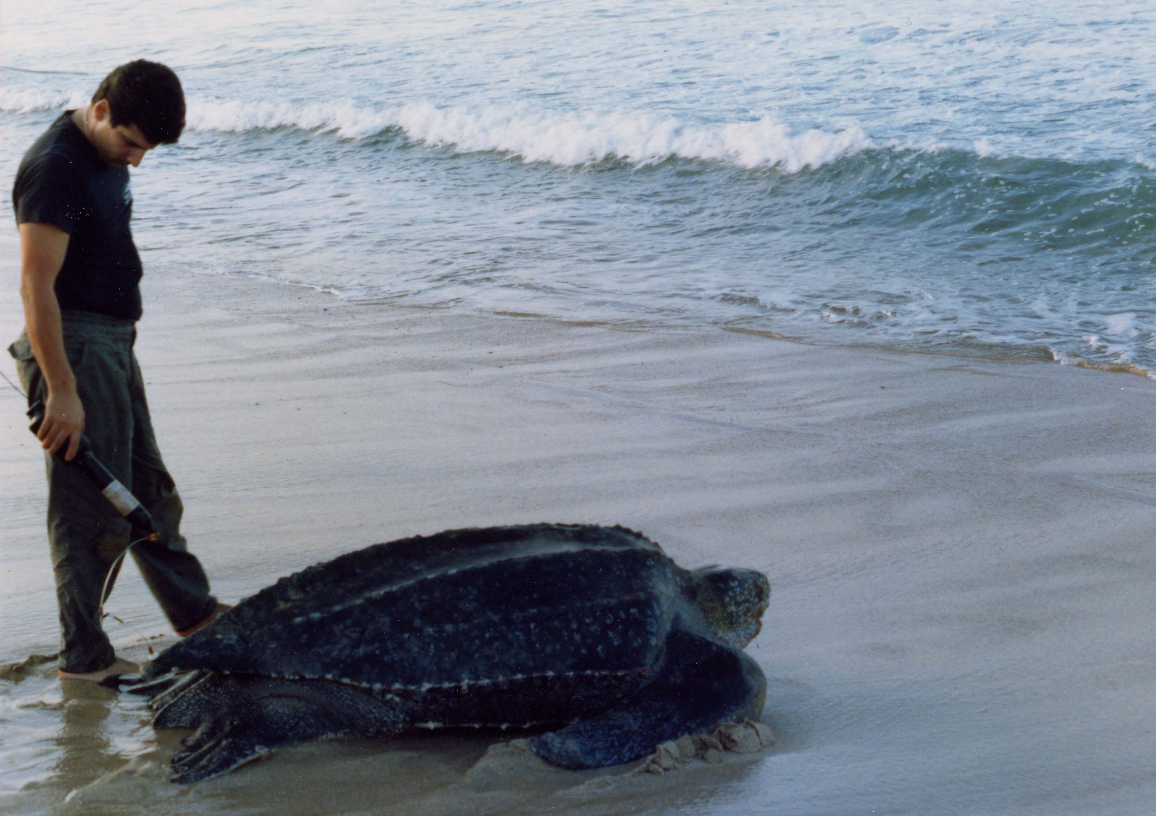
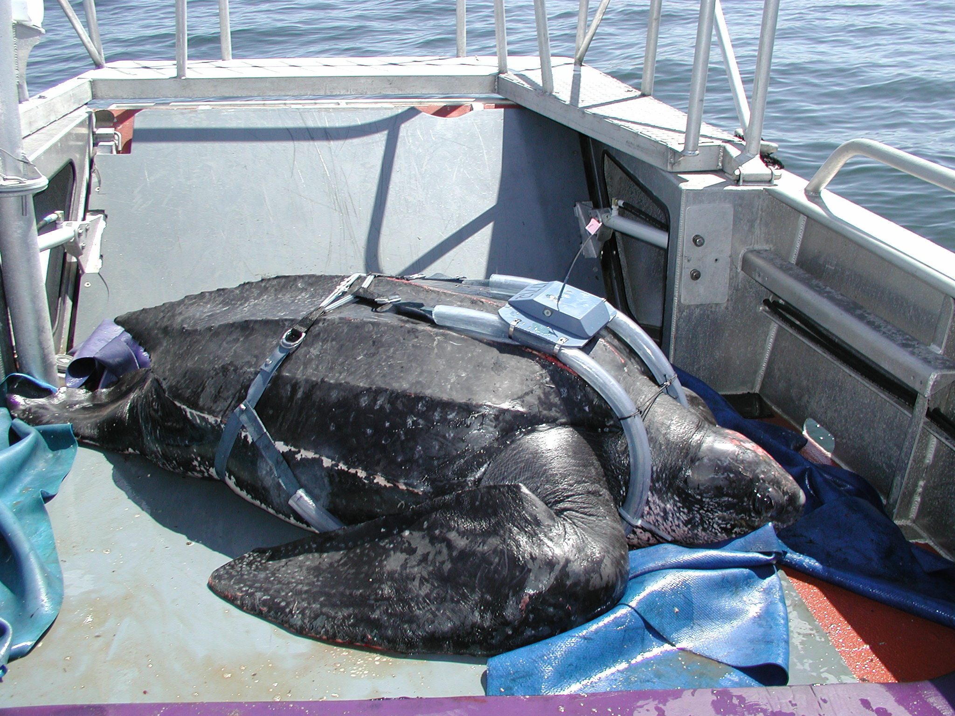
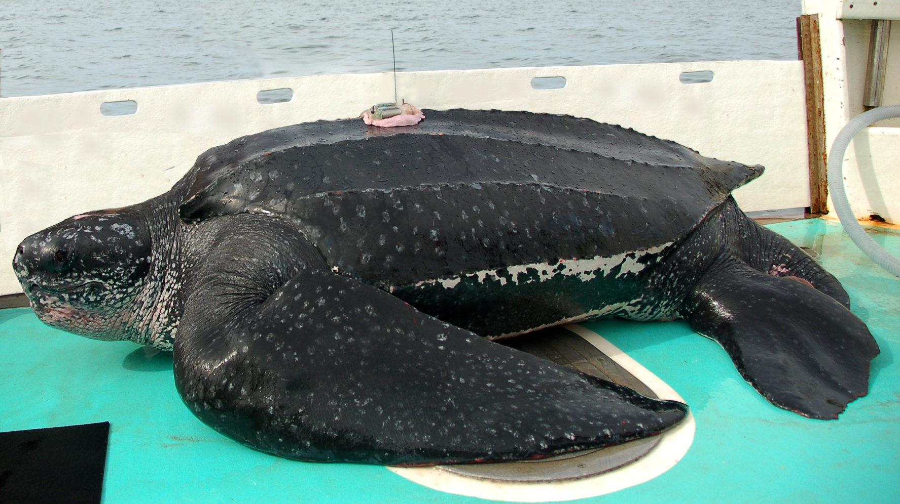
Telemetry techniques to study leatherback movements
Tether attachment (1993-1998)
Harness ‘backpack’ (1998-2009)
Direct attachment
2009-present

Slide 5
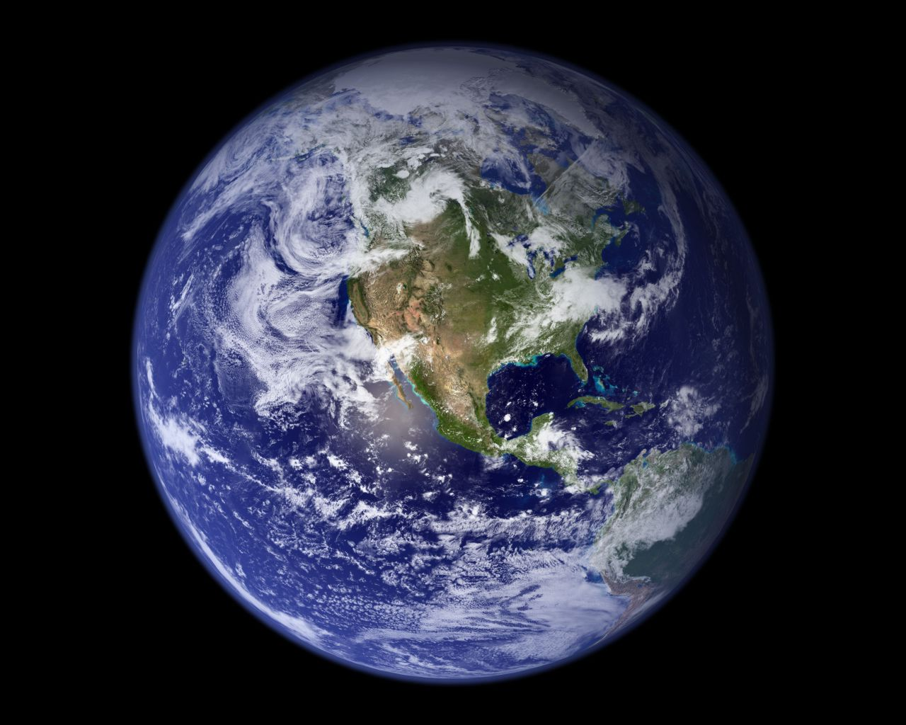
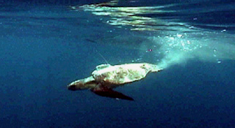
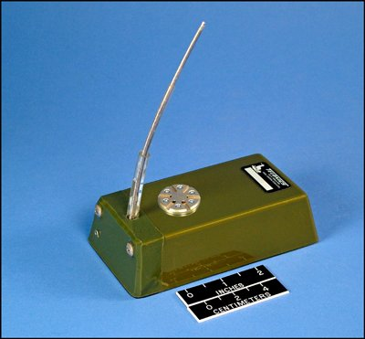

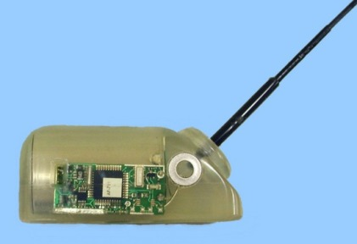
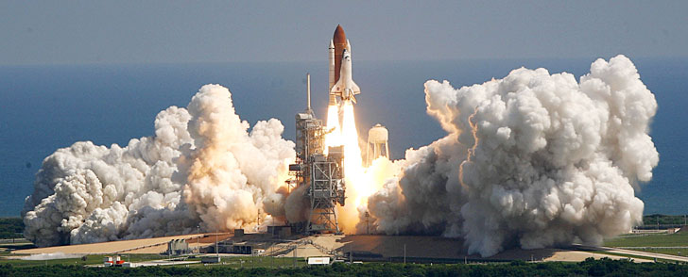



ARGOS (Advanced Research & Global Observation Satellite)

Slide 6
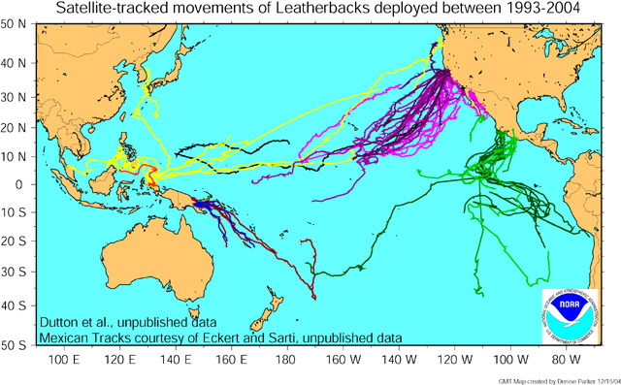
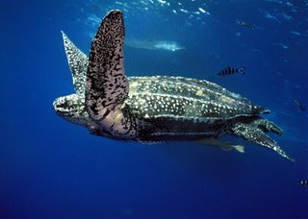

Slide 7
Post-nesting movements of leatherback turtles
nesting in Playa Grande, Costa Rica
Shillinger et al. 2008 (PLoS ONE)

Slide 8
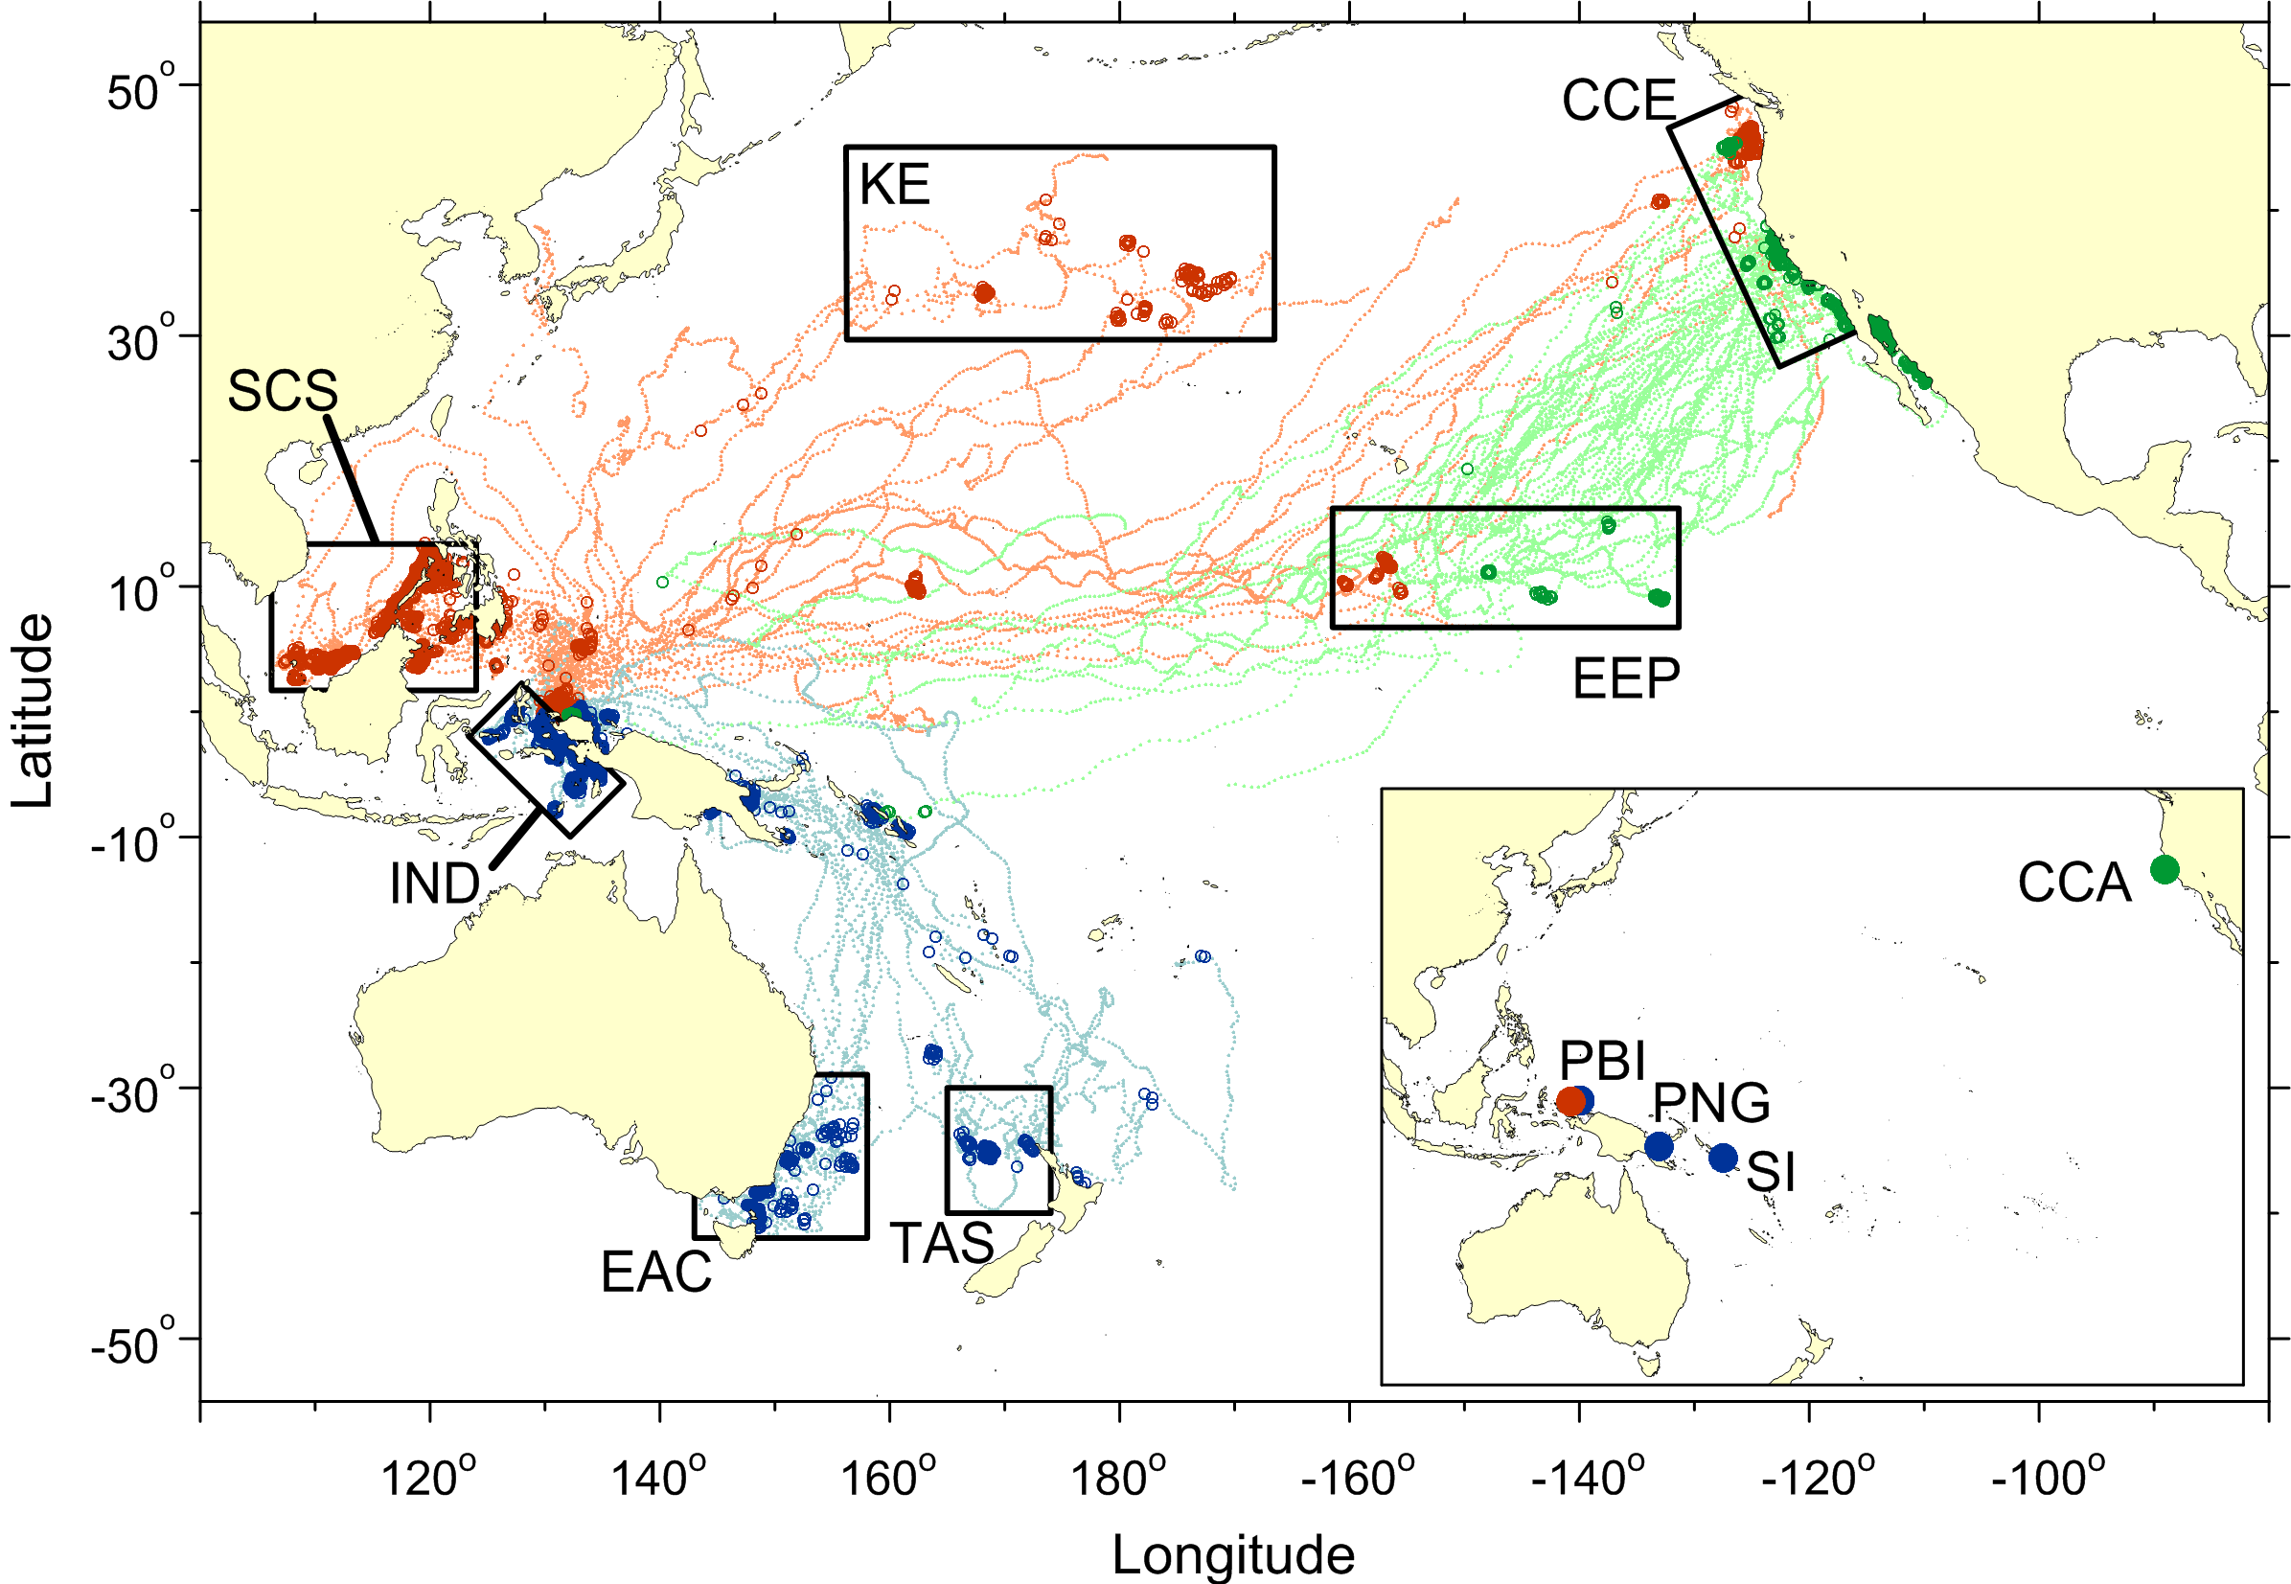
126 telemetry tracks of leatherback turtles. Circles indicate foraging behavior; dots indicate transiting behavior.
red = summer nesters, blue = winter nesters, green = deployments at central California foraging grounds.

Slide 9
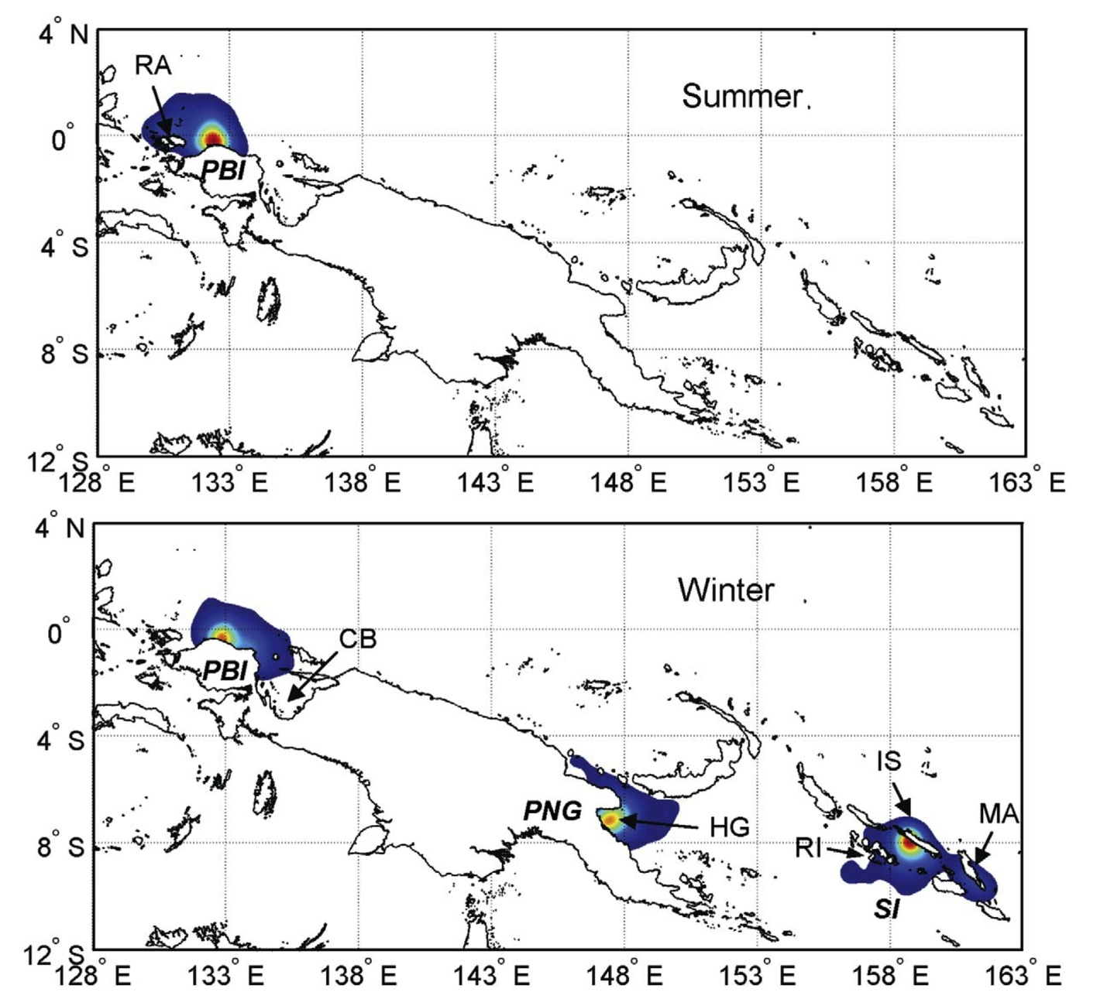
High-use areas of western Pacific leatherbacks during inter-nesting periods, derived using kernel density estimation for 89 satellite tracks from nesting deployments.
PBI = Papua Barat, Indonesia
PNG = Papua New Guinea,
SI = Solomon Islands,
RA = Raja Ampat Islands,
CB = Cenderawasih Bay,
HG = Huon Gulf,
IS = Santa Isabel Island,
RI = Rendova Island,
MA = Malaita Island.

Slide 10
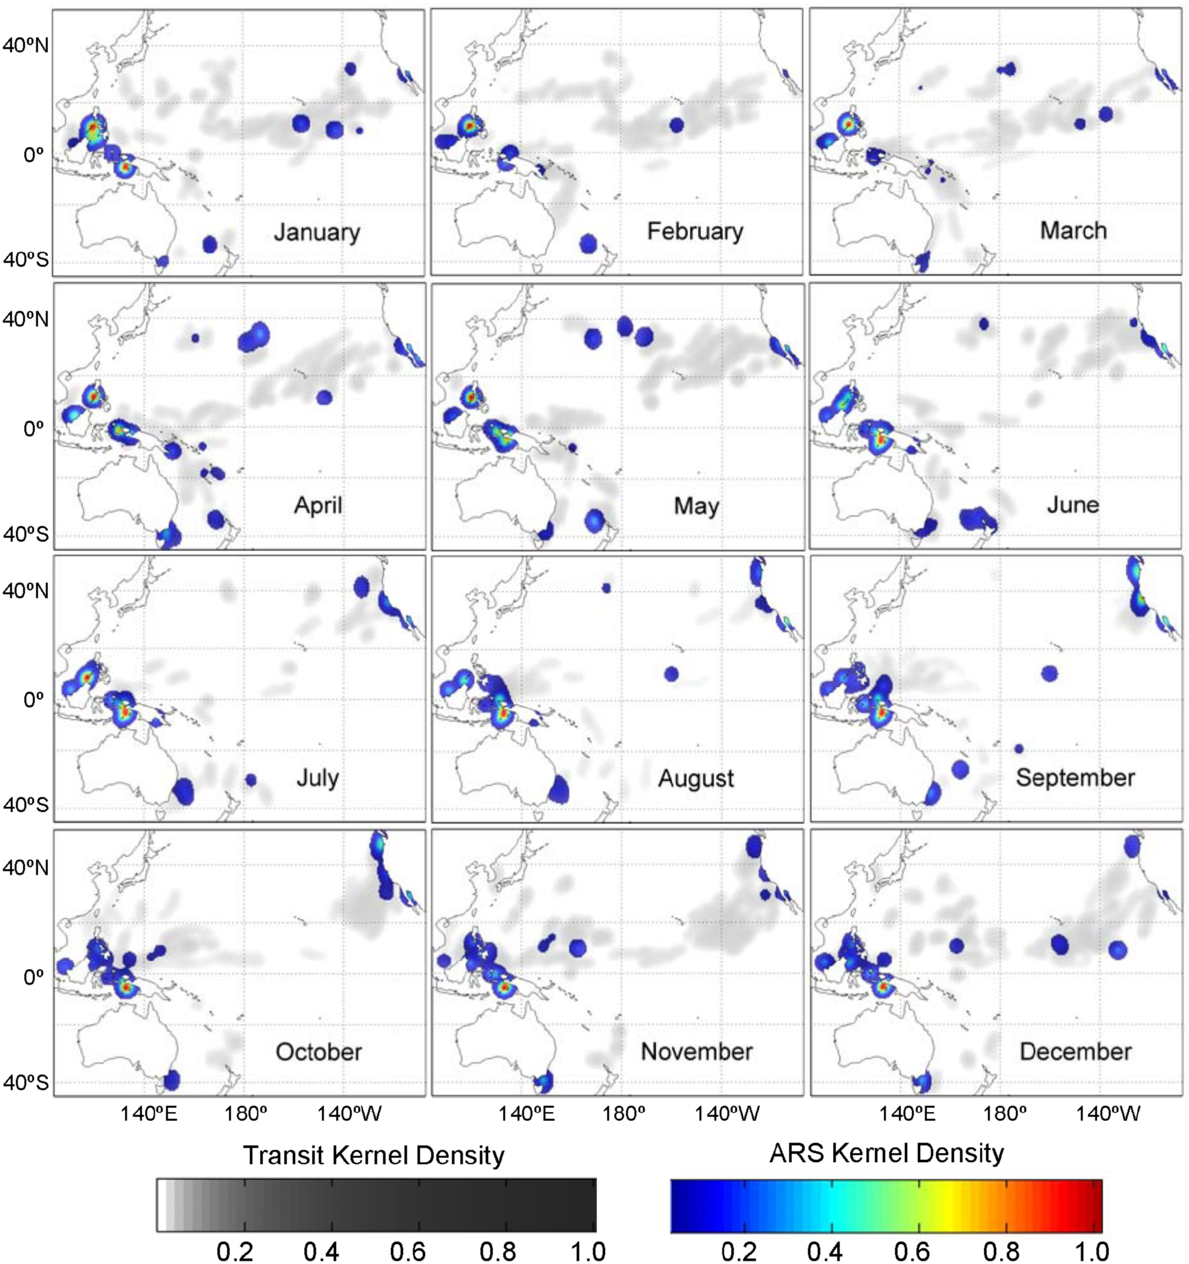
Monthly high-use areas derived using kernel density estimation.
Monthly high-use areas derived using kernel density estimation.
Gray-scale indicates transiting behavior; colors represent periods
of ARS behavior (presumed foraging).
Monthly high-use areas derived using kernel density estimation.
Gray-scale indicates transiting behavior; colors represent periods
of ARS behavior (presumed foraging).
Monthly high-use areas derived using kernel density estimation.
Gray-scale indicates transiting behavior; colors represent periods
of ARS behavior (presumed foraging).
Monthly high-use areas derived using kernel density estimation.
Gray-scale indicates transiting behavior; colors represent periods
of ARS behavior (presumed foraging).
Monthly high-use areas derived using kernel density estimation.
Gray-scale indicates transiting behavior; colors represent periods
of ARS behavior (presumed foraging).
Monthly high-use areas derived using kernel density estimation.
Gray-scale indicates transiting behavior; colors represent periods
of ARS behavior (presumed foraging).

Slide 11
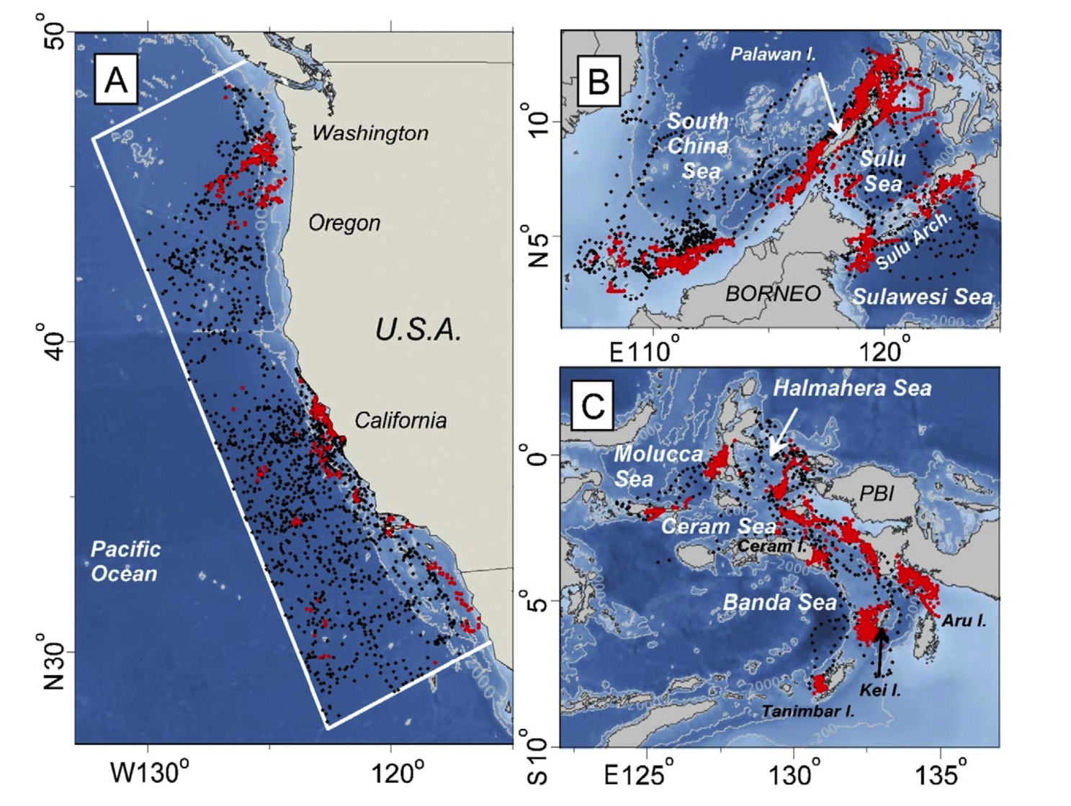
Leatherback telemetry locations with foraging behavior (red dots) and transit behavior (black dots) relative to bathymetry in high-use areas

Slide 12
Summary
There is little to no overlap between ‘eastern’ and ‘western’ Pacific leatherback stocks
Western Pacific leatherbacks use the entire North Pacific for foraging
Foraging in U.S. waters is seasonal
Foraging in the western Pacific, and South China Sea is year-round

Slide 13
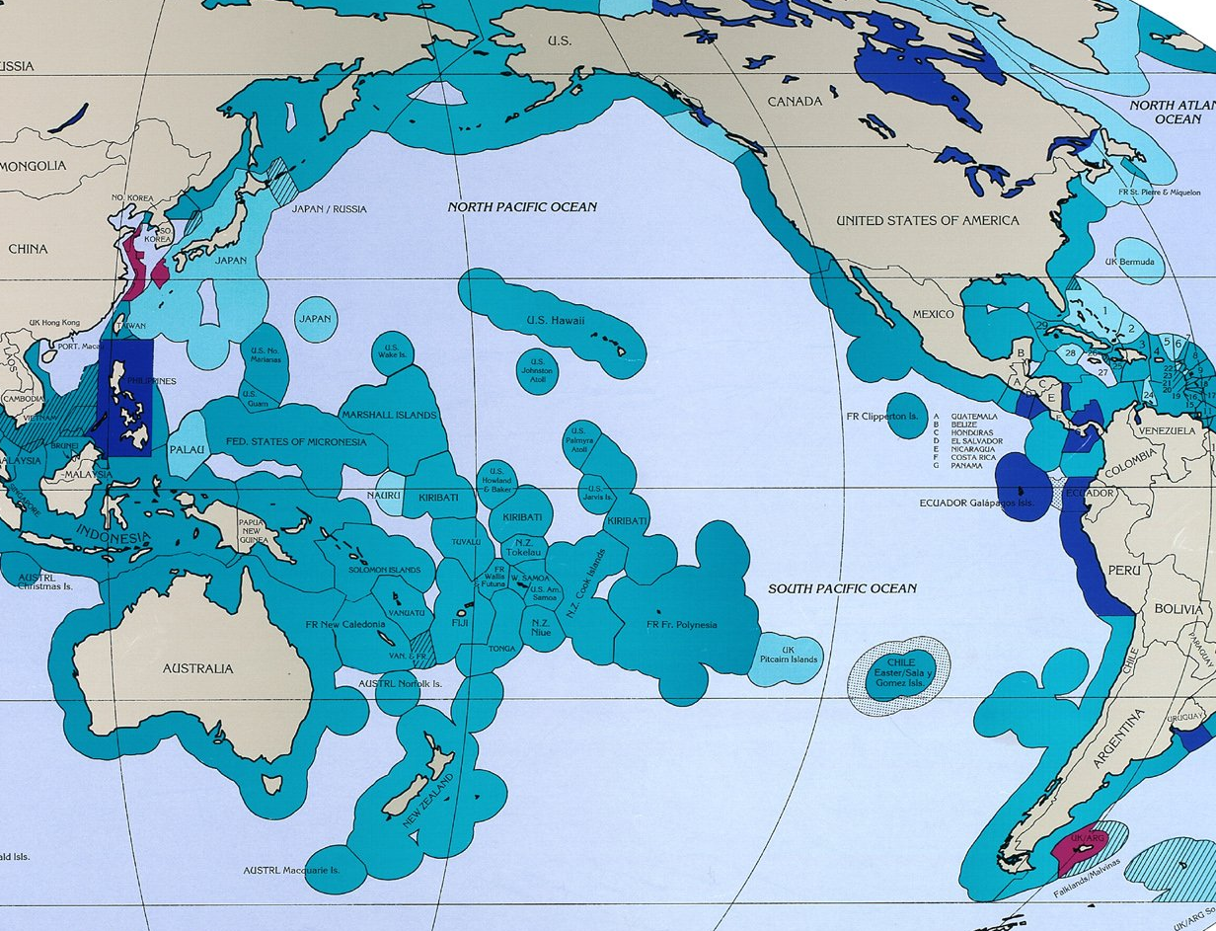
Densidad ‘Kernel’ de los avistamientos de la tortuga amarilla
Economic Exclusive Zones of the Pacific

Slide 14
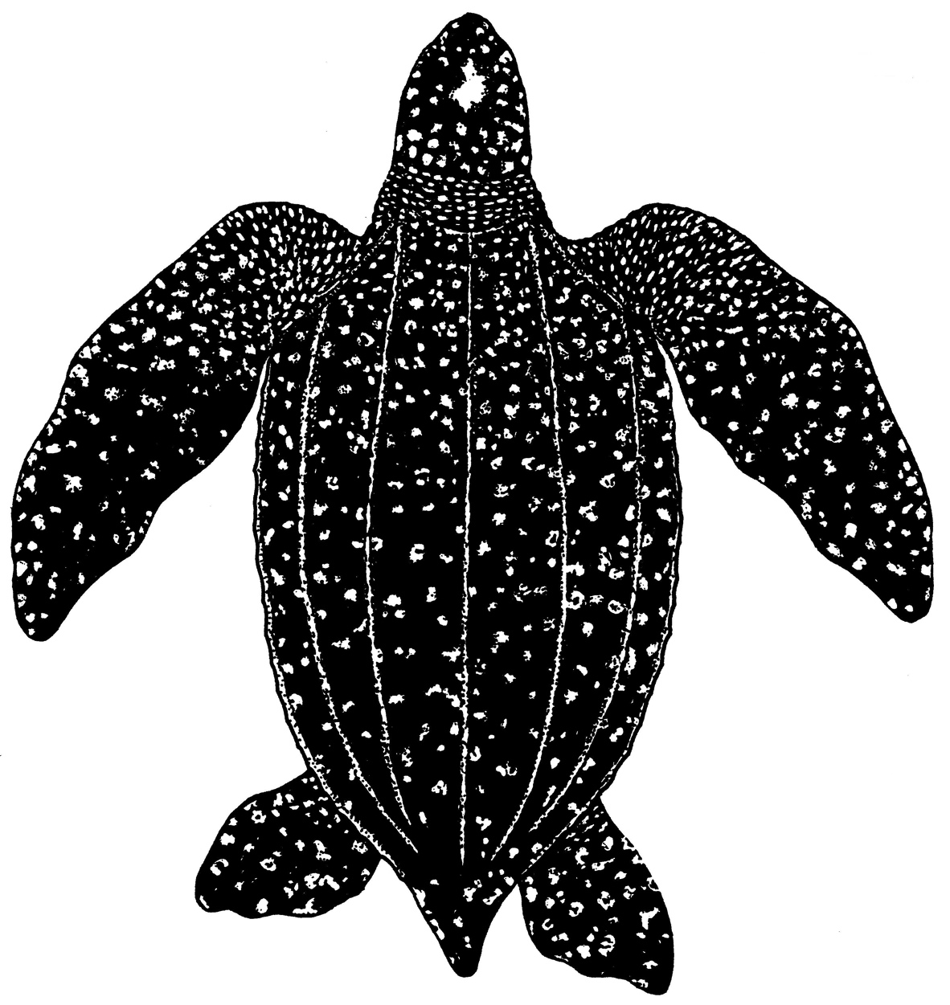


Pacific Leatherbacks
a shared resource between China and the United States

Slide 15
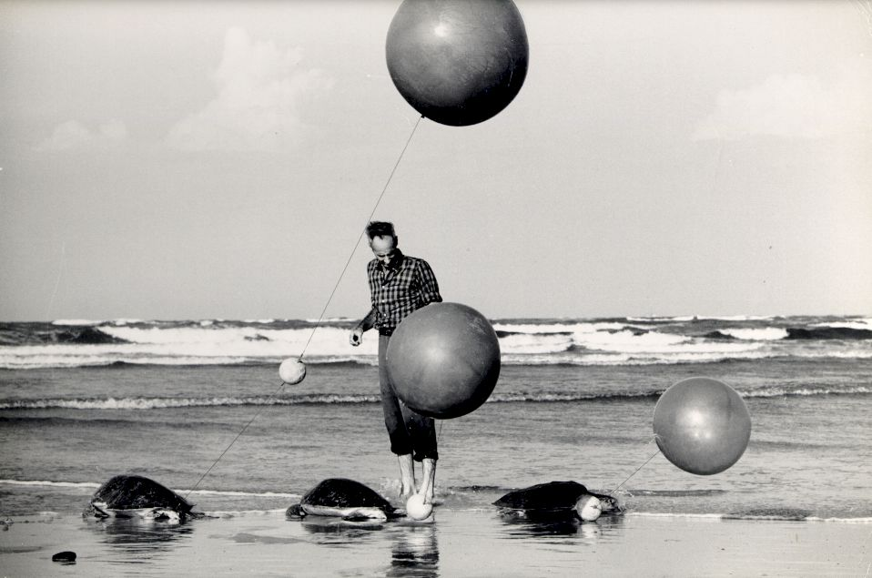

Sea turtle tracking before satellites
Archie Carr
(1909-1987)

Slide 16
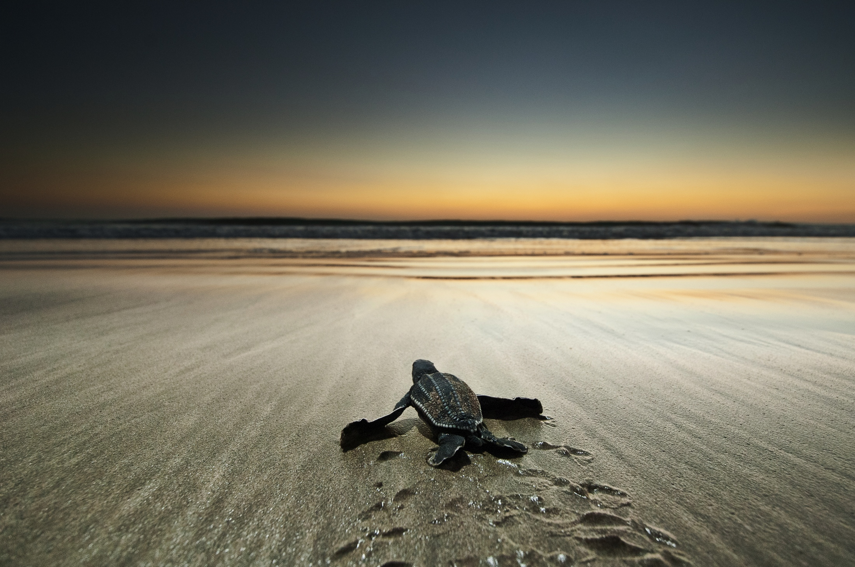
Sea turtle conservation will continue to rely on local, national, and international cooperation to combat the myriad of human impacts
XIE XIE

Slide 17
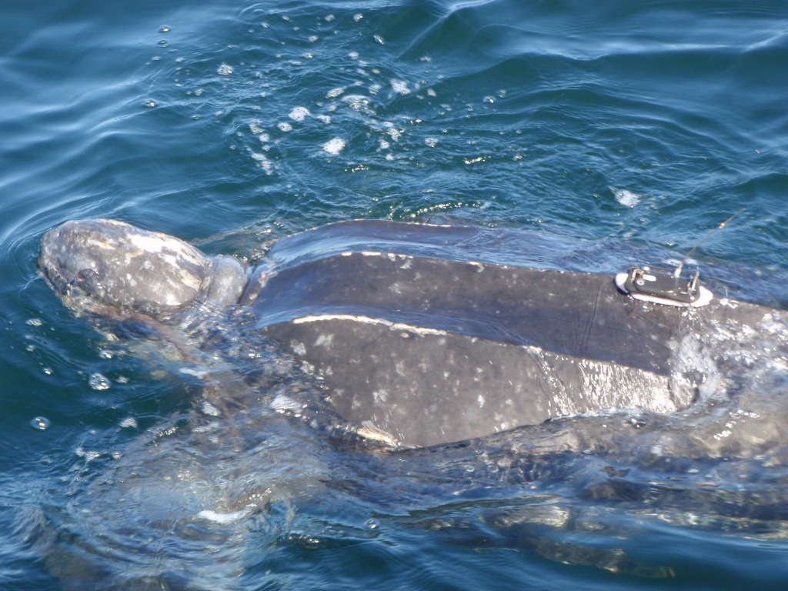

Slide 18
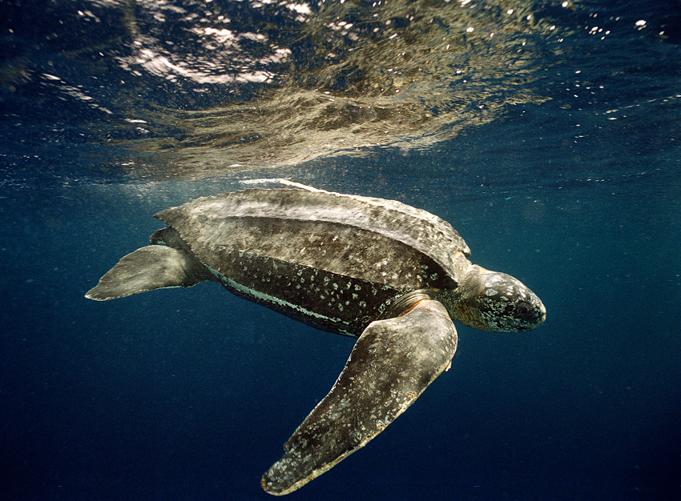
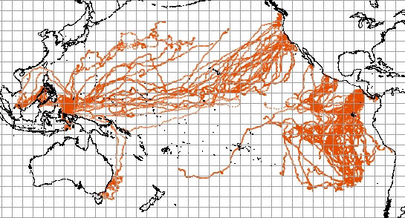
Dermochelys coriacea
258 satellite tracked turtles
Multiple foraging hotspots in eastern Pacific
Minimal overlap of EP and WP nesters in foraging grounds
Distinct E / W nesting stocks based in mtDNA
Largest rookery at Jamursba Medi, Indonesia (~200 turtles/yr)

