Slide 1
NOAA and the National Marine
Fisheries Service
Stewardship of Living Marine Resources for the 21st Century
Ned Cyr, Ph.D., Director
Office of Science and Technology
Notes:
Brief overview of U.S. responsibilities and activities in LMR science and management

Slide 2
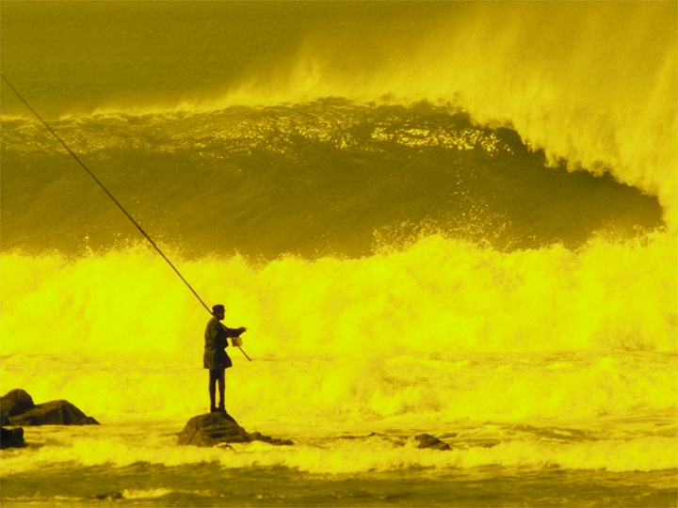
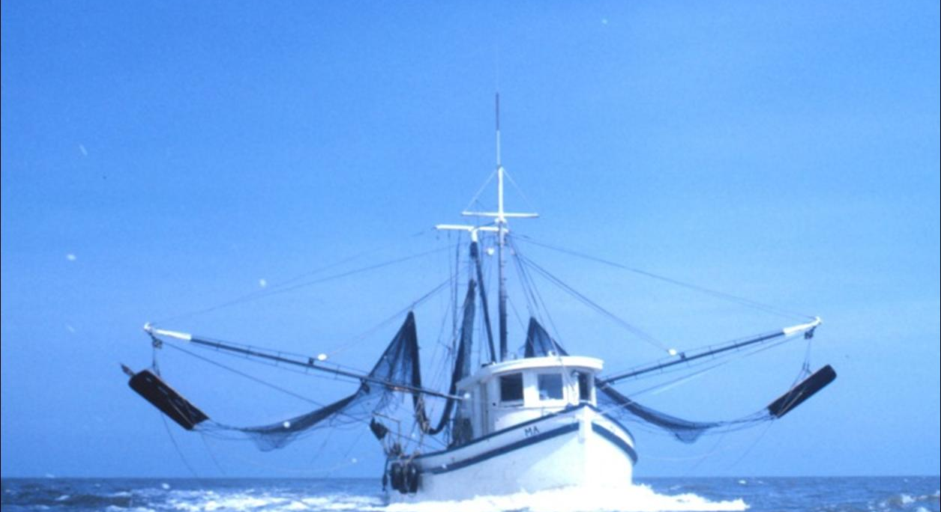
Mission and Vision
The American people enjoy the riches and benefits of healthy and diverse marine ecosystems
Stewardship of living marine
resources and the promotion of
healthy ecosystems through
science-based conservation and management
Notes:
NOAA’s mission of science, service, and stewardship is directed to a vision of the future where societies and their ecosystems are healthy and resilient in the face of sudden or prolonged change.
NOAA’s vision: Resilient ecosystems, communities, and economies can maintain and improve their health and vitality over time by anticipating, absorbing, and diffusing change. This vision of resilience will guide NOAA and its partners in a collective effort to reduce the vulnerability of communities and ecological systems in the short-term, while helping society avoid or adapt to long-term environmental, social, and economic changes.

Slide 3
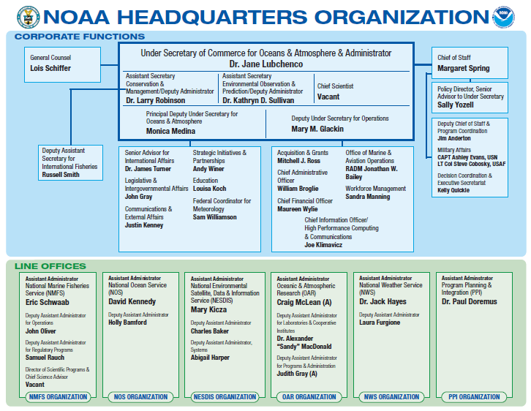
Notes:
Just to provide some context, this is the Organizational chart for NOAA.
NOAA is an approximately $4.5B agency with >13,000 employees, that comprises half of the budget of the DOC.

Slide 4
NOAA Fisheries Service Organization
Assistant
Administrator
Eric C. Schwaab
Director of International Affairs
Dr. Rebecca Lent
Deputy Assistant Administrator
for Regulatory Programs
Samuel Rauch
Director of Science Programs & Chief Science Advisor
Dr. Sam Pooley
(Acting)
Deputy Assistant
Administrator for Operations
John Oliver
Northeast
Regional Office
Pat Kurkul
Sustainable Fisheries
Emily Menashes
(Acting)
Northeast
Fisheries Science Center
Frank Almeida (Acting)
Science & Technology
Dr. Ned Cyr
Protected Resources
Jim Lecky
Law Enforcement
Alan Risenhoover
(Acting)
Management
and Budget
Gary Reisner
Pacific Island Fisheries Science Center
Dr. Sam Pooley
Southeast
Regional Office
Dr. Roy Crabtree
Southeast
Fisheries Science Center
Dr. Bonnie Ponwith
Northwest
Regional Office
Will Stelle
Habitat Conservation
Pat Montanio
Office of Policy
Dr. Mark Holliday
Chief Information
Officer
Larry Tyminski
Alaska Fisheries Science Center
Dr. Douglas Demaster
Northwest
Fisheries Science Center
John Stein
(Acting)
Aquaculture Program
Dr. Michael Rubino
Southwest
Regional Office
Rod Mcinnis
Seafood Inspection
Tim Hansen
EEO/Diversity
Natalie Huff
Southwest
Fisheries Science Center
Cisco Werner
Alaska Regional Office
Dr. Jim Balsiger
Pacific Island Regional Office
Michael Tosatto
Notes:
6/13/2011
4
This is the Org Chart for the National Marine Fisheries Service, or NOAA Fisheries.
3 major parts
Designed so that science and management are separate components. NMFS is a science-based organization. The management side may inform science of its information needs, but not the outcomes it wishes to have.
Budget is approximately $1B.

Slide 5
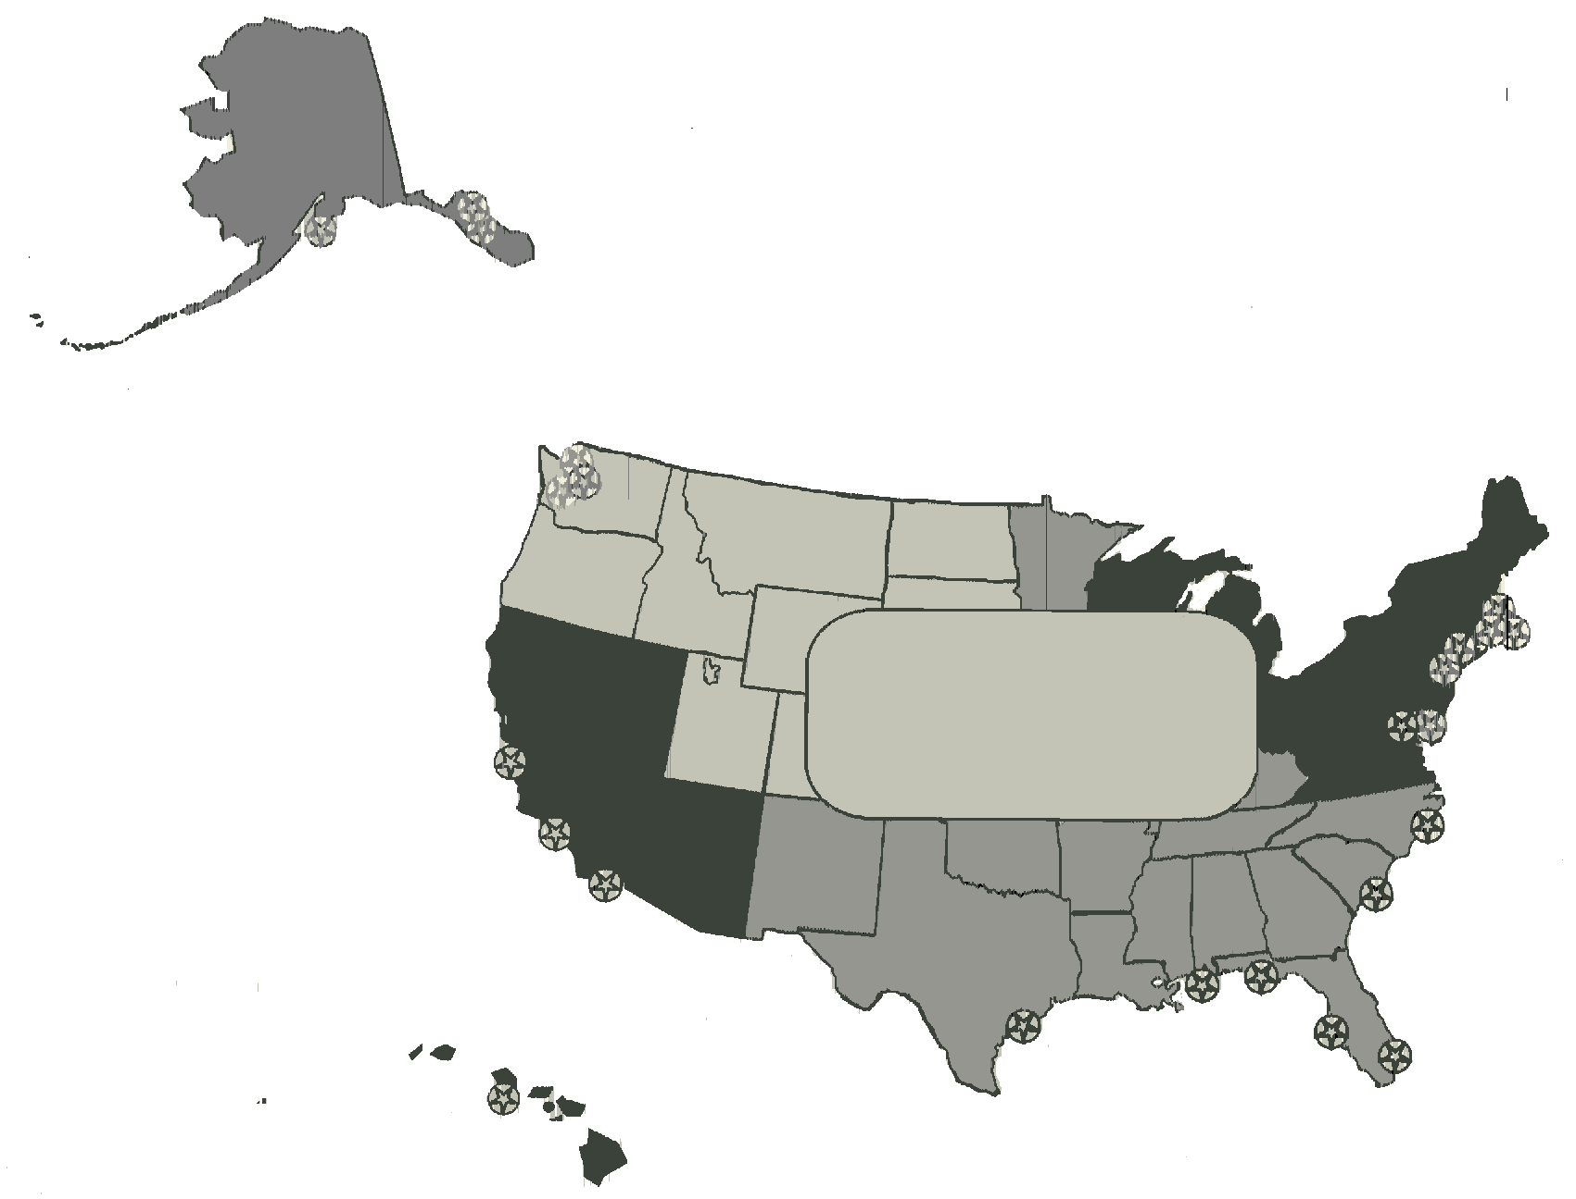
NOAA Fisheries Service
Organization
Alaska Region
Regional Office: Juneau, AK
Science Center: Seattle, WA (Sand Point)
Laboratories
Seattle, WA
Auke Bay, AK
Kodiak, AK
Lena Point, AK
Northeast Region
Regional Office: Gloucester, MA
Science Center: Woods Hole, MA
Laboratories
Woods Hole, MA
Narragansett, RI
Milford, CT
Highlands, NJ
Washington, DC
Northwest Region
Regional Office: Seattle, WA
Science Center: Seattle, WA
Laboratories
Seattle, WA
Newport, OR
Manchester, WA
Pasco, WA
NOAA Fisheries
Field Structure
Headquarters
Silver Spring, MD
Southwest Region
Regional Office: Long Beach, CA
Science Center: La Jolla, CA
Laboratories
La Jolla, CA
Santa Cruz, CA
Pacific Grove, CA
Southeast Region
Regional Office: St. Petersburg, FL
Science Center: Miami, FL
Laboratories
Miami, FL
Beaufort, NC (shared with NOS)
Panama City, FL
Pascagoula, MS
Galveston, TX
Pacific Islands Region
Regional Office: Honolulu, HI
Science Center: Honolulu, HI
Laboratory: Honolulu, HI
Notes:
6 regions
In each region, a pair of offices, one for science, one for management. Many subsidiary labs.

Slide 6
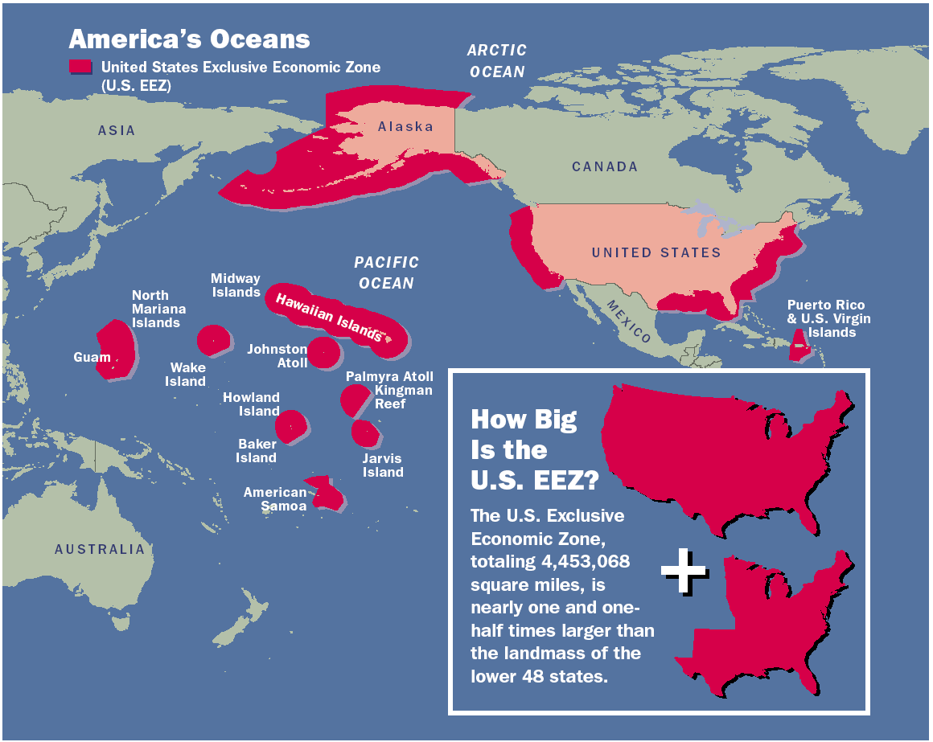
NMFS Jurisdiction
+ Great Lakes
+ additional responsibilities
in international waters

Slide 7
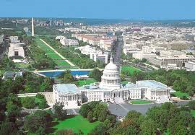
Major Legislative and Policy Mandates
Magnuson-Stevens Fishery Conservation and Management Act (MSA)
Endangered Species Act (ESA)
Marine Mammal Protection Act (MMPA)
National Environmental Policy Act (NEPA)
Oil Pollution Act (OPA)
National Ocean Policy
NOAA Aquaculture Policy

Slide 8

Why the NOAA Fisheries Service is Important?
Economic Development: Commercial & Recreational Marine Fisheries Contributed Over $72 billion Annually to the GNP in 2009
  Generates $166 billion in sales impacts
  Supports over 1.3 million jobs economy-wide
Protection and sustainability of Living Marine Resources through ecosystem-based management
Protection and restoration of ocean & coastal habitats
Conduct scientific research to inform societal decision making

Slide 9
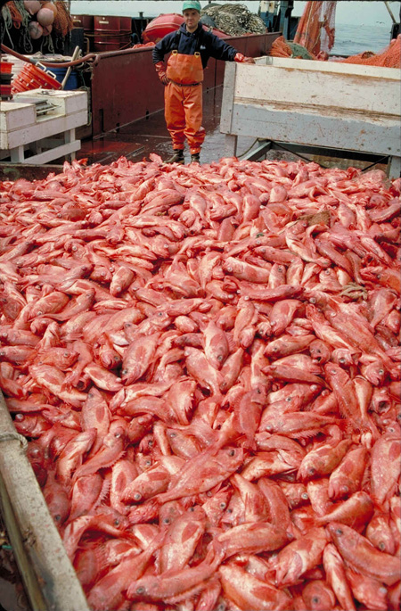
Major U.S. Living Marine
Resources Issues
Ensuring Sustainable Seafood
  Fisheries – end overfishing, establish catch
  limits, reduce bycatch
  Aquaculture
Protecting Threatened & Endangered Species
Protecting & Restoring Coastal Habitats
Seafood Safety/Health
  Deep Water Horizon
  Seafood Inspection
Climate change
Supporting Coastal Communities
9
Notes:
Sustainable fisheries includes:
Ending Overfishing
Establishing Annual Catch Limits
Improve Data, recreational Registry
Reducing Bycatch
Global trade stats
84% of seafood in U.S. is imported
Seafood trade deficit $10 billion
International Cooperation
• Work with other Federal agencies to establish a coordinated, consistent, and
comprehensive international strategy on sustainable marine aquaculture that supports and
is consistent with U.S. policies and priorities regarding food security, international trade,
healthy oceans, and economic well-being.
• Work with other nations, as appropriate, to adopt sustainable aquaculture and seafood
safety approaches using the best practices.
• Exchange scientific insights with other nations and promote joint participation in
cooperative research that is of potential multinational value, including addressing impacts
of aquaculture that breach international boundaries.

Slide 10
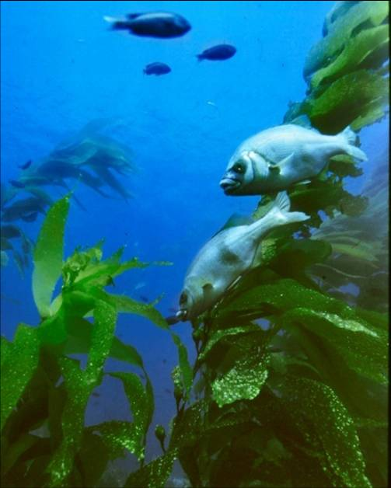
NOAA Fisheries Program Areas
Sustainable Fisheries
Protected Resources
Habitat Conservation
Aquaculture
Enforcement
Science and Technology
International
Notes:
These are our major programs or offices.
I’m the Director for Science and Technology
Let me briefly describe some activities and priorities in each of these areas

Slide 11
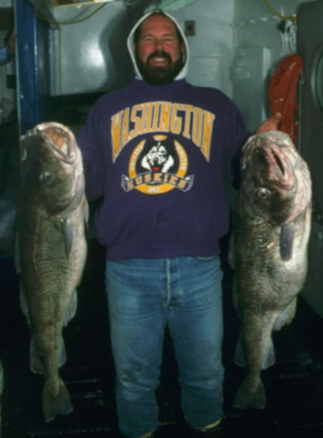
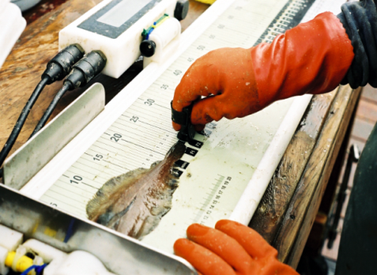
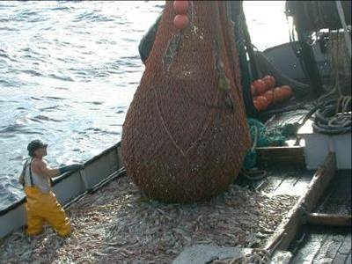
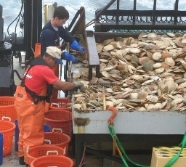
Sustainable Fisheries
Management of the Nation’s Marine Fisheries
Ending Overfishing and Rebuilding Fish Stocks
Support for 8 Regional Fishery Management Councils
46 Fishery Management Plans
528 regulated stocks
Notes:
Annual Catch Limits
Catch Share Programs
New England Groundfish
Disaster Program Assistance

Slide 12
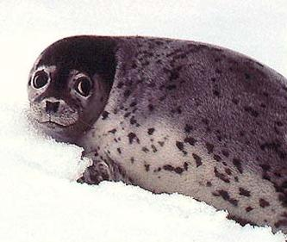
Protected Resources
1,955 Species listed in U.S. under Endangered Species Act
73 Species Listed as Endangered or Threatened under NOAA Jurisdiction
165 Marine Mammal populations protected by Marine Mammal Protection Act
19 Marine Mammal populations Listed as Depleted under NOAA Jurisdiction (special protection)
Notes:
Picture: Spotted Seal
There are 16 Depleted Marine Mammals Under US Jurisdiction:
beluga whale, blue whale, bottlenose dolphin, bowhead whale, fin whale, Hawaiian monk seal, humpback whale, killer whale (2 stocks), Northern fur seal, North Atlantic right whale, North Pacific right whale, sei whale, sperm whale, spinner dolphin, spotted dolphin, Steller sea lion (2 stocks).

Slide 13
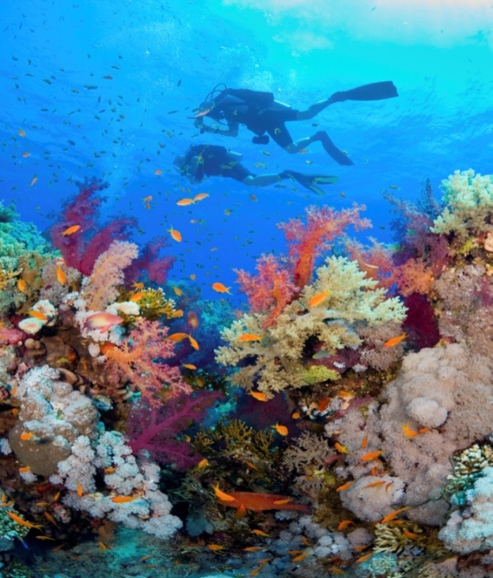
Habitat
Habitat Protection
  Coral Conservation
  Rivers -- Fish Passage
  Wetlands, Estuaries, and
  Essential Fish Habitat
Habitat Restoration
  Community Based Restoration
  Damage Assessment, Remediation and Restoration
  Coastal Wetlands Planning and Protection Act
Notes:
Restoration: one clear example is the impact of the DWH spill. NOAA serves as the steward of habitat and must ensure that it is restored after the oil spill.

Slide 14
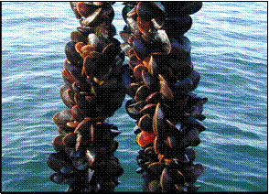
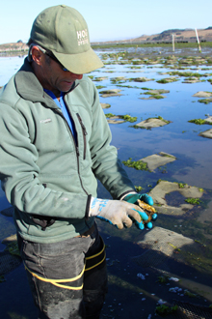
Marine Aquaculture
Establish Regulations/Policy
Conduct Outreach & Education
International cooperation
Science & Research
  Support regulatory and policy decisions
  Innovation and technology development
  Effects of changing ocean conditions
  Develop Alternative Feeds
  Modeling
NOAA Aquaculture Policy (released June 2011)
  Support sustainable aquaculture
  Create jobs and business opportunities
Notes:
NOAA is lead agency for U.S. marine aquaculture.
A key partner is the U.S. Department of Agriculture
We recognize this is an important issue for China and an important bilateral topic for us.

Slide 15
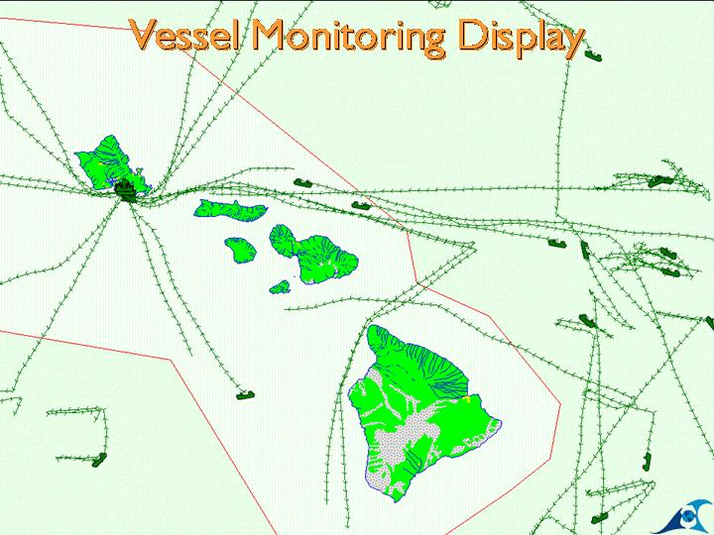
Enforcement
Patrols & Inspections
Investigations (U.S. and international)
27 State Cooperative Enforcement Partnerships
Coordination with U.S. Coast Guard
Nationwide Satellite Vessel Monitoring System (VMS)
View of Fishing Vessel Satellite tracks around the Hawaiian Islands through the Enforcement VMS .
National Marine Fisheries Service (NMFS): Stewardship of Living Marine Resources for the 21st Century
15
Notes:
Living Marine Resource Management is only as good as our ability to enforce regulations.
NOAA Enforcement monitors 6,240 Vessels, uses the data to assure compliance and provides data to the US Coast Guard, NOAA scientists, and fisheries managers.
The NOAA Office of Law Enforcement is accredited by and under the standards of the Commission on Accreditation for Law Enforcement Agencies (CALEA). The Commission's standards represent and are widely recognized as the best practices for law enforcement agencies management and operations both nationally and internationally.

Slide 16
Scientific Research
Living Marine Resource Surveys
  Fish Stock, Protected Resources, Habitat
Stock Assessments
Ecosystem Approaches to Management
  Integrated ecosystem assessments, ecosystem modeling, incorporating climate into fisheries forecasts
Advanced Sampling Technology
  Implementation of advanced acoustics, autonomous undersea vehicle and unmanned aerial vehicles
Fishery-dependent Data Collection
  Observers
  Landings statistics (commercial and recreational)
Notes:
Nine dedicated surveys vessels including our newest generation of 63m, quiet RVs.

Slide 17
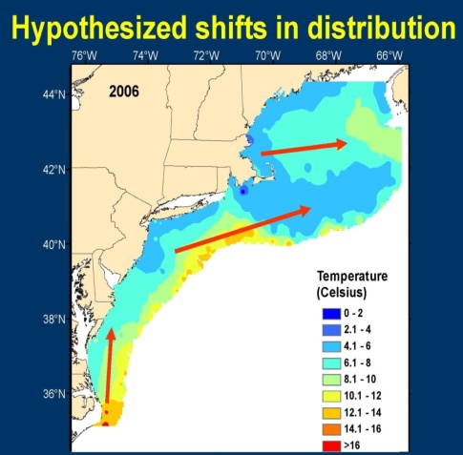
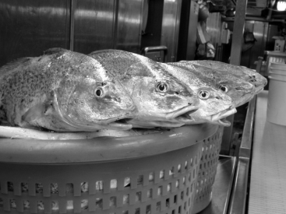
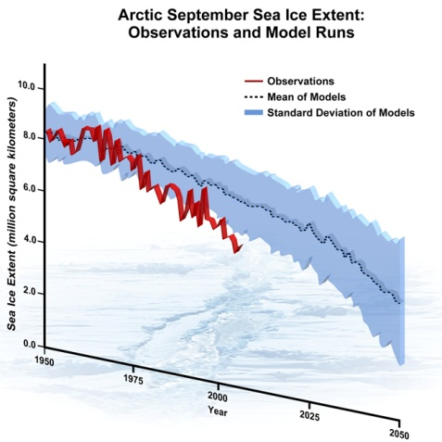
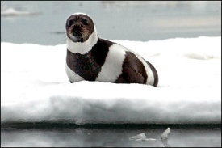
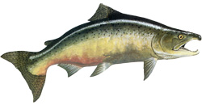
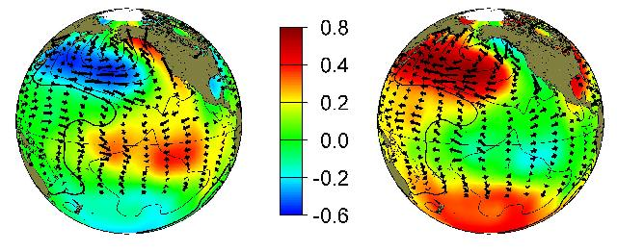
Climate Concerns
Ocean warming: impacts on ocean conditions, productivity, species distribution, abundance & phenology.
Loss of sea ice: impacts on living marine resources at both poles.
Sea level rise: direct and indirect impacts on coastal habitats and marine resources.
Ocean acidification: impacts on marine biota
Precipitation Changes: impacts on quantity, quality and timing of freshwater supply.
Attribution of climate signals: long term change vs. natural variability
Pacific Decadal Oscillation
warm
cool
Notes:
Images:
1. Hypothesized shifts in distribution of NE fish stocks from Nye, Hare et al.
2. Atlantic Croaker – one of the many NE fish stocks that have already shifted distribution northward (and depth) with shifting ocean temperature clines (as predicted)
3. Ribbon Seal
4. Loss of Arctic sea ice
5. Pacific Decadal Oscillation:
Typical wintertime patterns during warm & cool phases for:
Sea surface temperature (colors)
Sea level pressure (contours)
Surface windstress (arrows)

Slide 18
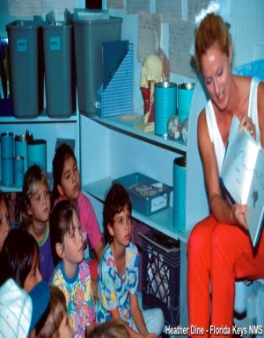
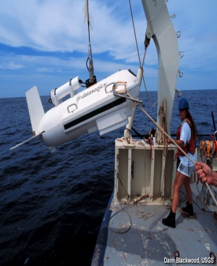
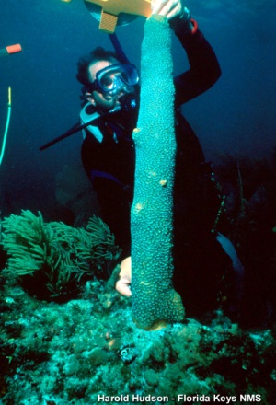
Marine Protected Areas (MPAs)
NOAA-National Ocean Service (NOS)
MPA Monitoring and Evaluation
  NOS- Office of National Marine Sanctuaries
  MPA Center
Capacity Building on MPAs
  MPA Capacity Building Programs
  APEC Research and Training Center in Xiamen
  Exchanges and Sistership agreements
  Collaboration with international agencies and programs (e.g., IUCN-World Commission on Protected Areas
Notes:
NOAA is one of the lead agencies in the US for the conservation of important marine species and ecosystems through marine protected areas.
Within the National Ocean Service, one of the main line offices of NOAA, the Office of National Marine Sanctuaries (ONMS) serve as the trustee for the nation's system of marine protected areas, to conserve, protect, and enhance their biodiversity, ecological integrity and cultural legacy.
The National MPA Center works in partnership with federal, state, tribal, and local governments to develop and implement a science-based, comprehensive national system of MPAs.
On capacity building, there are several activities that NOS has developed in the last years, including:
A comprehensive program for MPA capacity building, which has been implemented in several countries and region and in different languages, including some programs in China.
This capacity building program, along with other training programs of NOAA, will support the Pacific-region training activities of the APEC Research and Training Center for Marine Biodiversity and Conservation, which soon will be inaugurated this year in (Xiamen) China by SOA.
Also, NOAA has promoted the exchanges of technical personnel between MPAs with different countries worldwide
NOAA has also collaborated closely with international agencies to develop training and outreach materials and guidelines on MPA management effectiveness. This includes IUCN manuals on evaluation indicators, socioeconomic monitoring, and establishment of MPAs.
Please contact our colleagues from the International Program Office of the National Ocean Service for more information on this specific topic.

Slide 19
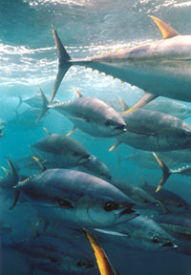
International Fisheries Activities
Represent the U.S. at regional fisheries management organizations and other scientific and management bodies
Secure equitable access for the U.S. to shared fish resources
Combat illegal, unregulated, or unreported (IUU) fishing
Reduce the international bycatch of protected marine resources
Maintain bilateral agreements with other countries (China, Canada, Norway, Russia and others)
Notes:
Picture: Bluefin Tuna

Slide 20
Contact
Dr. Ned Cyr, Director
NOAA Fisheries, Office of Science & Technology
1315 East West Highway
Silver Spring, MD 20910
Telephone: (301) 427-8100
Fax: (301) 713-1875
Email: ned.cyr@noaa.gov
Website: www.noaa.gov

