Slide 1
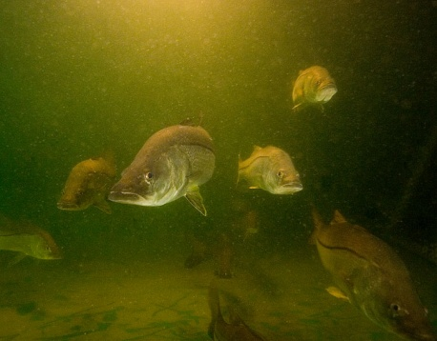
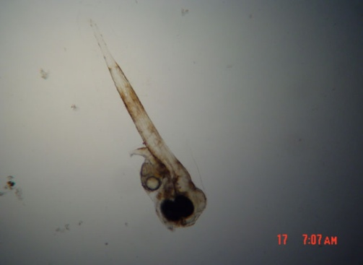
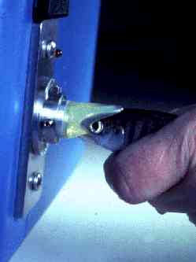
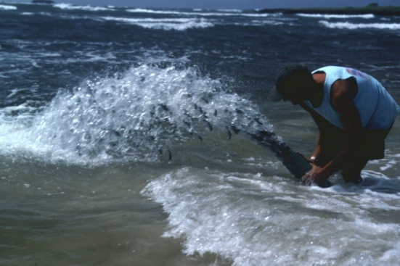
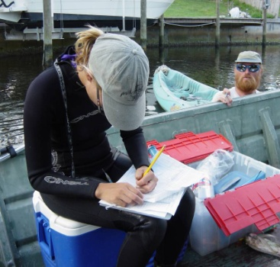


Theme 4. Stock Enhancement
Introduction
US Perspective on History, Pitfalls and Progress
Kenneth M. Leber

Slide 2
As population growth continues to increase, how will we sustain fisheries?
Harvest Management: Control fishing catch & effort – seasonal closures, size and catch limitations, area closures, incentives (catch shares), number of angler licenses (limited entry), spatial planning
Habitat Management: We can identify, protect and restore essential habitat – EFH, MPAs, spatial planning, habitat restoration, artificial reefs
Marine Fisheries Enhancement: Fishery managers can boost abundance by stocking hatchery-reared fish to increase the number of young fish (new recruits) in the population – in certain situations

Slide 3
Coupling Fisheries Management and Aquaculture
3rd ISSESR
Marine fisheries enhancement – Types:
  Stock Enhancement: release of cultured organisms into wild populations to increase the natural supply of juveniles
  Restocking: release of cultured organisms into wild populations to help rebuild depleted wild stock to higher abundance
  Sea Ranching: release of cultured juveniles into the ocean for harvest at a larger size (put-grow-take)
(Bell et al., 2008. Reviews in Fisheries Science, 16(1):1-9)

Slide 4
Historical Background: Evaluation of Marine Stock Enhancement
Early Constraints to Successful Enhancement
  Aquaculture constraints
  Assessment constraints
Pioneering Work to Quantify Stocking Effects
  Tsukamoto; Kitada; Tanaka; Yamashita; colleagues in Japan
  Svåsand, Jørstad, Kristiansen and colleagues in Norway
  Polovina; Stoner; Willis; Kent; Leber; Blankenship; Smith; et.al. in US
  Bannister and colleagues in the UK
  Støttrup and colleagues in Denmark
  Bell in Solomon Islands
  Rimmer, Russell and colleagues in Australia
Recent Approach
  Improved Experimental Design
  Comprehensive Assessment Efforts
1880’s – 1980’s
1990’s
2000’s

Slide 5
Science & Fishery Perspective-Driven Policy Development
New research in early 1990’s generated WAS & EAS special sessions at their annual conferences -- on marine stock enhancement
International Working Group on Stock Enhancement formed in 1993 in Spain
  Platform Paper: Responsible Approach
    Presented at 1994 AFS Symposium
International Symposium on Stock Enhancement and Sea Ranching (ISSESR): every 4-5 years
  Norway-1997, Japan-2002, US-2006, China-2011, (Australia-2015...)

Slide 6
“A Responsible Approach to Marine Stock Enhancement” *
(Spawned by Lee Blankenship, Devin Bartley, Don Kent, Ken Leber, Stan Moberly, Terje Svåsand, Katsumi Tsukamoto [and Rich Lincoln])
Stay Within Context of Fisheries Management Plan:
  1. Prioritize Species for Enhancement
  2. Make Stocking Plan that Fits with and Helps Achieve the Goals of the Fishery Management Plan and Identify the Expectations
Develop Sound Enhancement Strategy:
  3. Define Quantitative Measures of Success
  4. Use Genetic Resource Mgmt. to Prevent Deleterious Effects
  5. Use Disease and Health Management
  6. Consider Ecological, Biological, & Life-History Patterns
  7. Identify Hatchery Fish & Assess Stocking Effects
  8. Use an Empirical Process to Define Optimal Release Strategies
  9. Identify Economic & Policy Guidelines
  10. Use Adaptive Management
  (* Blankenship & Leber, 1995. Am. Fish. Soc. Symposium 15:67-175)
  PDF is online at www.StockEnhancement.org/science/publications.html
Notes:
6

Slide 7
Science & Fishery Perspective- Where Hatcheries Can Go Wrong
Replacement of wild with hatchery recruits, with no net increase in total stock
Unregulated fishing effort responses to presence of hatchery fish can cause overfishing of wild stock
“Overexploitation” of forage resource base for the stocked species
Genetic impacts on the long-term viability of the wild stock
Stress that it is critical to monitor the impacts of enhancement as the program develops to have evidence in hand if debate about effectiveness surfaces
(Carl Walters & Steve Martell, 2004)

Slide 8
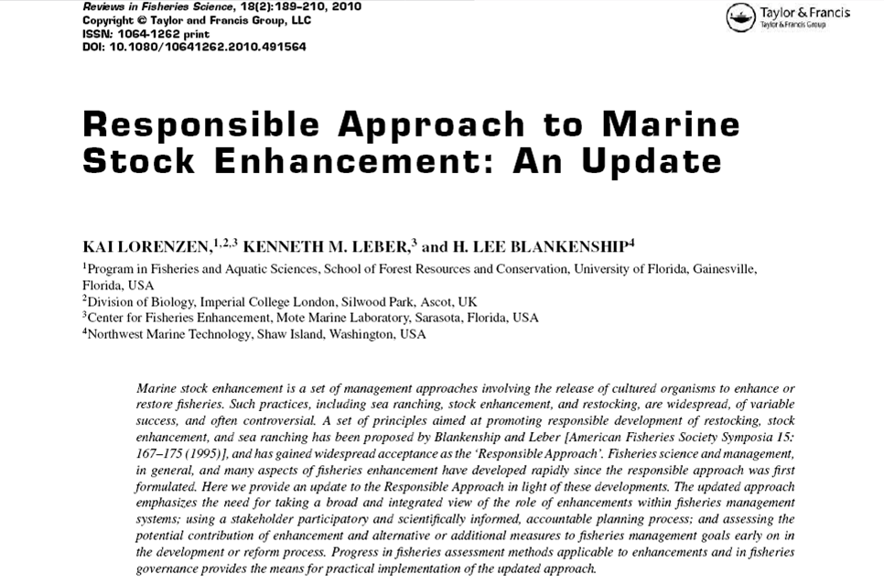
Updated “Responsible Approach to Marine Stock Enhancement” *
(Lorenzen, Leber, and Blankenship. 2010. Rev. Fish. Sci. 18(2):189-210)
Notes:
8

Slide 9
Most Enhancements are Weak in 5 Areas
Lack of a clear fishery-management perspective
Fishery stock assessments & modeling are integral to exploring the potential of stocking, yet both are found lacking in most stock enhancement efforts
Establishing an institutional framework for enhancements is largely ignored
Involvement of stakeholders in planning and execution of stocking programs is key from the start, but is rarely an integral part
Adaptive management is not well integrated into enhancement plans

Slide 10
Updated “Responsible Approach to Marine Stock Enhancement”
Stage 1: Initial Appraisal & Goal Setting
Understand the role of enhancement within the fishery system
Engage stakeholders & develop a rigorous decision-making process
Quantitatively assess contributions of enhancement to fisheries management goals / compare with harvest & habitat management
Prioritize and select target species and stocks for enhancement
Assess economic and social benefits and costs of enhancement
Stage 2: Research & Technology Development & Pilot Studies
Enhancement system designs suitable for fishery management objectives
Develop appropriate aquaculture systems and rearing practices
Use genetic resource management to avoid deleterious genetic effects
Use disease and health management
Ensure that released hatchery fish can be identified
Use an empirical process for defining optimal release strategies
Stage 3: Operational Implementation & Adaptive Management
Devise effective governance arrangements
Define a fisheries management plan with clear goals, measures of success and decision rules
Assess and manage ecological impacts
Use adaptive management
(Lorenzen, Leber, and Blankenship. 2010. Reviews in Fisheries Science 18(2):189-210)

Slide 11
Effect of Enhancements, harvest and habitat management should be modeled, a priori, and integrated into the decision making process
(http://www.aquaticresources.org/pubs/EnhanceFish_Manual.pdf)

Slide 12
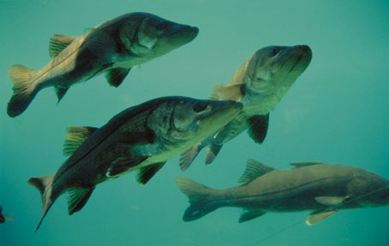
Genetic Management Is Essential
Avoid transfer of exogenous alleles
Avoid change in gene frequencies
Avoid inbreeding and outbreeding depression

Slide 13
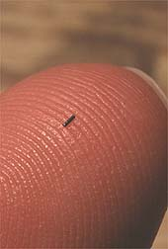
Virtually all aspects of enhancement research and management require the ability to identify released fish

Slide 14
Release Variables:
Critical Uncertainties
Critical Choices Managers of Hatchery Releases Need to Make
  Tag type, tag placement, tagged proportion
  Acclimation at release site
  Size-at-release (SAR)
  Season and tidal timing
  Release habitat/microhabitat
  Effects of interactions
  Release magnitude
Optimize Release Strategies
To Maximize Survival
Thus, use of pilot studies and adaptive management to optimize release strategies is key to understanding effects and effectiveness and efficiencies

Slide 15
Release Design
Day 1: Stocked Acclimation pens
NCO
NCL
CCL
NCM
Day 3: Released snook from acclimation pens
& also Stocked non-acclimated snook
NCO
NCL
CCL
NCM
Result: → Survival Increased ~100%
(Brennan, Darcy and Leber, 2006. J. Exp. Mar. Biol. Ecol. 16(1):1-9)

Slide 16
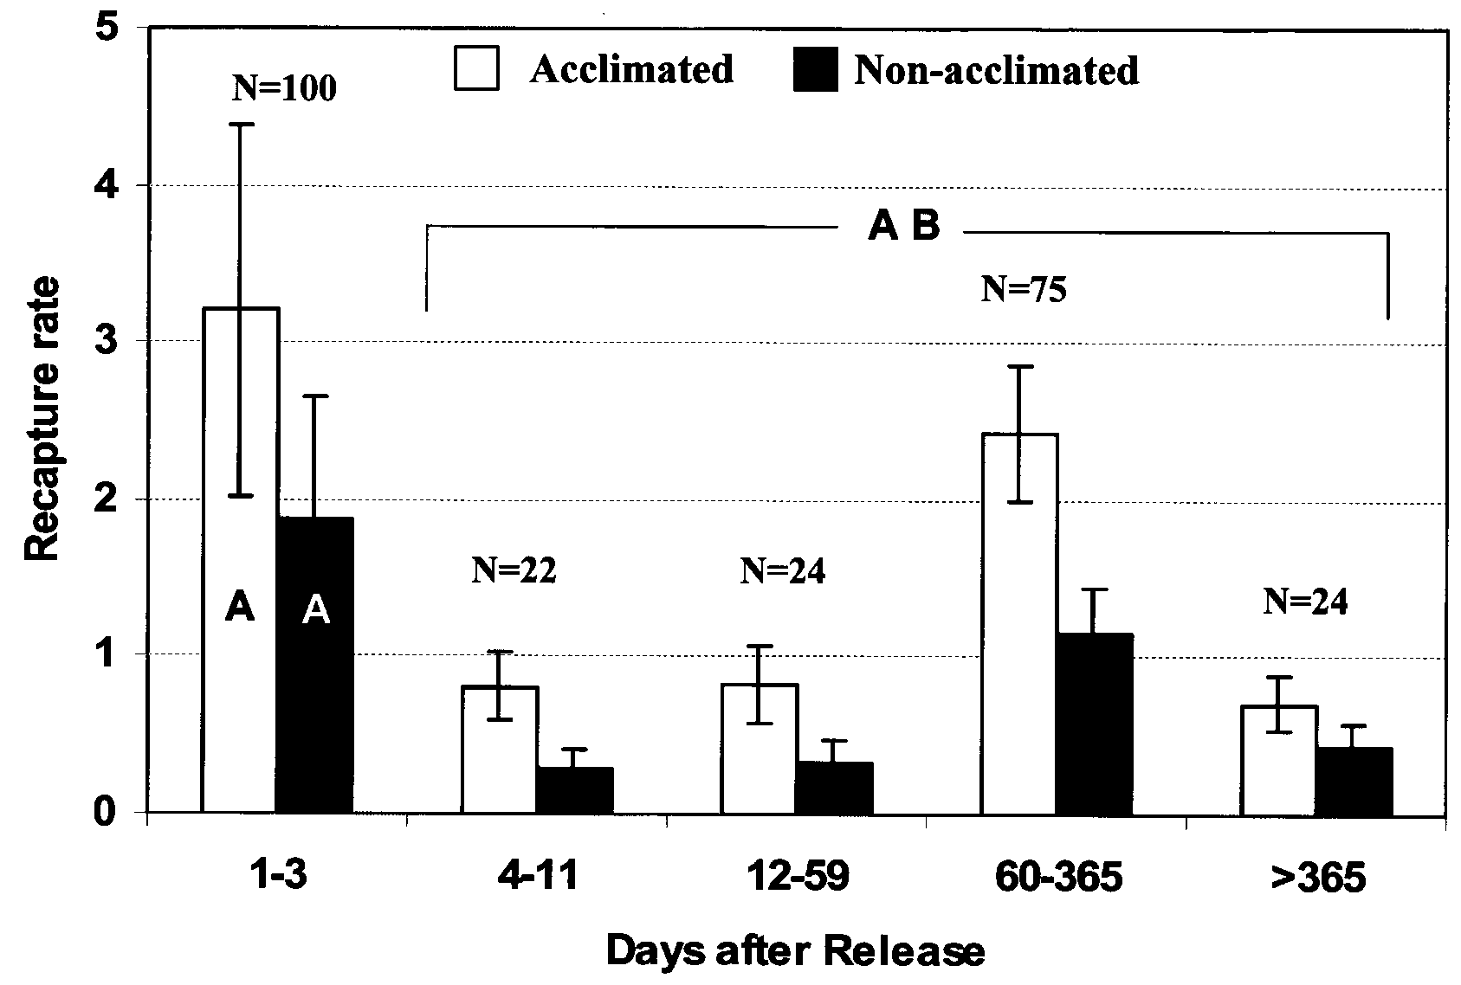
Acclimation effect on recapture rate
Of hatchery-released snook

Slide 17
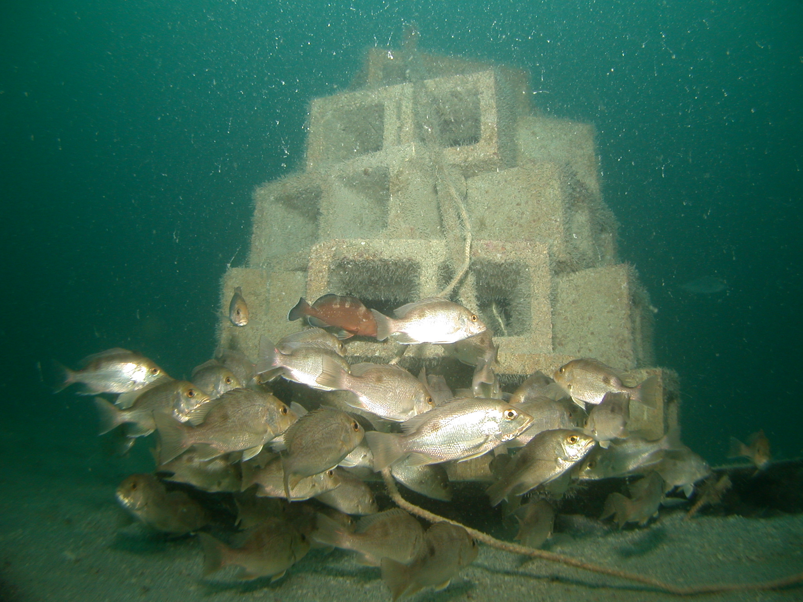
Reef Unit (no acclimation)

Slide 18
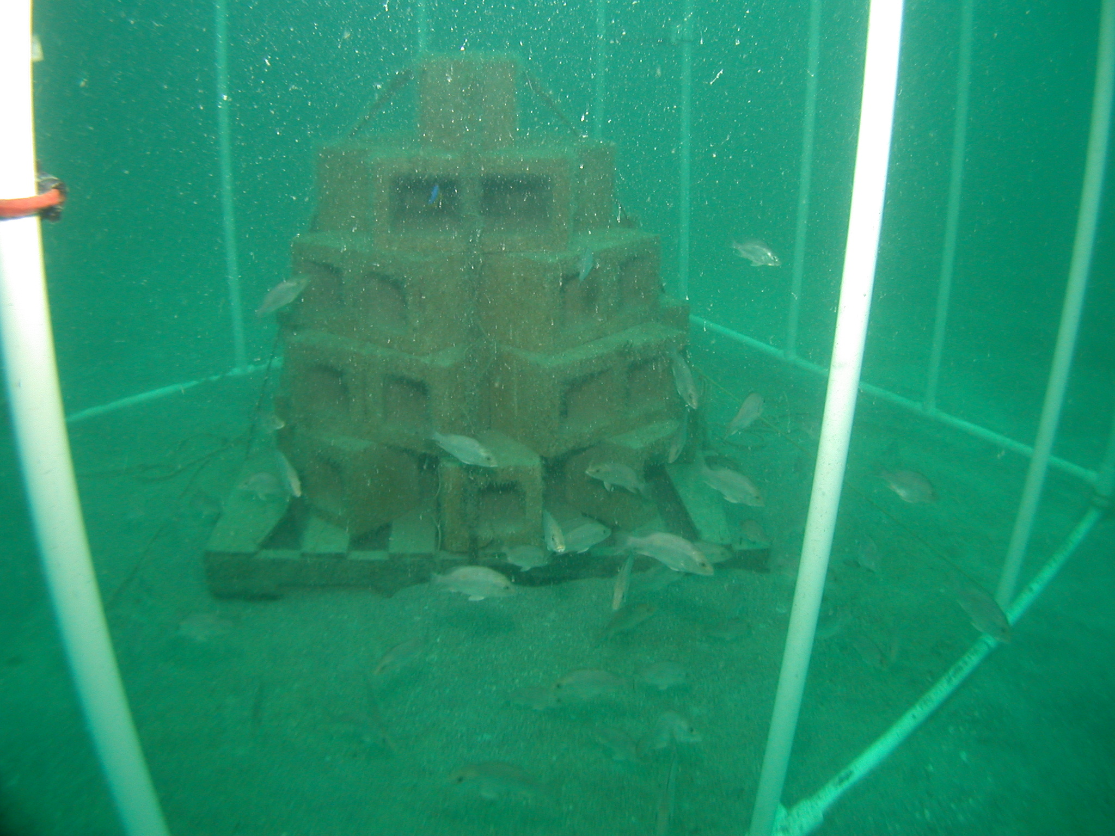
Netting Removed to Release Acclimated Fish

Slide 19
Red Snapper Recapture Rates at High Stocking Density Sites, Fall 2002

Slide 20
Pacific Threadfin in Hawaii
Releases at Kaalaea Beach
n=210
48-70 mm
Season: P < 0.007*
SAR: P < 0.001*
70-100 mm
Interact.: P > 0.085
100-130 mm
RECAPTURE FREQUENCY
n=172
n=155
SUMMER
FALL
WINTER
SEASON
Leber, K. M., N. P. Brennan and S. M. Arce. 1998. Recruitment patterns of juvenile, cultured Pacific threadfin, Polydactylus sexfilis (Polynemidae), released along sandy marine shores in Hawaii. Bulletin of Marine Science 62(2):389-408.

Slide 21
Pacific Threadfin in Hawaii
Releases at Kahana Bay
48-70 mm
Seas: P < 0.002*
n=526
70-100 mm
SAR: P = 0.392
Inter.: P > 0.006*
100-130 mm
n=277
n=276
RECAPTURE FREQUENCY
SUMMER
FALL
WINTER
SEASON
Leber, K. M., N. P. Brennan and S. M. Arce. 1998. Recruitment patterns of juvenile, cultured Pacific threadfin, Polydactylus sexfilis (Polynemidae), released along sandy marine shores in Hawaii. Bulletin of Marine Science 62(2):389-408.

Slide 22
Release Microhabitat has a Large Effect on Snook Survival; for example:
(>12 MONTHS AT SEA)
Release Site (coded wire tag info)
Notes:
22

Slide 23

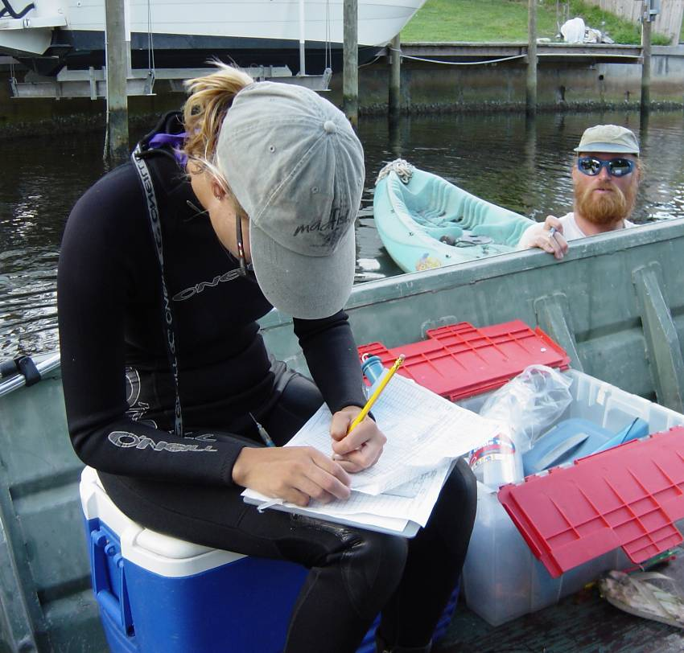
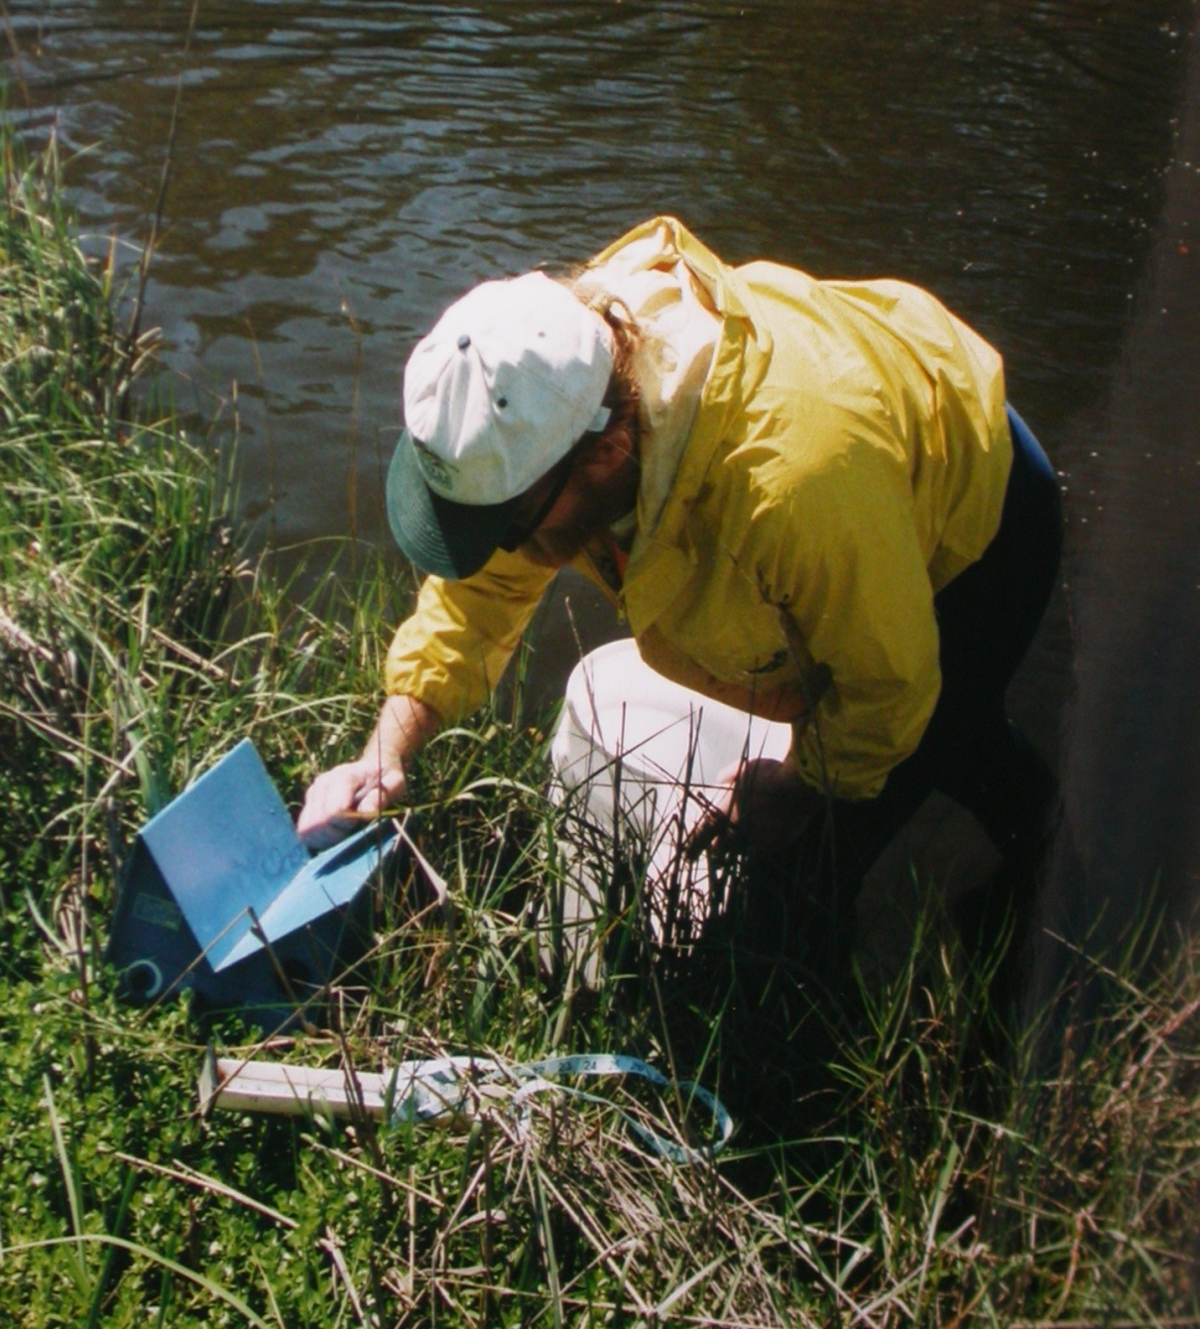
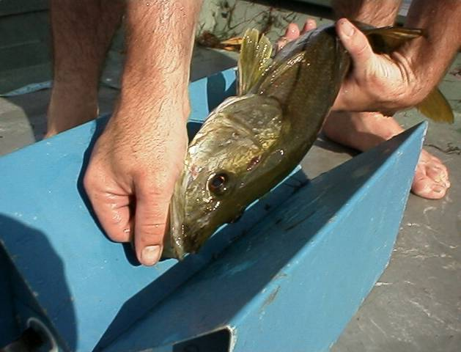
…assess enhancement
Effectiveness

Slide 24
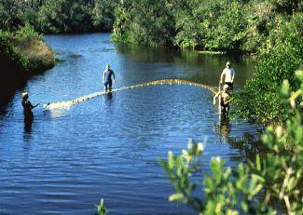
Requires evaluation of hatchery-wild interactions…
…at all three stages of developing enhancements

Slide 25
3rd ISSESR
Post-release loss
hatchery fish
~64-85%
Late
summer/fall
abundance
decline
Late
summer/fall
abundance
decline
Late
summer/fall
abundance
decline
Late
summer/fall
abundance
decline
(Brennan, N.P., C.J. Walters and K.M. Leber. 1998. Rev. Fish. Sci. 16(1-3):228-241 )

Slide 26
Adaptive Management is Crucial
Recognized “Production - Enhancement” Management Dichotomy
Management
Plan
“Adaptive”
Stocking
Impact
Assessment
Production
Production
Oriented
P.Eff.
Loop
E.Eff.
Loop
Enhancement
Oriented
Release
Strategy
Increased
Control
(Leber, 2002. Advances in Marine SE: Shifting Emphasis to Theory & Accountability. In Stickney & McVey )

Slide 27
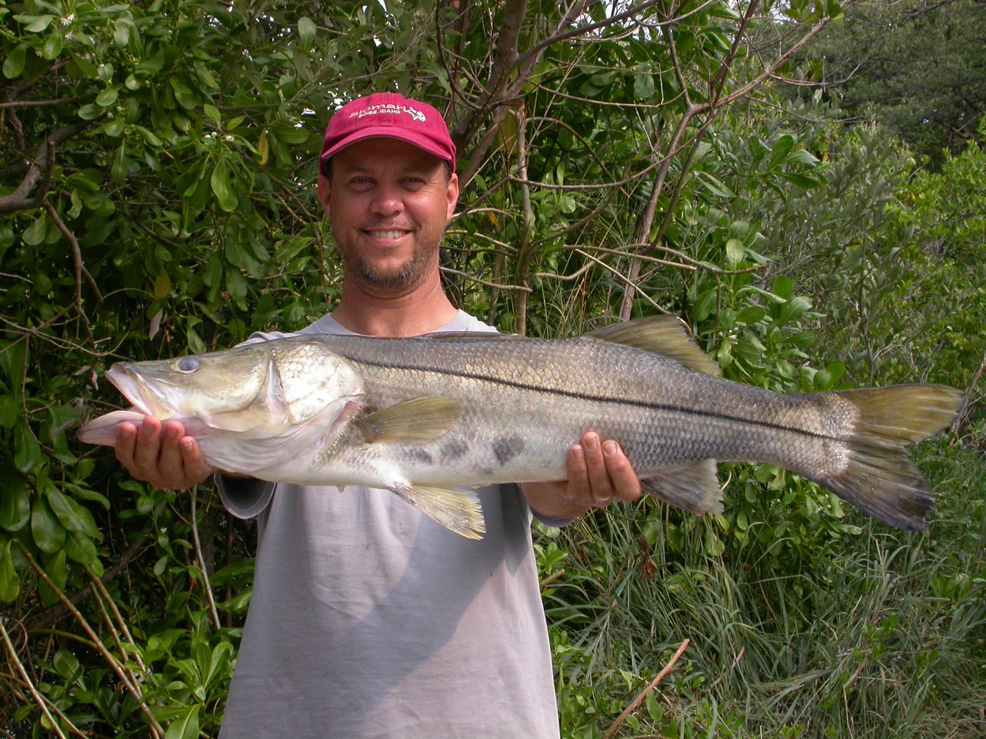
34” Hatchery Snook -- 6” when released Apr 1999 in Bowlees Creek
Caught July 2004 in Bowlees Creek

Slide 28
Legacy from the Past
Allure of a Quick Fix
  If not implemented responsibly, enhancements may lull fishery managers into false confidence
Isolation from the Fisheries Science Community
  Often run with no connection to existing fishery management process, with hatcheries isolated and operating independent from stock assessment and fisheries monitoring programs
(In: Leber, K.M., in press)

Slide 29
Enabling Factors for Expanding Successful Marine Enhancements
Greater awareness among all stakeholders of the issues, pitfalls, progress and opportunities
Use of Adaptive management is critical for managing enhancement programs for success
Adapt the Responsible Approach to local circumstances
Seek Assistance from established expertise in this field and the key associated fields
(In: Leber, K.M., in press)

Slide 30
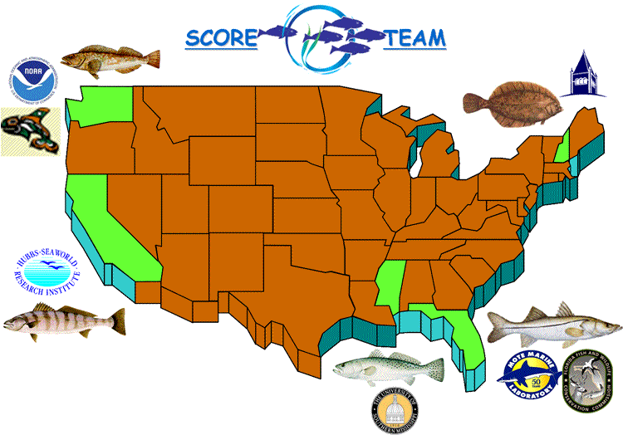

Slide 31
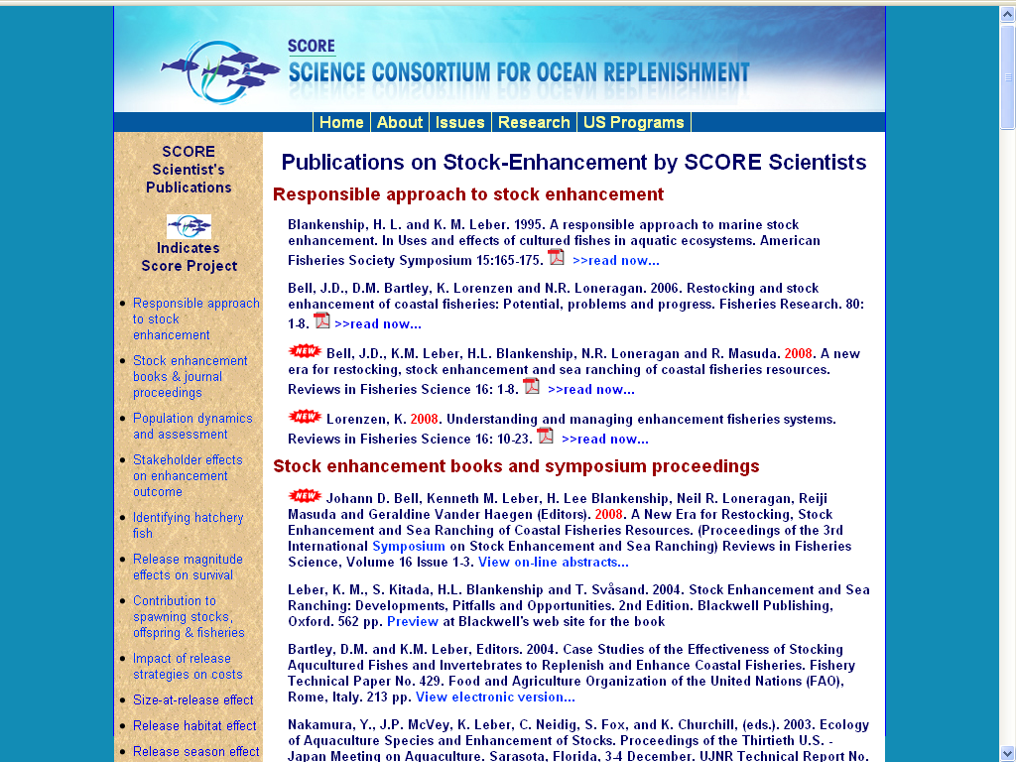
StockEnhancement.org/science/publications.html
65 Fisheries Enhancement Publications

Slide 32
Key Issues to Consider
Is Enhancement needed? Which form of enhancement (restocking, stock enhancement or sea ranching)?
Have stock assessments been done to evaluate current status of the reef fishes and other species targeted for enhancement? This would greatly increase the capability of models to predict enhancement yields.
Adaptive management is critical for managing enhancement impacts for success – is tagging and monitoring of stocking impact well integrated into enhancement management plan?
Is help needed to adapt the “Responsible Approach” to local circumstances

