Slide 1
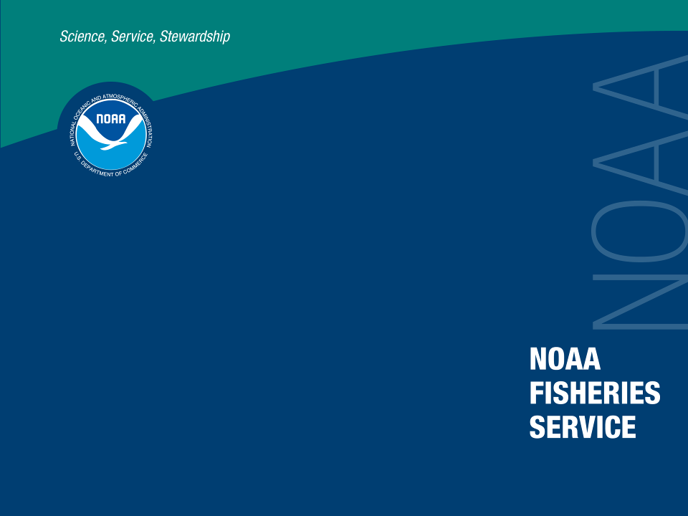
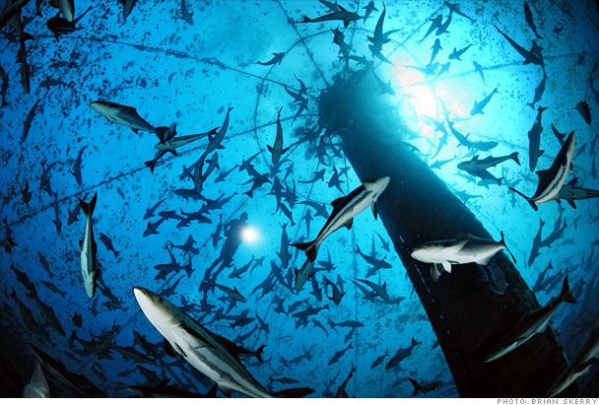
Marine Aquaculture in U.S.A.
David O’Brien

Slide 2
Today’s Talk
NOAA’s Role
Research Initiatives
U.S. Aquaculture

Slide 3
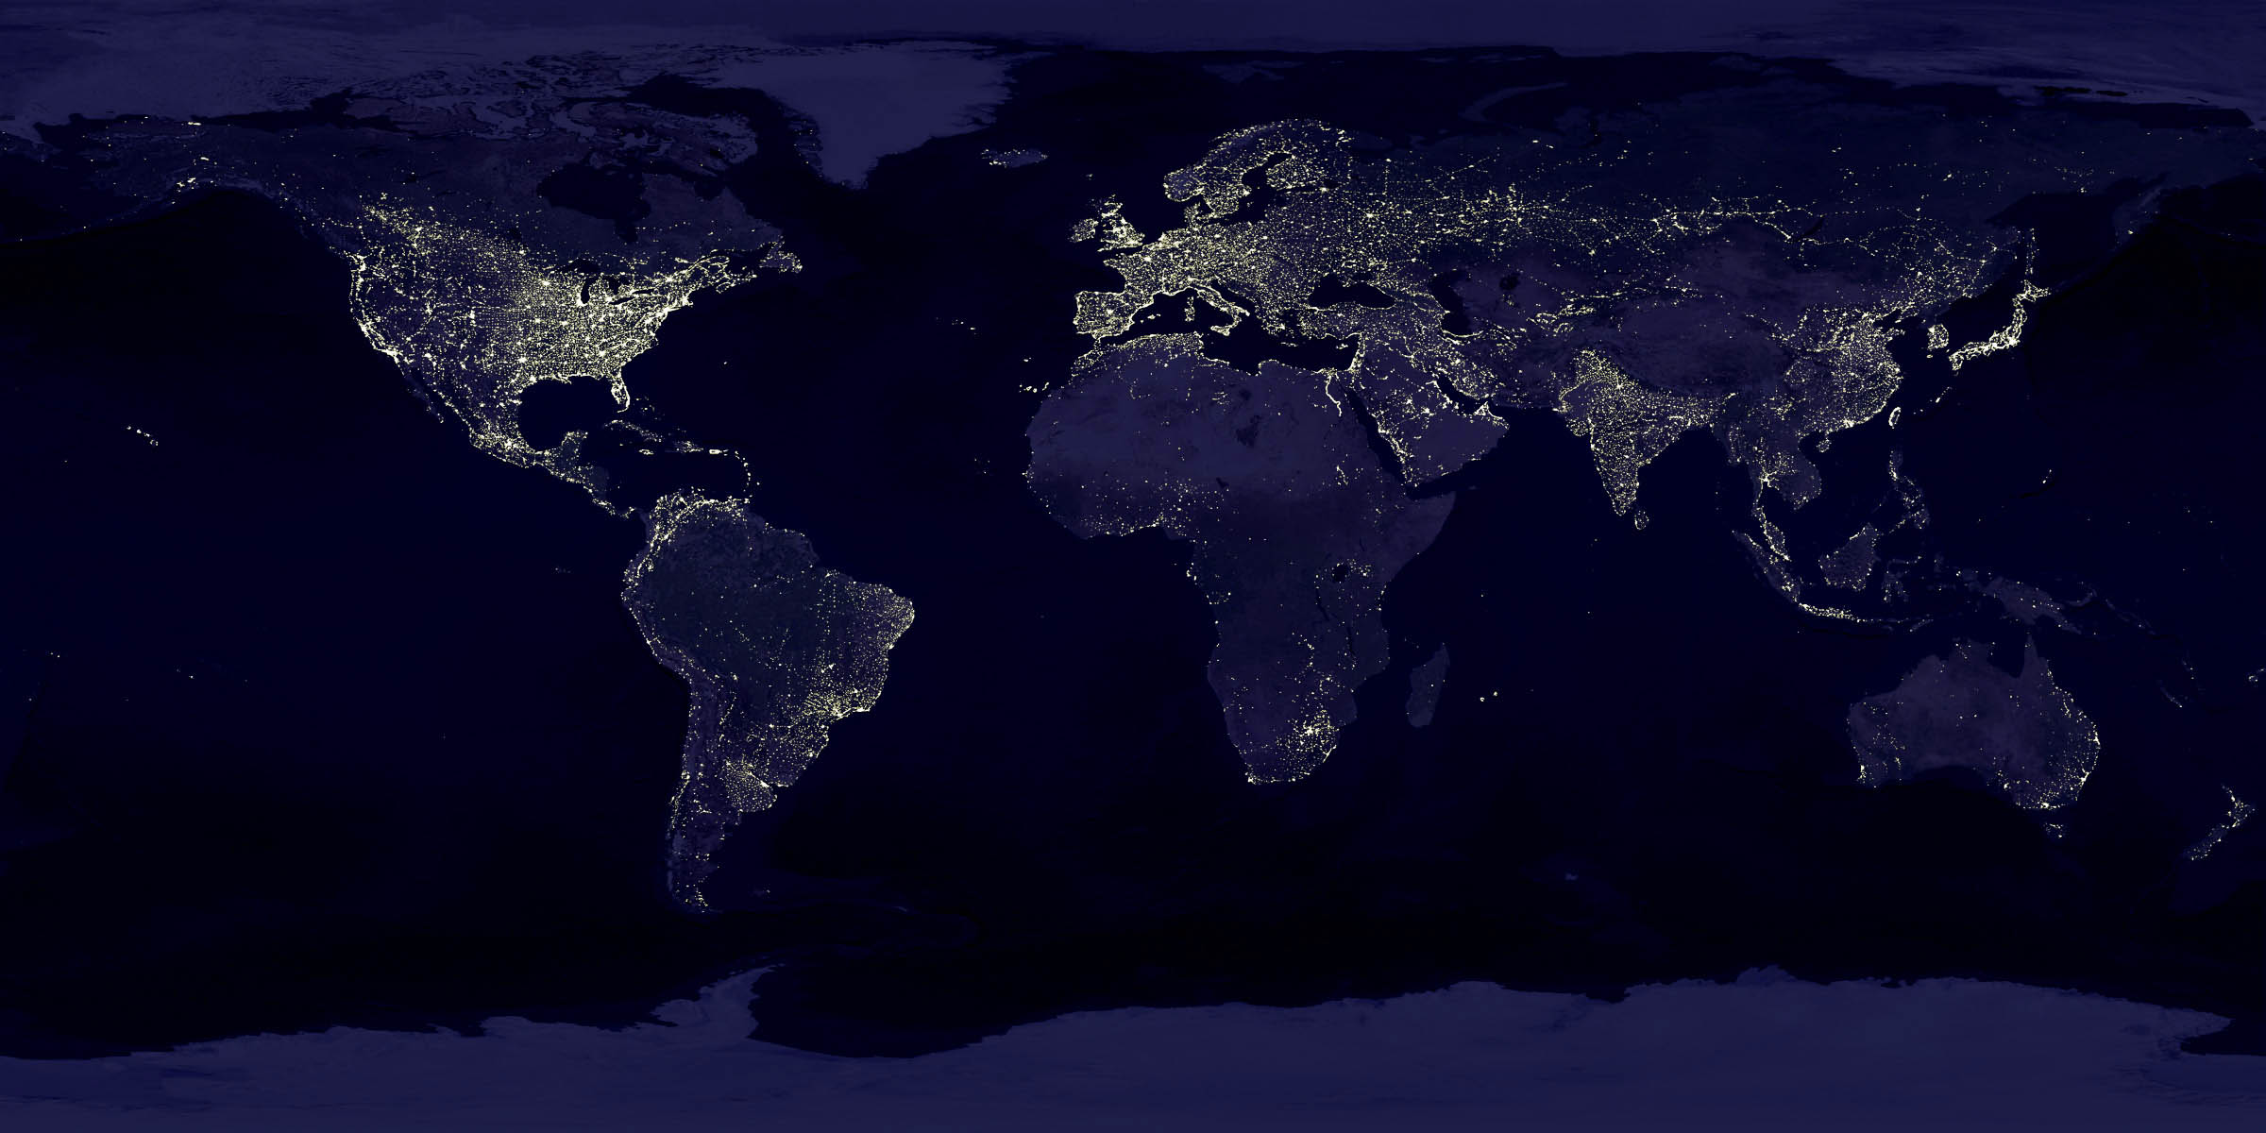
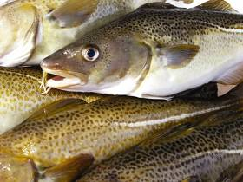
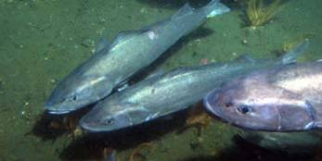
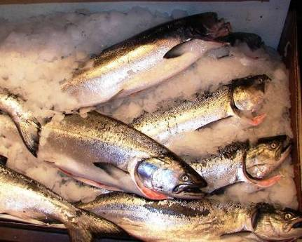
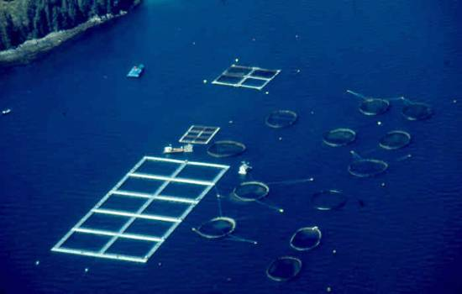
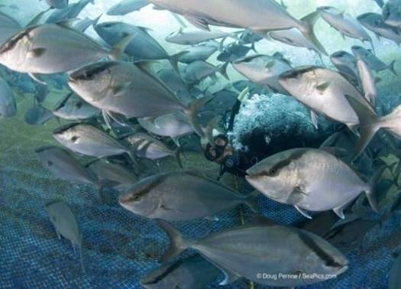
Marine Finfish

Slide 4
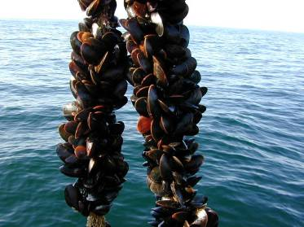
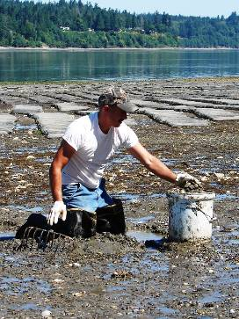
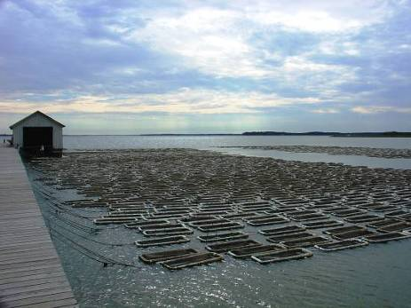
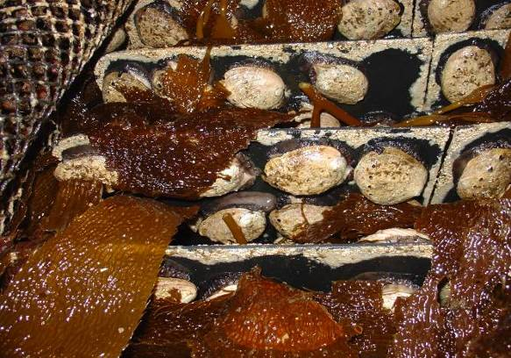
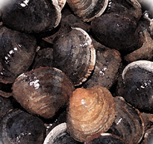
Marine Shellfish
Notes:
About 65% of domestic aquaculture production is molluscan shellfish
About 25% of domestic production is finfish (mostly salmon)
About 10% of domestic production is shrimp

Slide 5
U.S. Aquaculture’s Slow Growth
Notes:
US ranked 14th in global aquaculture production, despite large land area and largest EEZ
Challenges in US
Complicated regulations
High coastal land values
Social Issues
High production costs
Gulf FMP under review
Hubbs Sea World permit

Slide 6
NOAA’s Office of Aquaculture
Mission: Encourage the Development of Sustainable Marine Aquaculture
Healthy marine ecosystems
Create employment
Support fishing communities, complement wild catch
Restore and conserve marine and coastal habitat
Sustainable seafood
Notes:
Puts aquaculture in the context of stewardship, social, and economic goals – healthy oceans, jobs, working waterfronts, vitality of communities
Establishes a national approach to sustainable marine aquaculture including, but not limited to, federal waters
Sets NOAA’s priorities – for science/innovation, regulatory improvements, stakeholder/international partnerships
Provides guidance only – not a substitute for statutory/regulatory mandates and responsibilities
Reflects public input gathered through public engagement

Slide 7
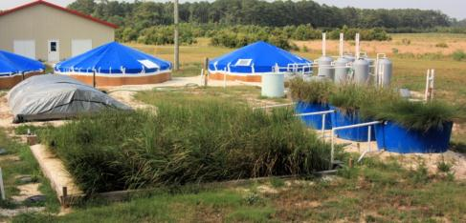
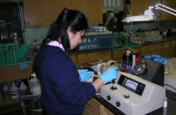
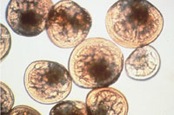
Current and Potential Research Partnerships
Shellfish aquaculture
Modeling impacts
Alternative feeds
Stock enhancement

Slide 8
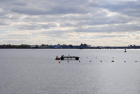
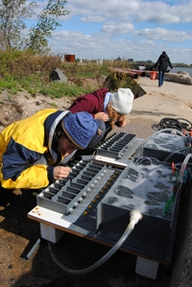
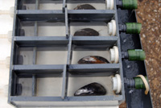
Marine Shellfish Farming
Quantify extraction of nutrients by shellfish
Coastal management
Genetics
Response to pathogens and ocean acidification
NOAA Fisheries Northeast Fisheries Science Center (Dr. Chris Brown)
Early stages of collaboration with CAS on gene expression
Possible collaboration with Sun Yat Sen University
Notes:
2 year pilot study
Bronx River, New York
Ribbed mussels (Geukensia demissa) can remove nitrogen and other excess nutrients from the water.
Scientists are monitoring the condition of the mussels, which are growing on lines hanging below the raft, as well as local water quality over time to see how each responds.
Results from the pilot study will also contribute to a system-scale evaluation of bioextraction use for all of Long Island Sound
nutrients
bacteria
Multiple partners: government (EPA), private (Pemaquid Mussel Farm), and local NGOs
Lines suspended from 20X25 foot raft (~6X8 meters) and relies on natural set of ribbed mussels. Raft installed in fall 2011.
Concept is not unique, but key test is for equipment to quantify extraction. Has implications for better understanding role of shellfish aquaculture, IMTA, and nutrient credits.

Slide 9
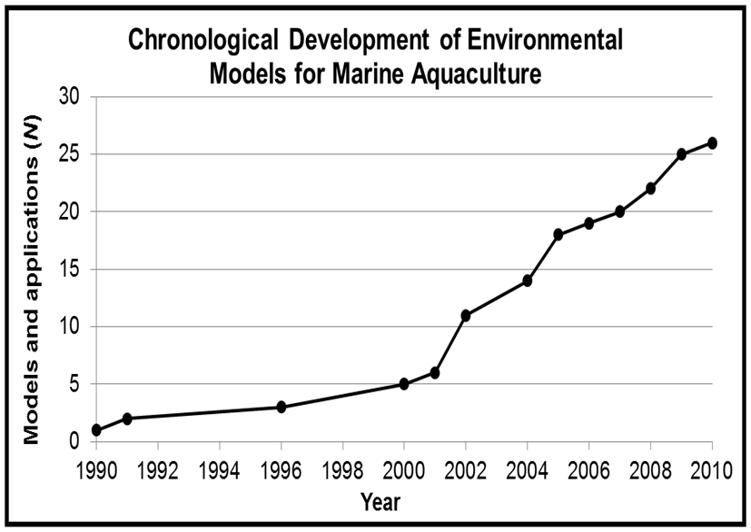
Modeling Environmental Impacts
Objective 1: Evaluate models used for siting and operating aquaculture operations.
Status:
Model comparisons underway
2011 modeling workshop
Notes:
AquaModel
Depomod
FARM
MOM
CSTT Model
LESV
ShellSIM
EcoWin
Etc.

Slide 10
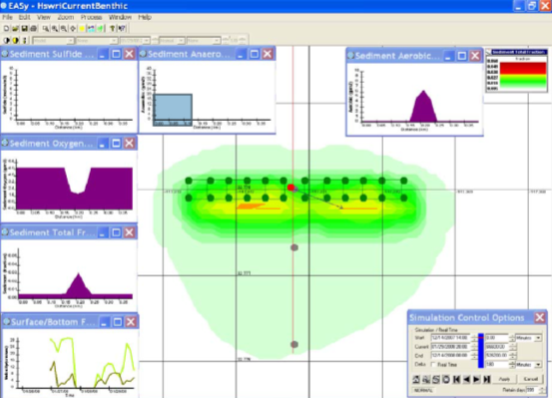
Modeling Environmental Impacts
Objective 2: Improve models
Status:
Working with private modelers
Partner with foreign government and industry
Notes:
Zone Selection
Criteria
Currents
Bathymetry
Temperature
Restrictions
Distance
Circulation
Farm Site Selection
Criteria
Resolved Currents
Resolved Bathymetry
Oxygen
Sediment
Species
Farm Size
Infrastructure

Slide 11
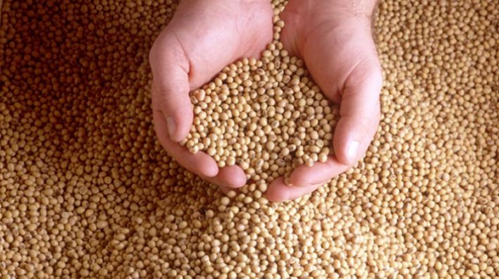
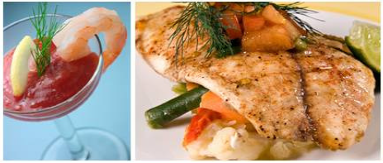
Alternative Feeds Development
Objectives:
Environmental
Economics
Human health
Status:
Initiative with USDA in 2007
Recently published report
Ongoing research
Notes:
North America is the worlds largest and most advanced producer of formulated animal diets (followed by the European Union and then China).
Currently, the production of feeds for aquaculture worldwide is the most rapidly expanding market in the animal feeds production sector increasing 6-8 percent per year. Aquaculture feeds could represent significant export opportunities for the US feeds sector and their suppliers.
Although the world production of fish meal and fish oil has been relatively constant for the past 20 years, the percentage consumed by aquaculture has risen, now accounting for 60 to 70 percent of the annual production of fish meal and 80 to 90 percent of the annual production of fish oil
As a potential indication of limited supply, the price of fish meal roughly tripled between 2002 and 2010, and supply remains limited while the demand for fish feed ingredients is expected to continue to rise
Interdisciplinary –
molecular genetics and breeding of both fish and plants
fish physiology and nutrition
grain chemistry and processing
recapture of trimmings
Success so far: trout, salmon
Use of taurine to enhance growth of fish fed on terrestrial plant based diets.

Slide 12
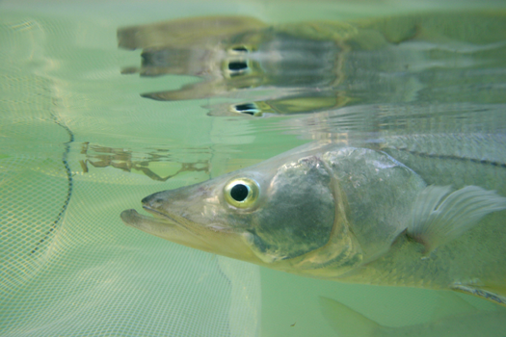
Stock Enhancement
Objectives:
Enhance natural populations
Rebuild depleted species
Assess impact of stock stocking programs
Status:
Ongoing research at Mote Marine Laboratory
Building collaboration with China
Notes:
This summer, NOAA scientists at the Northwest Fisheries Science Center in Seattle tested a novel new instrument – the Environmental Sample Processor, or ESP – for its ability to detect the microscopic species that cause harmful algal blooms and provide warning of an impending outbreak.
Each morning, the ESP collected 1 liter of water and tested for four different species of harmful algae using DNA probe technology. The ESP conducts the DNA processing and sends an email with the results to the scientists back at their offices.
ESP provided early warning of a large bloom that had the potential to kill fish. The information was rapidly disseminated to businesses and triggered increased site surveillance at fish farms throughout Puget Sound and British Columbia. growers may harvest their product early to avoid contamination with HAB toxins, fish farmers may ramp up site surveillance and prepare mitigation strategies, and salmon hatchery operators may delay the release of juveniles.
Worked with industry to document what may be an early impact of ocean acdification.
Intiially thought was a disease, but later thought to be OA
Worked wth industry to develop OA monitoring to aovid drawing water during events

Slide 13
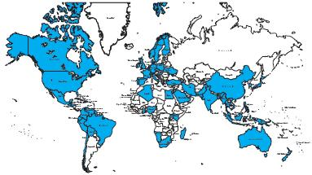
World Aquaculture Society
3,000 members
100 countries
Meeting in Seattle, February 2014

Slide 14
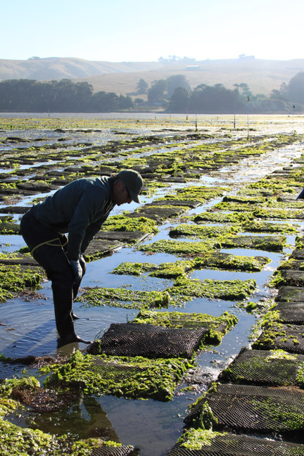
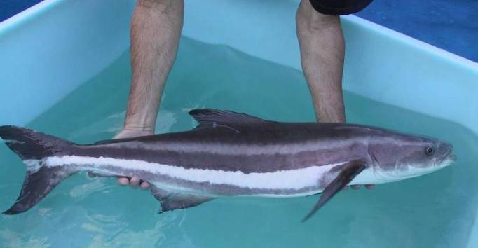
Thank You!
David O’Brien
david.o’brien@noaa.gov
www.aquaculture.noaa.gov

Slide 15
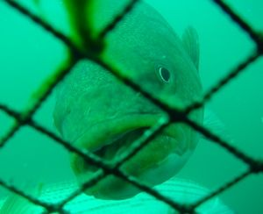
Barriers to U.S. Aquaculture
High costs of land and labor
Difficult and expensive permitting processes
Opposition and consumer confusion
Availability of inexpensive imported seafood

