Slide 1
Shortcomings in the Current Body of Marine Recreational Fisheries Economic Data
Mike Leonard: Ocean Resource Policy Director,
American Sportfishing Association
Rob Southwick: President, Southwick Associates

Slide 2
Introduction
Past management issues have suffered from limited or missing economic data elements.
Desired Goals:
1. Discuss challenges to filling these information gaps
2. Begin to prioritize information gaps
Examples of recent and ongoing issues are next.

Slide 3
Recent Issue: California salmon / Water allocations
Key Information Gaps:
Marginal changes in participation & spending resulting from changes in:
Fish stocks: we do not know the potential impacts from restoring stocks

Slide 4
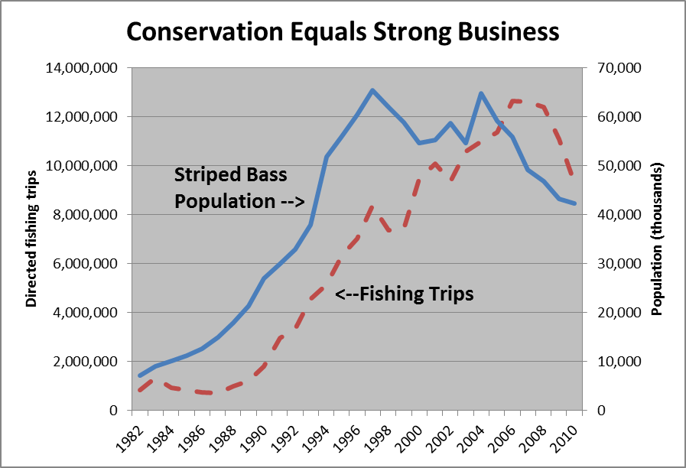
Data Source: Atlantic States Marine Fisheries Commission.

Slide 5
Recent Issue: California salmon / Water allocations
Key Information Gaps:
Marginal changes in participation & spending resulting from changes in:
Fish stocks: striped bass
Regulatory changes: reef fish, South Atlantic snapper
Access (California, Biscayne National Park)
In California, we heard (without statistical support):
“Anglers would simply shift 100% of effort & $$ elsewhere”
“Anglers will not shift to other recreations, will not reduce expenditures or take their dollars outside the economic area.”

Slide 6
Ongoing Issue: Weighing Economic Impacts in Regulatory Process
Key Information Gaps:
Lack of local and fishery-specific economic information
Lack of procedures for how to apply such information

Slide 7
Ongoing Issue: Weighing Economic Impacts in Regulatory Process
Requirements within MSA:
National Standard 8: “Conservation and management measures shall…take into account the importance of fishery resources to fishing communities by utilizing economic and social data… and to the extent practicable, minimize adverse economic impacts on such communities.”
Sec. 303. Contents of Fishery Management Plans:
“specify the pertinent data… including economic information necessary to meet the requirements of this Act
“assess, specify, and analyze the likely effects, if any, including the cumulative conservation, economic, and social impacts, of the conservation and management measures on participants in the fishery”
“include a description of the commercial, recreational, and charter fishing sectors which participate in the fishery, including its economic impact”

Slide 8
Ongoing Issue: Weighing Economic Impacts in Regulatory Process
Example: South Atlantic Red Snapper
In 2009, NMFS proposed 5,000 sq mi bottom-fishing closure
“cost and revenue data for even the most directly affected businesses, such as fish dealers and bait and tackle shops, is unavailable”¹
ASA and Big Rock Sports commissioned a survey of Southeast tackle dealers:²
1,300 stores selling bait and tackle will be directly affected
$78 million in sales would be lost in the first year of the ban
578 jobs will be affected
¹50 CFR Part 622
²Georgetown Economic Services. 2010. “An Economic Impact Study of the Effects of Closures in the South Atlantic Snapper-Grouper Fishery on the Bait and Tackle Retail Industry”

Slide 9
Ongoing Issue: Weighing Economic Impacts in Regulatory Process
Example: South Atlantic 240-foot closure
In 2011, bottom fishing closure at depths 240+ ft was enacted
Limited biological data. Economic data non-existent
After hearing considerable testimony from businesses severely affected (one ASA member laid of 72% of its long time employees), the SAFMC removed the bottom fishing closure

Slide 10
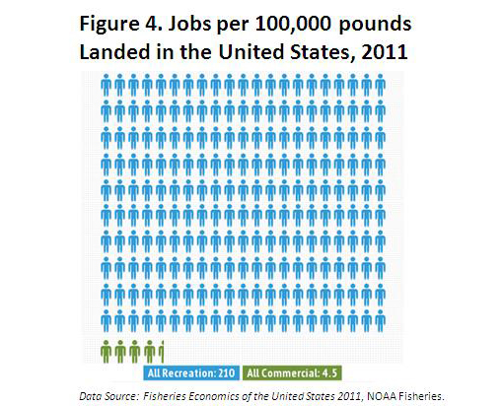
Ongoing Issue: Allocations
Key Information Gaps:
The economic impacts/contributions from various recreational & commercial allocations
Outside data often shows a need for re-examination:
Stripers: 17.3 greater impact at retail¹
Gulf red snapper: recreational sector has 16 times higher economic value²
¹ Southwick Associates. 2005. “The Economics of Recreational and Commercial Striped Bass Fishing”
² Gentner Consulting Group. June 2013. “Comparison of different red snapper allocation levels across recreational and commercial sectors”

Slide 11
Recent Issues: Marine closures in California; Biscayne National Park
Key Information Gaps:
No knowledge of where they fish spatially (no reliable GIS data)
This makes it difficult to measure the potential economic effects of selected area closures.

Slide 12
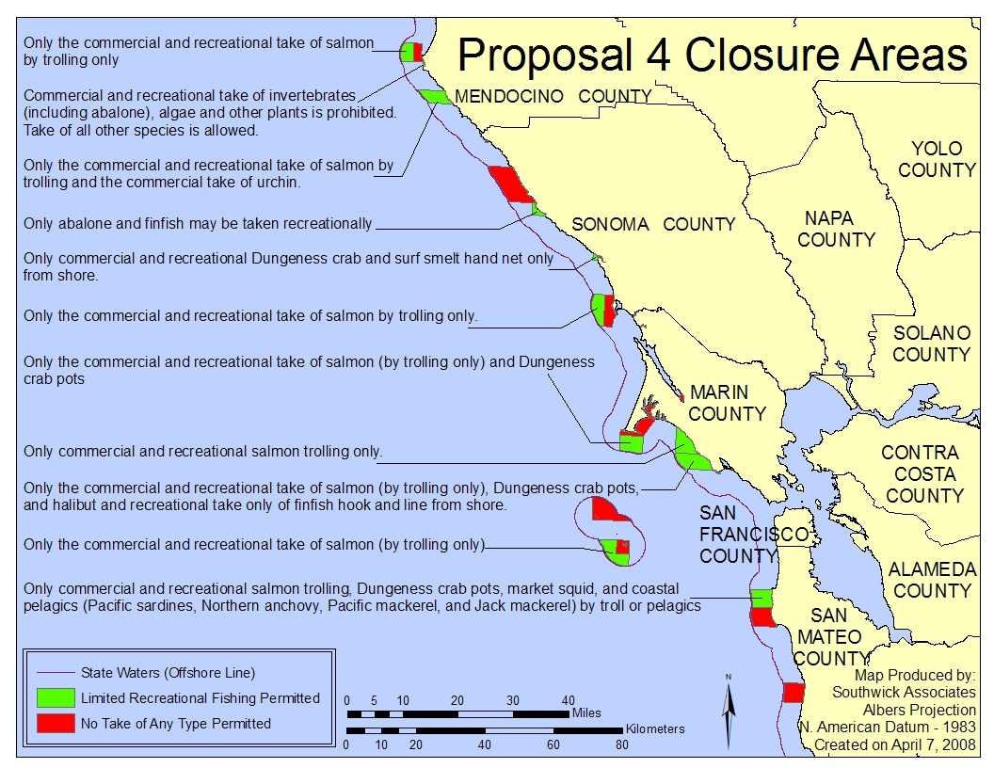

Slide 13
Conclusion
Important questions remain unanswered
Can we find solutions and answers?

