Slide 1
The role of recreational charter boats in coastal communities: an economic and social analysis in Oregon and Washington
NWFSC
Jerry Leonard
January 29, 2014

Slide 2
Charter Vessel Survey
Cost earnings survey of WA and OR recreational charter fleet.
  Estimate economic contribution of charter fleet
  Gain insights into the structure, perceptions, and economic conditions
    Vessel characteristics
    Years participating
    Share of household income
    Concerns for future

Slide 3
Study Details – Methods, Data, Dates, etc.
217 Washington and Oregon marine vessels in 2006 with $15.4 million in direct revenue.
Mail survey to all charter fishing license holders (marine or not).
Completed surveys were received from 95 ocean going vessels (41% response rate).

Slide 4
Data Description
Only census of entire charter fleet in WA and OR.
Detailed revenue data that includes revenue not earned from for-hire fishing.
Opinion data of operators on current economic conditions and economic outlook.

Slide 5
Management Needs
Results used in calculation of economic impact of groundfish management alternatives by Pacific States Marine Fisheries Council
Will be used by Council in calculation of recreational salmon management alternatives.
Insights on structure and economic conditions could be important for allocation decisions.

Slide 8
Contribution Estimates

Slide 9
Outlook Opinion

Slide 10
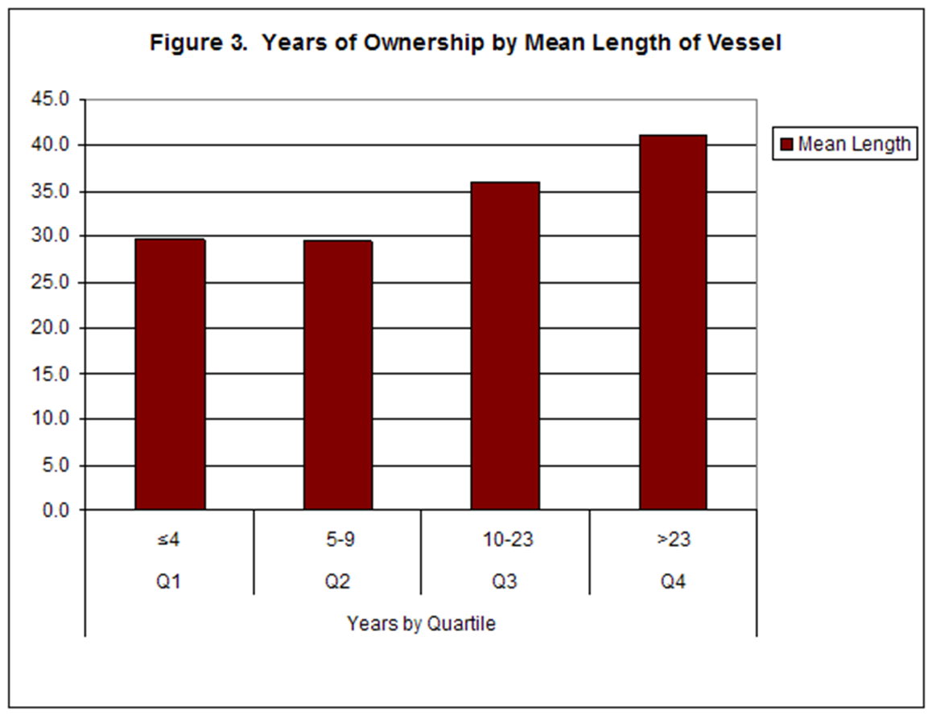

Slide 11
Outlook Opinion

