Slide 1
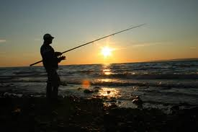
Recreational Anglers Attitudes and Preferences: Regional Results
Presented at the
Recreational Fisheries Constituents Economic Workshop
Silver Spring, MD Jan. 29 - 30, 2014
Ayeisha Brinson, NMFS Economist, ST
Kristy Wallmo, NMFS Economist, ST

Slide 2
Survey Overview: Design and Implementation
May 2012: Survey development
Input from regional recreational economists and recreational coordinators, constituent groups
June – Aug. 2012:
Instrument feedback from constituent groups, MAFAC, four focus groups in Orlando, Fl. and San Diego, CA.
Aug. – Sept. 2012: Survey finalized
Sept. 2012 – Jan. 2013: PRA Review and approval
Feb. 2013 – May 2013: Implementation
Survey implemented 36,362 mailings, 9,226 completed surveys
Six survey sections:
Fishing participation
Preferences for management strategies
Preferences for management objectives
Satisfaction with management
Managing the marine environment
Socio-demographics

Slide 3
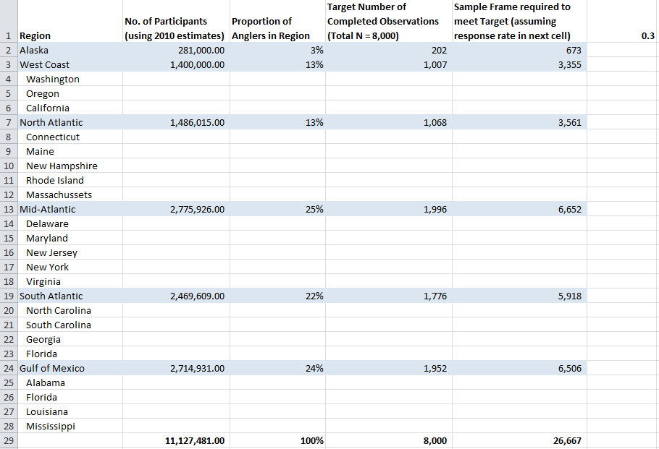
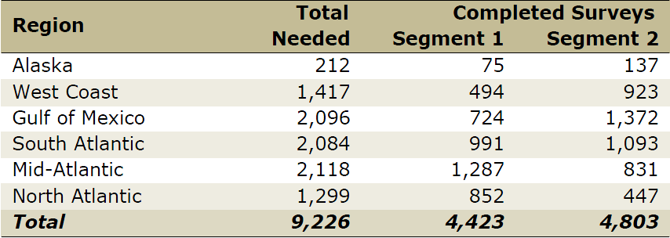
Survey Overview: Sampling Design
Stratified design within national framework
Contractor implemented telephone screeners before Segment 2 mailing
Response rates ranged from 21% (Gulf) – 38% (North Atlantic)

Slide 4
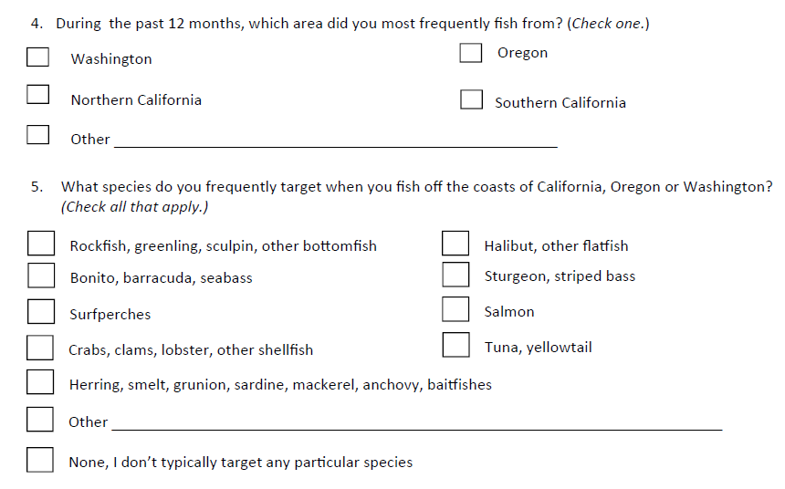
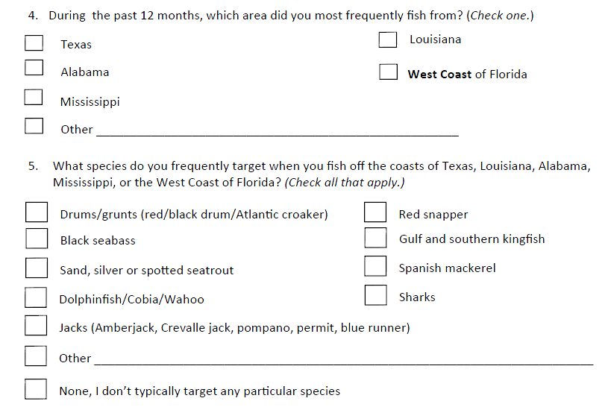
Survey overview: Differences in Regional Instruments
Fishing Location and Target Species

Slide 5
Results: Angler Avidity
 | Alaska | West Coast | Gulf Coast | South Atlantic | Mid-Atlantic | North Atlantic
Years fishing | 19.4 | 29.7 | 25.1 | 25.0 | 32.2 | 30.0
Days fished last year | 10.9 | 18.3 | 28.6 | 24.3 | 29.5 | 24.4
Fishing trips will decrease next year* | 32.1 | 21.5 | 20.3 | 17.1 | 20.5 | 16.0
Decrease due to*…
…fisheries regulations | 20.0 | 46.8 | 50.3 | 42.0 | 44.7 | 42.9
…fishery conditions | 33.3 | 51.9 | 25.5 | 33.1 | 47.3 | 46.9
…fishing trip costs | 70.3 | 60.0 | 59.6 | 64.3 | 68.3 | 63.0
…personal finances | 61.5 | 50.0 | 51.4 | 53.3 | 59.0 | 55.0
…change of residence | 15.2 | 15.9 | 12.9 | 15.2 | 11.2 | 10.8
…available leisure time | 51.6 | 50.6 | 52.0 | 55.3 | 55.0 | 59.0
*Respondents stating “Very likely” or “Somewhat likely”

Slide 6
Results: Fishing location and mode
 | Alaska | West Coast | Gulf Coast | South Atlantic | Mid-Atlantic | North Atlantic
During the last year, most fishing trips taken…
…Within 3 miles from shore | 72 | 75 | 78 | 86 | 86 | 85
…More than 3 miles from shore | 24 | 23 | 21 | 12 | 12 | 12
During the last year, most fishing trips taken from…
…Private boat | 43 | 54 | 56 | 46 | 52 | 48
…Shore (beach, bridge, pier, jetty) | 20 | 27 | 31 | 50 | 40 | 47
…For-hire vessel | 37 | 19 | 5 | 4 | 8 | 4

Slide 7
Preferences for Management Strategies
Establish minimum size limits of the fish you can keep
Establish maximum size limits of the fish you can keep
Limit the total number of fish you can keep
Manage some species as catch-and-release only
Establish longer seasons with more restrictive bag limits
Establish shorter seasons with less restrictive bag limits
Establish shorter seasons with a larger variety of species you can legally catch
Increase the recreational harvest limit by decreasing the commercial harvest limit
Divide the recreational harvest limit among different modes (e.g., private anglers and for-hire/charter boat anglers)
Restrict certain types of fishing gear
Require the use of release techniques that reduce fish mortality
Provide artificial fish habitat (e.g., artificial reef) in some areas of the ocean
Protect and restore fish habitat that has been degraded
Designate some areas of the ocean as marine reserves with catch-and-release only fishing
Close some areas of the ocean for certain seasons

Slide 8
Most Preferred Management Strategies

Slide 9
Least Preferred Management Strategies

Slide 10
Preferences for Management Objectives
Ensure that large quantities of fish are available to catch
Ensure that many different fish species are available to catch
Ensure that adequate numbers of trophy-sized fish are available to catch
Reduce the mortality associated with releasing fish that are not legal to keep
Ensure that future generations will have high quality fishing opportunities
Allocate some quota from commercial fisheries to recreational fisheries
Recover fish stocks that have been depleted
Protect marine biodiversity
Protect threatened or endangered marine species
Achieve consistency between state and federal fishing regulations
Simplify recreational fishing regulations
Monitor and enforce recreational fishing regulations
Ensure that the opinions of all recreational fisheries stakeholders are considered in policy-making
Ensure opportunities to fish in high quality fishing areas
Ensure that fishing sites are not heavily congested

Slide 11
Most Important Management Objectives

Slide 12
Least Important Management Objectives

Slide 13
Satisfaction with Management
Managing fish stocks to provide high quality fishing opportunities
Restoring fish stocks that have been depleted
Adjust regulations in a timely manner to address changing conditions of the fishery
Using management strategies that minimize costs to anglers
Ensure that the annual harvest limit provides enough fish for recreational fisheries
Ensure that state and federal regulations are consistent
Monitoring and enforcing recreational fishing regulations
Using high quality data and assessments in policy-making
Incorporating stakeholder interests in policy-making
Protecting fish or shellfish species that are declining
Protecting marine habitats
Addressing conflicts between anglers and marine mammals

Slide 14
Most Satisfied with Management

Slide 15
Least Satisfied with Management

Slide 16
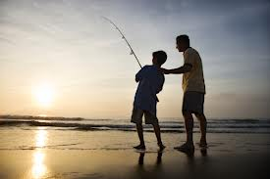
Next steps
National report done
http://www.st.nmfs.noaa.gov/humandimensions/social-indicators/index
Regional reports in development
Need input from regional coordinators on recent policy actions

