Slide 1
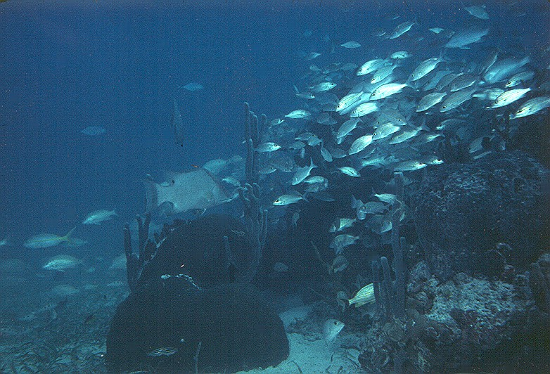
Coral Reef Fisheries
Day 3 restoring ecosystem function
Jim Bohnsack
Southeast Fisheries Science Center
NOAA Fisheries, Miami, FL

Slide 2
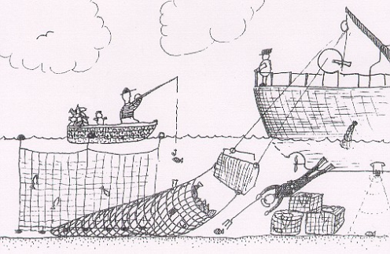
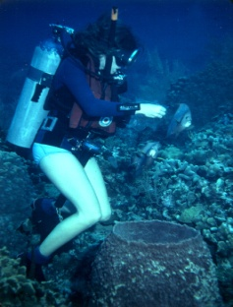
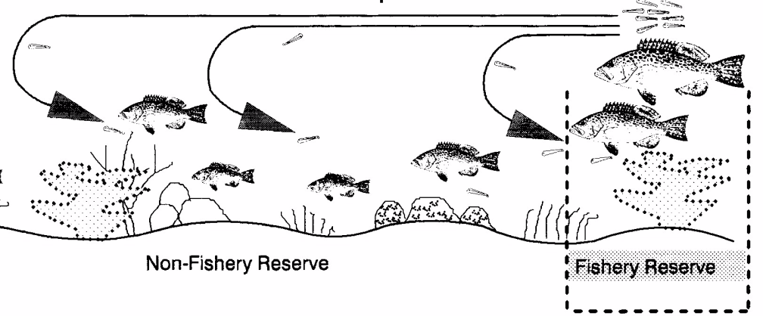
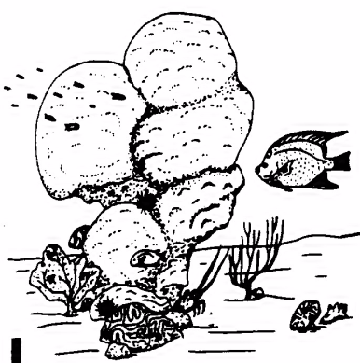
Marine
Ecosystem
Model
Ecosystem Goods & Services
Human Dimension
Ecosystem Structure & Function
Biotic Dimension
Impacts
+ Restoration
Physical Dimension
(Geology, Oceanography, Climate)

Slide 3
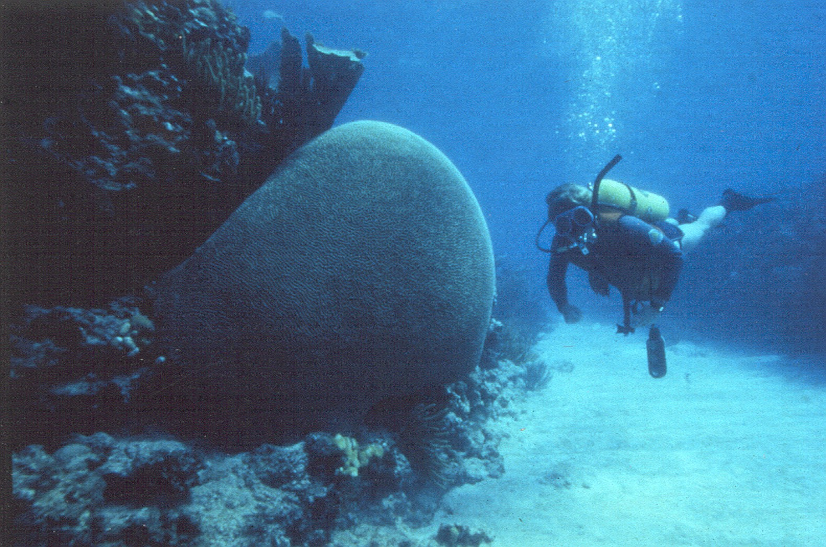
Conservation is a state of harmony between men and land (sea).
Aldo Leopold

Slide 4
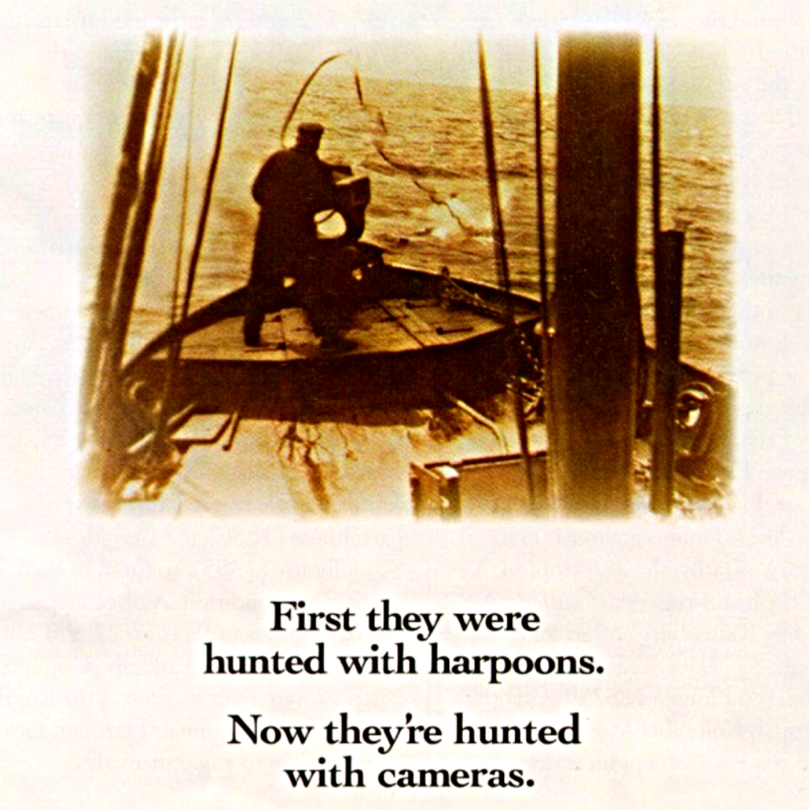
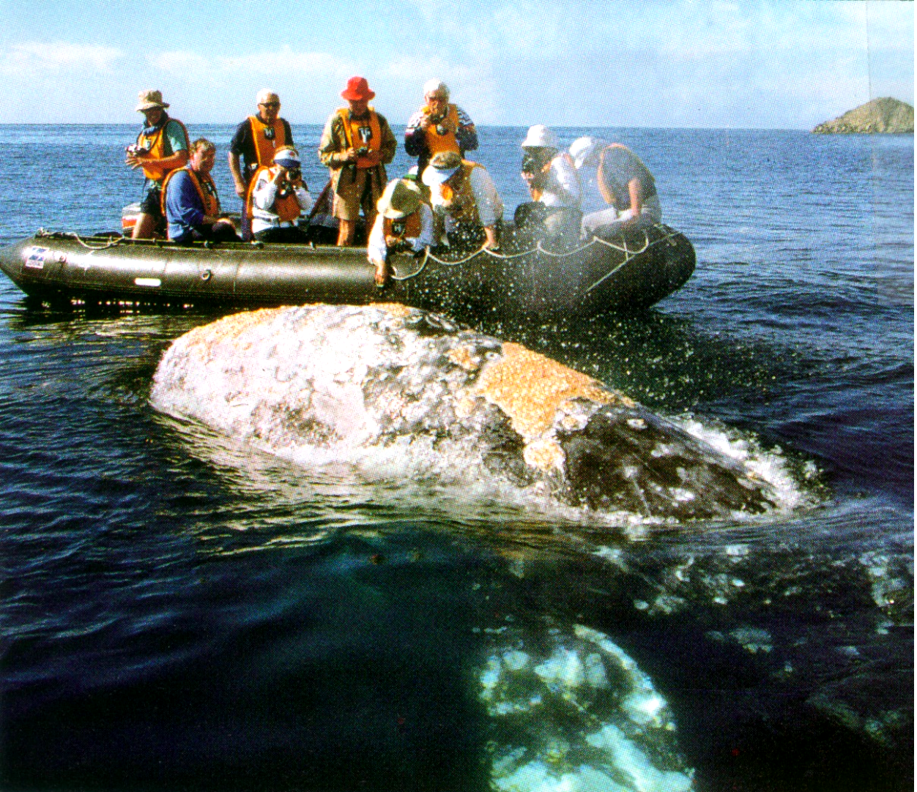
Conservation goals change

Slide 5
Coral reef Health is the ability for self renewal
Conservation is:
developing the understanding and creating the conditions for self renewal.
(i.e. Science and Management)
Integrity,
stability
and beauty

Slide 6
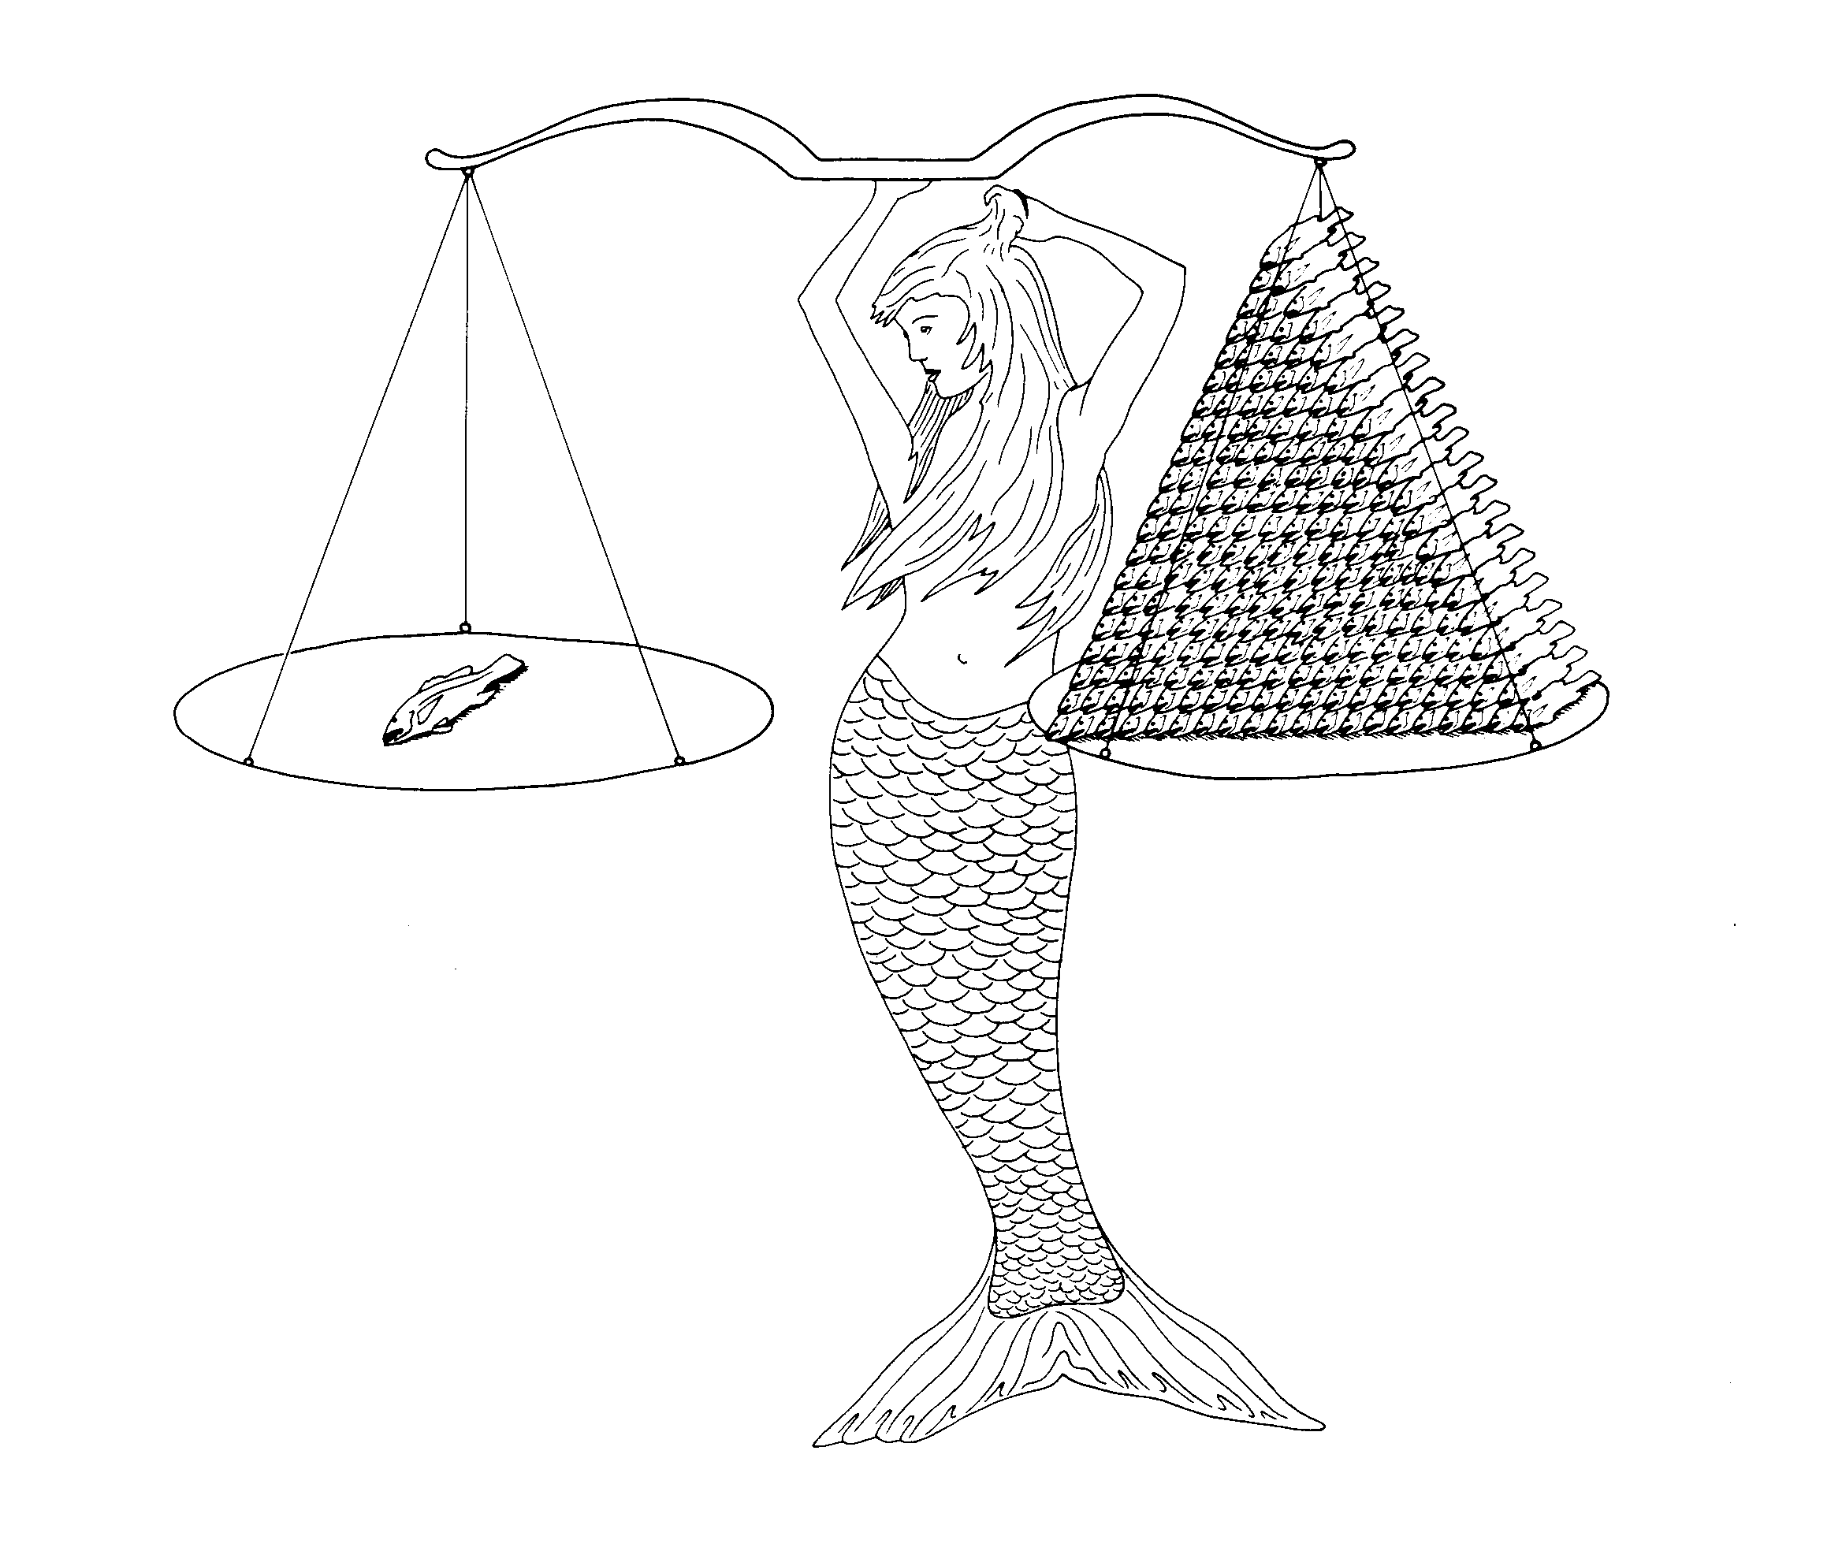
Red Snapper Fecundity
9,000,000 eggs
9,000,000 eggs
1 Female
10 Yr
12.5 kg
61 cm long
212 Females
3 - 4 Yr
1.1 kg each
42 cm long

Slide 7
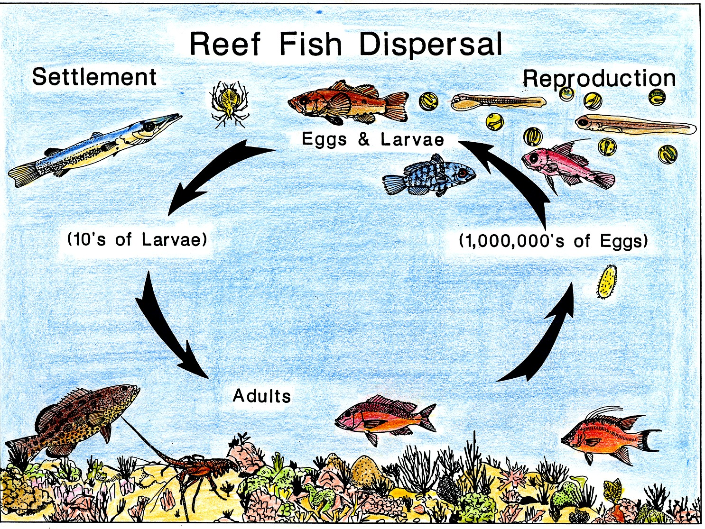

Slide 8
“The concept of marine reserves is simple: If protected from human interference, nature will take care of itself ”

Slide 9
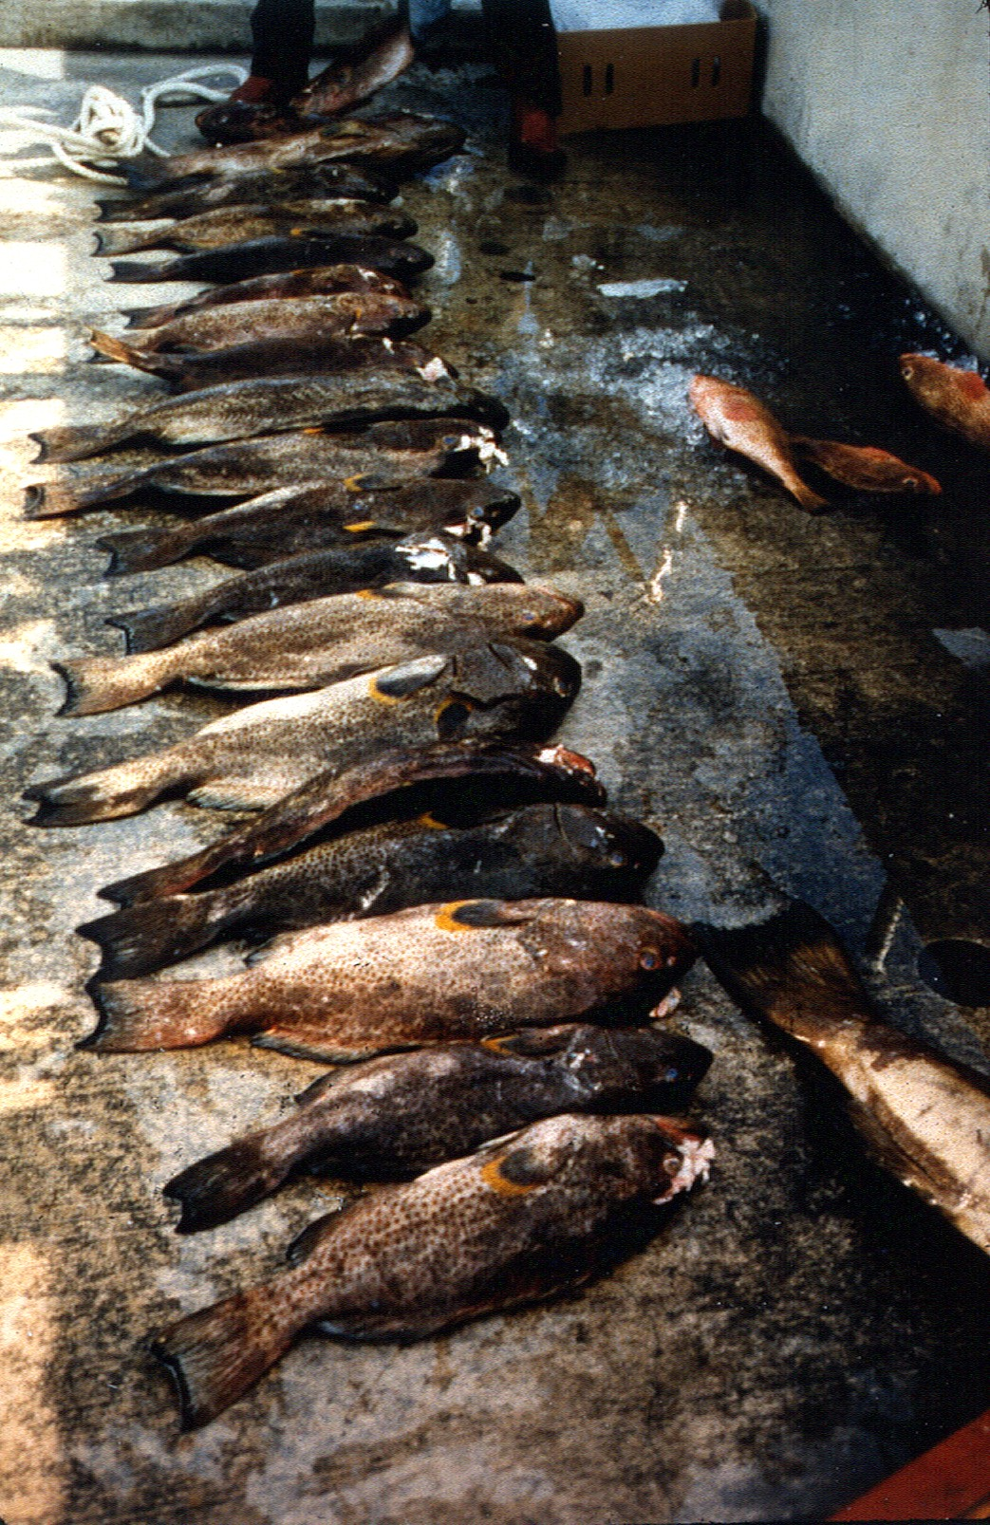
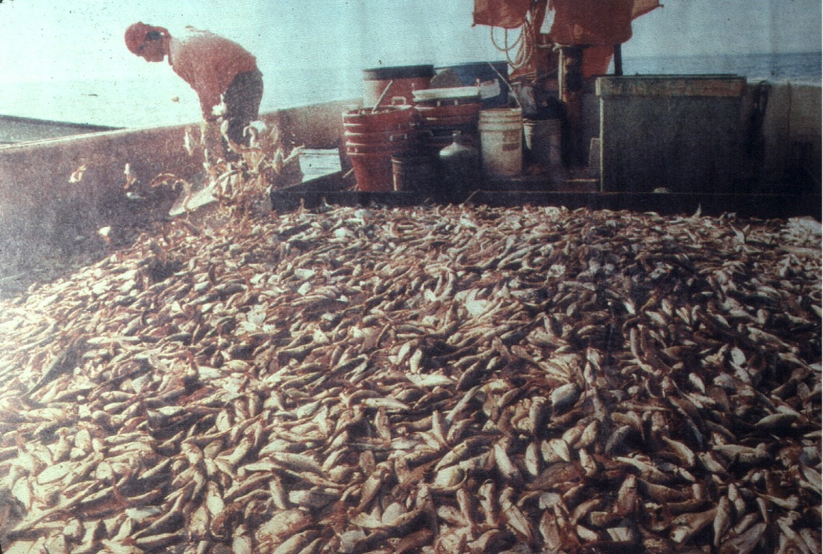
Deplete Target Species
Cause
Habitat Damage
Bycatch Mortality
of target and
non-target species

Slide 10
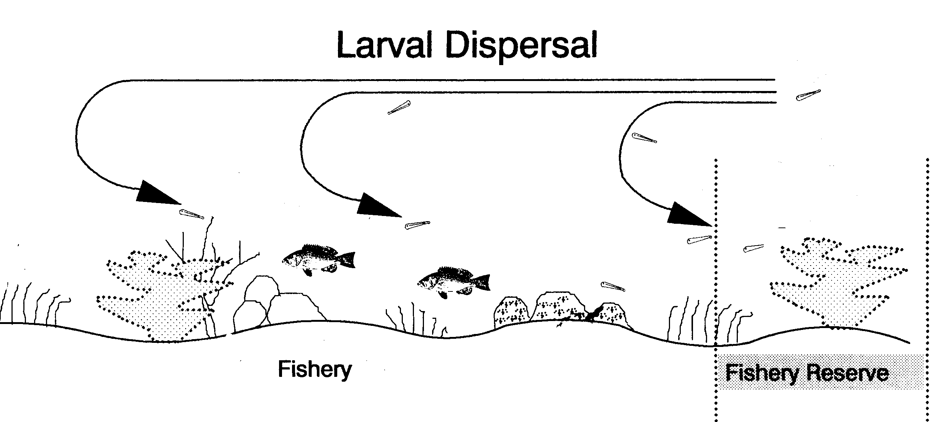
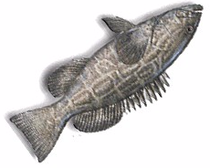
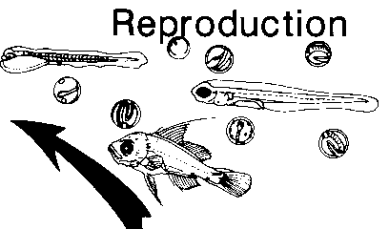
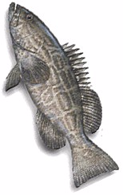
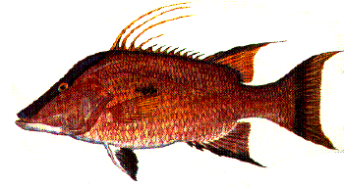
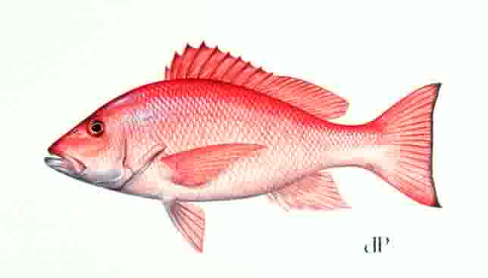
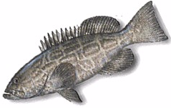
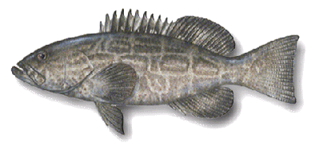
Spillover
Reproduction & Dispersal
Colonization & Growth
Abundance
Diversity

Slide 11
Shifting Baseline

Slide 13
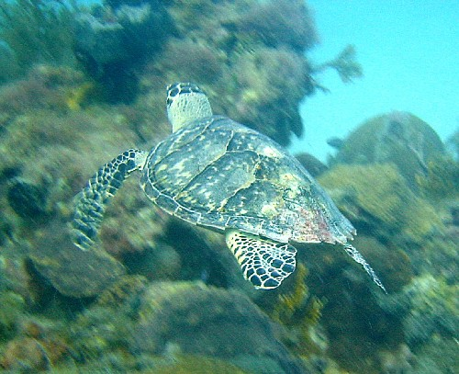
1969 – Endangered Species Act
2004 – Marine Turtle Protection Act
Endangered Species

Slide 14
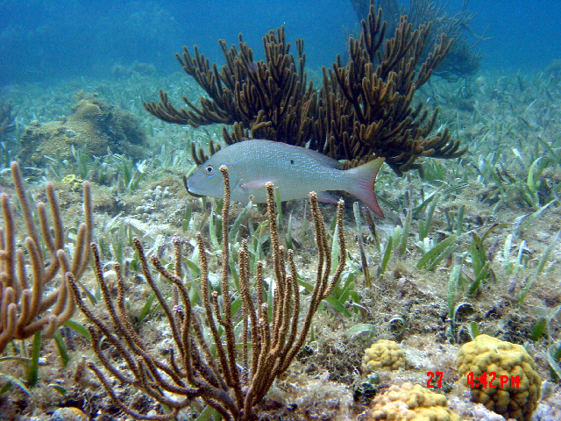
Habitat
1996 – Essential Fish Habitat Magnuson-Stevens Fishery Conservation Act

Slide 15
Cross-Shelf Habitat Classification
Florida
Reef Tract
Transition
Florida Bay
Hawk
Channel
Fore Reef
Nearshore
Midchannel
Reef Flat
Inshore
Patch
Deep Reef
HAWK CHANNEL
Offshore
Patch

Slide 16
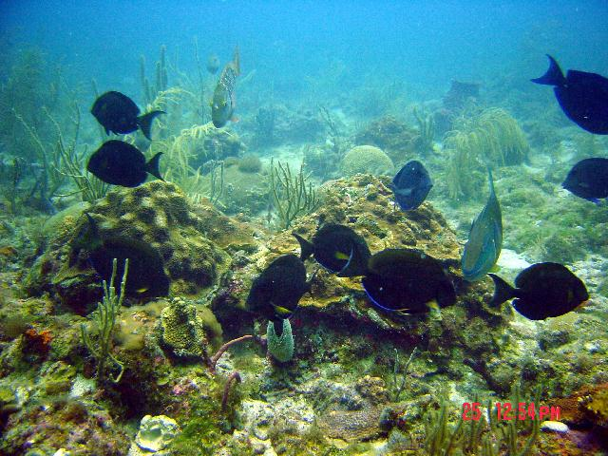
Non-Game Species

Slide 18
Marine Conservation Ethic
Frontier Development Ethic H > E
Romantic Preservation Ethic H = E
Utilitarian Conservation Ethic
H ← E
Ecological Biotic Ethic E H E H E H E

Slide 19
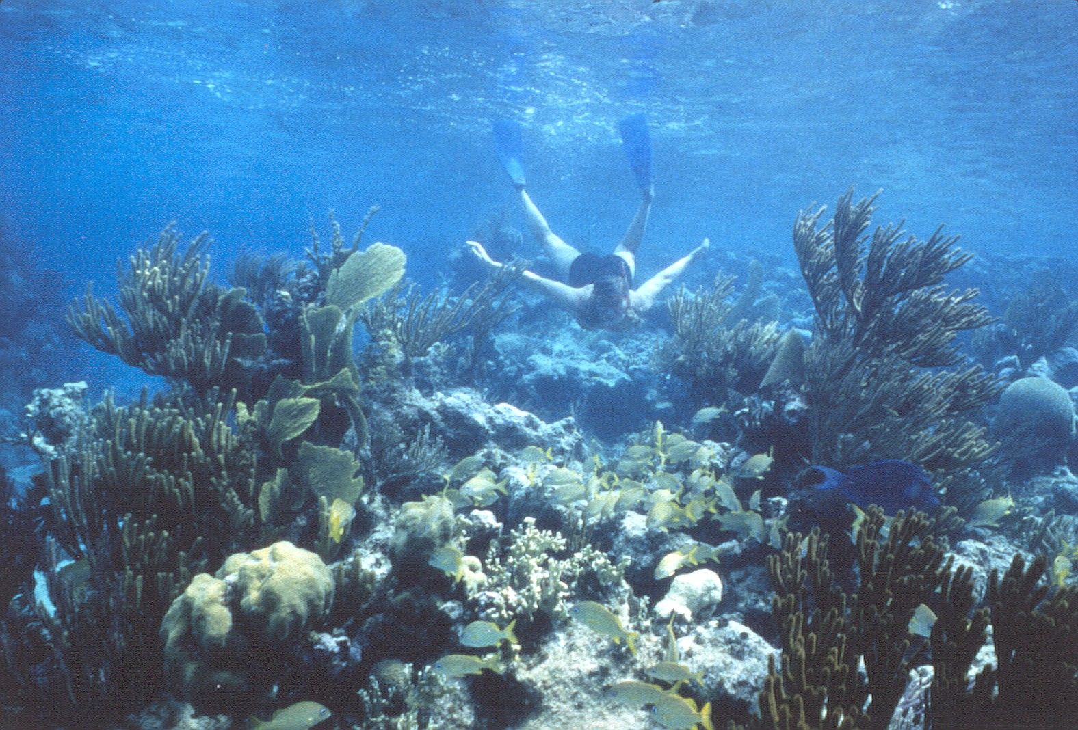
A conservation ethic requires:
Obligation, Responsibility, Self-sacrifice

Slide 20
