Slide 1









Autonomous Reef Monitoring Structures (ARMS): a Systematic Tool to Assess Spatial Patterns and Temporal Trends in Cryptobiota Biodiversity
Rusty Brainard, Molly Timmers, Julian Caley, Nancy Knowlton,
Ryuji Machida, Chris Meyer, Megan Moews, Gustav Paulay,
Laetitia Plaisance, Forest Rohwer, Robert Toonen

Slide 2




Partnerships
NOAA Pacific Islands Fisheries Science Center
Smithsonian Institution
Australian Institute of Marine Science
University of Florida Museum of Natural History
San Diego State University
Hawaii Institute of Marine Biology
Joint Institute of Marine and Atmospheric Research
Moss Landing Marine Laboratory
University of California at Los Angeles
L.A. County Museum
Many more!!

Slide 3
Background
Coral Reefs are the most biologically diverse marine ecosystem…however, this diversity is poorly known or understood.
Reefs are highly susceptible to human/global impacts and the vulnerability of reef systems is anticipated to increase with climate change and ocean acidification, yet…
We cannot effectively implement ecosystem approaches to fisheries management (EAFM) if we do not understand the basic community structure and diversity of organisms comprising the system.

Slide 4
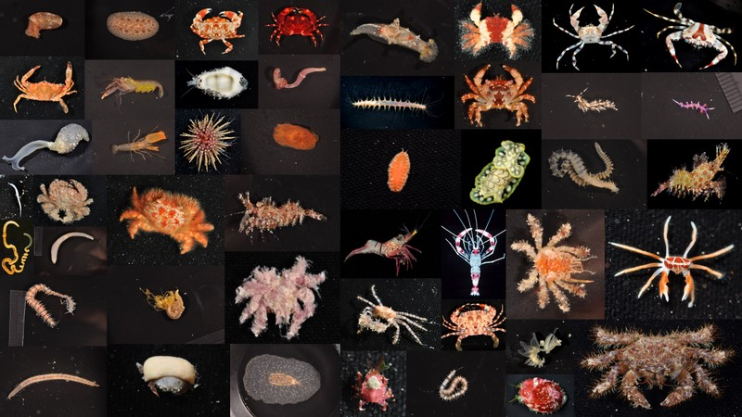
Why Cryptobiota?
Much of the biomass and most of the biodiversity of reefs lies within the complex architecture of the reef matrix
Many of the key ecological processes and functions are driven by microbial and crytobiota communities.
Ecological resilience generally increases with increasing diversity (functional redundancy)
standard method for molecular analysis o
Notes:
That in of itself is a huge driver to understand the diversity of this community.

Slide 5
ARMS
Autonomous Reef Monitoring Structures
Provides systematic and consistent metrics to assess and monitor spatial patterns of cryptbiota (or comparison between artificial and natural reefs)
Provides a standard method for molecular analysis of biodiversity.
Foundation to examine ecosystem concepts such as resilience, regime shifts, and connectivity across oceanographic, environmental, and anthropogenic gradients
Detect trends in coral reef biodiversity in response to climate change, ocean acidification, and other threats facing our reefs.

Slide 6
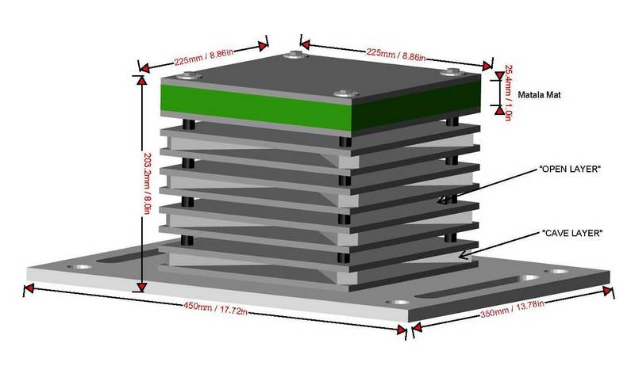
What?
Structural Design
Easy to build and inexpensive
  Less than ~$250 USD in materials
  PVC bolted together
Alternating open and semi-enclosed layers (4 each).

Slide 7
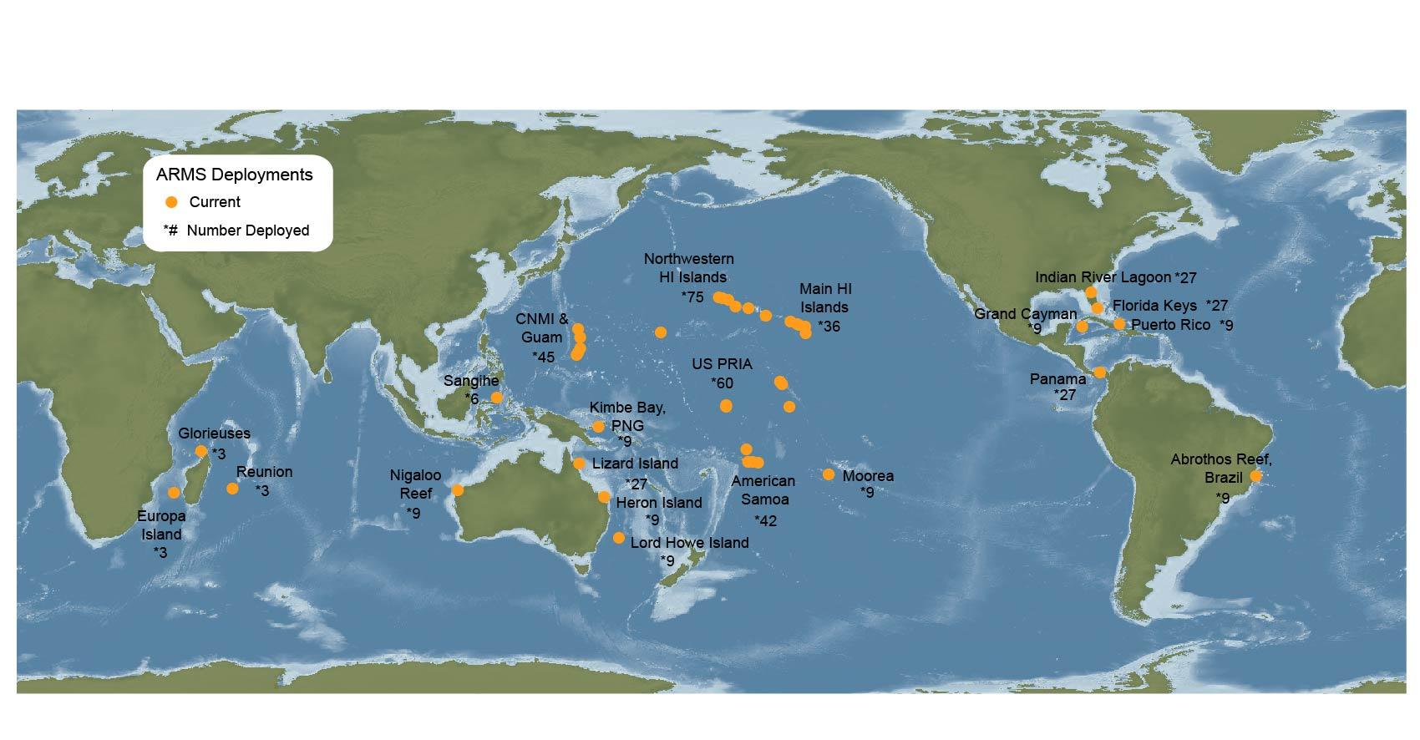
Where are they?
>650 ARMS deployed in shallow (12-15m) forereef habitats
>400 ARMS are part of NOAA CRED’s long term monitoring of the US Pacific Islands
Future Deployments: Coral Triangle, NWFSC, HI Mesophotic Reefs

Slide 8
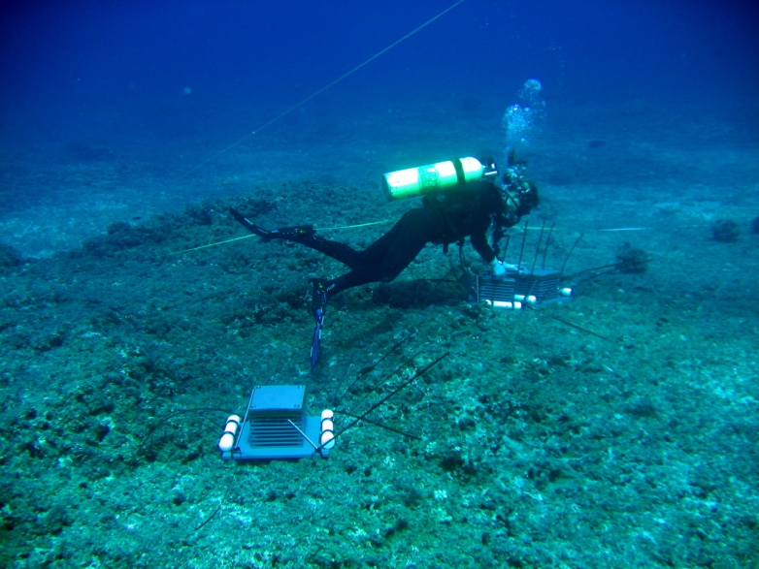
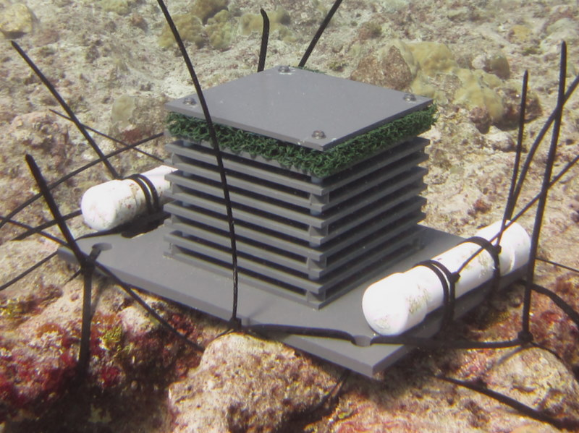
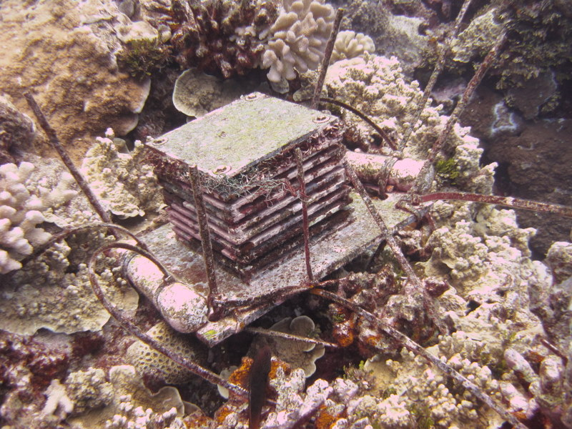
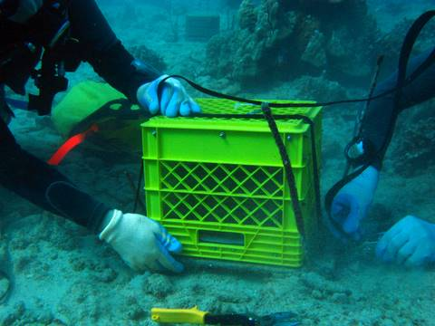
Deployment
Two or more divers to deploy
Fixed to bottom with stakes, weights, and zip ties
Standard “soak” time is 2-3 years
Recovery
Cover with mesh lined crate and bring to surface
Redeploy at same sites for monitoring purposes

Slide 9
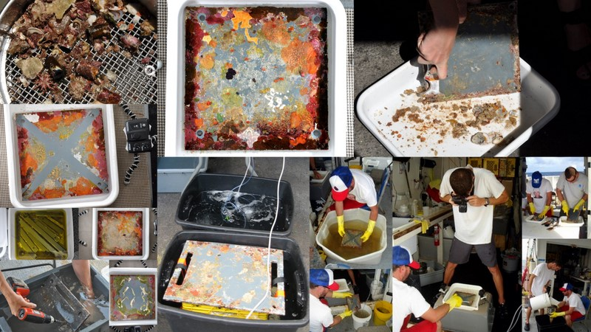
Processing
Dissemble
Plate Imagery
Brush Plates
EtOH lock-down
Filter Corners
Sieve:
5 mm
2 mm
500 um
100 um
Sort or Bulk Preservation
Plate Scrape and preserve

Slide 10


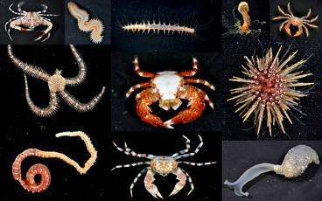
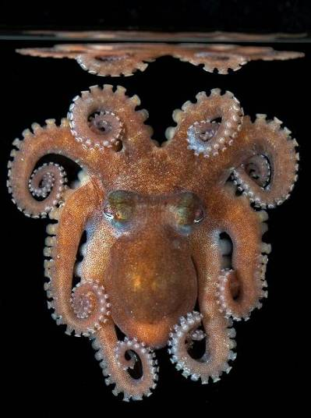









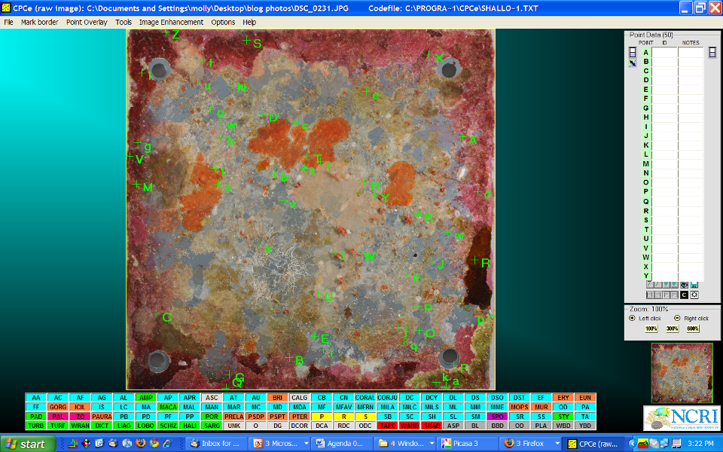
Data - community
Morpho-taxonomy
Can be used to compare patterns of diversity and community functionality across biogeographic, environmental, and human impact gradients (or natural vs. artificial reefs)
Sessile Community Composition
Plate image analysis can provide:
% of surface recruited to vs. non-recruited
% cover of sessile fauna

Slide 11
Data - Molecular
Bar-coding
Increases # sequences of known species and helps to eliminate possible species plasticity and time consuming taxonomic species identification
Mass Sequencing
Gives an Index of Diversity by providing a number of unique sequences from a sample
Microarray
- Detects presence of known or presumed species
- Could be used for alien species detection

Slide 12
Summary
Simplicity of ARMS design allows cost effective assessment and monitoring at local, regional, and global scales
ARMS provide a tool for systematic and consistent (repeatable) observations of spatial patterns and temporal changes of cryptobiota diversity
Use of advanced genetic techniques will significantly reduce the time and cost of biodiversity assessments
ARMS provide a useful tool for comparative analyses between natural and artificial reefs (do artificial reefs provide the full suite of ecosystem services?).

Slide 13
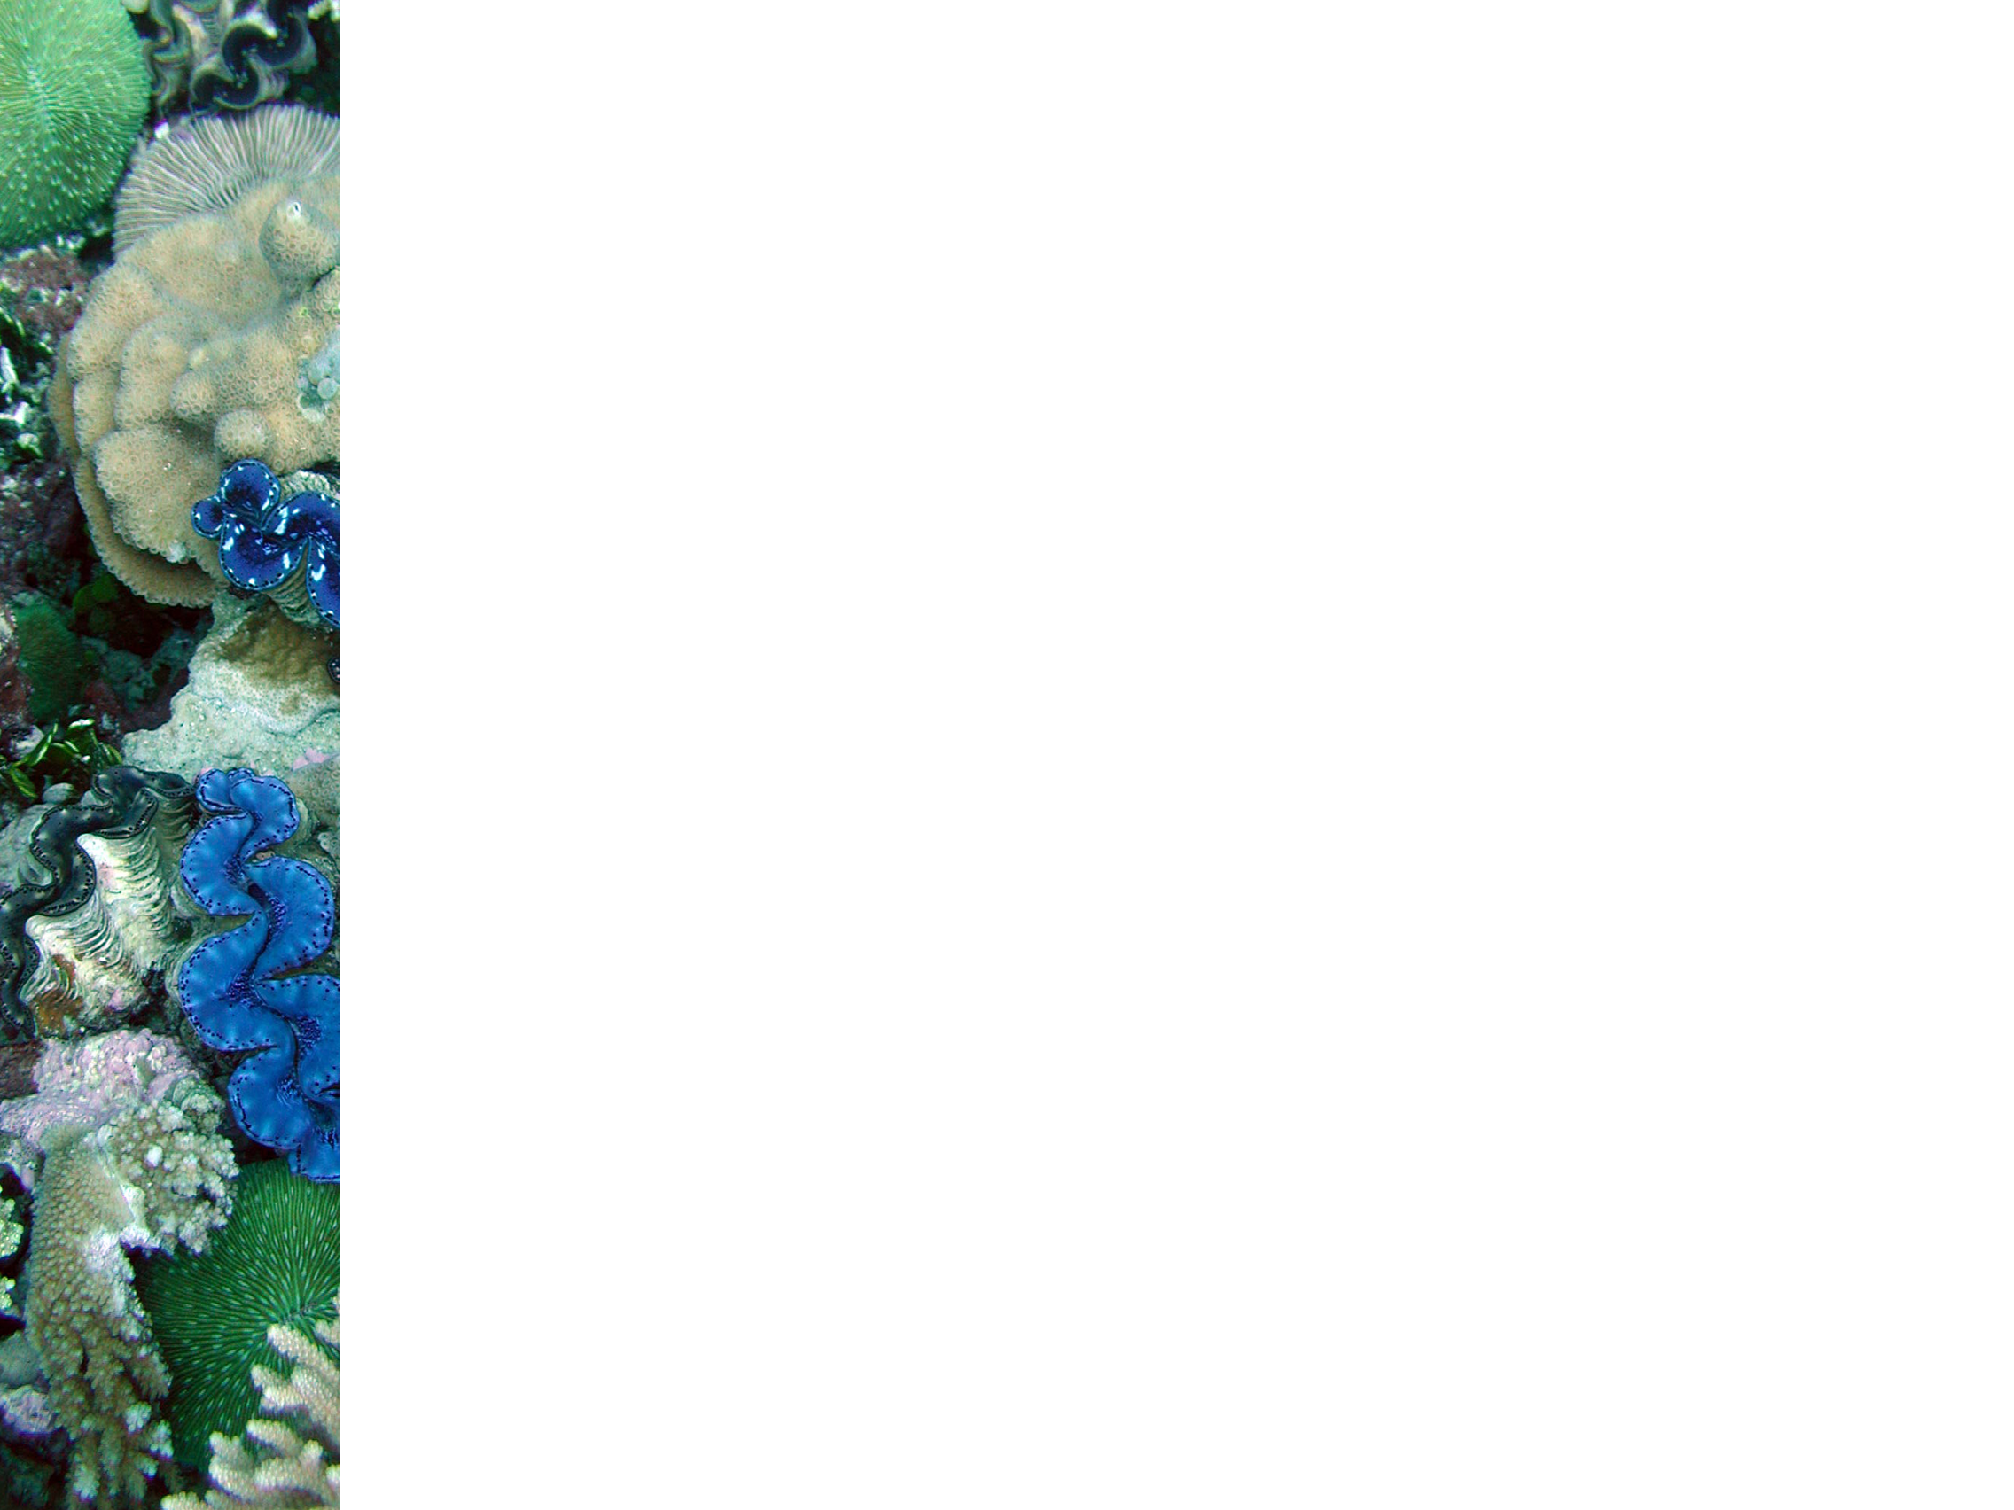
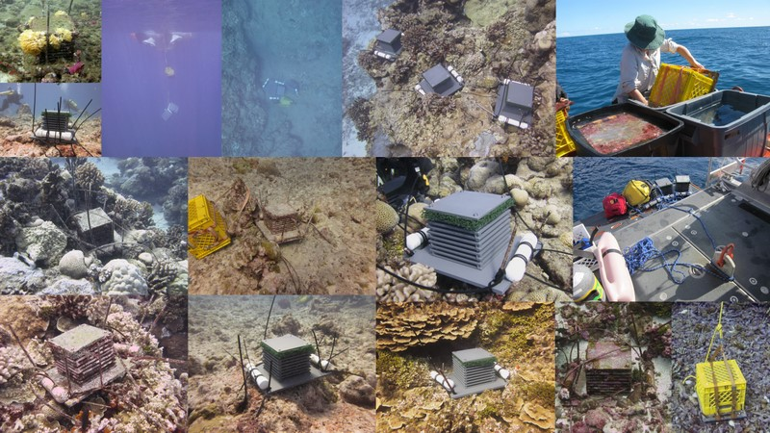
Thank you and Questions?
Rusty.Brainard@noaa.gov
www.pifsc.noaa.gov/cred www.creefs.org

