Slide 1
Stock Assessment Methodologies of reef systems: A Case study Using Yangmeikeng Artificial Reef
Chuanxin Qin Ph. D South China Sea Fisheries Research Institute, CAFS
Gerard DiNardo Ph.D Pacific Islands Fisheries Science center, NOAA
Pimao Chen Prof. South China Sea Fisheries Research Institute, CAFS
Hui-Hua Lee Ph.D Pacific Islands Fisheries Science center, NOAA
Notes:
Thank you, Chairman. I am Chuanxin Qin from SCSFRI. Severe recession of Fishery resources were showed recently years, so it’s important to how to protect marine environment and manage the fishery… so the topic I want to show today is …,

Slide 2
Contents
1
Exchange contents
2
Results
3
Conclusion
4
Next step plan
Notes:
The report contents four part…

Slide 3
1
Exchange contents
What did we do in Hawaii？

Slide 4
Contents: what did we do in Hawaii…
The content, method, data require, and data processing software of artificial reef fisheries resource stock assessment.
Introduced to R software for use in stock assessment
The fishery resources and resource management status in Hawaii and South China Sea were discussed. China’s Summer Fishing Moratorium (close season), stocking enhancement, artificial reef construction, MPA and other management strategies for fishery resources recession in China were discussed too.
Some similarities between artificial reef stock assessment and coral reef stock assessments. Thus, the statistics methods used in coral reef stock assessment can apply to artificial reef.
Notes:
When: I got to Hawaii on Aug. 2.
Thx Gerard and Hui-hua, you picked me up at airport.
How long: I stayed at Hawaii from Aug. 2 to Sep. 2.
What did I do in Hawaii…
Why we select Guangdong province? Guangdong province is in the south of China, the transition zone of the tropical and subtropical, and the long of coastline is 3360 km.
The Preliminary research was in the content, method, data require, and data processing software of artificial reef fisheries resource stock assessment. With the help of Dr. DiNardo and Dr. Lee, the useful of R software in stock assessment was studied.

Slide 5
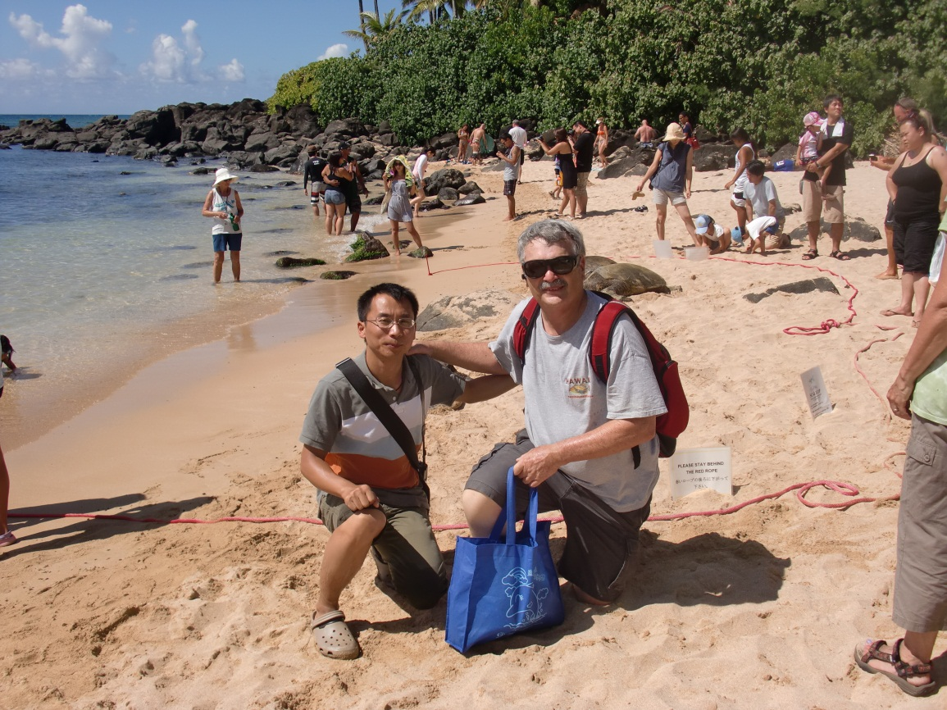
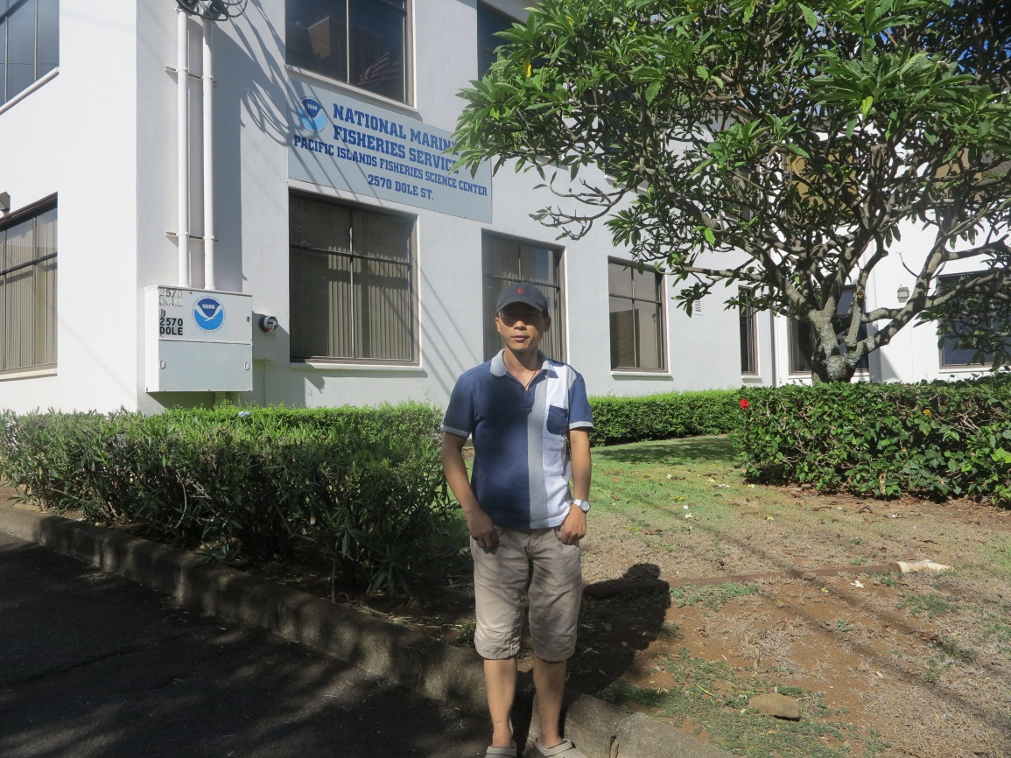
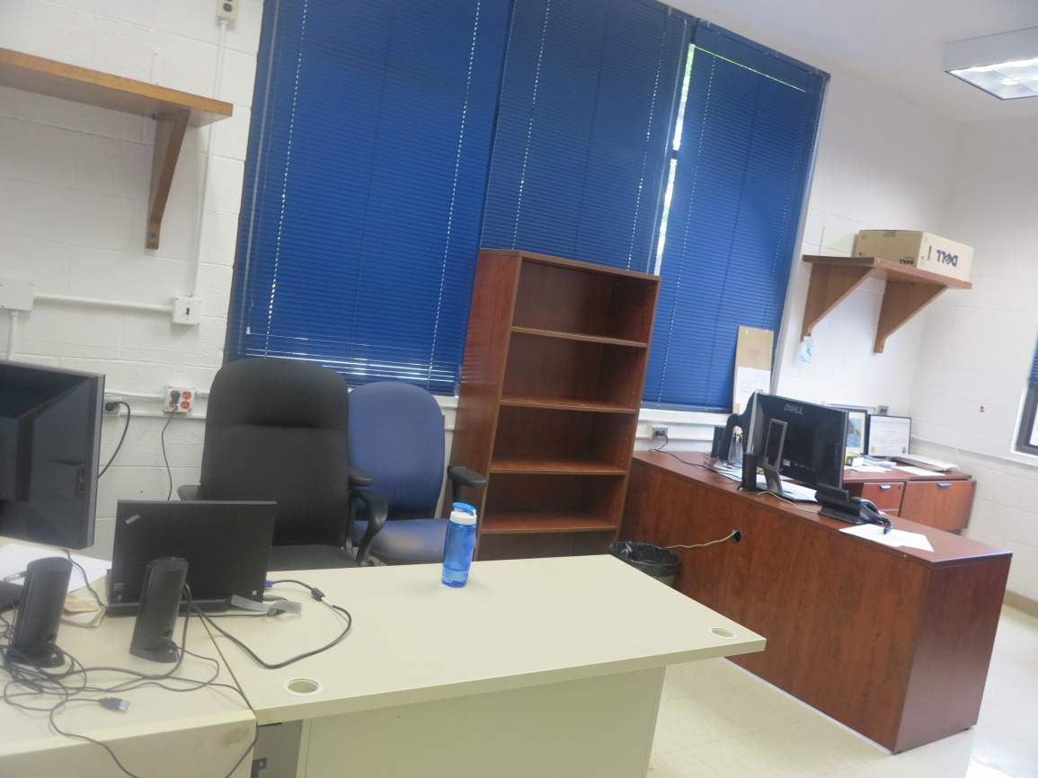
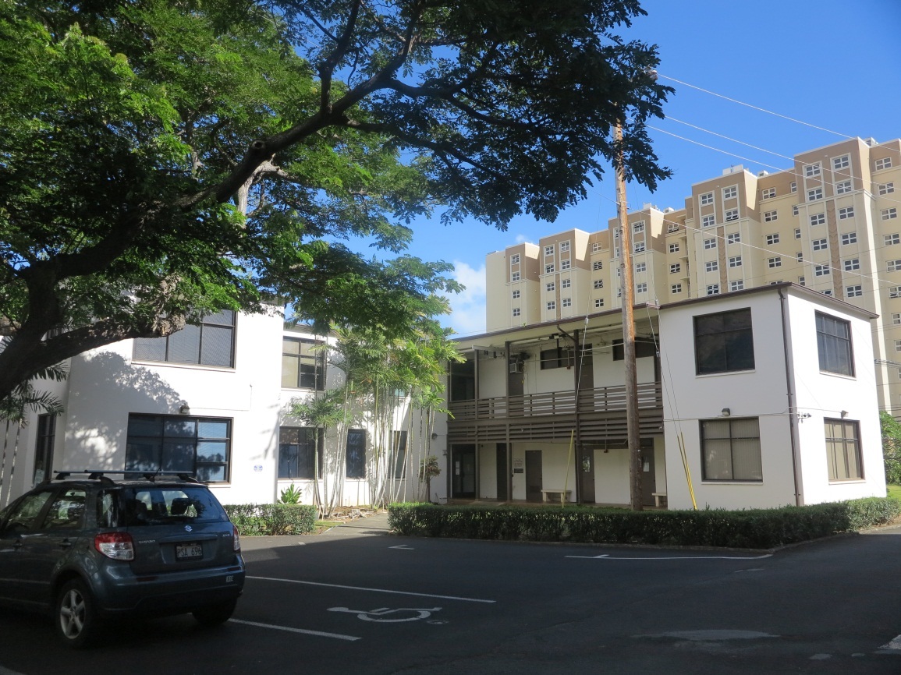

Slide 6
2
Results
What did we get?

Slide 7
1
Fisheries and Management in the Guangdong Province, China:
Challenges and Recent Developments
2
Evaluating the Efficacy of Artificial Reefs in the Guangdong Province, China:
A Case study Using Yangmeikeng Artificial Reef

Slide 8
1
Fisheries and Management in the Guangdong Province, China:
Challenges and Recent Developments

Slide 9
Rich biodiversity, high valuation
Rich biodiversity: fish species – 229, shellfish species – 84， cephalopodium species – 17,（Jia et al.，2012）
Fishery Production
Ecnomic valuation
Guangdong
2010
2000
The figure showed the China’s fishery economic valuation from 1990 to 2010
1990
Notes:
The costal of Guangdong Province is a main marine fishery area of China, historically. There was 229 species fish, 84 species shellfish, 17 species cepholopodium and others in Guangdong. Marine fishing of Guangdong Province is 5 percent of total China Fishery production and 13 percent of total China marine fishing in 1998 (Fisheries Statistical Yearbook, 1999).But the economic valuation of marine fishery in Guangdong is decline from 1990 to 2010. 20 percent in 1990, 13 percent in 2000, and 12 percent in 2010.

Slide 10
Ten billions
Fishery economic valuation of Guangdong province from 1992 to 2011
Notes:
The figure showed that from 1992 to 1996 the fishery economic valuation was increased quickly, but it was no obvious increase at the following phase.

Slide 11
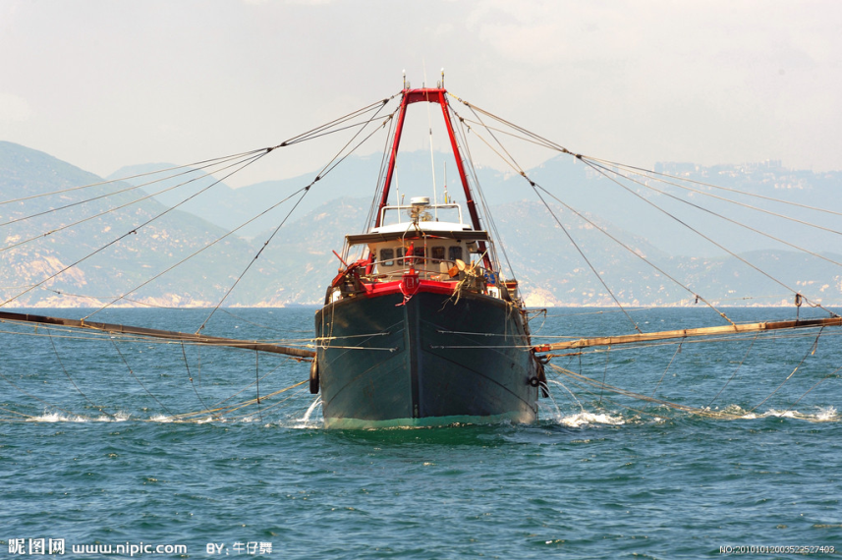
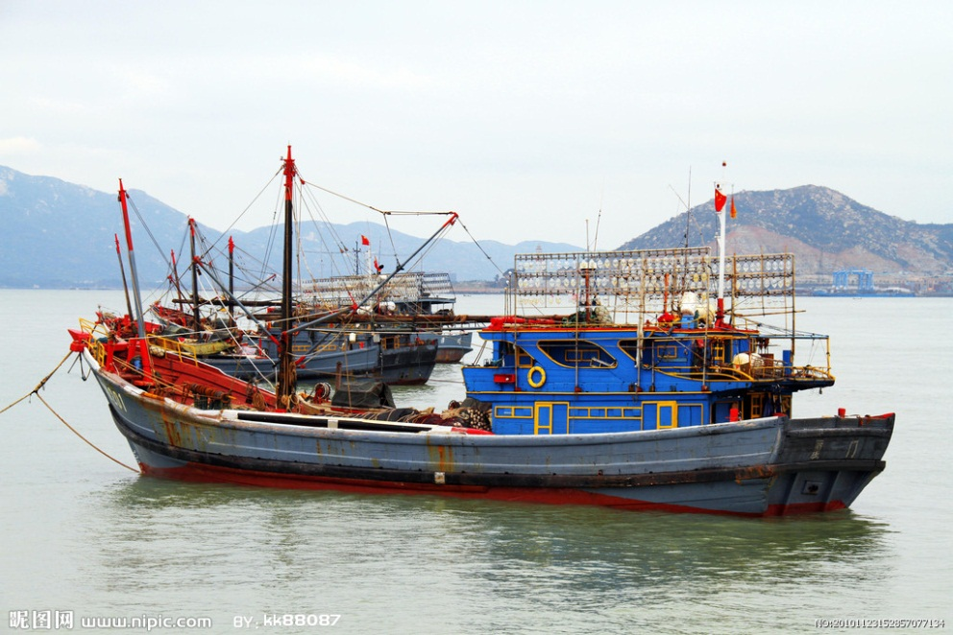
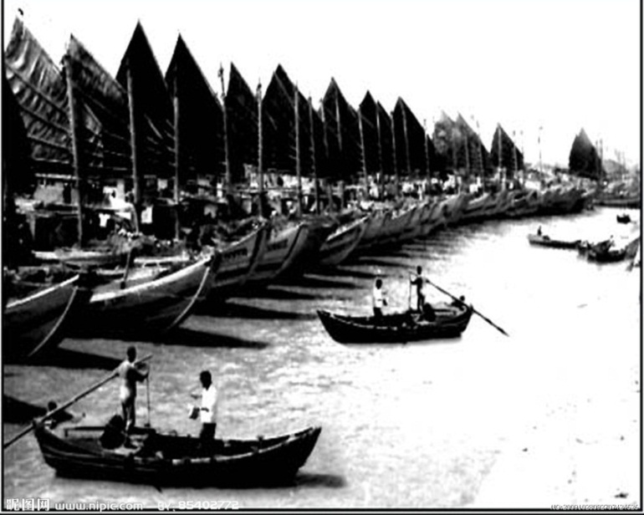
Commercial fisheries
Commercial Fisheries – trawl, gillnet, trap, landline
Fishery species – fish, shrimp, crab, shellfish…
80’ – to now
50’ - 70’
Notes:
Guangdong province commercial fisheries is including trawl, gillnet, trap, landline and so on. 1950’ to 1970’, fish boat was little and unmotorlized.

Slide 12
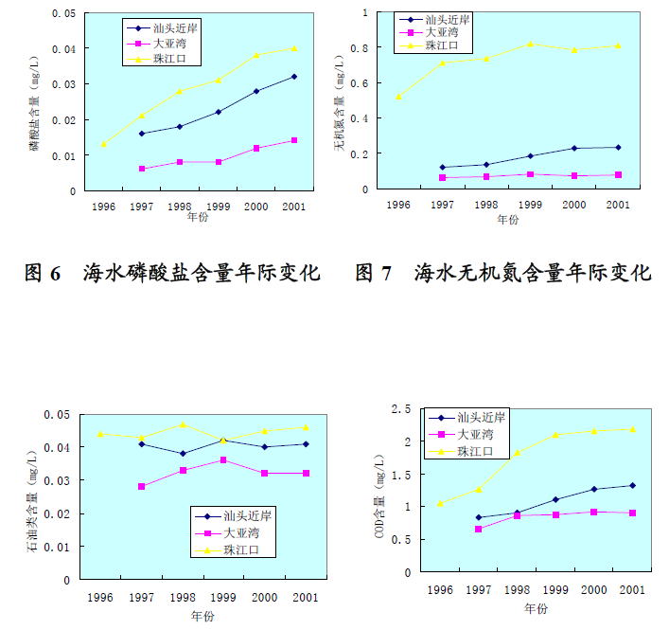
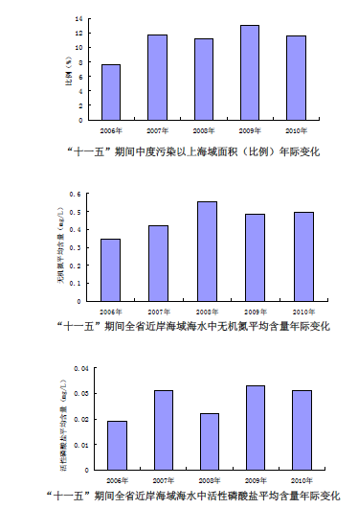
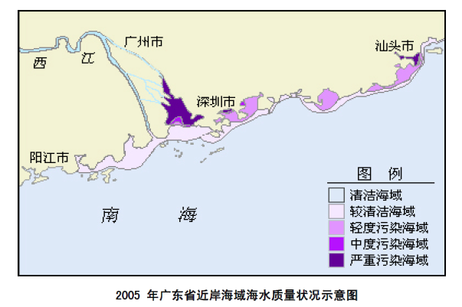
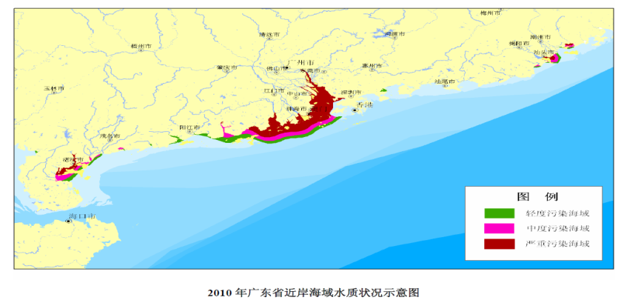
Challenge
Environmental pollution
Notes:
These figures all came from government bulletin of State Oceanic Administration People’s Republic of China. The figures all showed that environmental pollution recently was very serious. The marine animal’s habit was destroyed too.

Slide 13
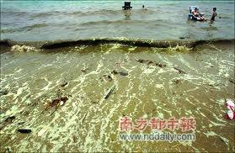
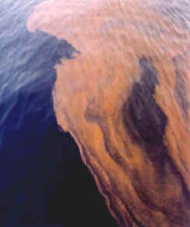
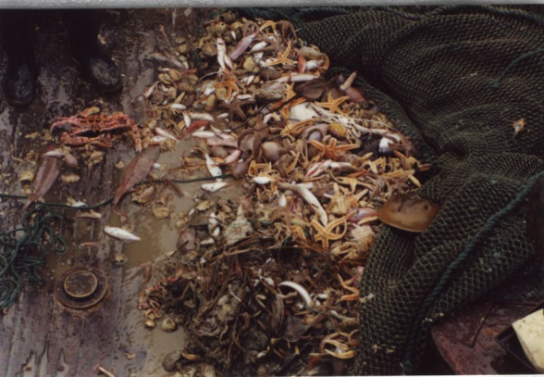
Challenge
Fishery resource decrease
Sea-related projects
Red tide
1980s起
捕捞过度
环境污染
作业破坏
近海渔业资源质量下降
产卵场栖息地生态恶化
以南海为例（潜在渔获量224~260万吨）：
Year CPUE (kg/h) Catch (10⁴ tons / Year) High value Trash fish
1970s: 207.26 150 90% 5%
2000s: 30.62 340 15% 80%
营养级下降

Slide 14
Total catch in Guangdong Province
Data collection - Fisheries Statistical Yearbook
Data – catch from 1950 to 2010
The catches of fishery resource in Guangdong province China
Notes:
From 1950 to 1980 catch of fishery in Guangdong Province was growth slowly. The catch of Guangdong’s present day fisheries have changed dramatically since 1980’s (Fisheries Statistical Yearbook, 1950-1998). The steeply increasion was shown from 1981 to 1998. The total catch has more than four times since 1980 to 1954500 Tons in 1998. Since then, the obvious decrease was shown (Fisheries Statistical Yearbook, 1999-2010).
The predominant commercial fishery was fish, which was caught by trawl, net gill, purse net, pole – and – line etc., and which was including more than ten commercial species. In 1951, over 88% of Guangdong’s total recorded commercial fishery was fish, and the percentage remained over 77% until 2010. However, the catch of shrimp and crab increased rom less than 1% in the 1950’s to more than 15% in the recent ten years, shellfish fishery showed the same trend.

Slide 15
CPUE
The fluctuation of CPUE of different fishing methods
Notes:
Simple catch per unit of fishing effort (CPUE) on yearly effort over the time period 1986-2010 is shown in Figure 4. The total fishing trends were rising over the time period 1986-2003, then it were to a stable level. Fishing methods employed in Guangdong province include trawl, gill net, pursue, stow net, line angle and others. The most important fishing method is trawl. Pursue is the second most important fishing method.

Slide 16
Vessel
Notes:
There are many elements to there recent changes in Guangdong’s fishery catch. Perhaps in the 1980’s the motor vessels began to bloom (fig…). Motor vessels were gradually replaced the non-motorized vessel in 1980s. Also change of fishing method and fishing tools increase the fish effort.

Slide 17
Conclusion
From 1950 to 1980 catch of fishery in Guangdong Province was growth slowly.
The catch have changed dramatically since 1980’s.
The steeply increasing was shown from 1981 to 1998. The total catch has more than four times since 1980 to 1954500 Tons in 1998.
Since then, the obvious decrease was shown.
In recent years catch increased slightly

Slide 18
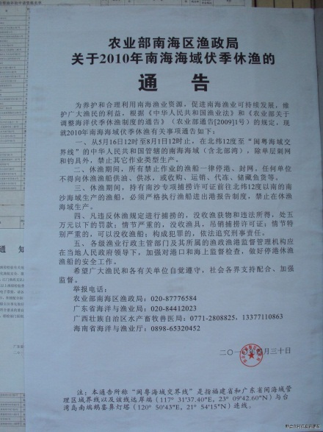
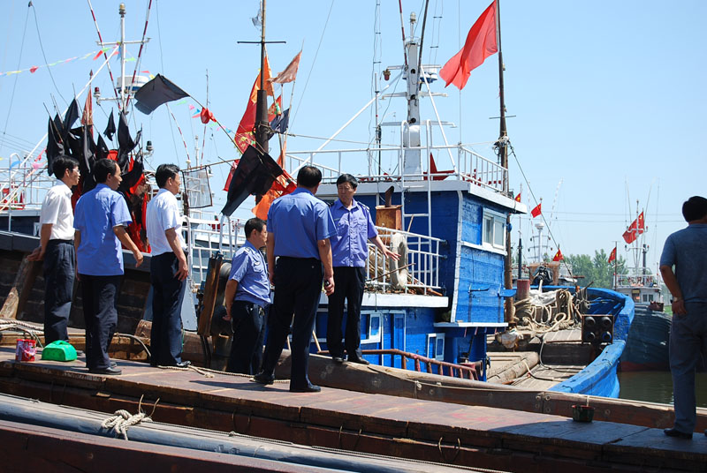
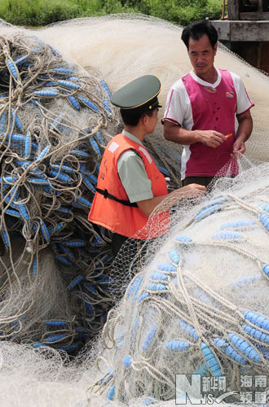
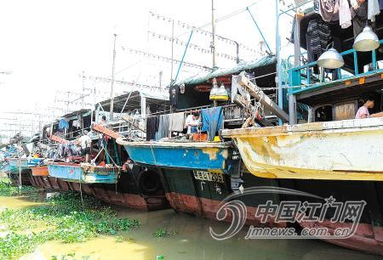
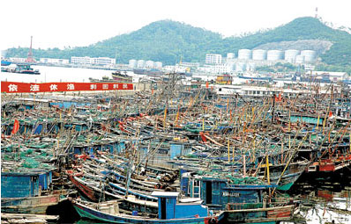
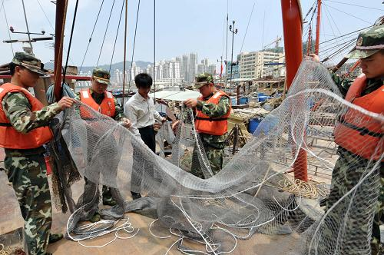
Fisheries management strategies in Guangdong province:
China’s Summer Fishing Moratorium (Close Season)
Object – Protect the fishery resource, sustainability…
Initial - 1999
Notes:
At this time

Slide 19
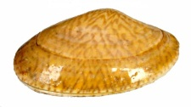
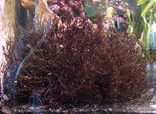
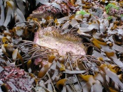

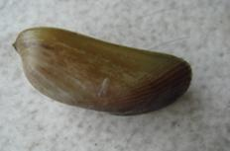
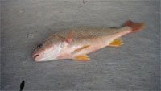
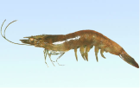
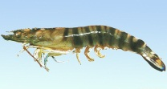
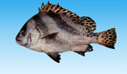
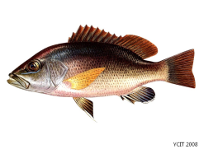
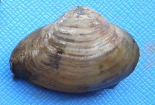
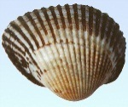
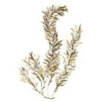
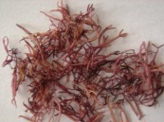
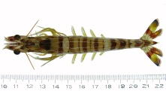

Fisheries management strategies in Guangdong province:
Stocking enhancement
Object: restoration of fishery resource
Initial: 1980, large scale from 2001
Species : fish, shrimp, shellfish, sea turtle, macroalgae…
Up to dozens of varieties…
shellfish
Chlamys nobilis, Meretrix meretrix, Paphia undulata, Mactra antiquata
Fish
Lutianus argentimaculatus, Lutjanus sanguineus, Acanthopagrus schlegel, parus latus, Plectorinchus cinctus
Macroalge
Porphyra sp., Gracilaria sp., Laminaria japonica, Sargassum sp.
Shrimp
Penaeus monodon, Penaeus japonicus, Fenneropenaeus chinensis, Penaeus （Fenneropenaeus） Penicillatus, Penaeus merguiensis

Slide 20
Why we selected these species
Local species
Economic evaluation
Food web: feed…
Seed
Biodiversity

Slide 21
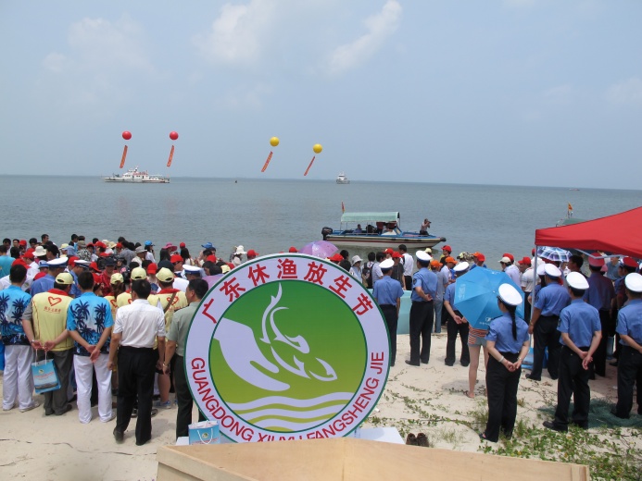
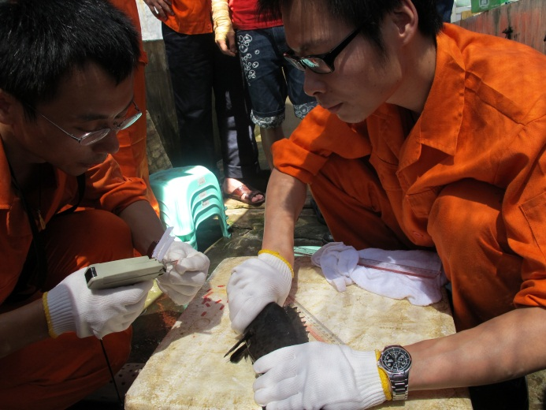
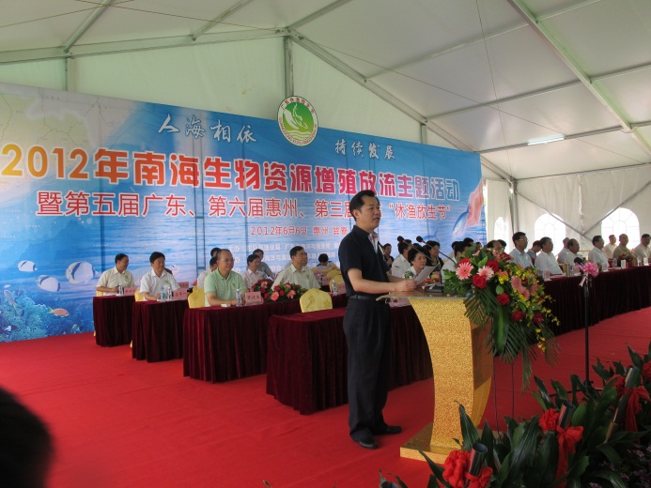
When we stocking…
During stocking the fishery is closed
Time: China’s Summer Fishing Moratorium in 2008
Why: prevent the larval from fishermen
Release fishing festival: Promot, Spur
Notes:
consciousness

Slide 22
No. | Species | Quantity, million per year
1 | 花鲈 Lateolabrax japonicus | 4
2 | 青石斑鱼 Epinephelus awoara | 2
3 | 斜带石斑鱼 Epinephelus coioides | 1
4 | 卵形鲳鲹 Trachinotus ovatus | 2
5 | 军曹鱼 Rachycentron canadum | 0.5
6 | 大黄鱼 Pseudosciaena crocea | 2
7 | 紫红笛鲷 Lutianus argentimaculatus | 2
8 | 红笛鲷 Lutjanus sanguineus | 2
9 | 星斑裸颊鲷 Lethrinus nebulosus | 2
10 | 真鲷 Pagrus major | 3
11 | 平鲷 Rhabdosargus sarba | 4
12 | 黑鲷 Acanthopagrus schlegel | 4
13 | 黄鳍鲷 Sparus latus | 3
14 | 断班石鲈 Pomadasys hasta | 2
15 | 三线矶鲈 Parapristipoma trilineatus | 4
16 | 花尾胡椒鲷 Plectorinchus cinctus | 1.8
17 | 斑节对虾 Penaeus monodon | 50
18 | 日本对虾 Penaeus japonicus | 50
19 | 中国对虾 Fenneropenaeus chinensis | 20
20 | 长毛对虾 Penaeus （Fenneropenaeus） Penicillatus | 100
21 | 墨吉对虾 Penaeus merguiensis | 100
22 | 杂色鲍 Haliotis diversicolor | 0.5
23 | 华贵栉孔扇贝 Chlamys nobilis | 300
24 | 文蛤 Meretrix meretrix | 400
25 | 波纹巴非蛤 Paphia undulata | 300
26 | 西施舌 Mactra antiquata | 20
27 | 绿海龟 Chelonia mydas | 0.0028
28 | 中国鲎 Tachpleus tridentatus | 4
29 | 大珠母贝 Pinctada maxima | 1.6
30 | 紫菜 Porphyra sp. | 4
31 | 宽额鲈Promicrops lanceolatus | 0.2
32 | 黄唇鱼Bahaba flavolabiata | 0.2
33 | 海萝 Gloiopeltis sp. | 2
34 | 蜈蚣藻类 Grateloupia sp. | 1
35 | 江蓠类 Gracilaria sp. | 4
36 | 麒麟菜类 Eucheumae sp. | 2
37 | 海带 Laminaria japonica | 1.5
38 | 马尾藻类 Sargassum sp. | 6
39 | 蕨藻类 Caulerpa sp. | 2
the plan of stocking enhancement in Guangdong province from 2010 to 2015 (Chen et al., 2009)

Slide 23
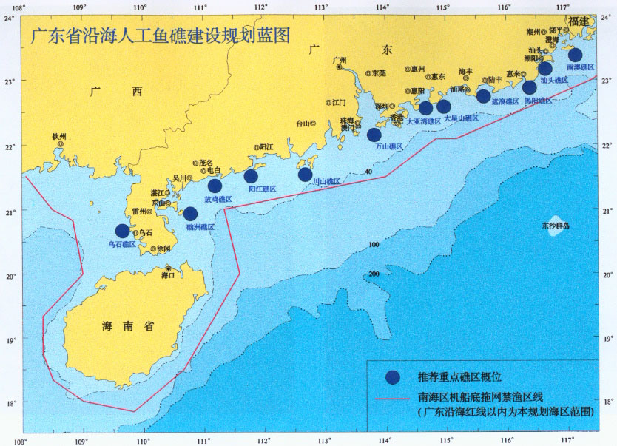
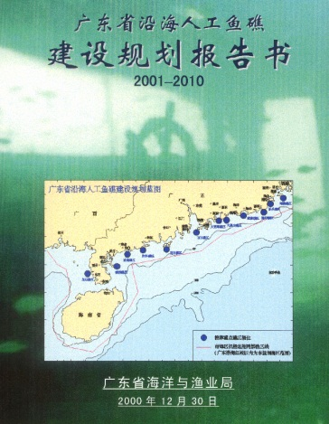
Fisheries management strategies in Guangdong province:
Artificial reef construction
History: Rich experiences of artificial reef achieved in Guangdong during 1981-1985, large scale construction from 2001 - Plan of artificial reef deployment

Slide 24
Construction schedule and scale

Slide 25
Fisheries management strategies in Guangdong province:
Other management strategies
MPA – 1983-1990 (5), 1990 – 1998 (3), 1999 – 2003 (24)…
Fishing license
Limit fishing (catch limit)
Minimum legal size
Gear constraint (mesh size)
Buy-back (vessel) and substities (not to fish)
Marine ranching combined with habitat enhancement

Slide 26
Discussion: it works or not…
The catch of Guangdong province from 1950 to 2010

Slide 27
Catch of grouper from 1982 to 2010
Notes:
Garouper

Slide 28
Catch of large yellow croaker from 1982 to 2010
Notes:
large yellow croaker

Slide 29
Catch of shrimp

Slide 30
Guangdong’s coastal fishery was overfishing
Fisheries management strategies in Guangdong province is working now…
Which one is best？
How and when?
We expected…
Fishery resource increasing
Environmental
Water quality
Others
Stocking enhancement
Close season
Artificial reef construction
Others

Slide 31
2
Evaluating the Efficacy of Artificial Reefs in the Guangdong Province, China:
A Case study Using Yangmeikeng Artificial Reef

Slide 32
Survey Station design: how to select the station
Reef unit
Difference of reef structure
reef modules
Reef set
The same reef unit or difference reef unit, a large scale
Assembling more than one group into coherent layout
Many reef sets, different reef unite and reef set
Reef group
Reef complex
The influence of water current
Water nutrition and fish…

Slide 33
Yangmeikeng Artificial reef
Construction time: Mar 20, 2007 to Dec 25, 2007
Reef Area: 2.65 km²
Construction scale: 12 type reef; 2272 reef, 18 reef group;
Reef volume: 95 100 m³

Slide 34
Reef modules
in Yangmeikeng reef

Slide 35
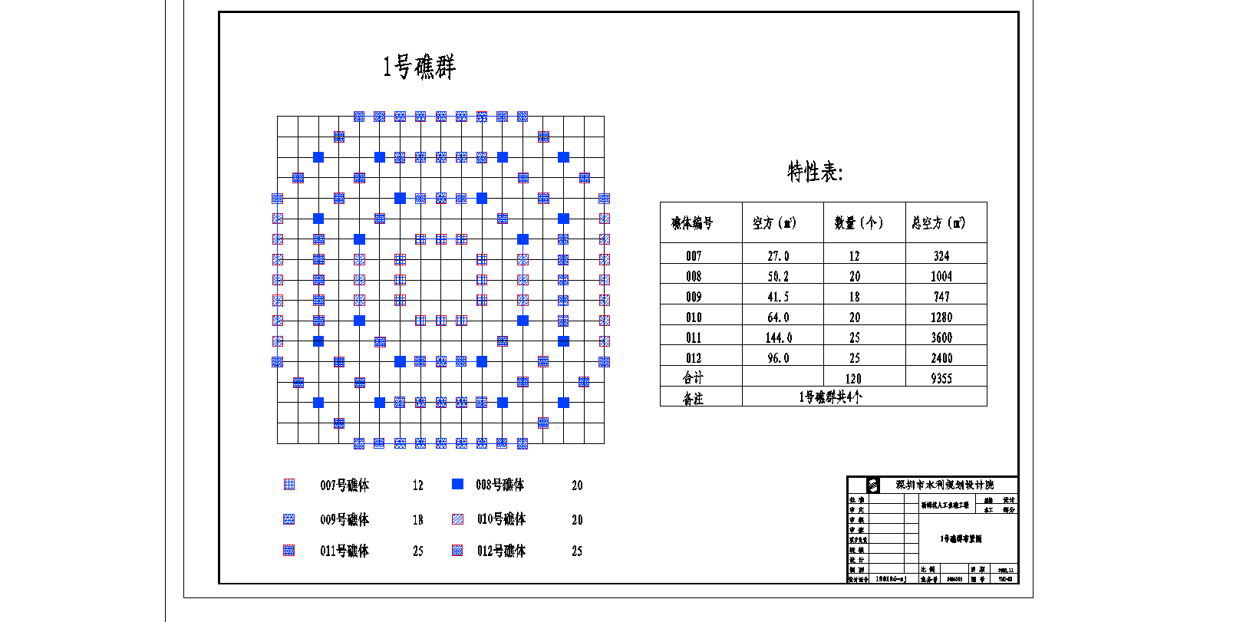
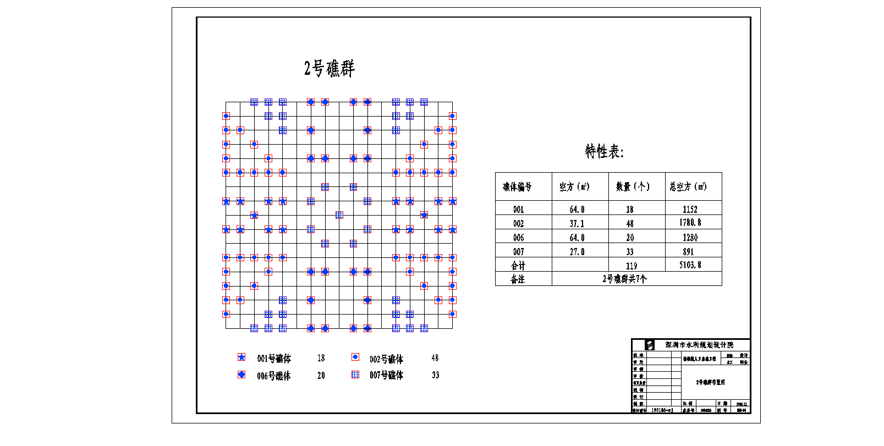
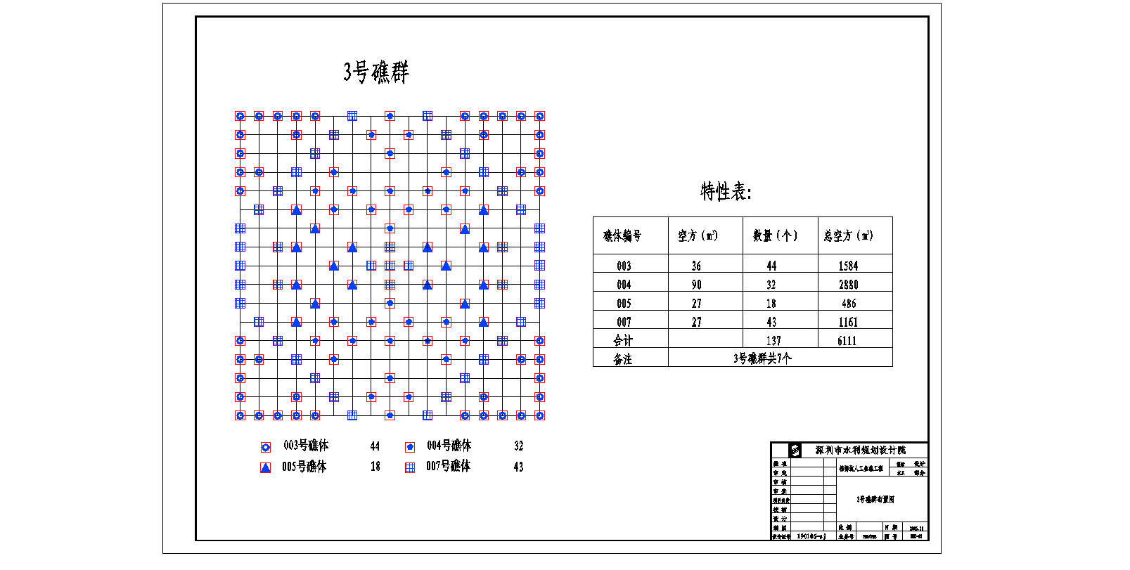
Reef group 1
Reef group
in Yangmeikeng reef
Reef group 3
Reef group 2

Slide 36
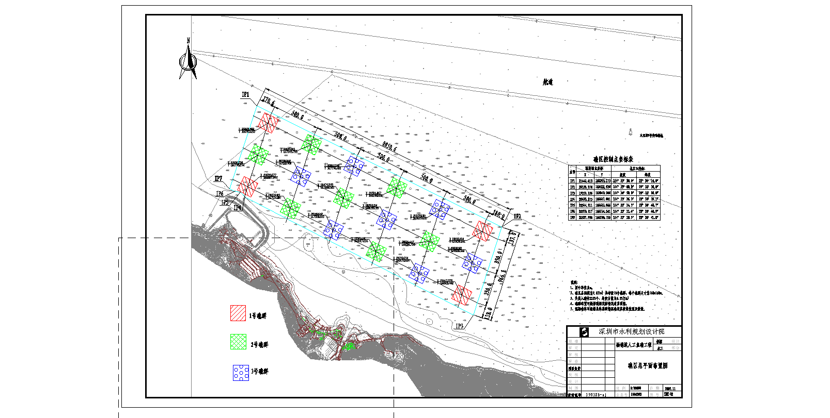
Reef complex
in Yangmeikeng reef

Slide 37
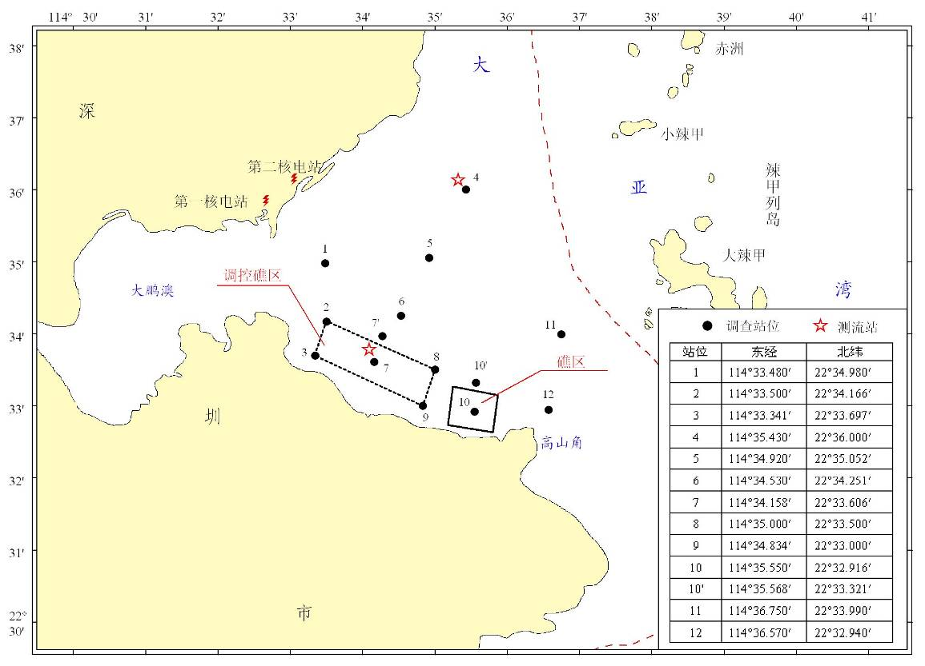
Survey station in Yangmeikeng reef

Slide 38
Data source: which style data we need
Survey data: trawl, gill net…
Historical data: trawl, gill net
Survey time: Mar 2007 (control survey); Mar, May, Aug, Nov 2008 and May 2009

Slide 39
Trawl data preliminary results
167 species fishery resoruce: 74 fish, 30 crab, 4 shrimp, 8 cephalopod, 35 scallop.
1.5 - 1.8 times
Survey fishery species in Yangmeikeng reef

Slide 40
2.72 – 8.10 times
4.68 – 17.48 times

Slide 41
1.57 – 3.14 times
Gill net data;
Total 75: 59 fish, 3 shrimp, 7 crab, 4 squila, 2 cephalopod
4.17 – 13.26 times

Slide 42
6.16 – 13.04 times

Slide 43
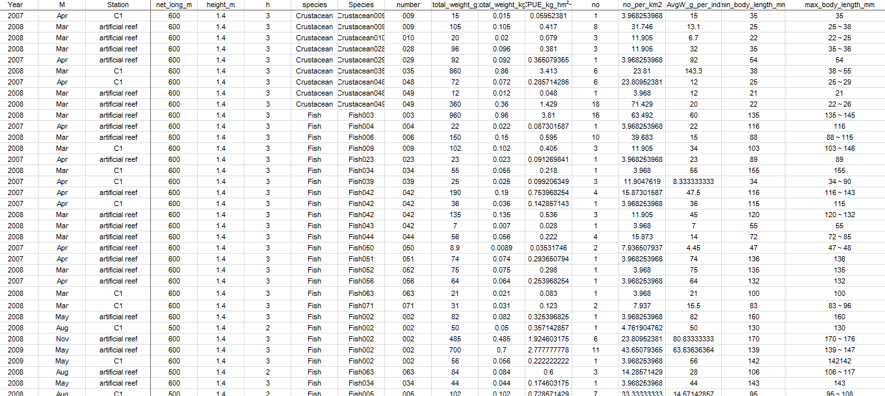

Slide 44
Further analysis:
Regression Tree will be used to analysis the catch data. – VERY VERY PRELIMINARY FOLLOW.

Slide 45
Yangmeiken
Sampling areas
(10-20 m depth)

Slide 46
Yangmeiken
Artificial reefs were deployed in 2008.
Both trawl and gillnet surveys were conducted before and after the effect.
2007: 1 survey (Apr)
2008: 4 surveys (Mar, May, Aug, Nov)
2009: 1 survey (May)

Slide 47
Sampling area
Trawl
Stations: 1, 4, 5, 6, 7 ,10, 11, 12
Gillnet
Stations: 4, 7
Note: fishing activities are prohibited in reef areas. Survey was conducted near reef.

Slide 48
Sampling method
 | Trawl | Gillnet
Identify species | All catch | All catch
Sampling catch (in no and weight) | Most fish were 100% sampled or subsample (25%). Crustacean were either 100% sampled or subsampled (6%, 12.5%, or 25%) | 100% sampled
Individual length and weight | Max and min | Max and min

Slide 49
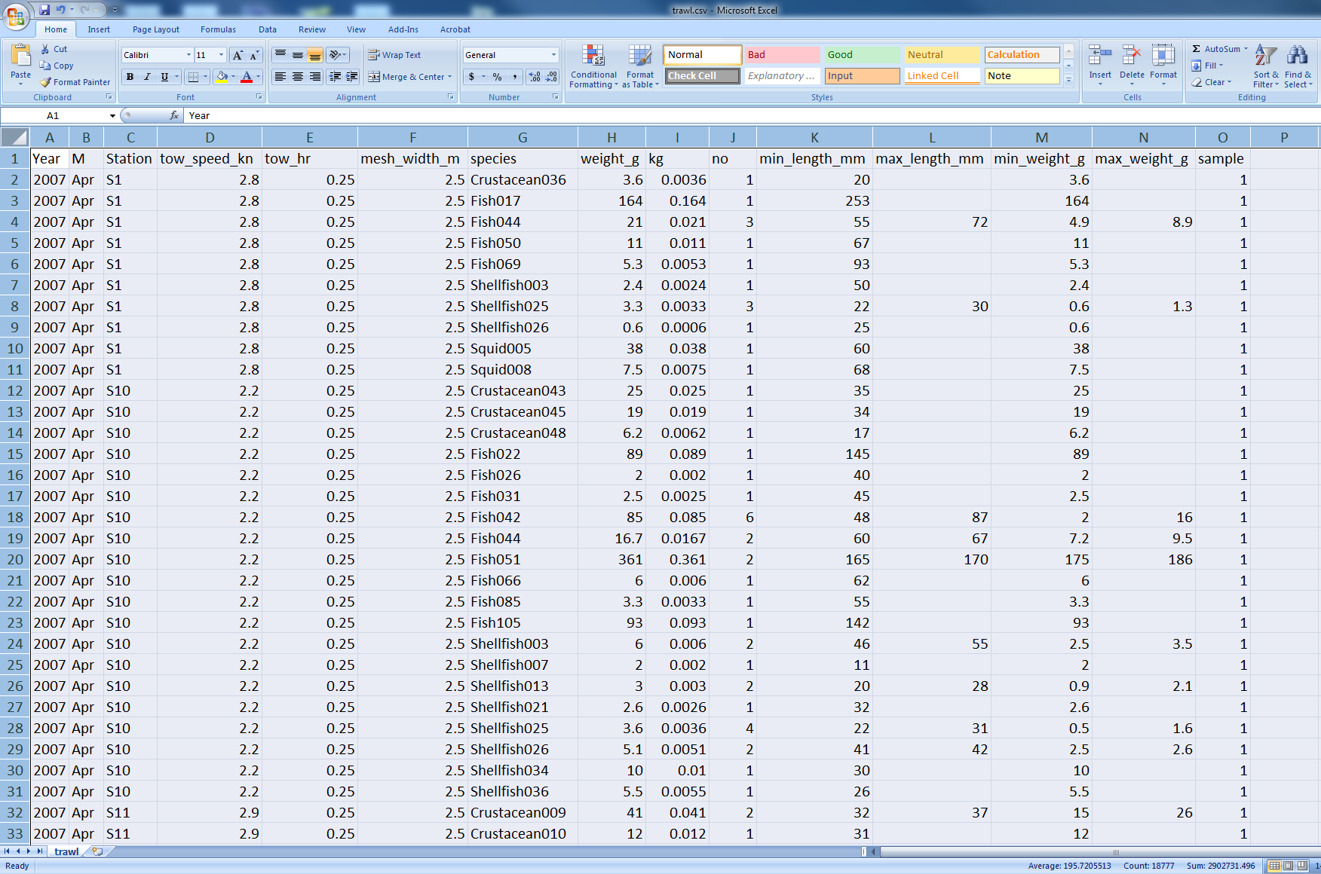
Trawl survey data

Slide 50
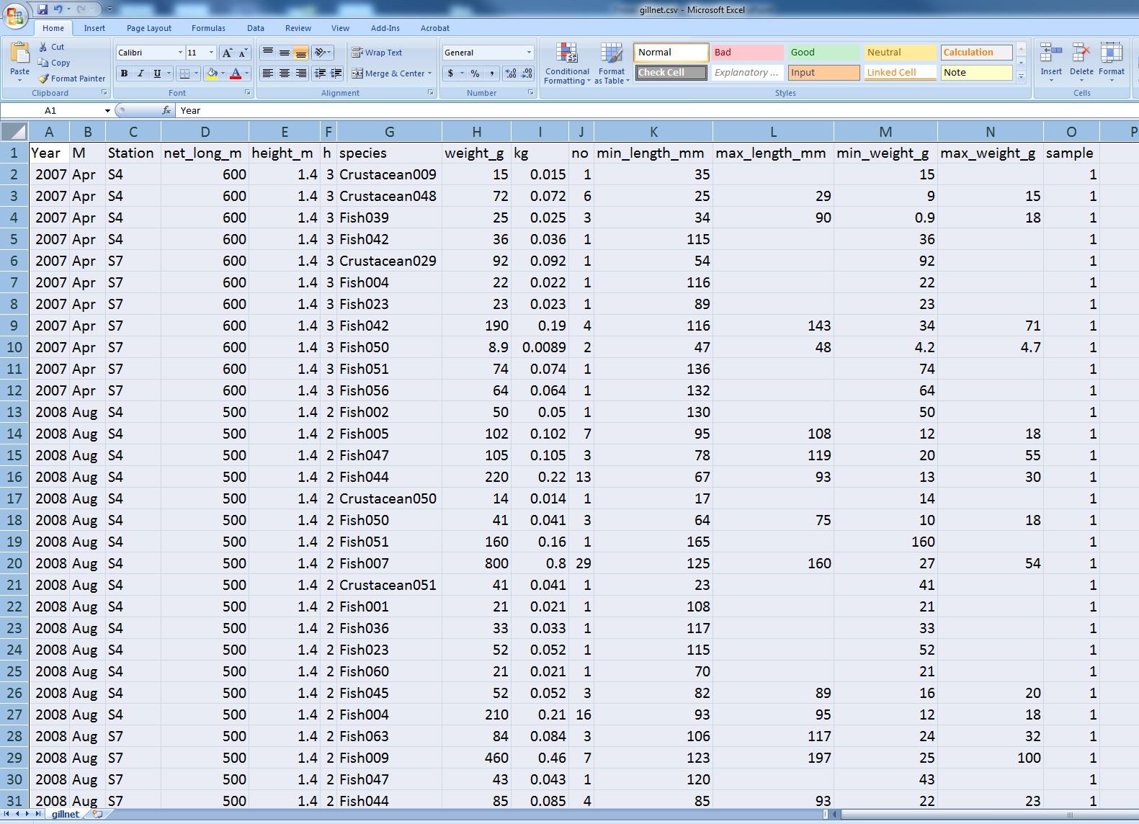
Gillnet survey data

Slide 51
Trawl survey data – Regression Tree
Fish sets (included all species)
CPUE ~ Year + season + Station, CPUE=no/swept_area(km²)
Fit all data (largest tree)
Cross-validation
Pruned tree based on the min deviance
S1,S4,S5,S7,
S10,S11,S12
S6
S1,S4,S5, S11,S12
S7, S10
S6, 2007
S6 2008, 2009,
Season 1, 2 ,3
S6 2008, 2009,
Season 4

Slide 52
Gillnet survey data – Regression Tree
Fish sets (included all species)
CPUE ~ Year + season + Station, CPUE=kg/swept_area(km²)
Fit all data (largest tree)
Cross-validation
Pruned tree based on the min deviance
S4
S7
S4
S7, 2007
S7, 2008, 2009,
Season 1, 2
S7, 2008, 2009,
Season 3, 4

Slide 53
3
What will we get from the data？
Conclusion

Slide 54
Conclusion
Management measures were taken to protect the fishery resources – closed season, habitat enhancement, stock enhancement.
The catch of three species of fish increased after the manage measures were adopted.
Preliminary regression tree analyses also detect changes in catch associated with the implementation of habitat and stock enhancements. Further analyses on the full data set are required to look for benefits.
Additional modifications to the existing surveys may be required to collect necessary data to assess benefits (e.g. size data).

Slide 55
4
What will we do next step？
Work plan

Slide 56
Future work plan
Complete paper describing fisheries management in Guangdong Province – publish in scientific journal
Conduct additional data mining of the Guangdong Prov. artificial reef survey data as well as fishery data.
Extend Regression Tree analyses to determine effects of the adopted fisheries management measures (habitat and stock enhancement)
Publish results of analysis in scientific journal.
Develop stock assessment models for reef species in Guangdong province that specifically account for habitat and stock enhancements.

Slide 57
Bottlenecks
Based on the Hawaii experience:
  Time – one month exchanges is not long enough to conduct the work. Exchanges should be three months.
  Support – sufficient financial support will be required to conduct exchanges.
  Data – a data exchange-sharing agreement should be established
  Monitoring – monitoring of existing reefs is not conducted. To conduct assessments a long-term monitoring program should be established.

Slide 58
Thanks!

