Slide 1
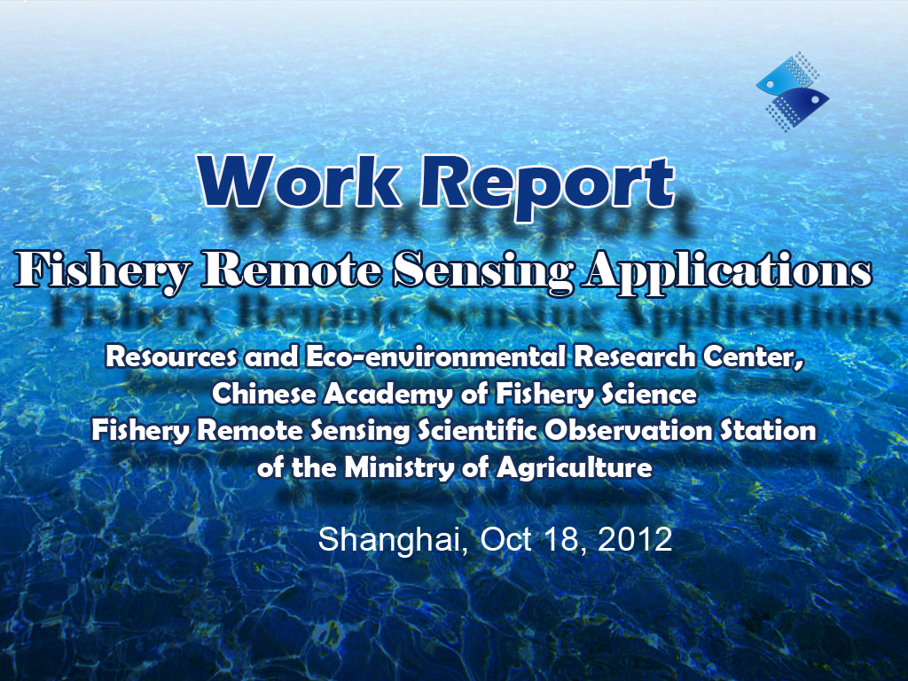
Work Report
Fishery Remote Sensing Applications
Resources and Eco-environmental Research Center,
Chinese Academy of Fishery Science
Fishery Remote Sensing Scientific Observation Station
of the Ministry of Agriculture
Wang Lin
Shanghai, Oct 18, 2012

Slide 2

Contents
Brief review of our research center
Case studies
Continue the fishery habitat remote sensing mapping effort
Proposals for cooperation

Slide 3
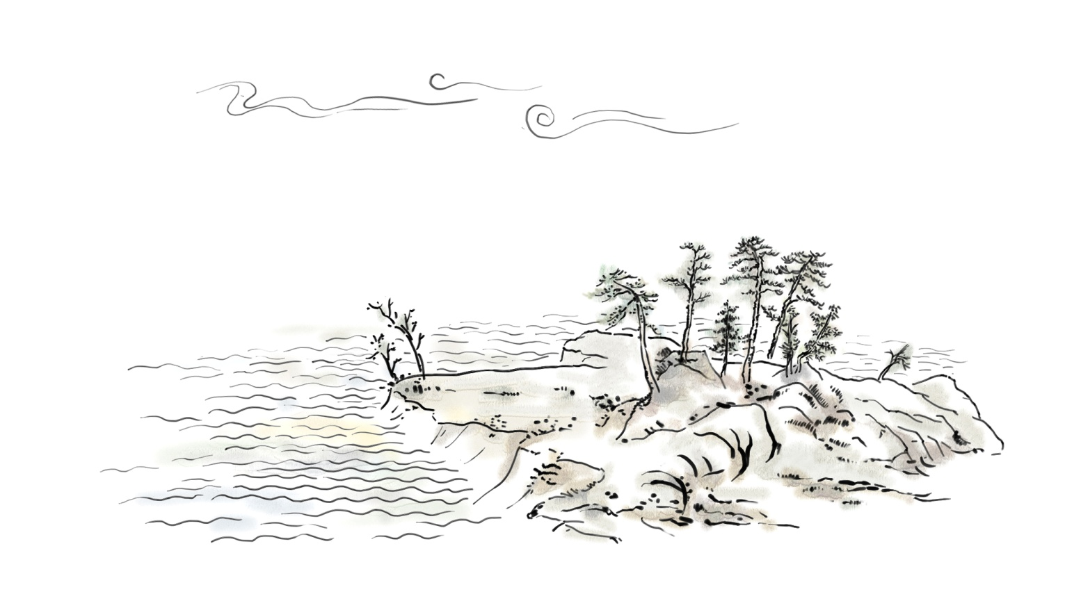
Chinese Academy of Fishery Sciences
Resources and Eco-environmental Research Center
Brief review

Slide 4
The Mission of the new Earth Science Initiative
To create and effectively disseminate fundamental knowledge about the fishery science and their interactions, its resources and environment, and the processes by which it changes;
To monitoring and predict the respond of fishery resources to natural environmental and human-caused change from local to regional and global levels;
To train students, future leaders, and educate the broader public in the fishery sciences for remote sensing and GIS technology application;
To integrate, synthesize, and apply scientific knowledge to societal problems, such as the sustainable development of fishery resources, water and other related resources, the identification and mitigation of risks posed by natural hazards, and the consequences of human activities on the environment.

Slide 5
Short-term goals
Interaction between fishery resource, ecological environmental change and human activities
Multi-scale observation and data assimilation
Spatio-temporal modeling of fishery ecological environmetal changes based on RS, GIS and high performance computing
Fishery ecological disaster monitoring and impact assessment
Fishery Science
Ecology
Ocean science
Geography
Geocomputational science
Observation, experiment, simulation combined in support of fishery resources and ecological environmental protection.

Slide 6
Research strategies
Observation – data accumulation – modeling –
understanding – policy making
Environment policy
Effect evaluation
Impact assessment
Improve policy
Experiment and observation
Simulation and prediction
Understanding

Slide 7
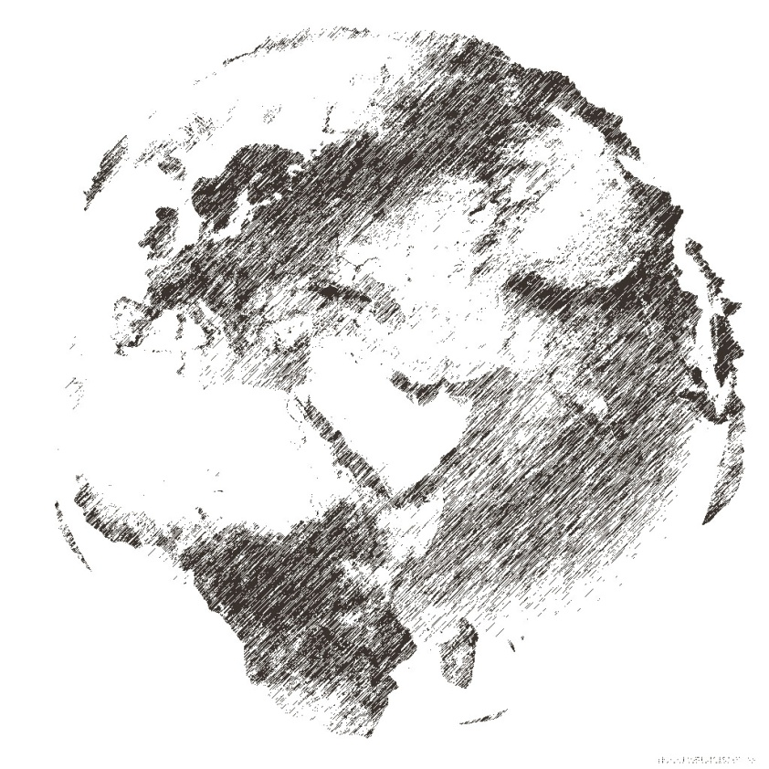
Chinese Academy of Fishery Sciences
Resources and Eco-environmental Research Center
Case studies in costal area

Slide 8
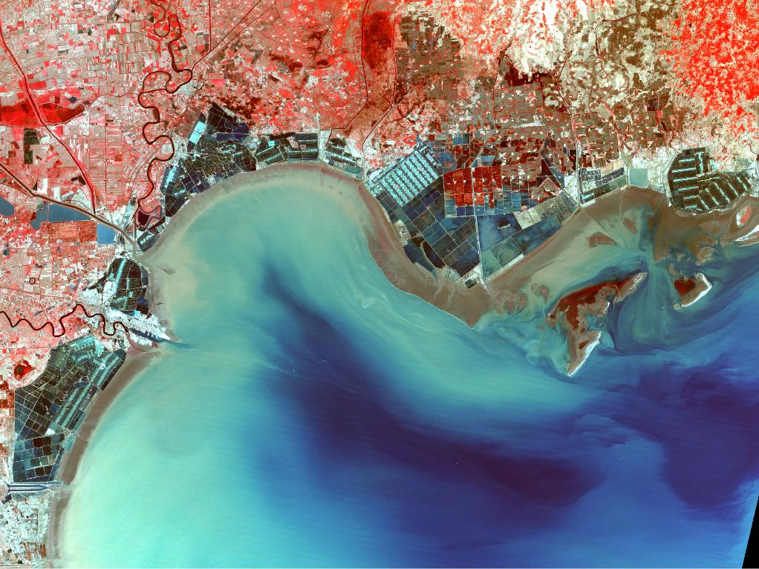
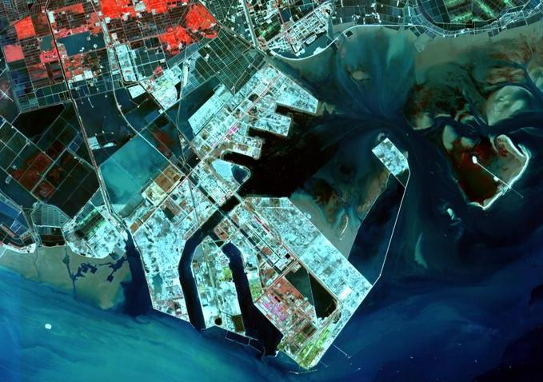
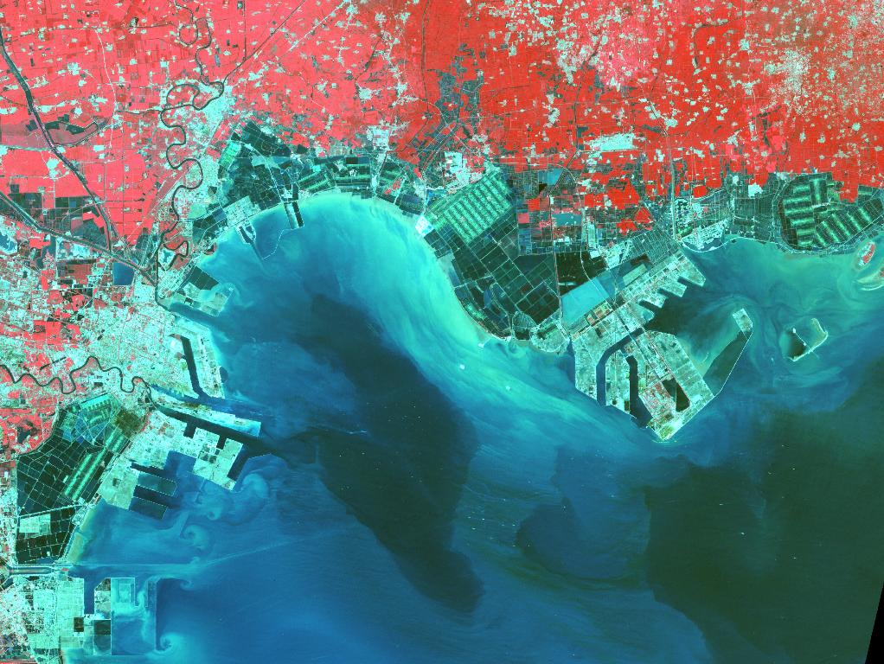
Change detection of major costal wetland cover through the reclamation construction period using time-series RS data over north of Bohai Bay, China.
1987
2012 Caofeidian
2011
Notes:
采用美国Landsat专题制图卫星自1987年以来的卫星遥感图像，对渤海湾北部海域围填海工程（范围主要涵盖了河北曹妃甸和天津滨海新区）的发展变化开展监测。以2003年5月18日对应的滩涂、沉水植物分布范围为基准，定量获取围填海工程占用海域、滩涂、及沉水植物分布面积的动态变化情况。

Slide 9
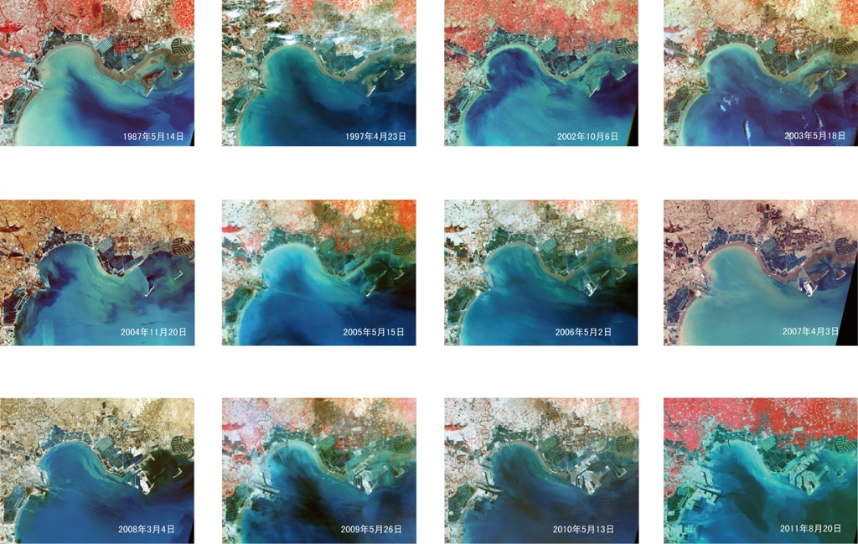
Time series Landsat TM and ETM+ data

Slide 10
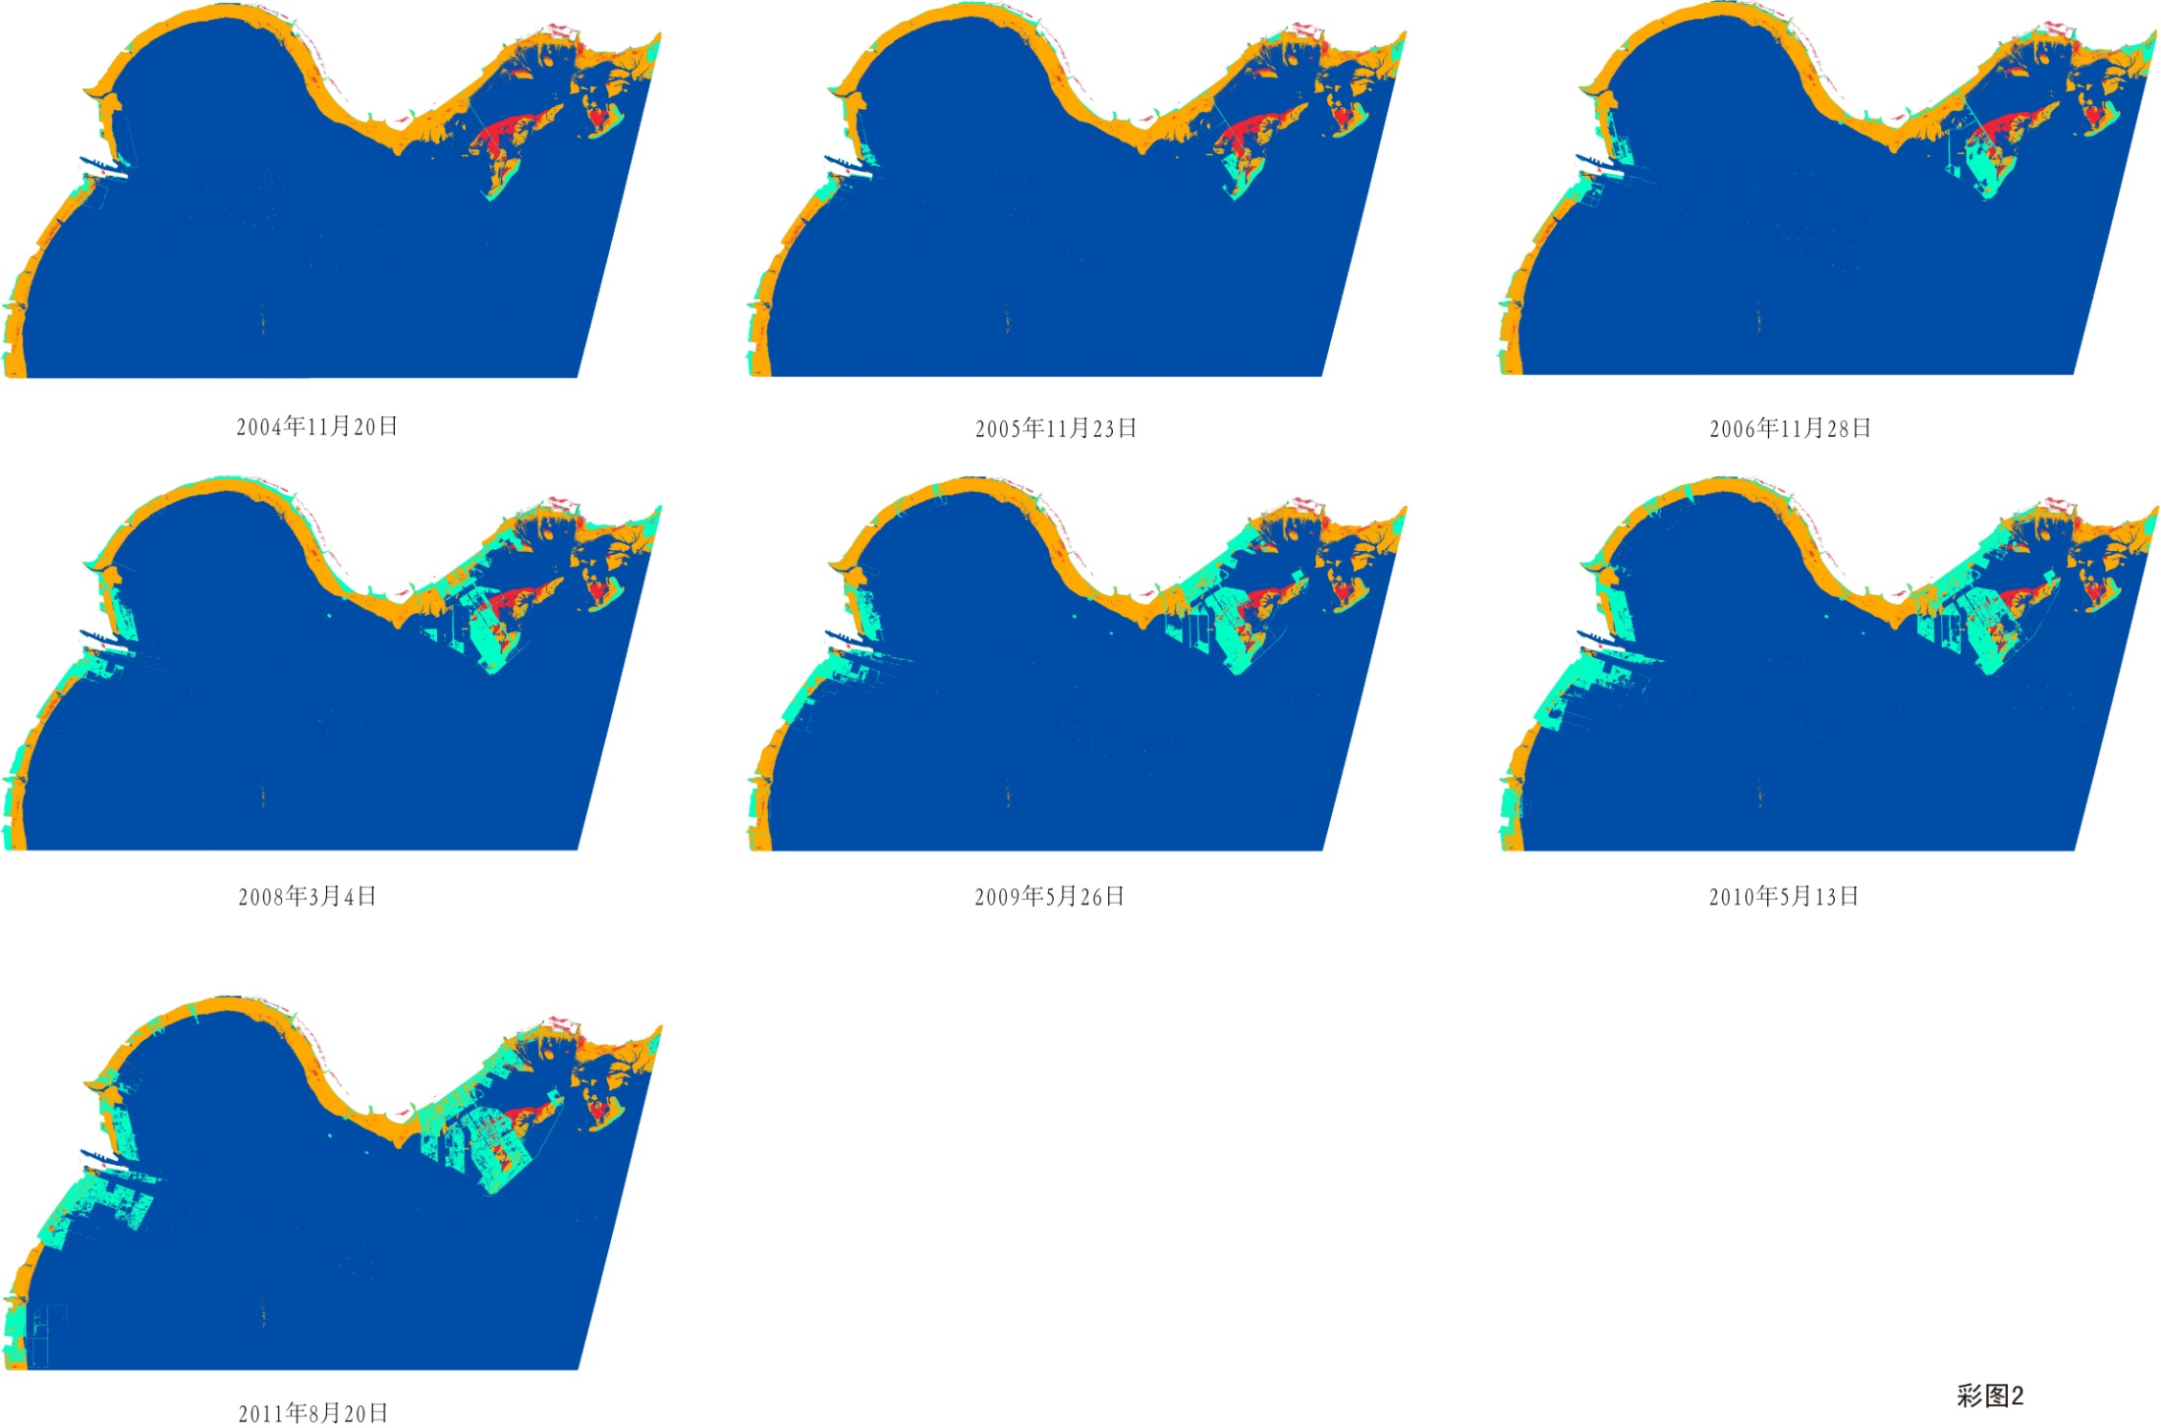
Sea, interstitial wetland, aquatic macrophytes distribution mapping for different years since from 2004

Slide 11

The reclamation occupation area and the rate of change
 | Sea occupation /km² | Intertidal wetlands occupation/km² | Aquatic macrophytes occupation/km²
2004.11.20 | 37.25 | 27.96 | 0
2005.11.23 | 68.52 | 48.4 | 0
2006.12.28 | 114.59 | 68.35 | 4.49
2008.03.04 | 216.14 | 149.74 | 9.14
2009.05.26 | 328.16 | 152.74 | 12.43
2010.05.13 | 445.12 | 177.26 | 16.04
2011.08.20 | 545.51 | 188.98 | 23.65

Slide 12
Automatic detection of shoreline change on costal with respect to comparing the impacts between fisheries and sea reclamation
Landsat TM and ETM+
No | Date | Length of the shoreline/km
1 | 05/14/1987 | 224.5
2 | 04/23/1997 | 241.8
3 | 06/18/2000 | 244.8
4 | 02/08/2002 | 248.8
5 | 05/18/2003 | 252.2
6 | 11/20/2004 | 251.3
7 | 05/15/2005 | 258.0
8 | 05/02/2006 | 260.3
9 | 04/03/2007 | 286.8
10 | 03/04/2008 | 384.1
11 | 05/26/2009 | 4588.2
12 | 05/13/2010 | 486.9
13 | 08/20/2011 | 522.5
Spectral (At sensor) Radiance
TOA Reflectance
The general length of the shoreline gradually increased, but the relative natural shoreline decreased from 221km for 1987 to about 100km for 2011, and the seaward of the extended shoreline is 421 km,which occupied 80.7% of the whole length.
RTOA(Green)
RTOA(IR)
Applying NDWI
Automatic Thresholding
Binary Image(Land and Water)
Coastline Contouring
Notes:
Coastline were extracted from satellite images for 1987、1997、2000、2002、2003、2004、2005、2006、2007、2008、2009、2010 and 2011 by segmentation with histogram based on automatic threshhoding method. then, the detected coastline is transferred to GIS environment as a shape file for further processing and mapping. We found that the general length of the shoreline gradually increased, but the relative natural shoreline decreased from 221.5km for 1987 to 100.9km for 2011,and the seaward of the extended shoreline is 421.6km,which occupied 80.7 percent of the whole lengh.

Slide 13
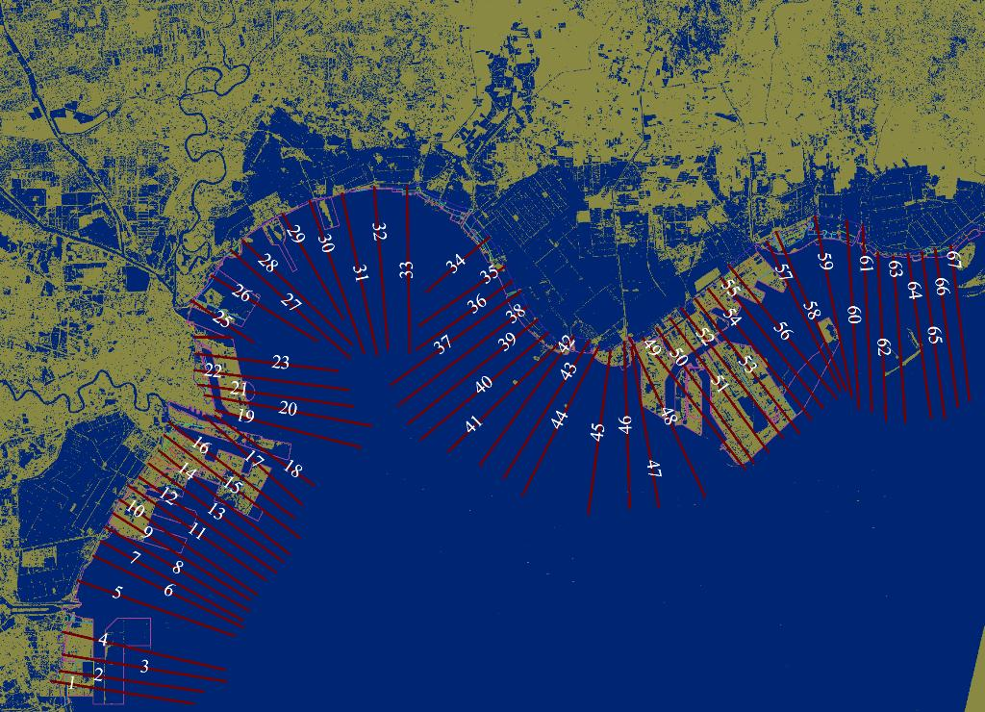

The coastal land loss is arising primarily because of human activies such as agriculture, irrigation, reclamation and fishery.
On the one hand, the most significant changes were observed at the reclamation projects of Caofeidian and Tianjin Port, in this area the net rate of erosion averaged over 32 transects was 375m/yr.
On the other hand, the net rate of erosion averaged over 34 transects which represented the impacts by agriculture, irrigation and fishery was 34m/yr.
According to this, the impact of the reclamation is 10 times as large as agriculture and fishery to the coastal land loss over the north Bohai Bay.
the coastline rate of change was calculated using DSAS software with Weighted Linear Regression Rate-of-change(WLR) techniques.
Notes:
After this stage, the coastline rate of change was calculated using DSAS software with Weighted Linear Regression Rate-of-change(WLR) techniques. As a result of analysis, the coastal land loss is arising primarily because of human activies such as agriculture, irrigation, reclamation and fishery. And among of these reasons, the most significant changes were observed at the reclamation projects of Caofeidian and Tianjin Port, which represented the two biggest ocean projects over the north of Bo Sea Bay, with 852m/yr average rate of change at Caofeidian and 542m/yr at Tianjin Port.
You need set a baseline, and DSAS generates transects that are cast perpendicular to the baseline at a user-specified spacing along-shore. The transect shoreline intersections along this baseline are then used to calculate the rate-of-change statistics.

Slide 14
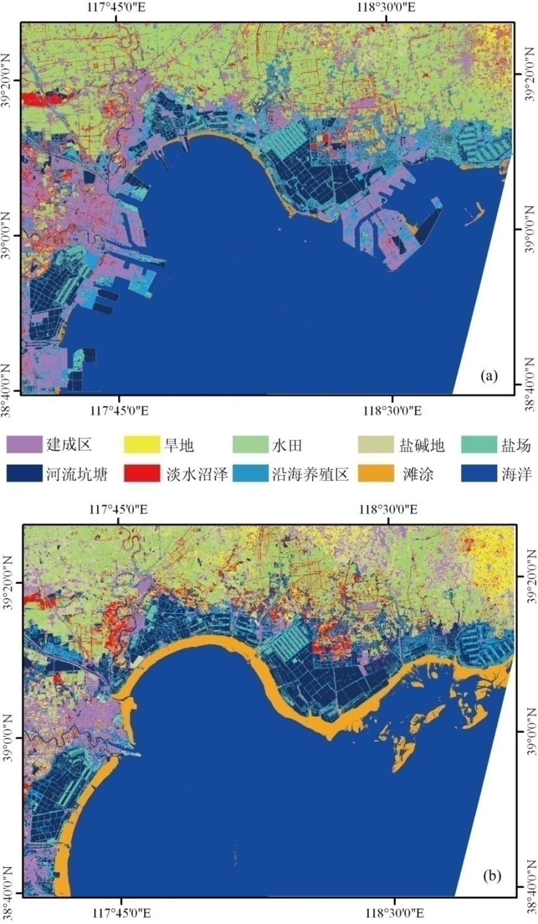

Landscape analysis of coastal ecosystem supply and demand for: the effects of reclamation, land cover change, and classification method
Land use and land cover change between 2003 and 2011
Land cover types | The area of each type in 2003/km² | The area of each type in 2011/km² | Change amont/km²
Human-dominated cover types | 768.44 | 1237.63 | 469.19
Dry land | 285.85 | 131.13 | -154.72
Paddy field | 1279.63 | 1844.7 | 565.07
Saline land | 657.44 | 53.3 | -604.14
Saltern | 162.49 | 363.22 | 200.73
Water bodies | 718.29 | 712.49 | -5.8
Freshwater wetland | 339.42 | 431.33 | 91.91
Aquaculture | 718.13 | 714.56 | -3.57
Intertidal wetland | 484.02 | 64.89 | -419.13
Sea and ocean | 4586.29 | 4446.75 | -139.54
合计 | 10000 | 10000 | 0
2011年
2003年

Slide 15
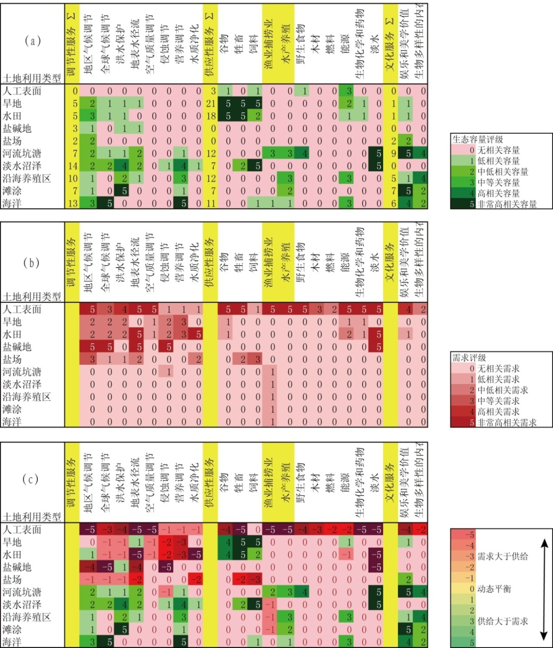
Identification the multi-indicators and data to quantify the broad range of ecosystem services.
A matrix linking 8 Regulating ecosystem services, 11 Provisioning ecosystem services and 2 Cultural ecosystem services to 10 land cover types.
By linking the 0-5 values to appropriate spatial data in GIS, estimates of ecosystem services supply, demand and budgets can be mapped in spatially explicit units of similar biophysical settings (land cover types in combination with soil types, hydrological and climatic conditions)
There is an obvious undersupply of ecosystem services like freshwater and seawater aquaculture in human-dominated land cover types while these area were primarily change from occupying the fishery water.
0 no relevant capacity
1 low
2 relavant
3 medium
4 high
5 very high
0 no relevant demand
From people within
particular LC for the
selected ecosystem
service
1 low
2 relavant
3 medium
4 high
5 very high
Budgets of
the supply
and demand
Notes:
Our selection of ecosystem services is based on a combination of different ecosystem service lists provided in recent literature.
The different land cover type’s capacities to provide particular services were assessed on a scale consisting of :0 = no relevant capacities, 1 = low, 2 = relevant capacities, 3 = medium, 4 = high, 5 = very high. The matrix values are based on experience from different case studies in different China coastal regions and have to be considered as hypotheses of possible capacities of ecosystem services provision.
因此，为达到可持续发展的目标，应逐步放缓工程的进度，或者延长达到该进度所需要经历的时间；适当增加水产养殖业的发展，以满足建设工程发展带来的对这类生态系统服务功能的需求量。另外，差值矩阵也表明渤海湾北部沿海养殖业仍然有其发展的容量，应鼓励其发展和增加水产品的出口。

Slide 16
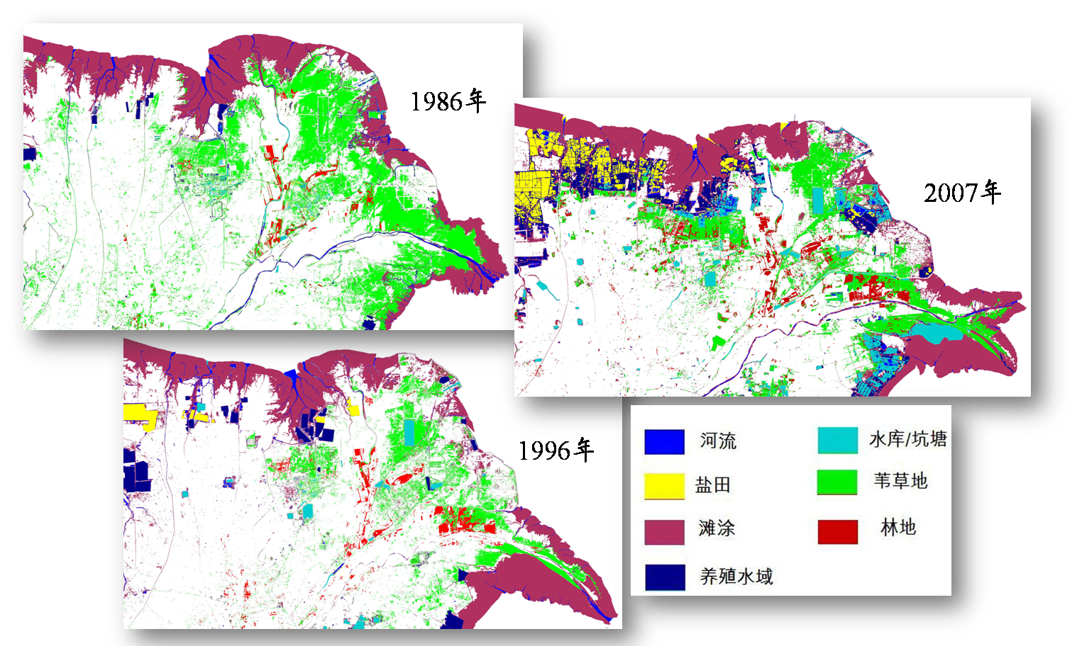
Change detection of major wetland cover types using time-series RS data over Yellow river delta
2009
Notes:
major wetland cover types were extracted from satellite images for 1986,1996 and 2009 with hierachical classification and decision tree model. Area of wetland over this region increased initially and decreased afterwards, the proportion of the constructed wetlands has always been increasing, area of salina wetlands increase most, and tidal flats reduce least. the wetland salinization has aggravated. The accuracy of the classification can reach to 90%, superior to traditional supervised and unsupervised classification.

Slide 17
Chinese Academy of Fishery Sciences
Resources and Eco-environmental Research Center
Case study in lake-wetland habitat

Slide 18
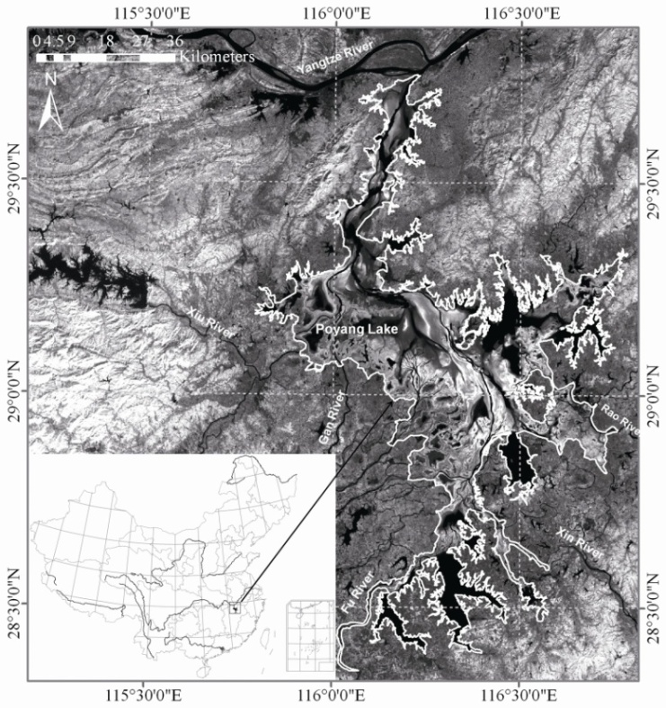
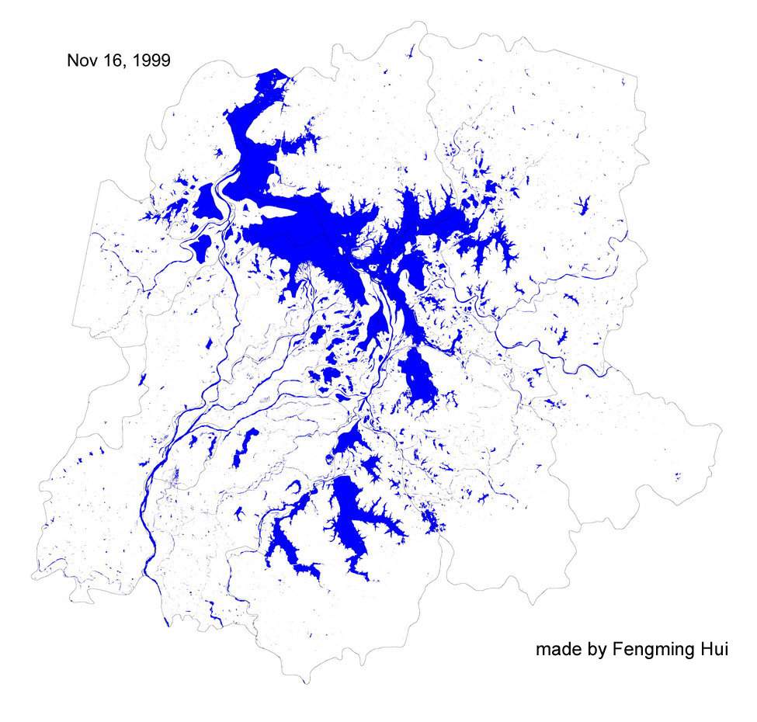
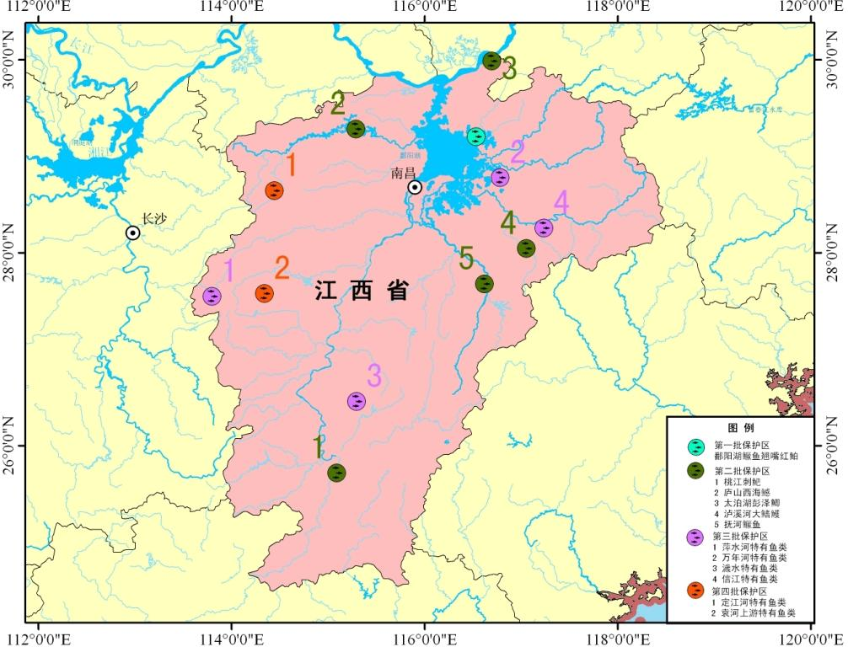
A new time series vegetation–water index of phenological–hydrological trait across species and functional types for Poyang Lake wetland ecosystem
项目立项背景及意义
鄱阳湖水位年内季节性动态变化
Notes:
I will go over this quickly and leave some time for discussion.

Slide 19
Trait | Description | Description of variables in analysis
Traits recorded on the 51 representative species
1-photosynthesis pathway | Photosynthetic metabolism, on the basis of literature¹ and leaf anatomy observation | using in dendrogram acquisition, C₄ = 1; C₃ = 2
2-Carbohydrate storage | Capacity to store carbohydrate than can be broken down and allocated to new growth (thickened roots and stems, bulbs, rhizomes)² | using in dendrogram acquisition, no specialized storage organs = 0; slightly storage organs = 1; strong storage organs = 2
3-Carbon immobilization | Capacity to invest C in support tissue (xylem and bark), in compounds that cannot be broken down to be used in further biosyhthesis² | using in dendrogram acquisition,herbaceous monocots = 1; Herbaceous dicots = 2
4-Life span | The period to complete its life cycle of the non-woody plant, based on literatured³ and field observation | using in dendrogram acquisition, perennials = 1; annual or biennial = 2
5-Life-forms | the relationship to the height of the water table, based on literatured³ and field observation | using in dendrogram acquisition, hygrophyte = 1; emergent = 2; floating = 3; submerged = 4
6-Ramification | Degree of ramification at the base of the plant⁴ | using in dendrogram acquisition, no evident divided = 0; evident divided = 1;
7-Reproductive phenology | Seasonality of maximum production of flowers and fruits, based on literature³ and field observation | using in dendrogram acquisition, no evident peak = 1; winter, autumn, early spring = 2; spring, late spring, spring-summer, late summer-early autumn =3; late spring-summer, summer = 4
8-Percentage flowering of the year | Percentage flowering of the year, based on literature³ and field observation | using in dendrogram acquisition, 0 –≤ 0.25% = 1; >0.25 - < 0.50 = 2; 0.50 -≤1 = 3
9-Maximum Height | Maximum height of species above the ground with percent cover ≥20%, based on field observation | using in dendrogram acquisition, 0 –≤ = 1; >10 - < 50 = 2; 50 - < 100 = 3; ≥ 100 = 4
10-Leaf area | Leaf length×width of per leaves (cm²)⁵, based on field observation | using in dendrogram acquisition, aphyllous = 0; > 0 - <² = 1; 10 - < 50 = 2; 50 - ≤100 = 3; > 100 = 4
Characteristics of or around the sample plot
1-Habitat types | Supporting distinct foraging guilds by birds or fish species, on the basis of literature⁶ | using in dendrogram acquisition, no specified foraging guild = 1; guild include Greater White-fronted Geese, Greylag Geese (Anseranser), and often Swan Geese = 2; foraging guild include mallard, gadwall, = 3; represented by Siberian Cranes，White-naped Cranes = 4
2-Percent cover | Estimated percent cover for each species and non-vegetated cover type (if present) such as water, sand, mudflat, based on field observation; | connecting the above known ground traits to the imagery Training samples were selected at the image points corresponding to the field sample plots with the ≥ 80% cover by the species from each PFT and homogeneous landscape composition for 60×60 m or more around them
3-Landscape characteristics | Recorded the vegetation landscape characteristics and homogeneity level around the plots more than 60 × 60 m
4-Sampling position | Recorded the geographic coordinates of the plot center, based on field observation
Notes:
Wefocused on 1) traits describing photosynthesis pathway and carbon storage potential, inundation tolerance, morphology and phenology, and 2) characteristics related to waterbird foraging preferences, plot-level plant percent cover, and homogeneity of landscape composition around the sample plots.

Slide 20
PFTs | Growth form | Vegetative traits
PFT 1-1 (6) Perennial C₄ grasses | Upland dry, water table not greater than below soil surface to 1 above the soil | C₄ pathway; High carbohydrate storage; All species are herbaceous monocots and perennial; Some C-immobilization in xylem and bark; Some high ramified at ground level; No specified foraging guild by birds; Production of flowers and fruits peak: late spring - early summer; Various canopy height above the soil from 20 – with average ; Average percentage flowering of the year is 36.2 %; Average leaf area of per leaves is 62.4cm²
PFT 1-2 (6) Perennial C₃ reed | River banks or low-lying catchments; Water table from below the soil surface to 1 above the soil | C₃ pathway; Moderate to high carbohydrate storage; All species are herbaceous monocots and perennial; No evident ramification; Foraging guild by birds include Greater White-fronted Geese, Lesser White fronted Geese, Greylag Geese (Anseranser), Bean Geese (A. fabalis), and often Swan Geese; Production of flowers and fruits peak: late spring-summer, summer; Canopy height above the soil from 12 – with average ; Average percentage flowering of the year is 32.1 %; Average leaf area of per leaves is ²
PFT 2-1 (9) C₃ (sedges & taller forbs) | Lakeshores/open flat marshland; Water table from below the soil surface to 1 above the soil | C₃ pathway; Moderate carbohydrate storage; Short-term C-immobilization in standing dead matter; Various lifespans; Have no or very low ramification at ground level; Foraging guild by birds seems as PFT 1-2; Various production of flowers and fruits peak: winter, autumn, early spring; spring, late spring, spring-summer, late summer-early autumn; Canopy height above the soil from 35 – with average ; Average percentage flowering of the year is 25.8 %; Average leaf area of per leaves is ²
PFT 2-2 (17) Short C₃ forbs | Lakeshores/open flat marshland especially the narrow transition zone between the lake and the marshland; Water table from below the soil surface to 1 above the soil | C₃ pathway; Low to moderate carbohydrate storage; Very low to nil C-immobilization in xylem; All species are herbaceous dicots and ramified at ground level; Various lifespans; Foraging guild by birds seems as PFT 1-2; Production of flowers and fruits peak: spring, late spring, spring-summer, late summer-early autumn; Canopy height above the soil from 14 – with average ; Average percentage flowering of the year is 34.8 %; Average leaf area of per leaves is 13.6 cm²
PFT 3-1 (5) Floating aquatic macrophytes | Mud-forming floating on the water surface at water height above the soil surface at water depths 0.3 | C₃ pathway; Low to moderate carbohydrate storage; Various lifespans; stem ramified; Foraging guild include mallard, gadwall, spot-billed duck and common teal.; Production of flowers and fruits peak: spring, late spring, spring-summer, late summer-early autumn; Canopy height under water from 145 – with average ; Average percentage flowering of the year is 44.8 %; Average leaf area of per leaves is ²
PFT 3-2 (8) Submerged aquatic macrophytes | Under the water at 0.2 – 3 m water depths | C₃ pathway; Low carbohydrate storage; All perennial; All stem ramified; Foraging guild represented by Siberian Cranes, Hooded Cranes(Grusmonacha), White-naped Cranes, Eurasian Cranes (Grusgrus) and Swan Geese; Various production of flowers and fruits peak: winter, autumn, early spring; spring, late spring, spring-summer, late summer-early autumn; Canopy height under water from 220 – with average ; Average percentage flowering of the year is 38.5 %; Average leaf area of per leaves is ²
Notes:
The PFT classification scheme was generated using a two-step hierarchical cluster analysis of 51 species by their traits with SPSS statistical software. The dendrogram resulting from the hierarchical cluster analysis shows the assignment of selected plant species into three major PFTs (emergent plants, hygrophilous vegetation and aquatic macrophytes), each containing two minor PFTs (six functional groups
total) with the distinct vegetative traits.

Slide 21
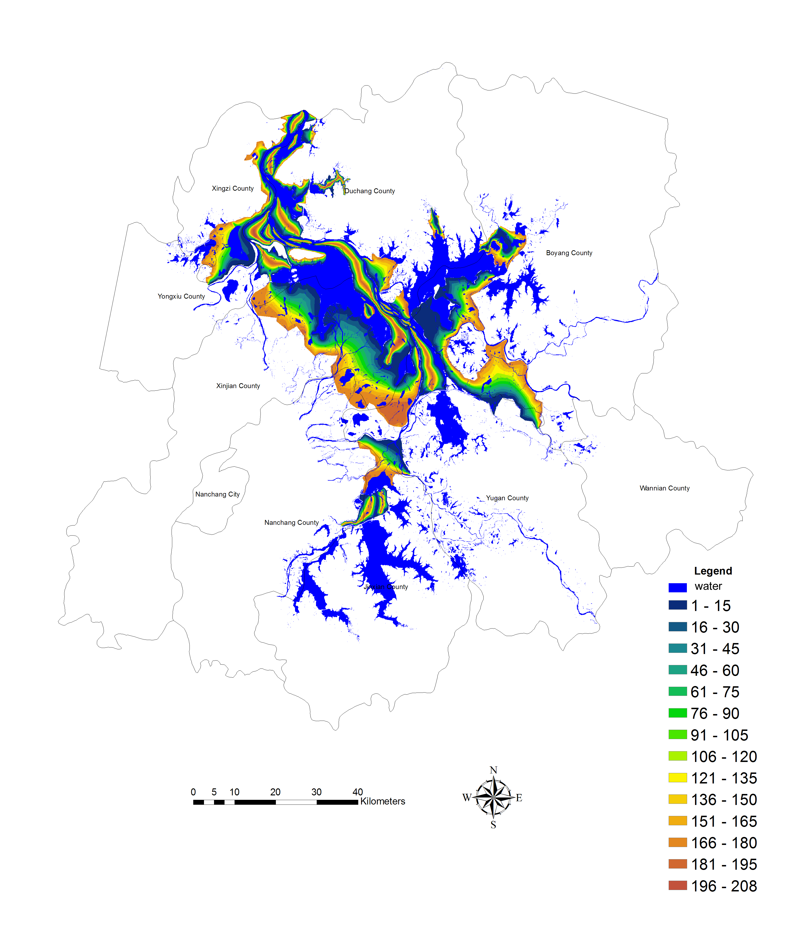
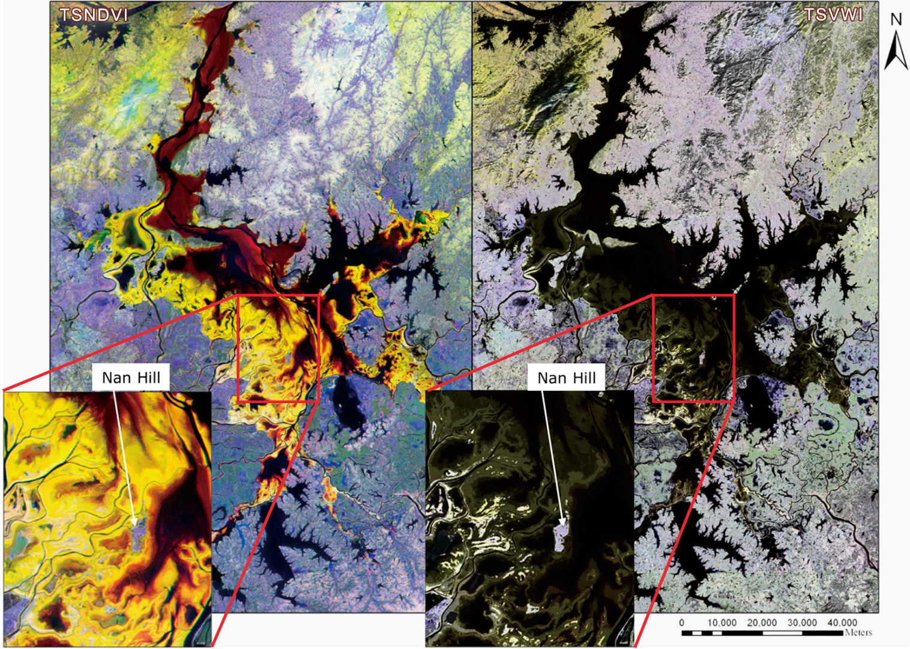
Modeling spatial-temporal change of water body and a new time-series vegetation-water index
Date | Hydrological period | y=ax+b/r² | GCPs | Cloud coverage /if over Poyang Lake | RMSE
19/04/2007 | Infilling | y=0.98x+16.36/0.84 | 21 | 0 | 0.4812
06/05/2007 | Infilling | y=0.91x+19.49/0.66 | 315 | <2%/NO | 0.9278
26/07/2007 | High water level | y=1.53x-62.28/0.85 | 28 | 0 | 0.4273
16/08/2007 | High water level | y=0.87x+14.46/0.80 | 26 | <2%/NO | 0.4942
17/10/2007 | Draw-off | y=1.21x-4.45/0.94 | 25 | <2%/YES | 0.4953
30/11/2007 | Draw-off | y=1.44x-44.28/0.96 | 24 | 0 | 0.4114
01/01/2008 | Low water level | y=1.28x-29.12/0.97 | 28 | 0 | 0.8993
16/02/2008 | Low water level | y=x/1.00 | 28 | 0 | 0.4492
02/03/2008 | Infilling | y=1.63x-49.03/0.91 | 25 | 0 | 0.3448
12/05/2008 | Infilling | y=1.87x-90.25/0.87 | 32 | <2%/YES | 0.4547
数字表示洲滩出露水面的天数
TSVWI =

Slide 22
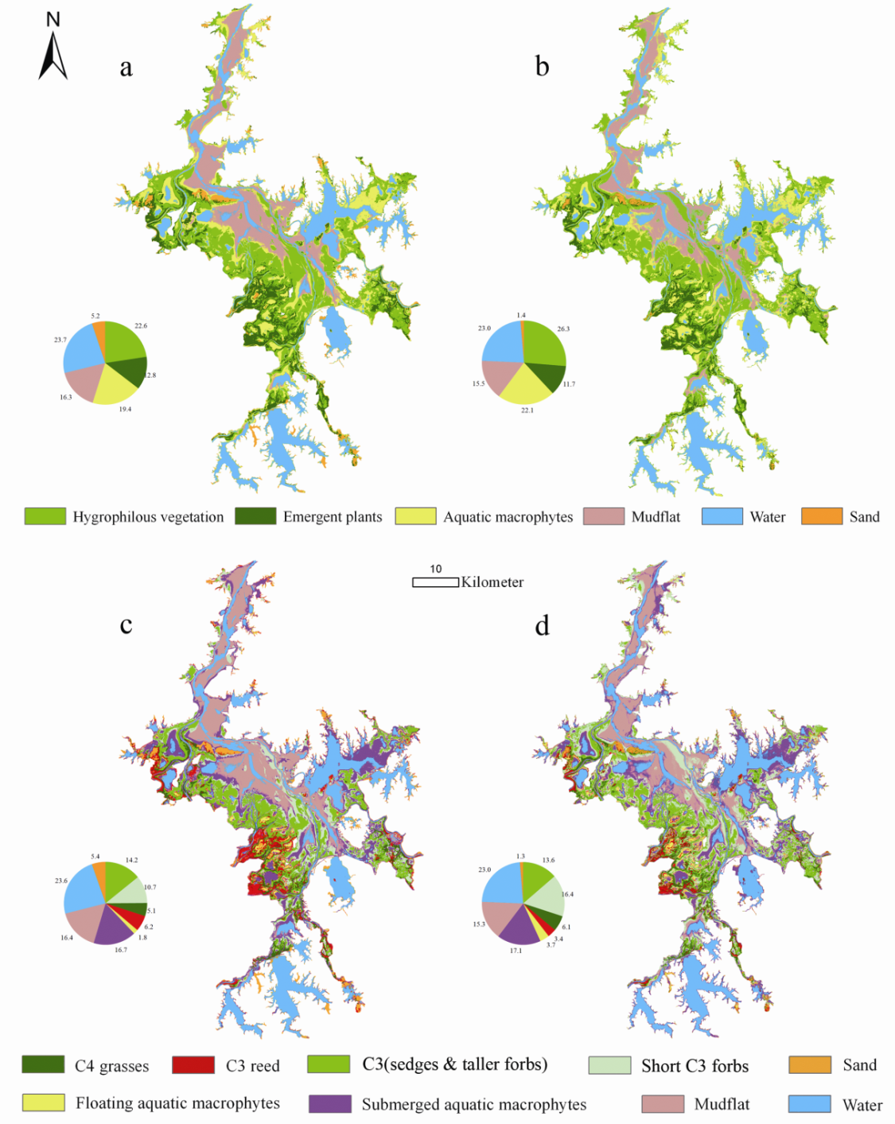
Discriminating the aquatic PFT using remote sensing data and time-series classification with SVM method
the time series NDVI-based SVM classification method mapped aquatic and wetland PFT distribution with an overall accuracy of 81.3%.
However, when the information on water level fluctuation was combined with time series NDVI into a new time series index (referred to as time series VWI), the overall accuracy increased to 90.4%.
Wang L., et al. Remote sensing of Environment, 2012.
Notes:
In the next research, we will examine the linkages between this functional diversity of wetland vegetation with fishery habitat associations. And we will assess the impact of different water-control strategies on the fishery resources and ecosystem function using the scenario simulation method.

Slide 23
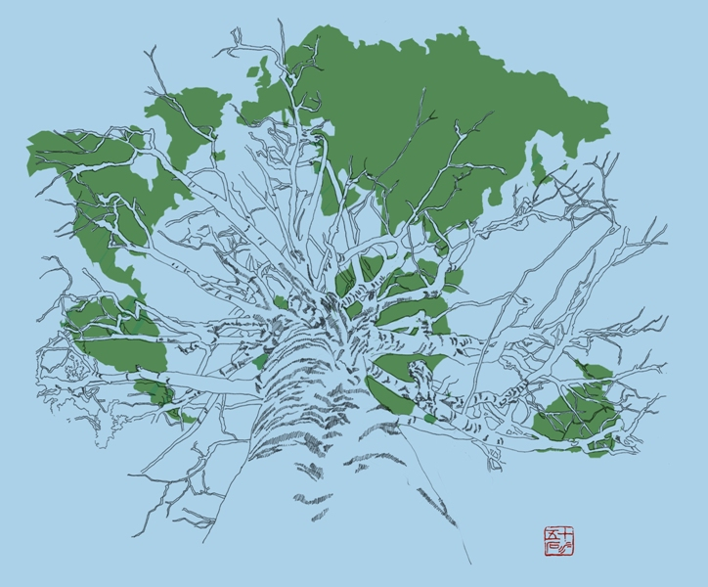
Chinese Academy of Fishery Sciences
Resources and Eco-environmental Research Center
Continue the fishery habitat remote sensing mapping effort

Slide 24
Development plan
Construction the nationwide fishery resource habitat classification (include the whole coastal and inland area).
Mapping fishery resource habitat according to the classification system using above 30-meter resolution remote sensing data and the Object-based classification method.
Probe a new set of software tools for large area mapping.
Mapping of 2010, 2000 and 1990.
Acquire evolving set of nationwide fishery resource habitat validation samples for over 5000 locations .
Acquire evolving set of training samples of over 12000 locations.
Establish a new strategy of classifying the nationwide fishery habitat and analysis the dynamics.

Slide 25
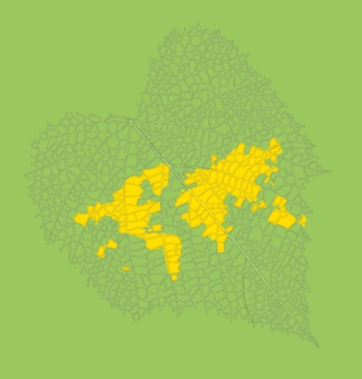
Chinese Academy of Fishery Sciences
Resources and Eco-environmental Research Center
Suggestions about collaborative research

Slide 26
Suggestions about collaborative research
Manifestation of Landscape-level variation and transitions of costal and lake-wetland ecosystem caused by disturbance, climate change and human activities.
Manifestation of landscape ecosystem service and function for fishery at different scale.
Understanding the landscape-level associations among fishery diversity, abundance of endangered species and characteristics of seasonal habitat in a large conservation hotspot
……

Slide 27
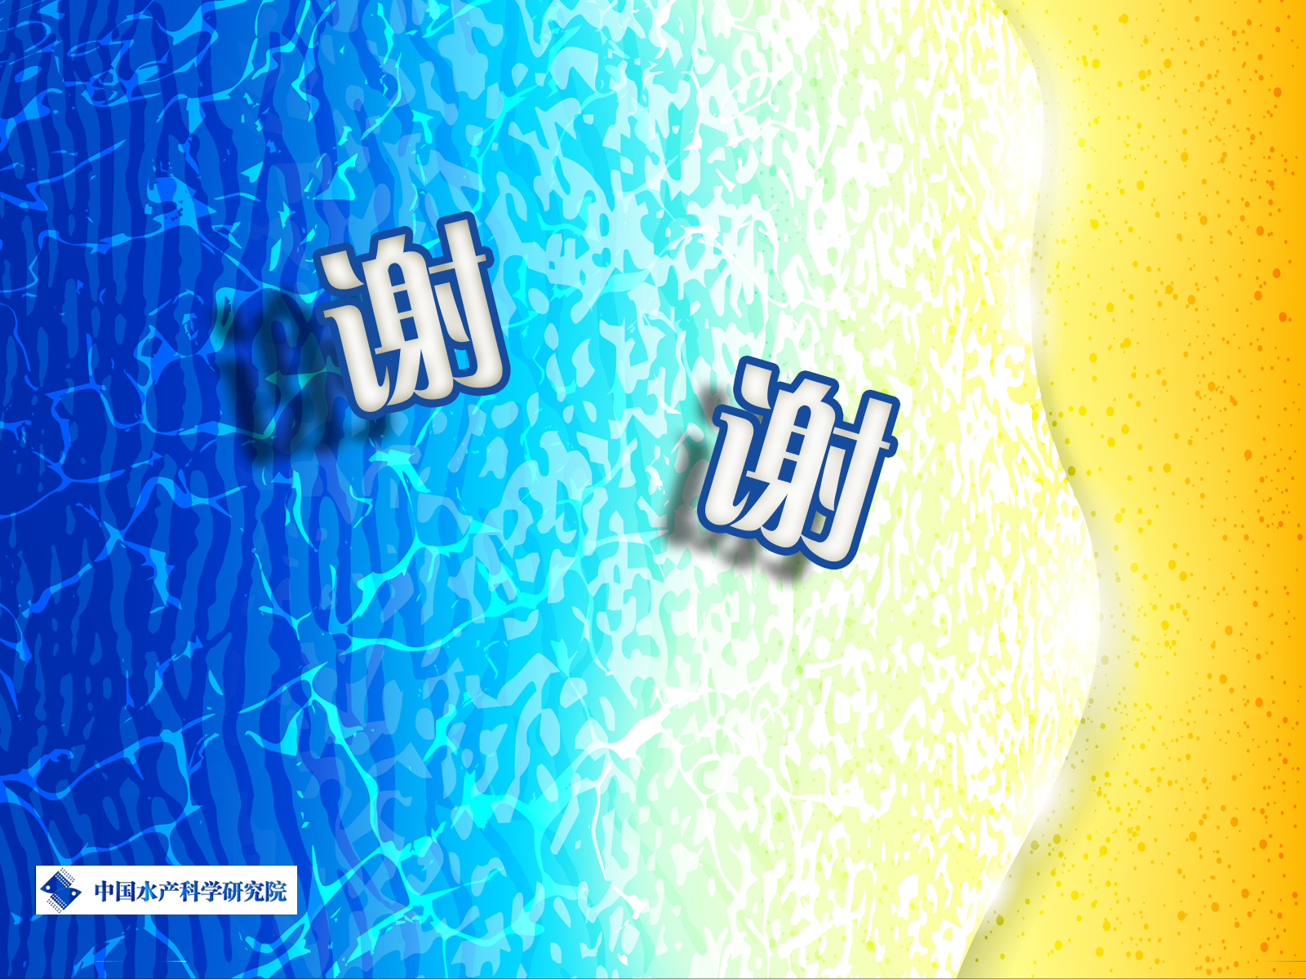
Thank you!

