Slide 1
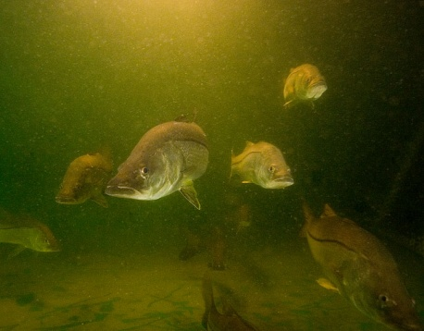
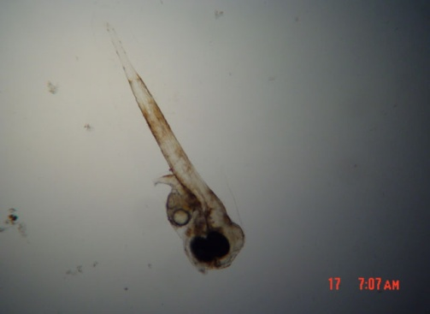
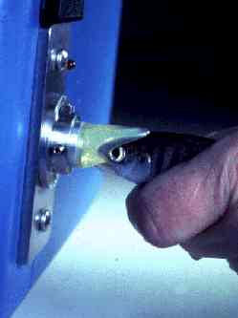
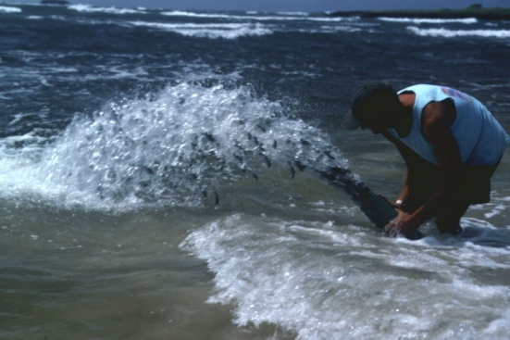
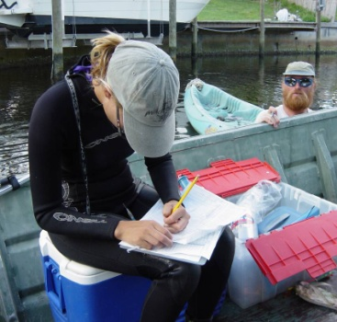



YSFRI-MML Collaborations on Stock Enhancement
Definitions
Collaborations with YSFRI
Advances in the stock enhancement science
Evaluation Methods
Opportunities
Next Steps
Kenneth M. Leber

Slide 2
Coupling Fisheries Management and Aquaculture: Some Definitions
3rd ISSESR
Culture-Based Fisheries Enhancement – Types:
  Stock Enhancement: release of cultured organisms into wild populations to increase the natural supply of juveniles & optimize harvests by overcoming limitations in juvenile recruitment
  Restocking: release of cultured organisms into wild populations to help restore severely depleted spawning biomass to self sustaining levels
  Sea Ranching: recurring release of cultured juveniles into the ocean for harvest at a larger size (put-grow-take)
(Bell et al., 2008. Reviews in Fisheries Science, 16(1):1-9)

Slide 3
Coupling Fisheries Management and Aquaculture: Some Definitions
4th ISSESR
Culture-Based Fisheries – Types:
  Stock Enhancement…
  Restocking…
  Sea Ranching…
  Supplementation: moderate releases of cultured fish into very small and declining populations to reduce extinction risk and conserve genetic diversity
  Reintroduction: temporary releases to reestablish a locally extinct population
(Lorenzen et al, 2010. Reviews in Fisheries Science, 18(2):189-210)

Slide 4
LMR Panel Objective from Honolulu LMR Meeting in 2012:
LMR aquaculture-based marine fisheries-enhancement collaboration
  ~To initiate a China–US collaboration on marine fisheries enhancement involving CAFS and US scientists ~
    Result: Scientific Exchange Between Yellow Sea Fisheries Research Institute-CAFS (YSFRI) and Mote Marine Laboratory (MML)

Slide 5
New Collaboration Initiated in 2012
“The Key Technologies in Rebuilding the Declining Fishery Stocks in Coastal Waters: A Cooperative Program between YSFRI & MML”
  Joint YSFRI (CAFS)-MML proposal submitted to China Ministry of Science and Technology in summer 2012
  Funding was recently approved !!!
  “… the program aims to develop the key technologies needed for rebuilding declining fisheries stock and their habitat, and improve the assessment system needed to measure, control and ensure success of enhancement effects on declining fishery stocks.”

Slide 6
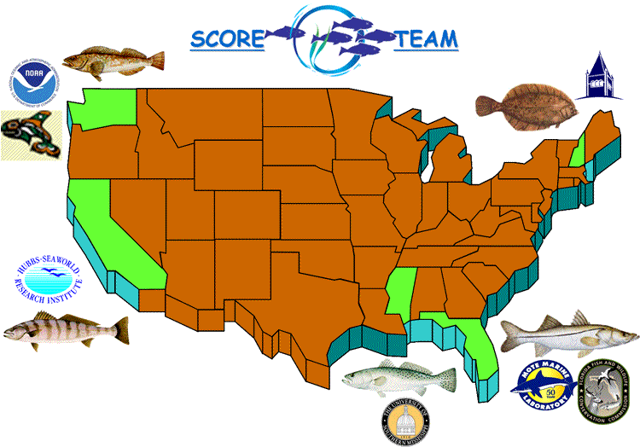
Advances in Marine Stock Enhancement

Slide 7
“A Responsible Approach to Marine Stock Enhancement” *
(Spawned by Lee Blankenship, Devin Bartley, Don Kent, Ken Leber, Stan Moberly, Terje Svåsand, Katsumi Tsukamoto [and Rich Lincoln])
Stay Within Context of Fisheries Management Plan:
  1. Prioritize Species for Enhancement
  2. Make Stocking Plan that Fits with and Helps Achieve the Goals of the Fishery Management Plan and Identify the Expectations
Develop Sound Enhancement Strategy:
  3. Define Quantitative Measures of Success
  4. Use Genetic Resource Mgmt. to Prevent Deleterious Effects
  5. Use Disease and Health Management
  6. Consider Ecological, Biological, & Life-History Patterns
  7. Identify Hatchery Fish & Assess Stocking Effects
  8. Use an Empirical Process to Define Optimal Release Strategies
  9. Identify Economic & Policy Guidelines
  10. Use Adaptive Management
  (* Blankenship & Leber, 1995. Am. Fish. Soc. Symposium 15:67-175)
  PDF is online at www.StockEnhancement.org/science/publications.html
Notes:
7

Slide 8
Key Advances in Development of Culture-Based Fisheries
Large increase since 1990 in scientific publications -- leading to greater awareness among all stakeholders of the issues, pitfalls, progress, and opportunities
Adaptive management has fostered optimization of release strategies, markedly increasing hatchery-release impact
“Responsible Approach” → adapted to local circumstances
Clear examples of success
  Hokkaido scallops – large scale restoration of scallop fishery
  Zhangzidao scallops – expansion of the success in Hokkaido
  Coho salmon in Japan; variable success with several other species
  Sport fisheries supplementation and restoration in US
  Australian pilot-scale success with black bream;
  Carp, barramundi, etc. lake & reservoir stocking
(Leber, K.M., in press – Marine Fisheries Enhancement: Coming of Age in the New Millennium)

Slide 9
Focused Research on Release Variables:
Critical Uncertainties
Critical Choices Managers of Hatchery Releases Need to Make
  Tag type, tag placement, tagged proportion
  Acclimation at release site
  Size-at-release (SAR)
  Season and tidal timing
  Release habitat/microhabitat
  Effects of interactions
  Release magnitude
Optimize Release Strategies
To Maximize Survival
Use of pilot studies and adaptive management to optimize release strategies is key to understanding effects and effectiveness and efficiencies

Slide 10
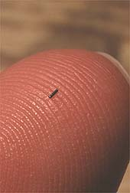
Virtually all aspects of enhancement research and management require the ability to identify released fish

Slide 11
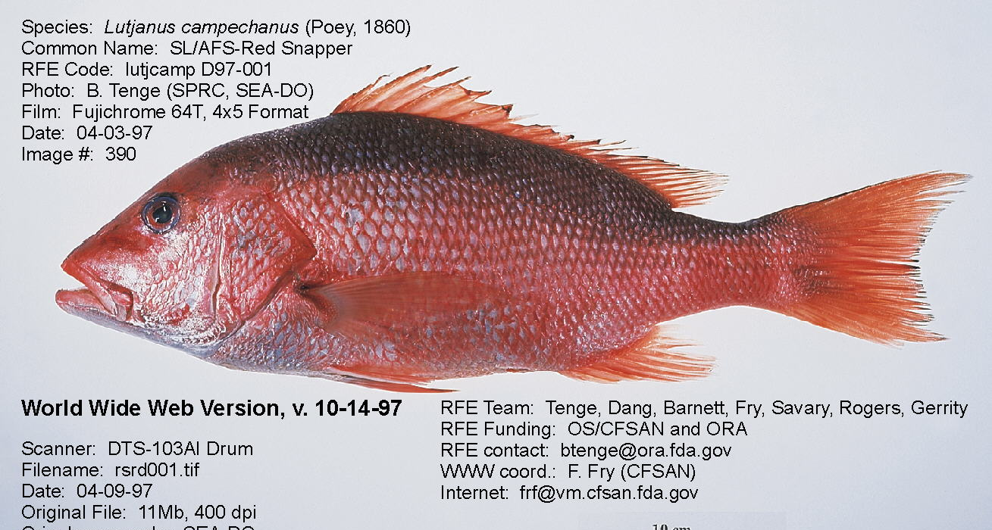

Identify treatments with
Coded Wire Tag (CWT) Location
Dorsal
Muscle
Nape
Muscle
Nose
cartilage
Caudal
Peduncle
Muscle
Cheek
Muscle
5 established tag locations with reliable retention(>=95%)

Slide 12
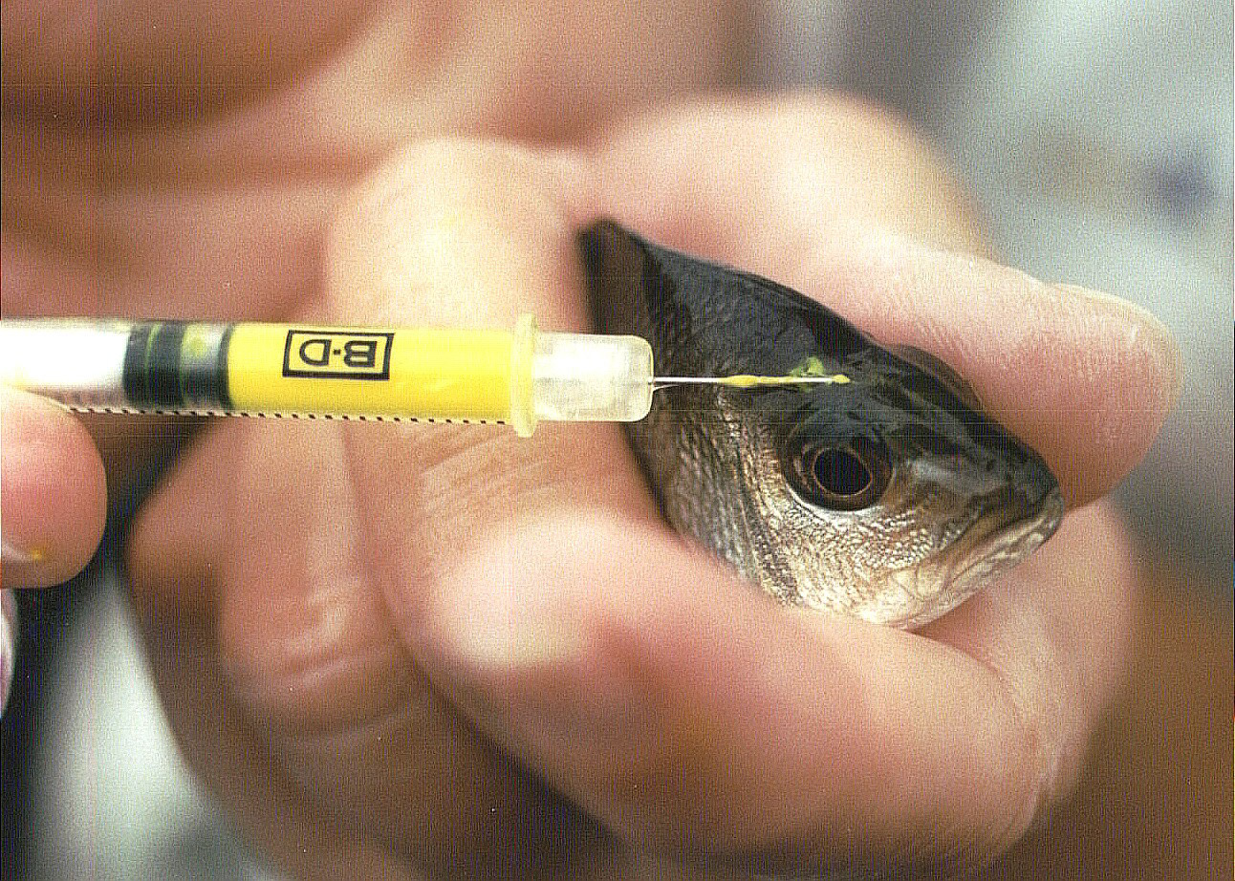
Adapting Visible Implant Tag (VIE) Technology to the Red Snapper, Lutjanus campechanus

Slide 13


Identify Treatments with VIE Location and Color
3 locations with >=94% VIE retention 6 months after tagging
Not easily visible
to divers (in situ)
?
Both fin rays are visible
to divers (in situ)
Nose
Bridge
Caudal
Fin
Rays
Color Code Options:
Anal Fin
Rays
Fluorescent red
Fluorescent green
Fluorescent orange
Fluorescent yellow
Blue (non-fluorescent)

Slide 14
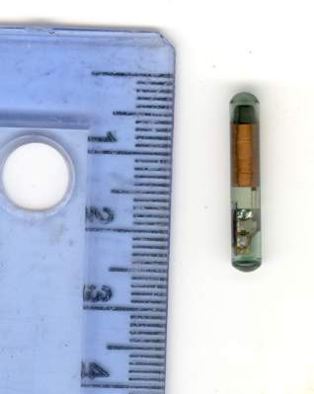
PIT Tags
(Passive Integrated Transponders)
Half-duplex
  23mm x 3.85mm
  0.6 g
Lasts life of fish (No battery)
Individual ID Number
Inserted into abdominal cavity

Slide 15

Solar Panel
12 volt batteries
Tag Reader
Computer
Creek
Edge
Creek
Edge
Antenna
Side View
Creek Bottom
Antenna – 6 awg welding cable 10m x 0.5m

Slide 16
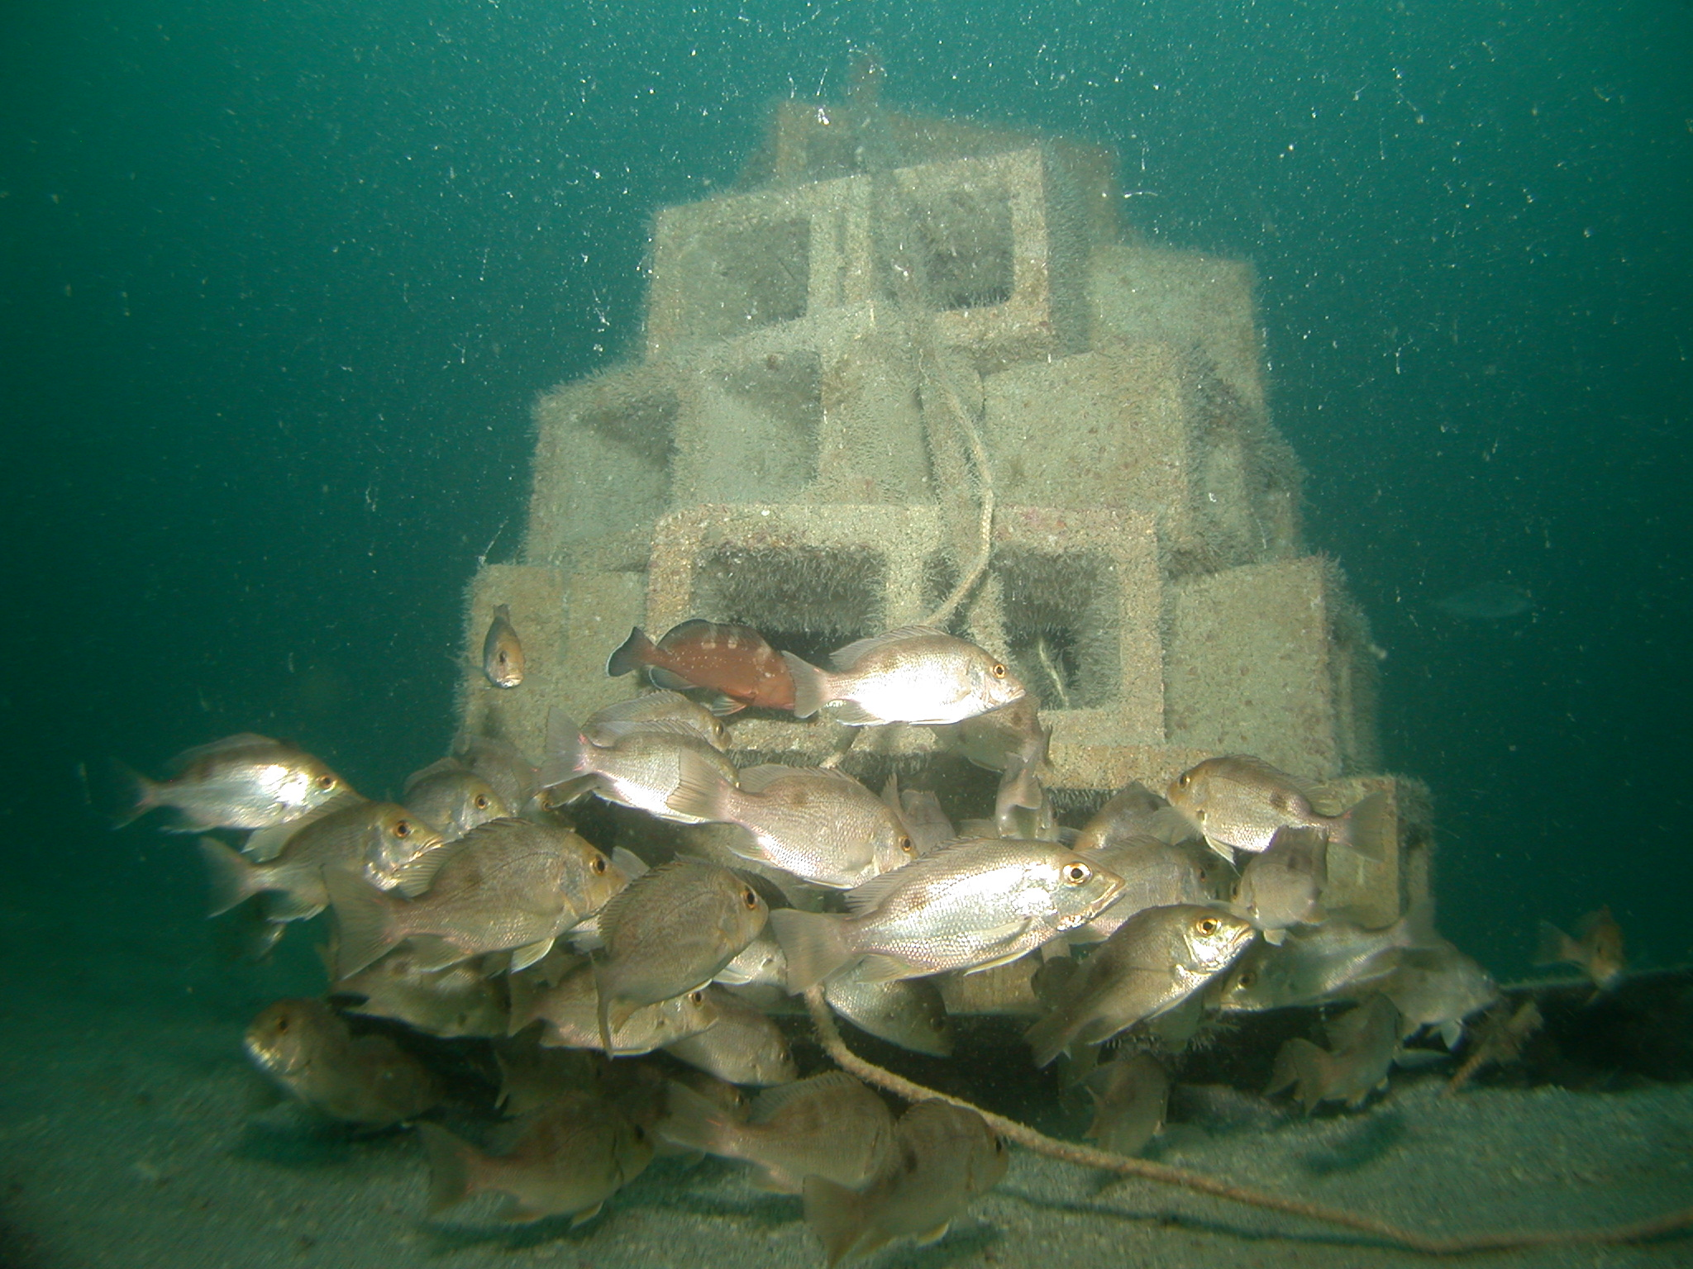
Reef Unit (no acclimation)

Slide 17
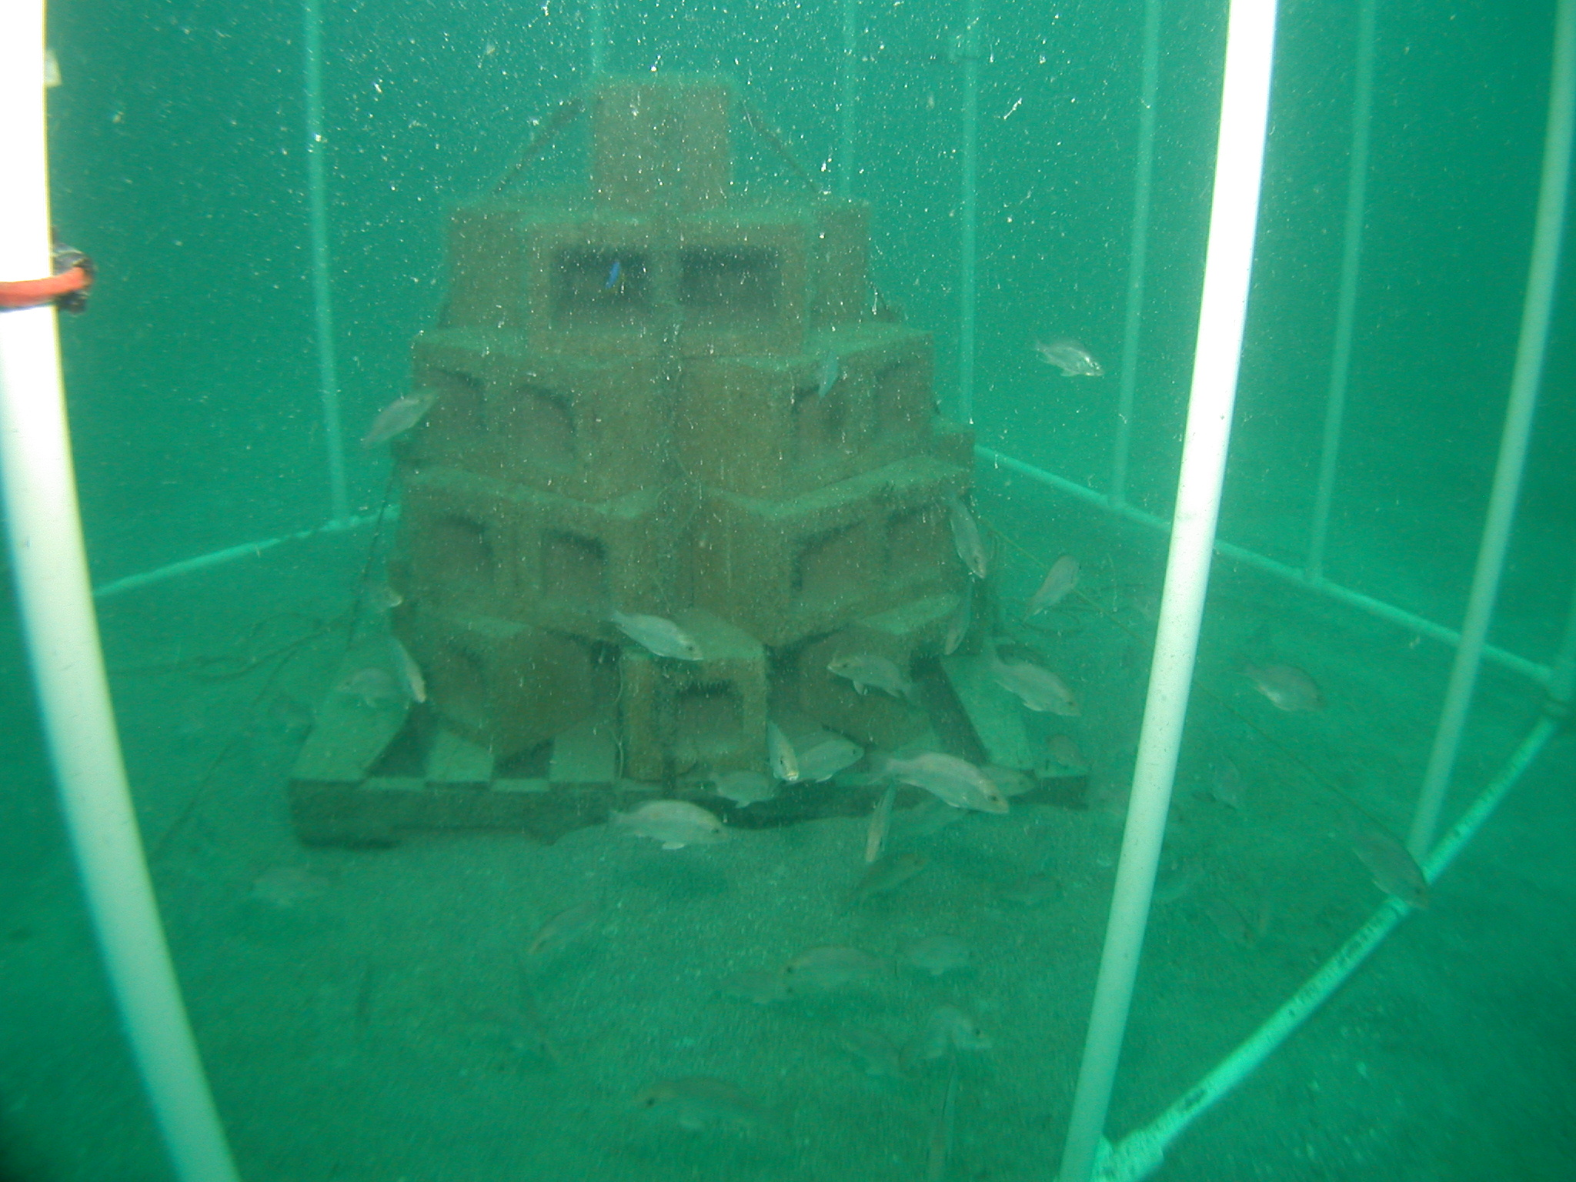
Netting Removed to Release Acclimated Fish

Slide 18
Red Snapper Recapture Rates at High Stocking Density Sites, Fall 2002

Slide 19
Opportunities:
Potential Collaborations
Coral Conservation-Hatchery Research in Florida Keys
Marine Fish Aquaculture Research for Stock Enhancement
Design and Management of Recirculating, zero-discharge marine aquaculture systems

Slide 20
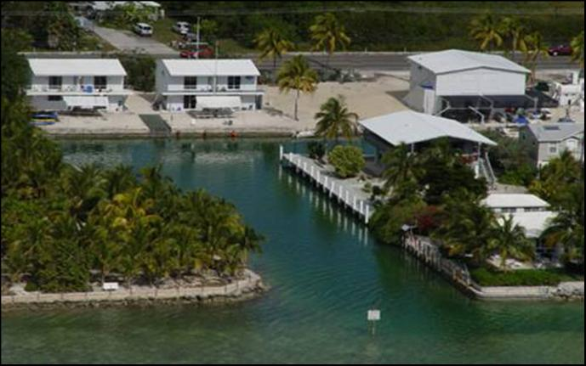
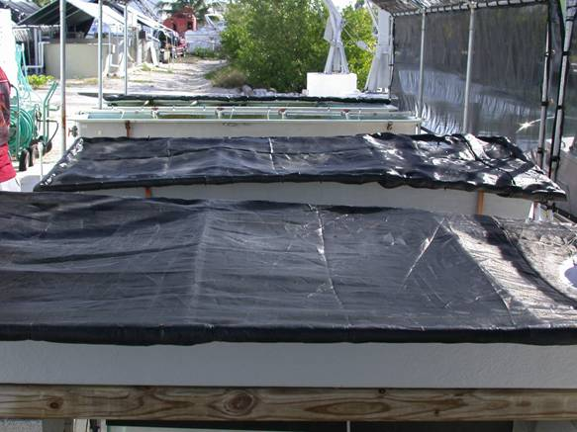
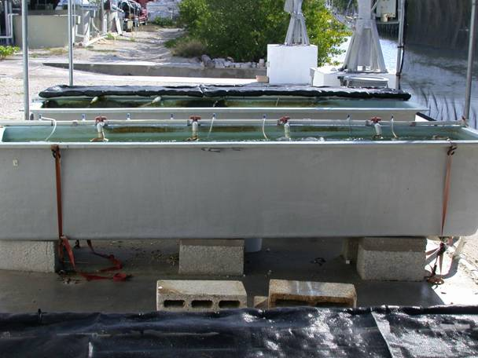
Mote’s Tropical Research Lab-Summerland Key
Open (outside) Raceway Culture Systems

Slide 21
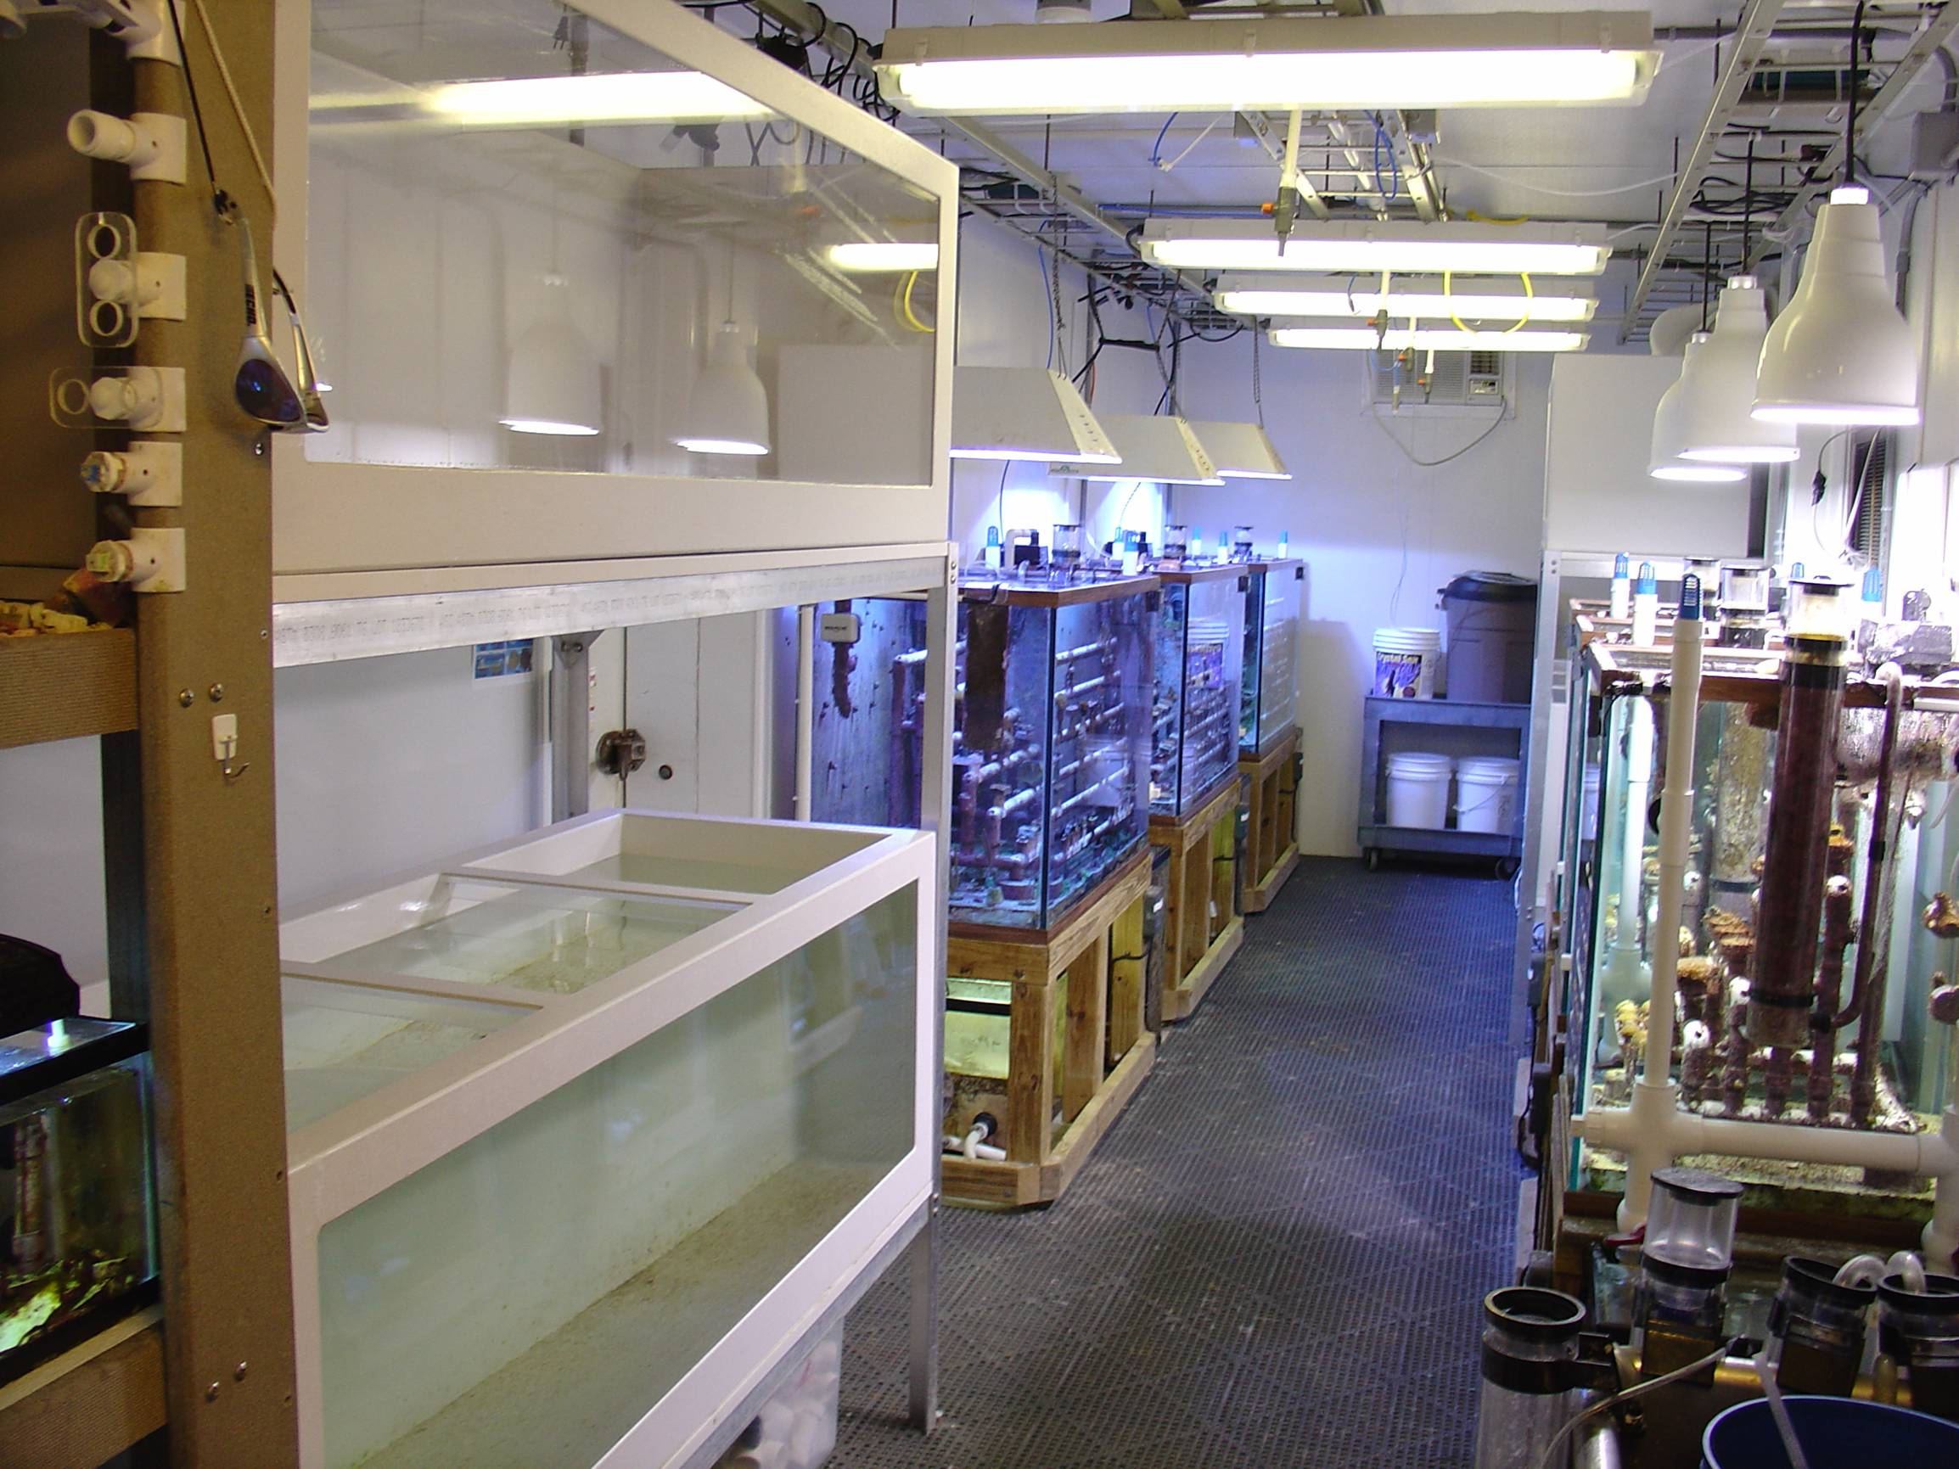
Environmentally Controlled
Coral Culture Systems
Mote’s Tropical Research Lab

Slide 22
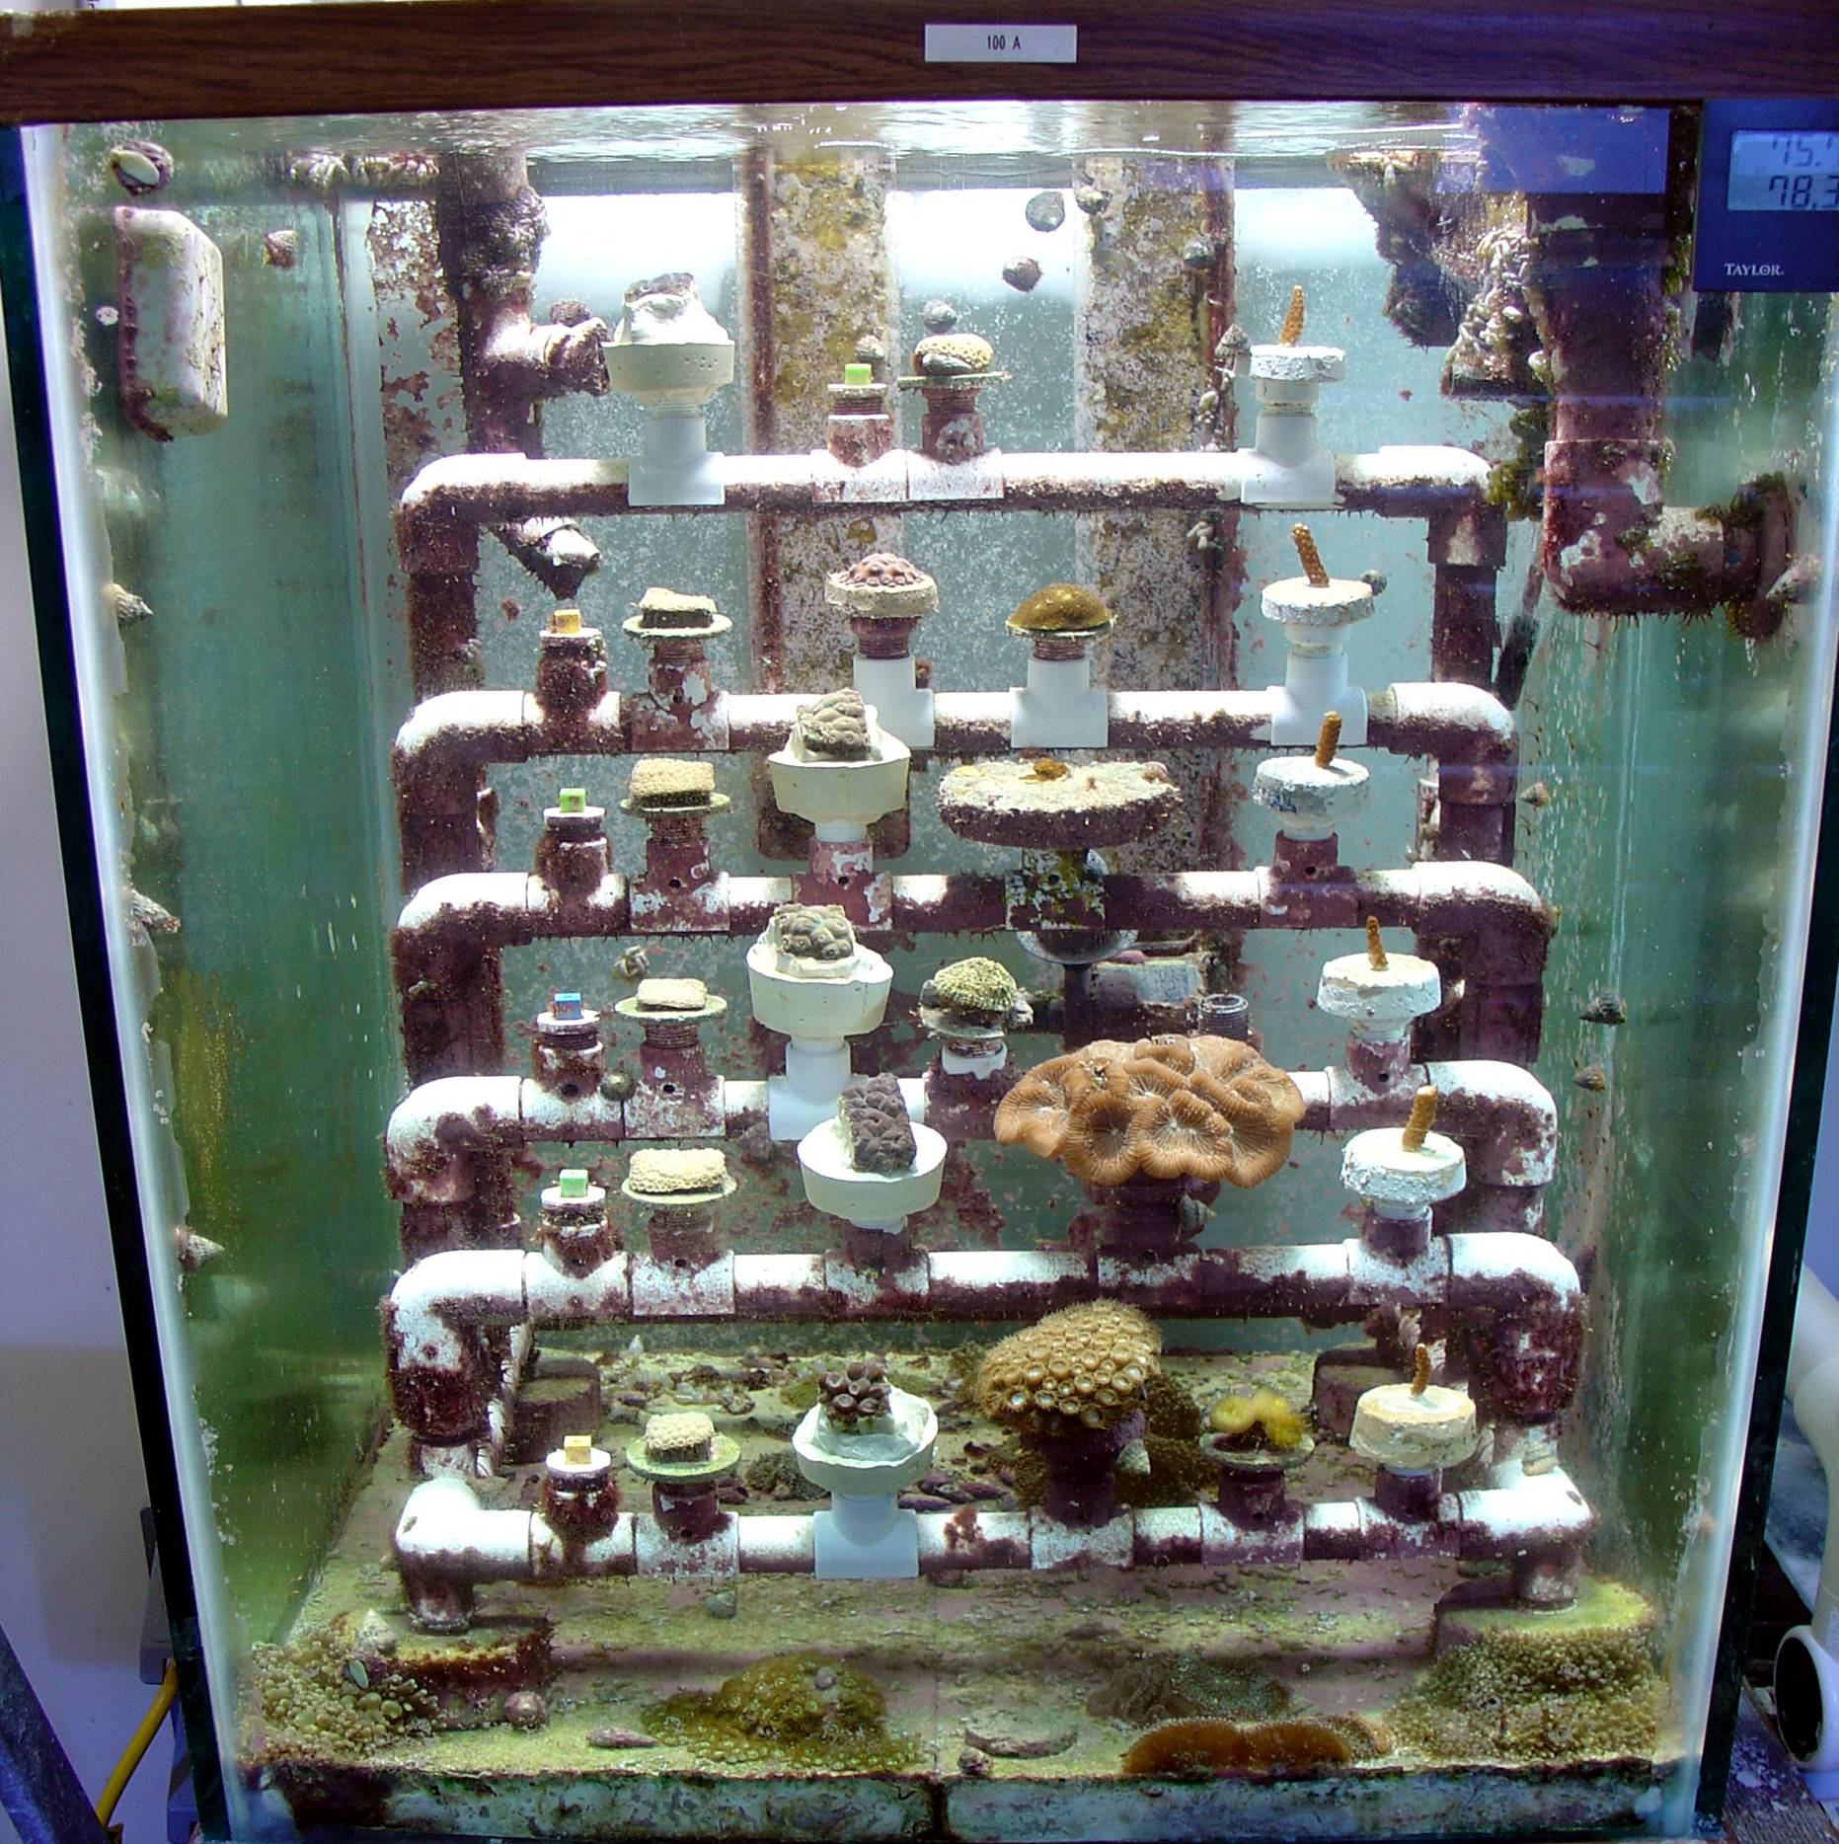
Tank 100A – 10-18-07
M.ann-A13
M.cav-Y1
A.cer-E7
A.cer-E8
M.ann-A14
M.cav-L
P.ast-C
M.cav-Y2
A.cer-E9
M.ann-A15
A.pal-E
M.cav-Y3
M.ali-A
A.cer-E10
M.ann-A16
M.cav-Y4
A.cer-E11
M.ann-A17
M.mea-A
A.cer-E12
M.cav-K
M.ann-A18
M.cav-Y5
E.fas-A2

Slide 23
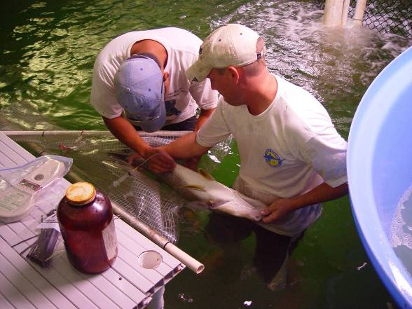
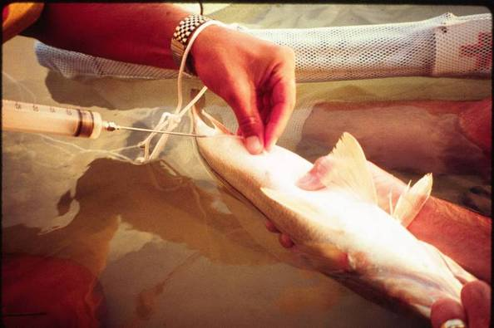
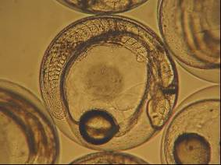
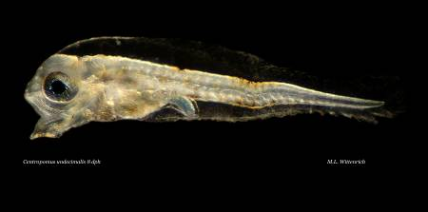
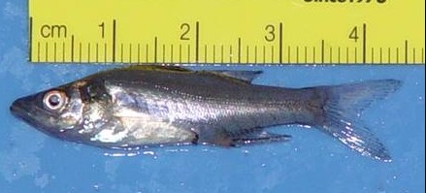
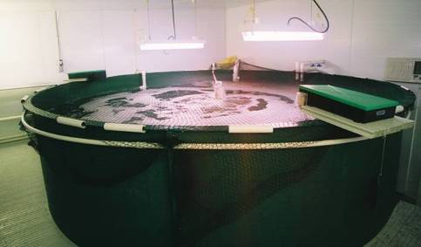
Snook Captive Breeding Research
20 years of research led to success in captive maturation and spawning of snook 2006/2007
Possible keys to success
large breeding tanks
controlled temperature and lighting
addition of moon cycle
induced spawning

Slide 24
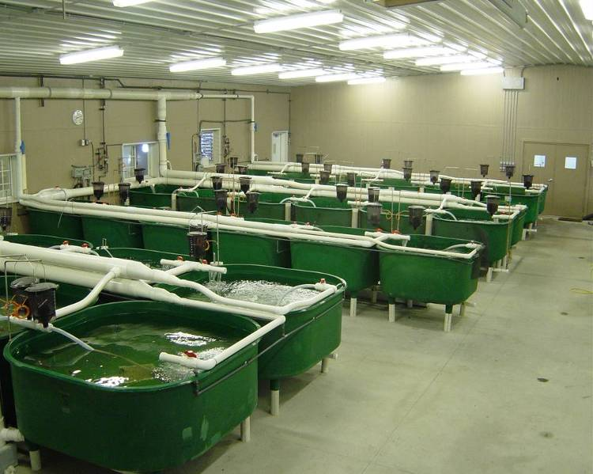
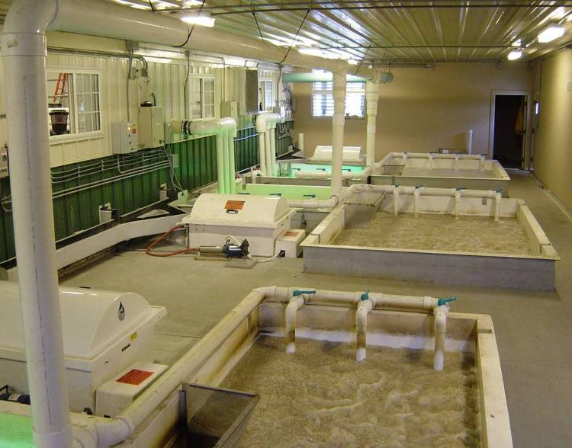
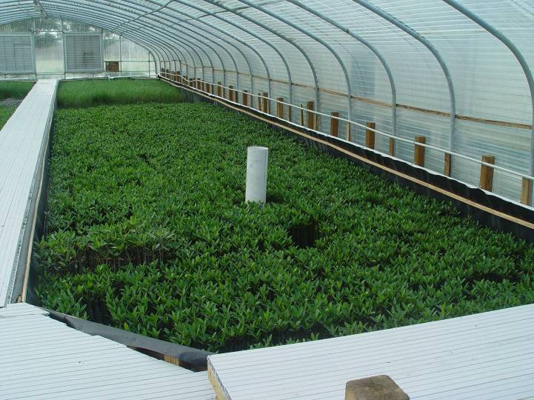
Sustainable Aquaculture System Technologies
Environmentally controlled tank systems
Water recycle systems to conserve water resources and reduce environmental impact
Integrated systems that produce both fish & plants

Slide 25

Mote Marine Laboratory Research Programs
81 research staff, 31 doctoral-level scientists, 22 programs
Aquaculture Research
Behavioral Ecology & Physiology
Benthic Ecology
Chemical Ecology
Coral Reef Restoration
Coral Reef Science
Dolphin Research
Ecotoxicology
Environmental Health & Monitoring
Environmental Laboratory for Forensics
Fisheries Habitat Ecology
Manatee Research
Marine Biomedical Research
Marine Immunology
Marine Microbiology
Marine Stock Enhancement
Ocean Acidification
Phytoplankton Ecology
Sea Turtle Conservation & Research
Sensory Biology & Behavior
Shark Biology & Conservation
Stranding Investigations
Notes:
Give a brief overview of the presentation. Describe the major focus of the presentation and why it is important.
Introduce each of the major topics.
To provide a road map for the audience, you can repeat this Overview slide throughout the presentation, highlighting the particular topic you will discuss next.

Slide 26
Next Steps
Secure Funding To:
Support Scientist & Student Exchanges @ ~ $15,000 each
Increase the Availability of Resources for Culture-Based Marine Stock Enhancement, Restocking and Sea Ranching
  Compile Bibliographic Literature on Stock Enhancement Science
  Conduct Bilateral Course on Culture-Based Fisheries Enhancement
    Could be arranged if funding existed for tuition & travel
  Conduct Stock-Enhancement Modeling Workshop
    Could be arranged if funding existed for tuition & travel
Increase LMR Attendance at Scientific Symposiums on Marine Fisheries Enhancement

Slide 27
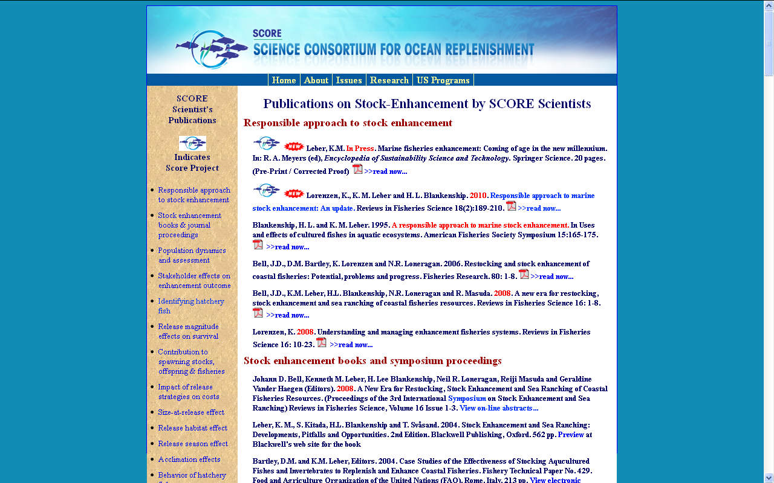
StockEnhancement.org/science/publications.html
65 Fisheries Enhancement Publications

Slide 28
Effect of Enhancements, harvest and habitat management should be modeled, a priori, and integrated into the decision making process
(http://www.aquaticresources.org/pubs/EnhanceFish_Manual.pdf)

Slide 29
Enabling Science & Fishery-Driven Policy Development
New research in early 1990’s generated WAS & EAS special sessions at their annual conferences -- on marine stock enhancement
“W.A.S. International Working Group on Stock Enhancement” formed in 1993 at Symp. in Spain
  Platform Paper: Responsible Approach
    Presented at 1994 AFS Symposium, published in 1995, updated 2010
International Symposium on Stock Enhancement and Sea Ranching (ISSESR): every 4-5 years
  Norway-1997, Japan-2002, US-2006, China-2011, (Australia-2015...)

Slide 30
Stock Enhancement Symposium: PACON 2012
Kona, Hawaii, December, 2012
WANG Qing-yin, Professor ← CO-CHAIR with Ken LEBER
Director general of Yellow Sea Fisheries Research Institute, CAFS
GUAN Chang-tao, Professor
Head of Division of Marine Fish Culture and Engineering
CHEN Yong, Professor
Vice President of Dalian Ocean University
ZHANG Xiu-mei, Professor
Deputy Head of Fisheries College, Ocean University of China
CHEN Pi-mao, Professor
Deputy Head of Marine Fishery Resources Division
ZHANG Shou-yu, Professor
College of Marine Sciences, Shanghai Ocean University
KONG Jie, Ph.D.
Head of LAB. of Genetic Resources and Breeding
ZHANG Pei-dong, Associate professor
Fisheries College, Ocean University of China
LI Wen-tao, lecturer
Fisheries College, Ocean University of China
LIN Jun, Ph.D.
College of Marine Sciences, Shanghai Ocean University
TIAN Tao，Ph.D.
Liaoning Center for Marine Ranching Enginerg. Sci. Res., Dalian Ocean Univ
QIN Chuan-xin, Ph.D., Associate professor
Marine Fishery Resources Division South China Sea Fisheries Research Institute, CAFS

